Slide 1
How do we know when data is "right"?
Kae Petrin, Civic News Company

Slide 2
Journalists have an ethical responsibility to represent data as accurately as we do anything else.

Slide 3
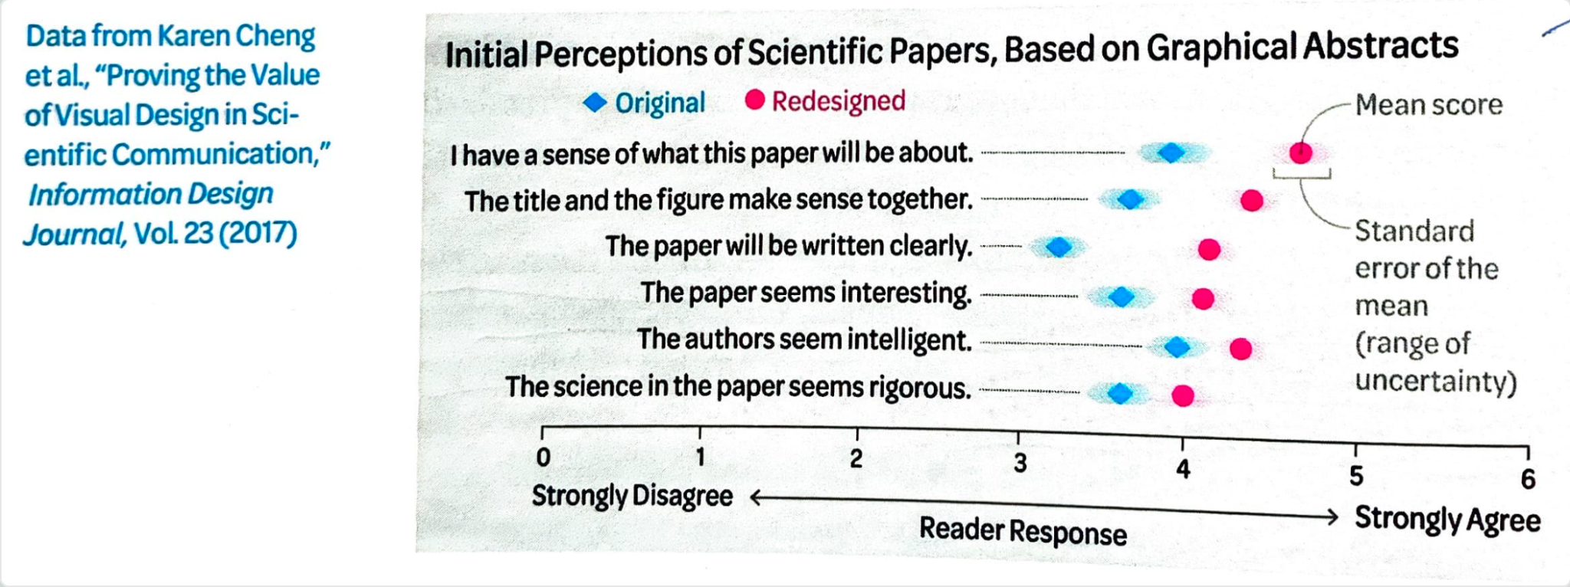
Building Science Graphics: An illustrated guide to communicating science through diagrams and visualizations, by Jen Christiansen
Notes:
extra important because data – and especially polished visuals – increases audience's perceptions of accuracy and rigor. so if we've made an error with data… we're giving an extra-false impression of superior accuracy

Slide 4
Where does data go wrong?
External creation, definition, access, and transmission
Internal decision-making, interpretation, and presentation

Slide 5
What data isn't
Data is not objective: it's gathered by people, and those people may have an agenda or ideology
Data is not complete: almost by definition, underrepresented populations are often missing
Data is not final: many stories start with analysis, but they don't finish there
Data is not ethics: populations are made of people
Notes:
THOMAS: Data is a powerful tool. But it has limits, and we try to keep those in mind while we're working with it, so that we deliver journalism that's both accurate and responsible.

Slide 6
Data in an age of institutional decay
We often rely on government data, which may be increasingly scarce or unreliable
The data we do get may be more affected by political chicanery
That said, remember that much of education was already administered at the local and state level
Notes:
Recently I saw a story noting that the NIH was killing funding for its Women's Health Initiative, which tracks trials of medication and health for thousands of participants over multiple decades. We know that datasets have been taken down or crudely trimmed to remove references to race or gender. And agencies that we normally rely on for cross-sectional data at the national level are being gutted.
Ultimately, I think our concern continues to be the fracturing of data quality across state lines, as we rapidly become a country where the quality of citizen education and care varies widely depending on who runs your local government.

Slide 7
Is my data complete, consistent, and accurate?

Slide 8
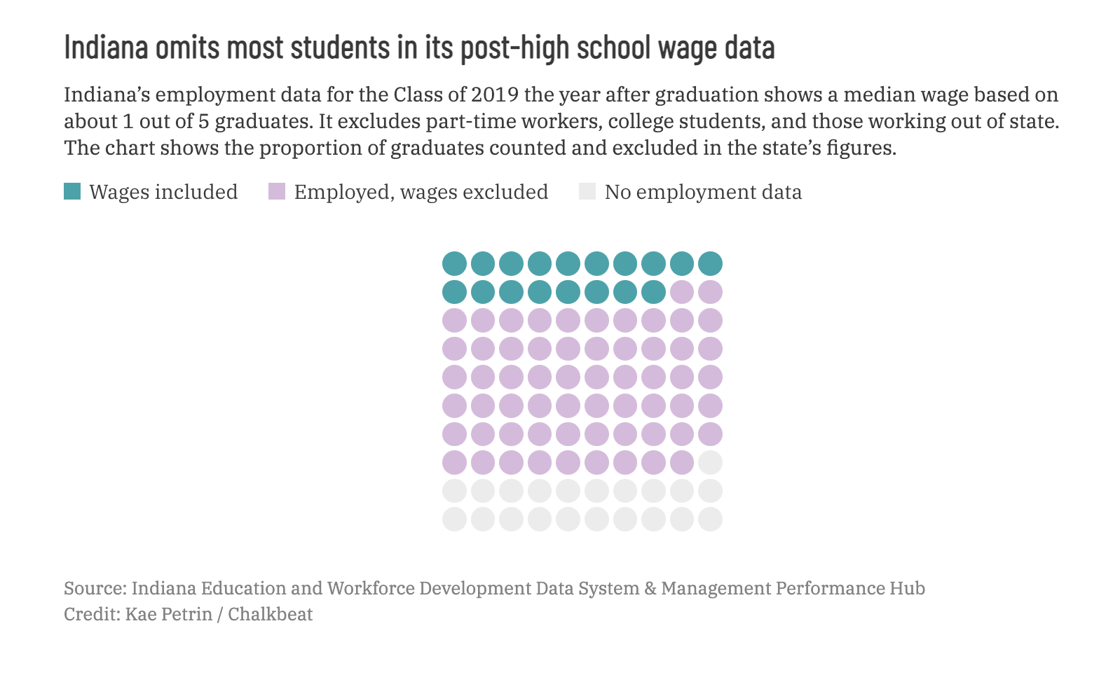
Beware of data definitions
How much money do high school graduates make? Indiana digs into the numbers.

Slide 9
How to interview your data
WHO collected the data and is represented by it?
WHAT am I actually looking at? What is missing?
WHERE does this data cover geographically?
WHEN was the data collected and updated? What's the lag?
WHY was data collected? (Legal mandate, lawsuit, research?)
HOW was data collected, updated, and reported?
Notes:
WHO: Who collected the data? Who is in the data? Is this a complete universe, a representative sample or a non-representative sample?
Are the definitions available? Do they seem reasonable?
WHAT: What am I actually looking at? Figure out basic shape of the data (e.g. the range of the time period) and what important or irregular columns mean.
What is missing? E.g.: time periods, underrepresented groups, locations.
WHERE: Which areas does this data cover?
WHEN: When was data collected? Is it up to date?
WHY: Why was data collected? (E.g.: mandated by law or a lawsuit, market research, voluntary survey).
HOW: How was data collected? Uploaded automatically or manually? Is it self-reported?

Slide 10
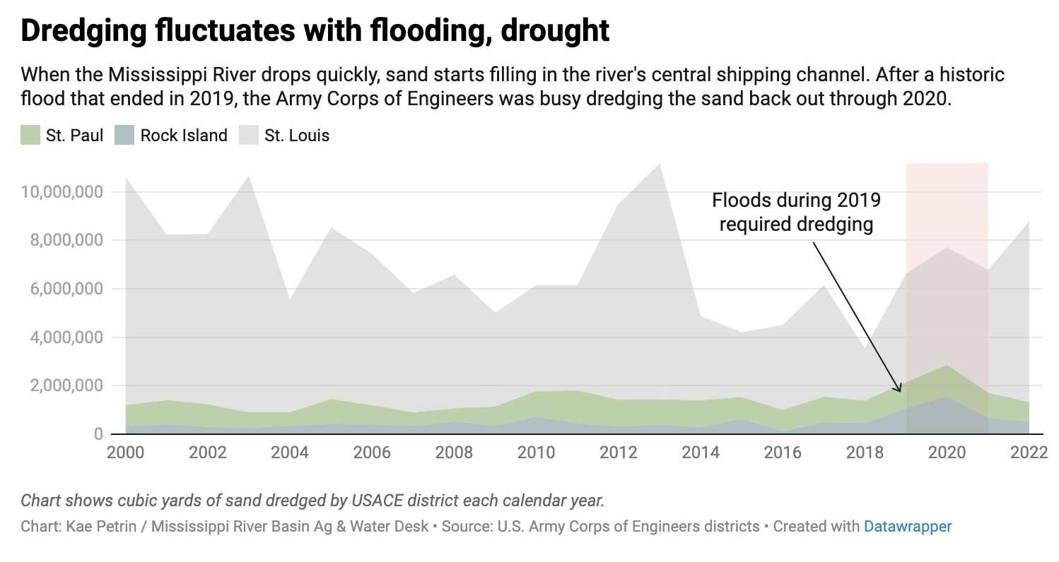
Watch for incomplete datasets

Slide 11
Quick sanity checks: group everything
How many unique values do you have each year?
How many blank values do you have each year?
Are any years missing?
Do your totals add up to known, similar numbers?
  Use reference points like number of schools in a district, number of districts in a state, number of total kids in a geography, or past studies and press releases based on the same source
Are certain columns or labels used in some data subsets but not others?
If you count non-unique values, do you see multiple where you should see one? One where you should see multiple?
Look for changes in trend or pattern.

Slide 12
Is my data telling a story that is meaningful, fair, and just?

Slide 13
How do we find the meaning — and the story?
Select reasoned definitions and criteria
  This is both for consistency and defensibility
  It helps manage change over time
Use barometers that mean something in their context
  Test scores don't mean anything on their own. Sometimes the tests change or are rescored. But proficiency rates may have more meaning. Rates of students sitting for tests may matter more. Or, does a specific score lead to remedial requirements? Think about what prompts action.
A trend isn't always a story
Be honest about what we do — and don't — know

Slide 14
Questions to ask about flawed and limited data
What are the bounds of time/space/category where the data is consistent enough for comparison?
What accounts for large numeric shifts that might not be in the dataset, or might be explained by methodology?
Is the data actually useless, or does it simply need careful context and caveats before use?
If the quantitative data is limited, can it still lead to reporting questions that would bear more qualitative fruit?
Can you explain these variables clearly and simply to an audience?

Slide 15
Data viz & reporting solutions
Bad or flagged data: Analyze then visualize how much of the data has suppression, high margins of error, etc, especially when it shows a reporting or recording failure
Missing data: visualize the information that is missing — show concretely what's there and what's not
Inconsistently collected data: show the extent and failure of current collection, availability, etc (i.e. states, cities, school districts where a given survey wasn't distributed)
Non-comparable data: use small multiples or interactives that require toggling
Overall spotty data: limit your visualization to the numbers that are OK

Slide 16
How do we know we're not wrong?
Ask clear questions that you can prove — or disprove
Start from what you already know
Restructure your data and see what happens
Retrace your steps with different tools — like a calculator
Try a new method of calculation, with fresh assumptions
It’s all about shifting perspective.
Read more about ways to think through your results.

Slide 17
But how do we know we're "right"?
Think about it from the other direction: we're proving the null hypothesis.
If someone attacks the work, how would they do it?
How do you defend it?
Can you justify the decisions you made?
On what basis?
Notes:
Are we mistaking density for frequency?
Are we ignoring reversion to the mean?
Does changing your definitions significantly change your findings?
Do the decisions you've made have some sort of external validity, or are they entirely arbitrary?
What sort of research methods from other industries (academic, policy, etc) can we apply to check whether our methods are robust?
Put the data in broader context: how does it relate to ongoing political conversations? How could it be used, best- and worst-case scenarios?

Slide 18
Resources for learning more

Slide 19
Learning more and checking your work - web resources
Small teams & solo work: Using a QA process to build confidence in your data stories
Scraping data in innovative ways
How to responsibly visualize flawed data
Datawrapper Data Blog
The Quartz guide to bad data
Guidelines for reporting on multiracial people
7 tips for data-driven journalism about LGBTQ+ communities

Slide 20
Books on thinking about data
Investigative Reporters & Editors' Numbers in the Newsroom
The Wall Street Journal's Guide to Information Graphics
How Charts Lie by Alberto Cairo
Precision Journalism by Philip Meyer
Data Portraits: Visualizing Black America by W.E.B. DuBois
Invisible Women: Data Bias in a World Designed for Men by Caroline Criado Pérez
Queer Data by Kevin Guyan
Predatory Data: Eugenics in Big Tech and Our Fight for an Independent Future by Anita Chan

Slide 21
Learning to code
Journalism-specific resources
R for Data Journalists
First Python Notebook
The Elegant Selection & JavaScript for the Web Savvy
Other resources
Eloquent JavaScript & JavaScript Basics

