Slide 1
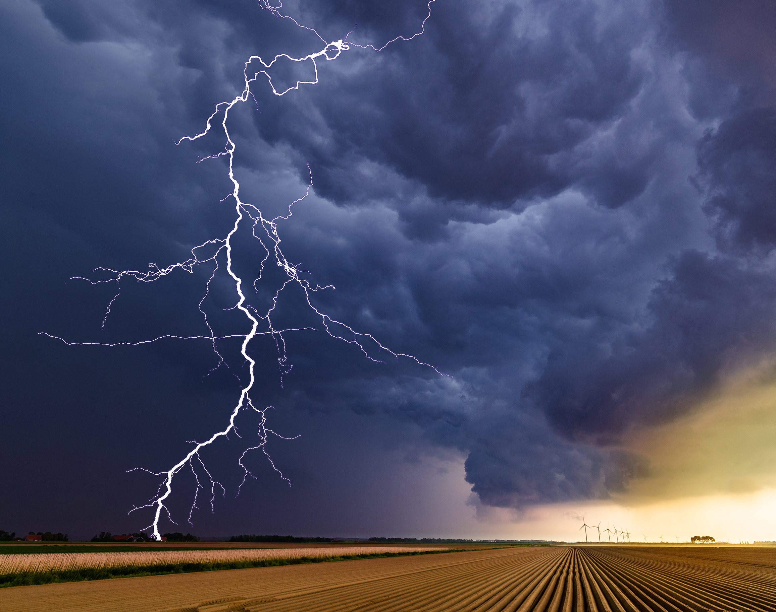
Crisis Narrative of Mental Health
TLDR; media version
Ben Locke, Ph.D.
Chief Clinical Officer
Togetherall
EWA 2025
St. Louis

Slide 2
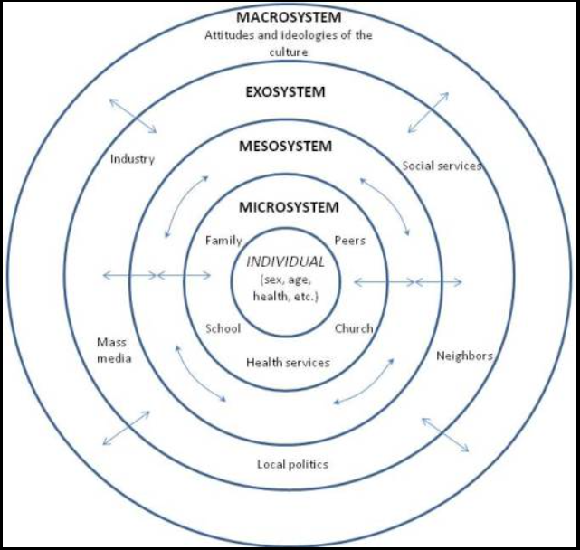
Cultural Narratives Live Here
Macrosystem: Broad, overarching cultural stories, ideologies, attitudes, and values of a culture that shape the worldview and behaviors of its individuals
Spoken and unspoken
Compliance and participation rather than awareness
Change over time
Who contributes? (everyone)
(Bronfenbrenner, 1979: Ecological Systems Theory)

Slide 3
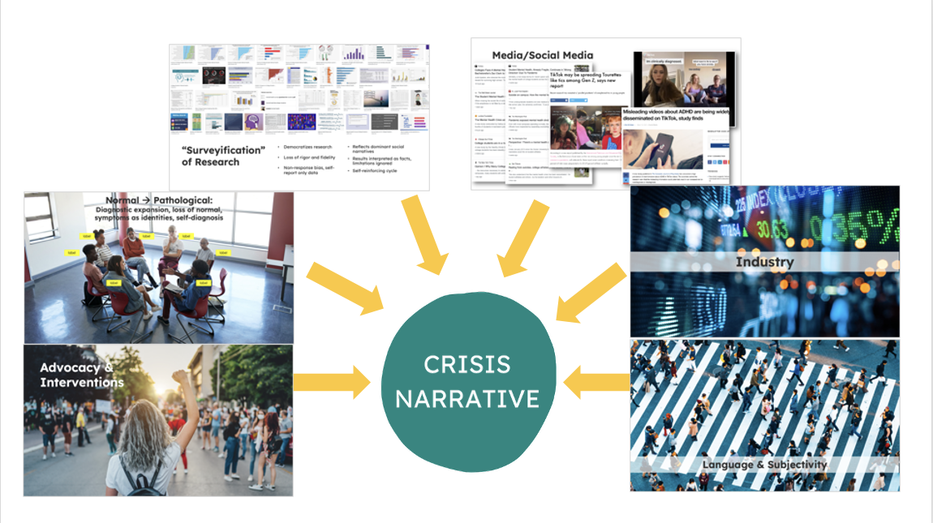
Key Ingredients

Slide 4
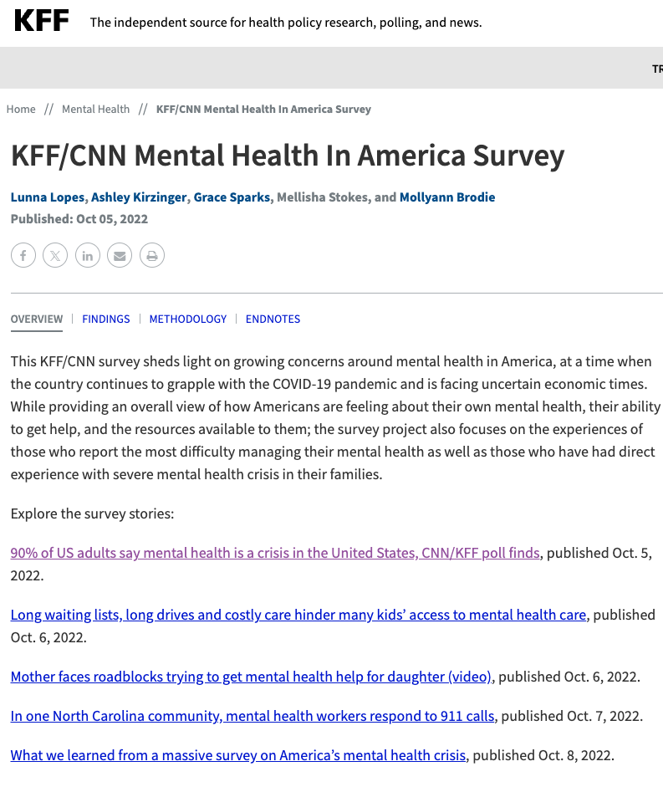
Example #1
Advocacy
Research
Media
Industry
Social Media
Kaiser Family Foundation
  ”Mental Health In America Survey”
  CNN as a partner, Opinion poll
Question: In the U.S. today, is mental health:
  a crisis
  a problem but not a crisis
  not a problem at all
90% of US Adults say “mental health is a crisis”
  Less than 2k
  Random snail-mail
  Random pre-paid phone plans

Slide 5
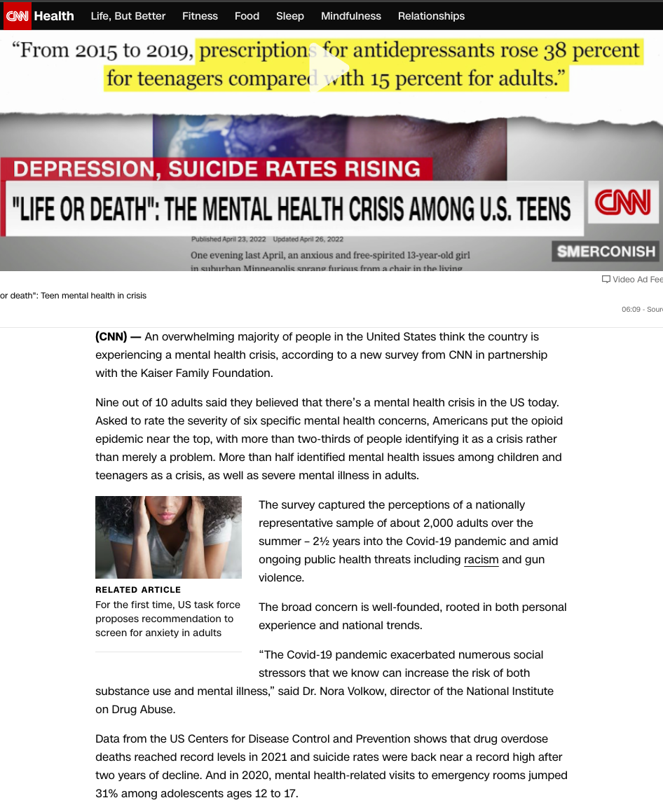
Advocacy
Research
Media
Industry
Social Media
“An overwhelming majority of people… think the country is experiencing a mental health crisis” (CNN)
“LIFE OR DEATH.. Mental Health Crisis” juxtaposition (NYT)
No underlying data @ MH

Slide 6
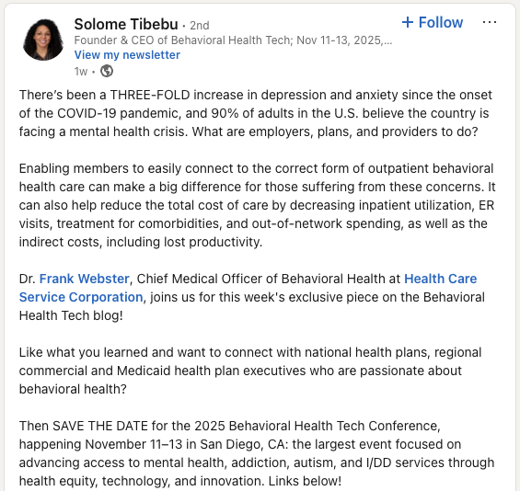
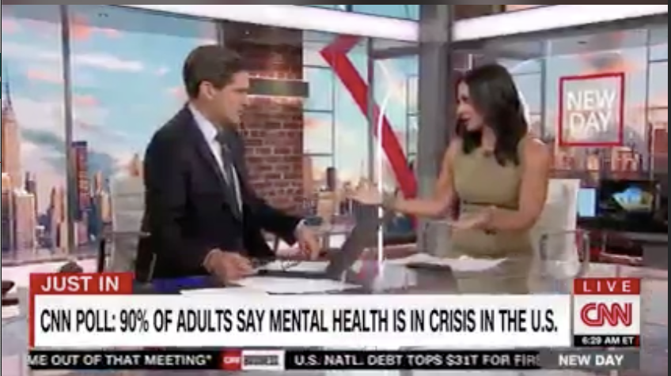
Advocacy
Research
Media
Industry
Social Media

Slide 7

Example #2: Research + Self-report (Language + Subjectivity) = Prevalence Inflation
Clinician: Suicidality as a presenting concern
Student Self Report: “Thoughts of ending my life”
  > 0 in the last two weeks
Reporting self-reported data dramatically exaggerates prevalence.
  Best Case Scenario
    What happens in a worst-case?
  Risks of over-reliance of surveys
  Language / Subjectivity
432% Increase
Research
Subjective
Media
Narrative

Slide 8
Some Recommendations:
Details matter.
Surveys are flawed. Methodology matters. Generalizability is limited.
Beware using of “mental health crisis” for financial goals at the cost of social contagion
Beware of crisis narrative use for business interests (e.g., AI investments)
Question tendency to pathologize normal experiences
Non-professional subjective use of psychological jargon is not the same as professional evaluation
Critically examine
claims, evidence, and goals.

Slide 9
Optional Readings ☺
CRISIS NARRATIVE:
Video Webinar: https://www.youtube.com/watch?v=qJza2dCmK48
Blog 1: https://togetherall.com/en-us/blog/examining-the-crisis-narrative-of-collegiate-mental-health-the-discussion-is-just-beginning/
Blog 2: https://togetherall.com/en-us/blog/revisiting-the-crisis-narrative/
RESEARCH CONCEPTS:
Lucy Foulks (UK): https://doi-org.ezaccess.libraries.psu.edu/10.1111/camh.12760
  “Scoping review: potential harm from school-based group mental health interventions”
Nick Haslam (AUS): https://psycnet.apa.org/doi/10.1080/1047840X.2016.1082418
  “Concept creep: Psychology’s Expanding Concepts of Harm and Pathology”
ON CONTAGION:
Media Guidelines - American Foundation for Suicide Prevention (AFSP) https://afsp.org/ethicalreporting/
Psychology Today: The Girls who Caught Tourettes from TikTok:
  https://www.psychologytoday.com/us/blog/its-catching/202110/the-girls-who-caught-tourettes-tiktok
Hysterical: https://wondery.com/shows/hysterical/
NPR examination of misinformation about ADHD on TikTok: https://www.npr.org/2025/03/24/nx-s1-5336303/adhd-symptoms-adult-tiktok

Slide 10
My Transition to Togetherall
Post-crisis narrative
  “We can’t put the cat back in the bag.”
  Normalize human distress and match with
  Modern support systems (instant access, digital, safe, real people at scale)
We are facing 3 key realities:
  Demand exceeds supply
  There are not, and will not, be enough providers
  Mental health services must evolve
Togetherall:
  Sought out a social-impact business with external guard-rails (Guardian Council)
  People Helping People → Scaled by technology → Moderated by licensed clinicians

Slide 11



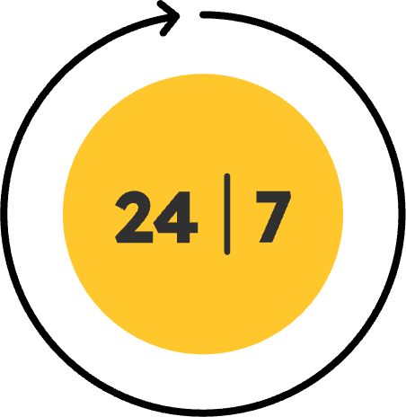






Togetherall is an accessible, safe, and vibrant community
Accessible
Safe
Vibrant
20M+ people
have access; ~10K new members every month
24/7 Clinically moderated
Immediate
Access
Anonymous
Available
24/7
400+ organizational partners
Average of 30 activities per member
Risk Escalation Processes
Mobile First

Slide 12
ben.locke@togetherall.com

