Slide 1
Beyond the Violence
A Solutions Journalism Approach to Covering the Impact of Guns on Children

Slide 2
Guns are the leading cause of death of children in the United States.
"In the U.S., gun death rates in this age group have increased by 106 percent since 2013 and have been the leading cause of death among this group since 2020," the Johns Hopkins Center for Gun Violence Solutions wrote in a 2024 report.

Slide 3

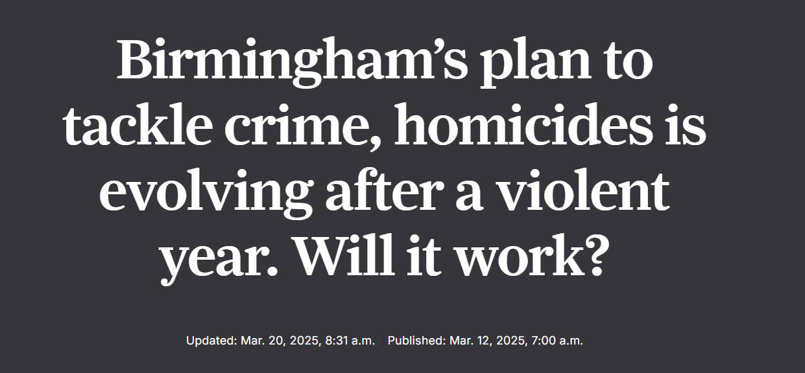

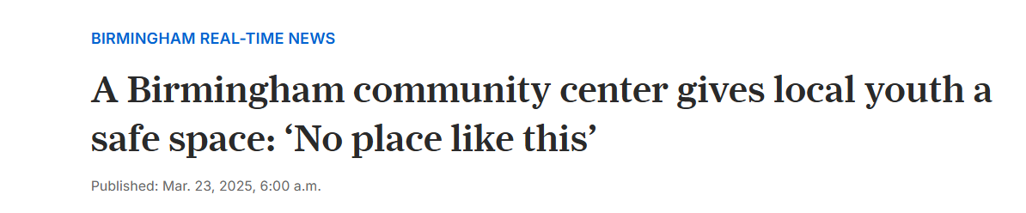
AL.Com beyond the violence

Slide 4



Slide 5



Slide 6



Slide 7
Finding accurate data is hard
WONDER, CDC data
Gun Violence Archive (derived from media reports)
FBI Crime Data Explorer (data is voluntary and likely inaccurate)
Local police, coroner’s information

Slide 8
Identifying potential solutions, stories
Understand trauma-informed reporting practices
  DART Center
Understand evidence-based best practices
  PROGRESS research
  Local community violence intervention programs
    Violence interrupters
    Focused deterrence
    Environmental risk factors
  May vary by community, issue
Understand potential ways to structure a story
  Solutions Journalism Network
  Trusting News Network

