Slide 1
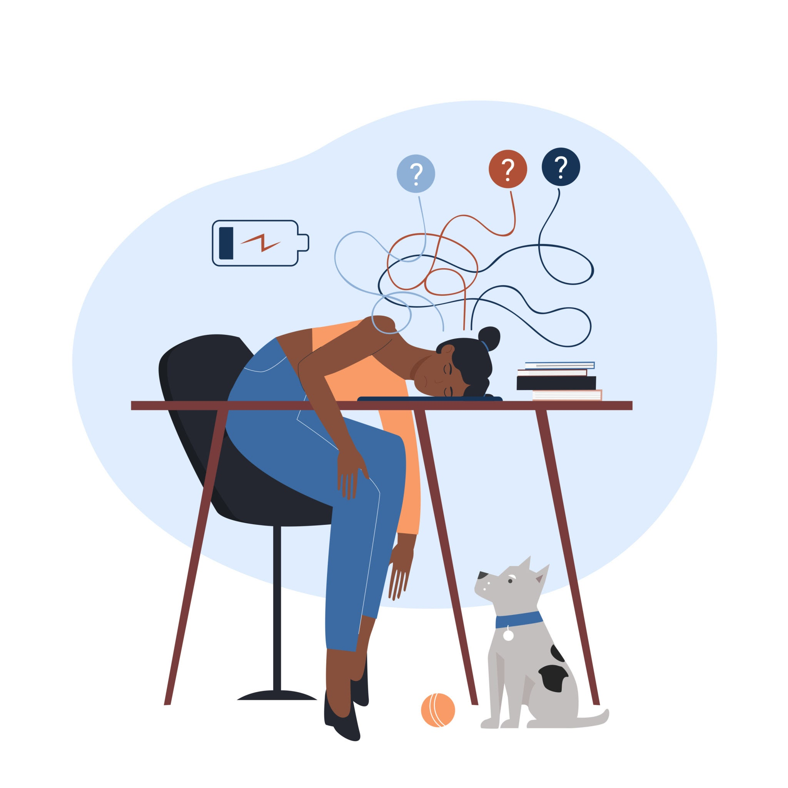

Burnout in Journalism
Alanna “Lane” Dvorak
Notes:
Delete the gray box and instructions. Insert your image. Arrange > Order > Send to back

Slide 2
Notes:
Add the presentation title in the upper left corner.

Slide 3

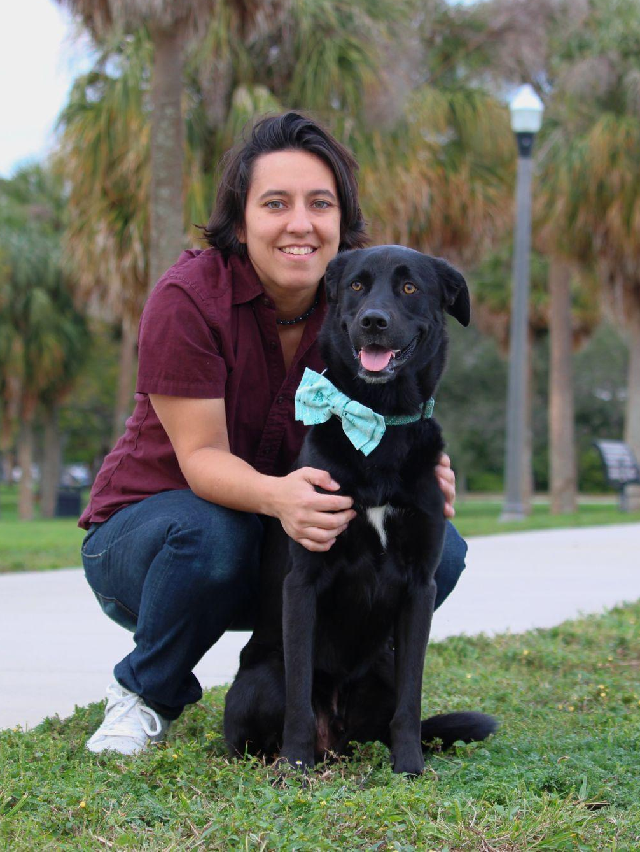
| Burnout in Journalism
Alanna “Lane” Dvorak
International training manager at Poynter
Help develop curriculum for in-person, virtual and hybrid training across a variety of journalism disciplines, but with an emphasis on fact-checking
Originally worked as a print journalist in the DC area
Sports aficionado, trivia nerd, fan of Leo the dog (pictured here)
Notes:
Add the presentation title in the upper left corner. Add information for each speaker. Replace rectangles with headshots.

Slide 4
| Presentation Title Here
Stress vs. burnout
When do you need help to manage?
How to manage stress levels and prevent burnout
Notes:
Add the presentation title in the upper left corner.

Slide 5
What is stress?
Stress is natural human response that prompts us to address challenges and threats. We all experience stress, professionally and personally.
What’s important is how we respond to stressors and how long we are exposed to them.
Notes:
Stress affects both the mind and the body. A little bit of stress is good and can help us perform daily activities. Too much stress can cause physical and mental health problems. Learning how to cope with stress can help us feel less overwhelmed and support our mental and physical well-being.
How does it work? There are healthy and unhealthy levels of stress. People engage in stressful activities all the time: short amount of high-level stress that is gone. But stressors in everyday life aren't generally short. Or we'll dwell on them. Think about stress coming in waves, broken apart by rest. When you're at that peak continuously is where you come at risk of burnout. From a biological perspective, it’s moving from your sympathetic nervous system, that fight or flight reaction, to the parasympathetic nervous system
Real rest: Turning off the nervous system for recovery.
Fake rest: Things you think are soothing that aren't, things that might hide your fatigue. Bingeing, for example, might not actually be something that relieves you. Drinking.

Slide 6
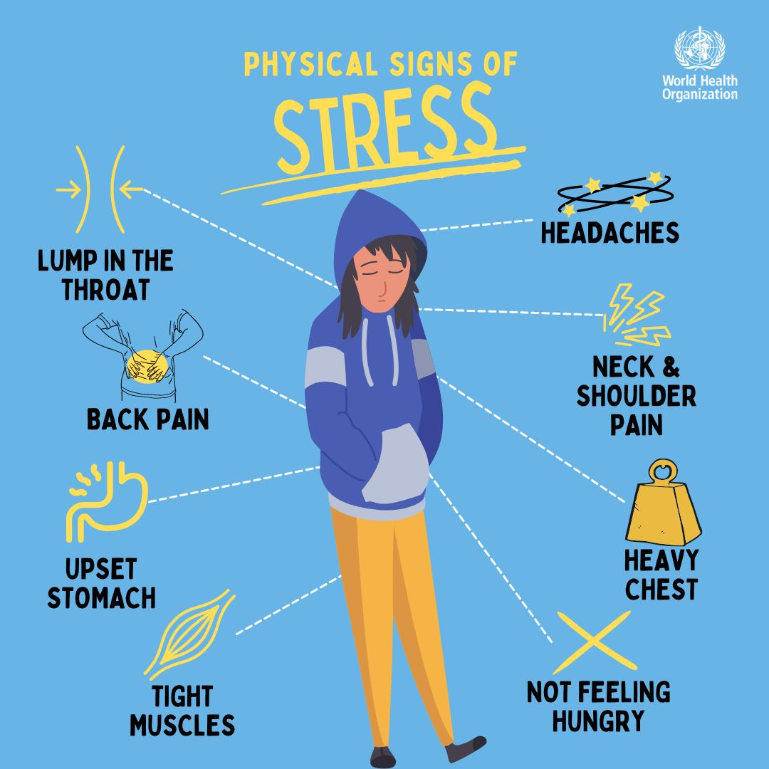

Slide 7
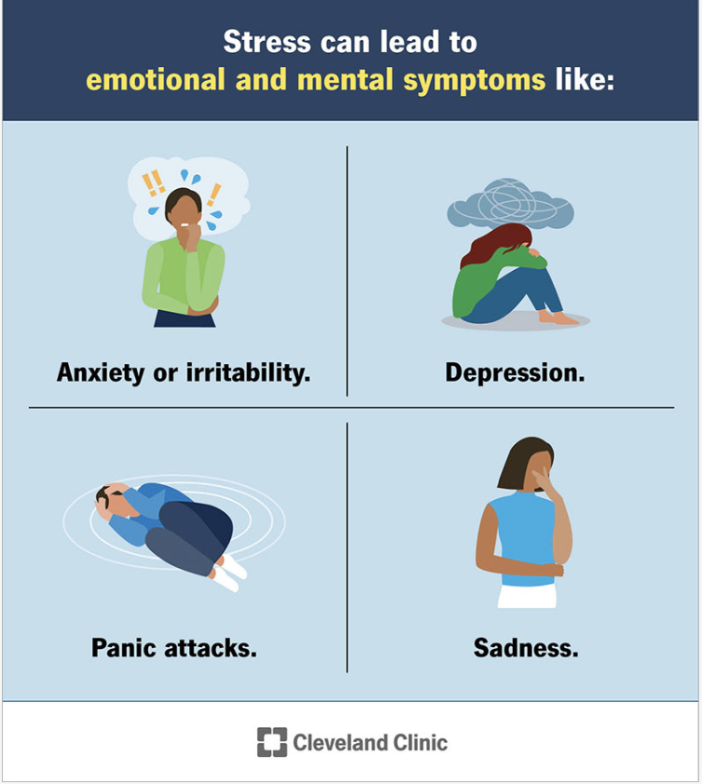

Slide 8

Burnout =
Chronic workplace stress that has gone unmanaged for too long
Notes:
Constant stress + fake rest = burnout
Real rest: Turning off the nervous system for recovery.
Fake rest: Things you think are soothing that aren't, things that might hide your fatigue. Bingeing, for example, might not actually be something that relieves you. Drinking.

Slide 9
Top causes of burnout
Unfair treatment at work
Unmanageable workload
Unreasonable time pressure
Lack of role clarity
Lack of communication and support from manager
Gallup “Employee Burnout”
Notes:
63% more likely to take a sick day
Half as likely to discuss how to approach performance goals with their manager
23% more likely to visit the emergency room
2.6 times as likely to leave their current employer
13% less confident in their performance
Fatigue and physical and emotional exhaustion
Resentment, cynicism and detachment
A sense of incompetence or hopelessness: a lack of accomplishment and feeling ineffective at work

Slide 10
When do you need help?
Tired
Unmotivated, cynical
Hopeless, depressed, always anxious
Unable to function
Notes:
Do you know your mental health signs? Deviation from normal behavior? Sleeping? Eating? Change in routine? This is long term too.

Slide 11
The value of breaks
Regular breaks throughout the day
But also, giving yourself uninterrupted work -no meetings, calls, turn off Slack
Lunch breaks
Disconnecting during off hours and weekends
Taking vacations and holiday time
Notes:
For most full time employees in the US, you get two 15-minute paid breaks.
Think of these as micro, meso and macro breaks
Any different types of breaks you guys take?

Slide 12
Digital hygiene
Check email in batches and not after hours
Keep inbox closed or use tools like Inbox When Ready to hide incoming messages
Limit screen time and social media time; limit or turn off notifications or get them sent in batches
Discuss with your team how to use Slack statuses and pausing notifications
Notes:
Tools you can put on your computer, like Freedom or Session. News feed eradicator. You can also uninstall apps from your phone. Status updates on slack
What other techniques do people use? Any tools?

Slide 13
Institutional ways to prevent burnout
Early Fridays
Focus Fridays
Regular check-ins
Mentoring and check-ins. Establish a culture of support
Notes:
Early Fridays: some companies have a routine where every other Friday, or whatever cadence, employees leave a few hours early. One organization I’ve spoken with does a biweekly Cafe Monday. The whole staff goes to a cafe for two hours and can talk about anything, personal or professional.
Focus Fridays: as we’ve all learned, Zoom fatigue is real. Maybe implement a day where you do no meetings.
Poll the crowd.
Trivia channel

Slide 14
Key steps on how to prevent burnout
Self-Awareness: listen to your body’s distress signals
Take supportive action: stop & consider “what do I need right now would help right now?”
Create boundaries:
  Engage regularly in activities that comfort you or help you maintain stability
  Take regular breaks at work especially from work you find most distressing
Create a personal & professional support system for yourself
Notes:
Add the presentation title in the upper left corner.

Slide 15
Manage your stress before you get to burnout
Daily routine
Sleep hygiene
Exercise regularly
Eat well
Stress management techniques
Notes:
Sleep hygiene: Comfortable dark room. Go to bed around the same time. Limit the blue lights!

Slide 16
Stress management techniques
Five senses grounding exercise
Box breathing
Movement
Guided imagery
Notes:
5 things you can see, four you can touch, 3 you can hear, 2 you can smell, 1 one you can taste

Slide 17
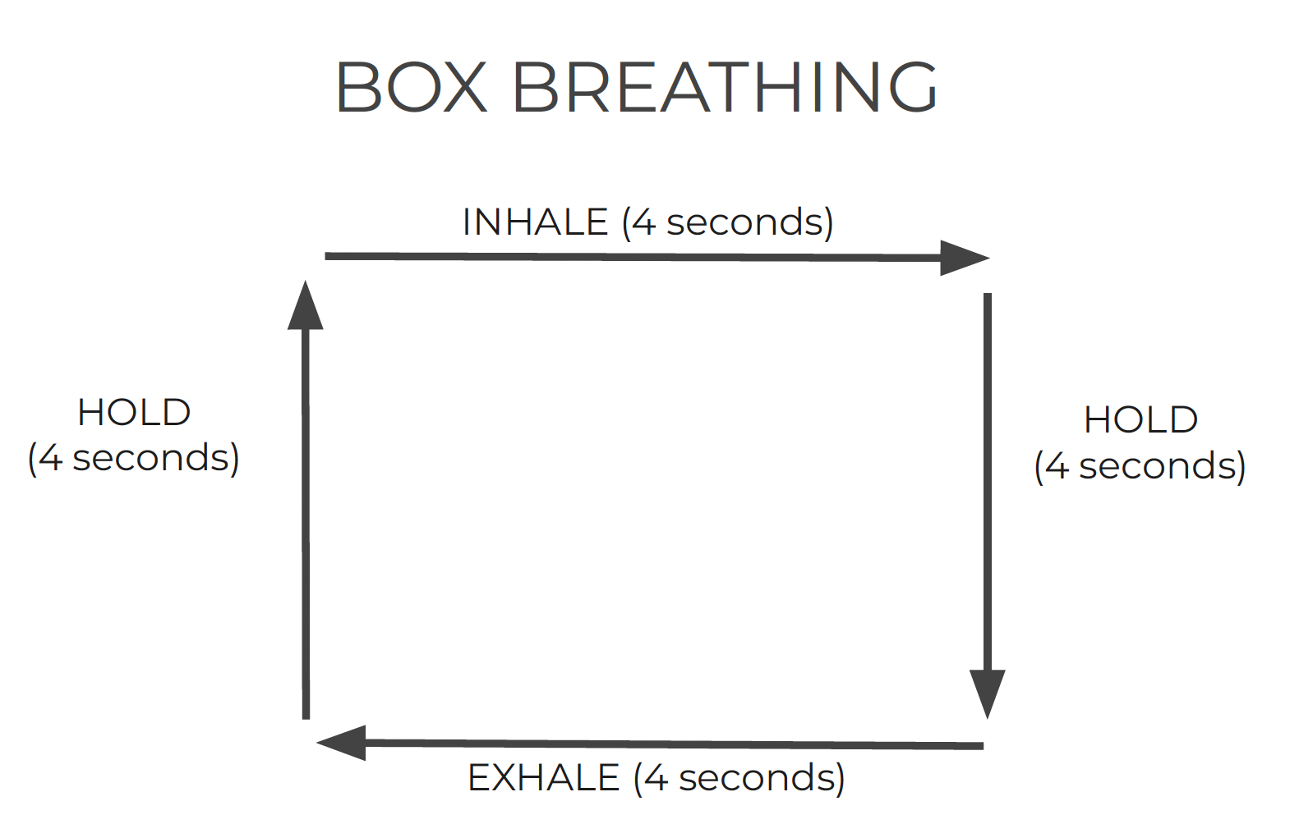

Slide 18
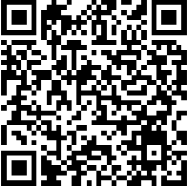
Mental Health Readiness Checklist
with the Self-Investigation

Slide 19
| Burnout in Journalism
Keep learning.
Enroll in an upcoming course.
poynter.org/shop
Notes:
Add the presentation title in the upper left corner.

Slide 20
Thank you!
Notes:
Add the presentation title in the upper left corner.

Slide 21

| Burnout in Journalism
Questions?
Notes:
Add the presentation title in the upper left corner. Add concept label and statement to the large text box.

