Slide 1
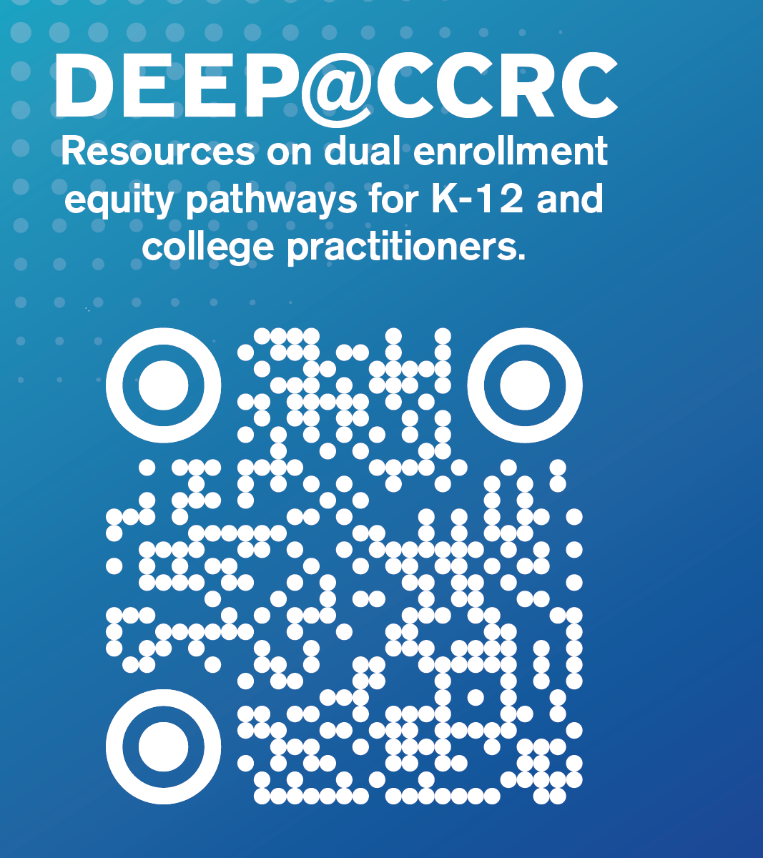

5 Things to Know about Dual Enrollment
John Fink
Community College Research Center
EWA National Seminar, May 2025

Slide 2
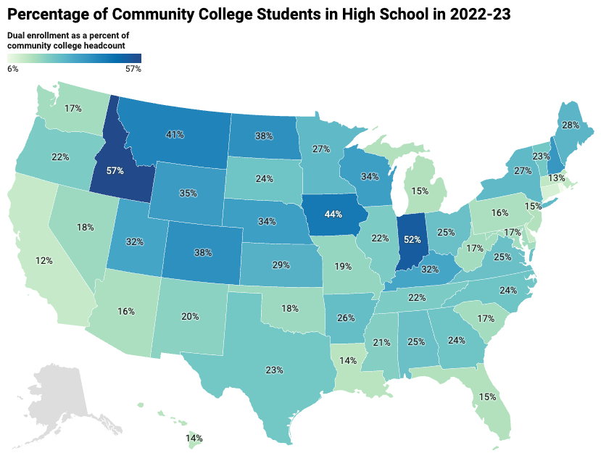
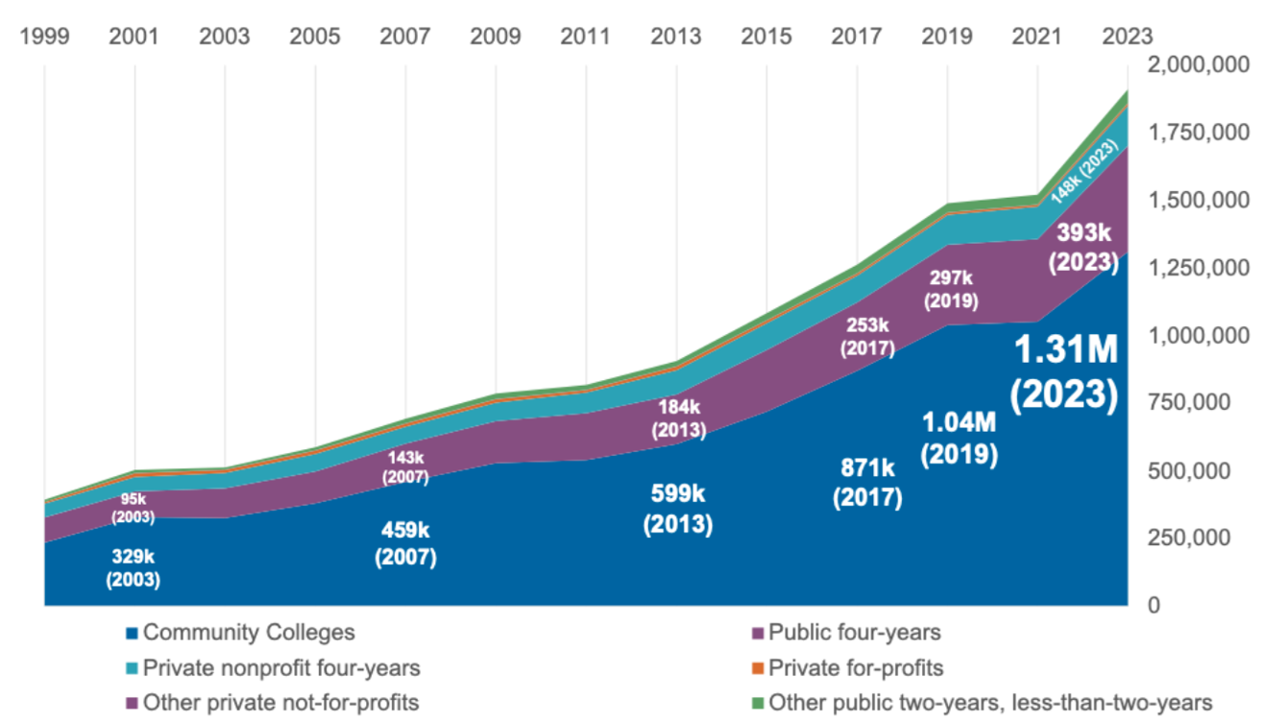
1) Dual enrollment is big (and growing), varied, and especially important for community colleges
Growth of Dual Enrollment, 1999-2023
CCRC analysis of IPEDS Data
https://ccrc.tc.columbia.edu/easyblog/how-many-students-are-taking-dual-enrollment-courses-in-high-school-new-national-state-and-college-level-data.html

Slide 3
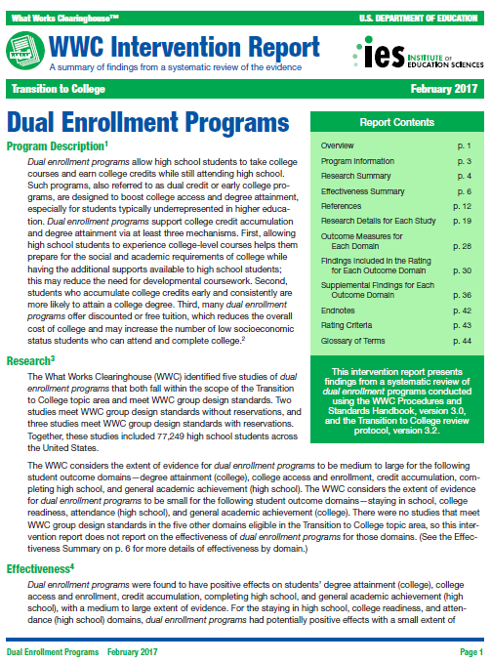
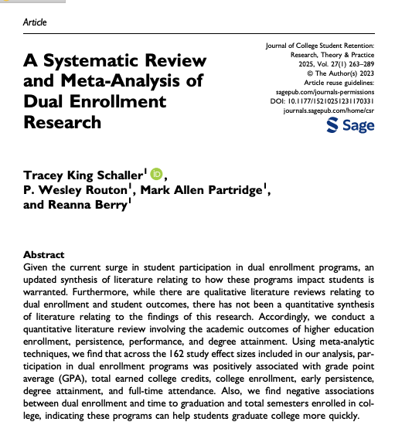
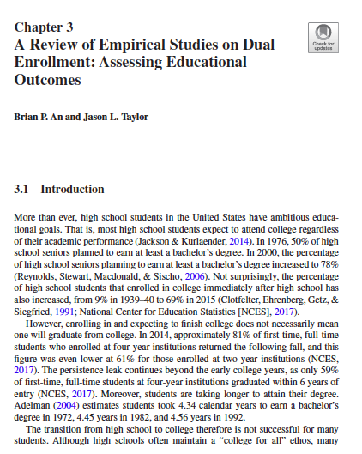
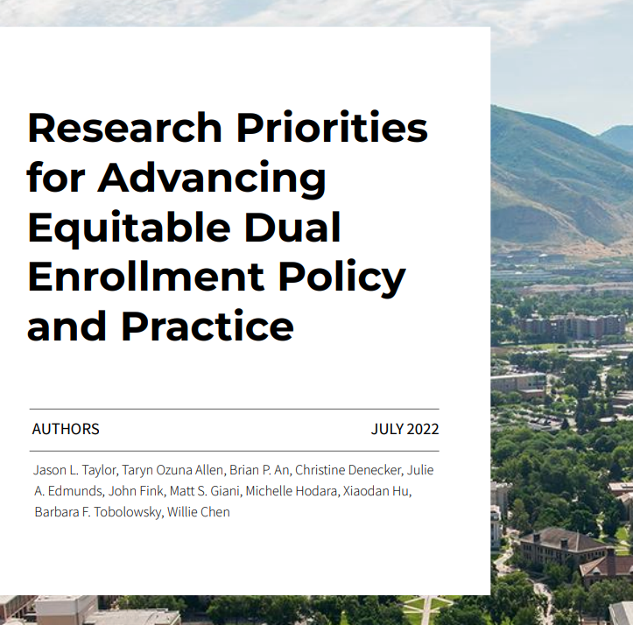
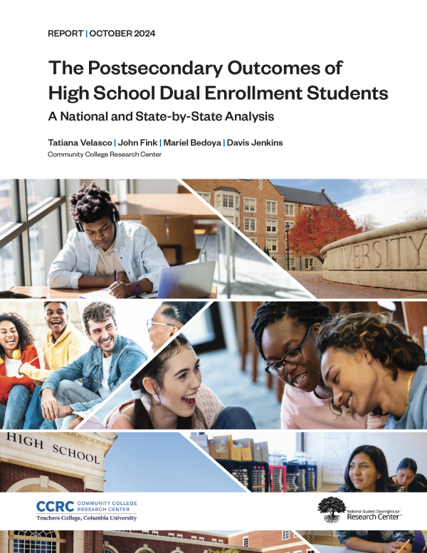
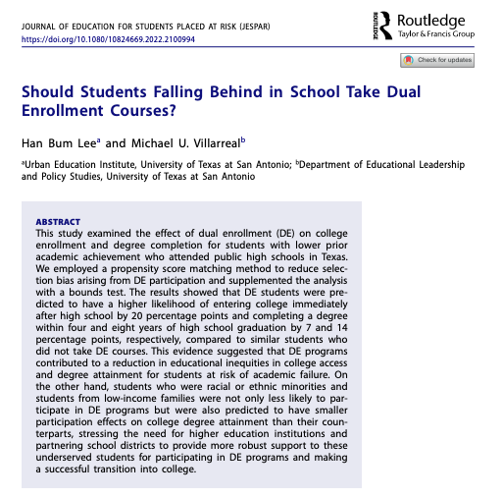
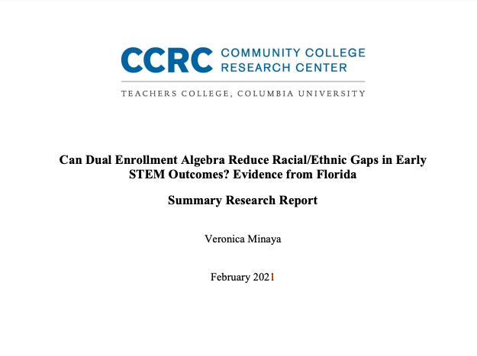
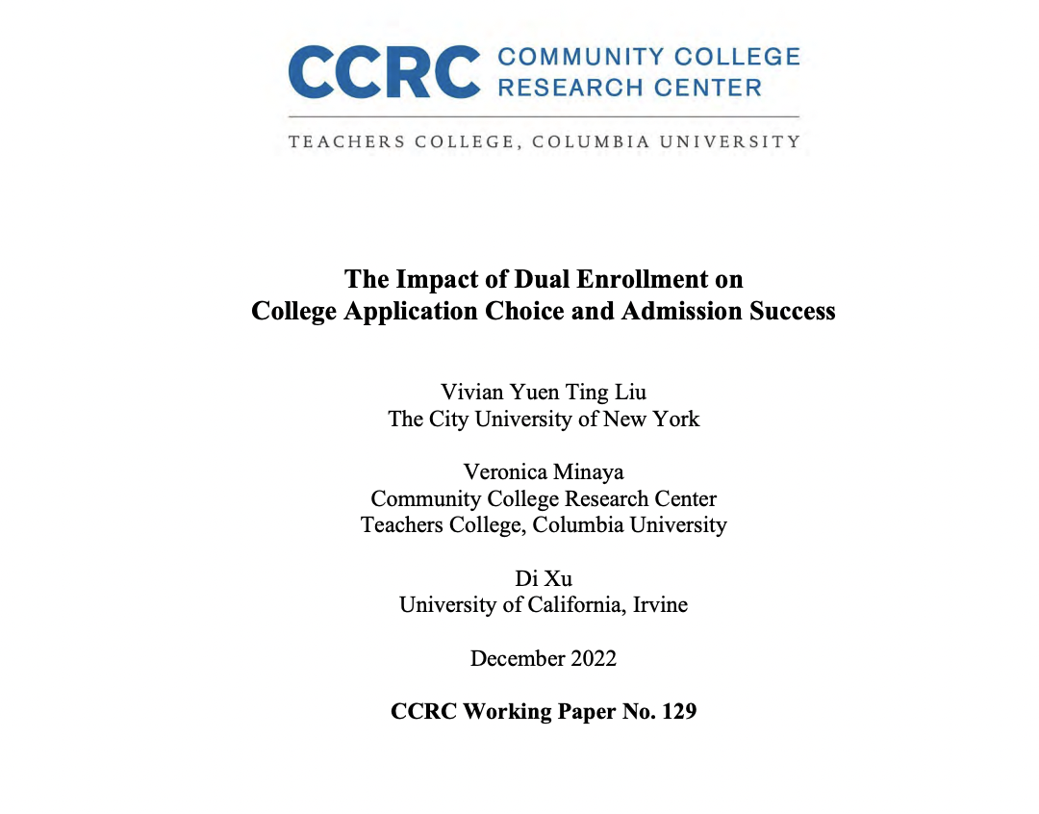
2) Strong research base showing that DE works as a lever for expanding college access & attainment
Reviews & Meta-Analyses
+ DE benefits Black, Latino, low-income and other priority groups

Slide 4
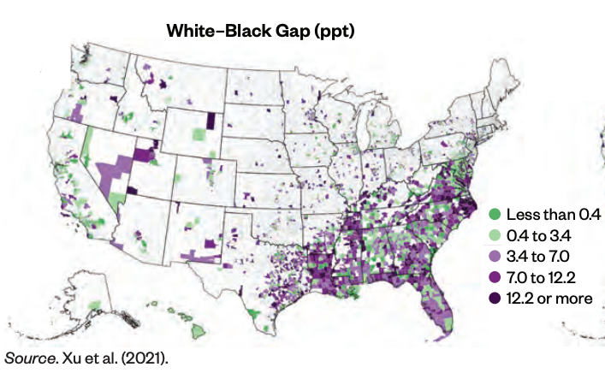
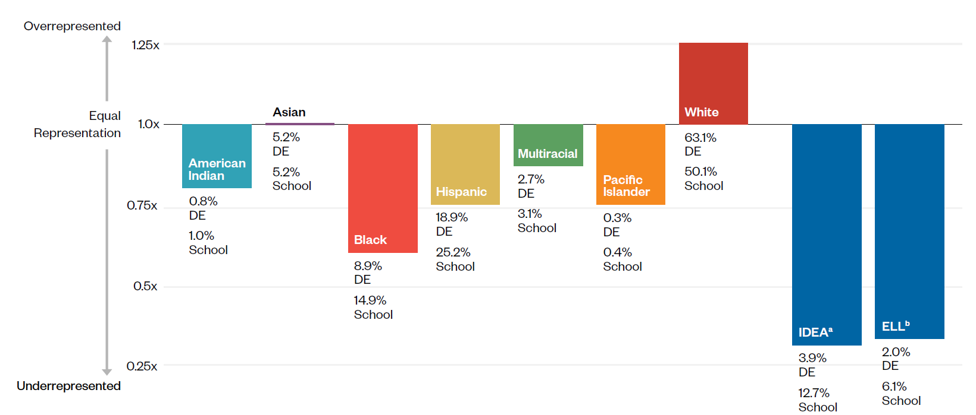
3) Access to dual enrollment courses is uneven, gaps are widespread, but 1 in 5 districts have closed gaps for Black and Latino students
Gap for Black Students
https://ccrc.tc.columbia.edu/publications/revamping-dual-enrollment-equitable-college-degree-paths.html

Slide 5
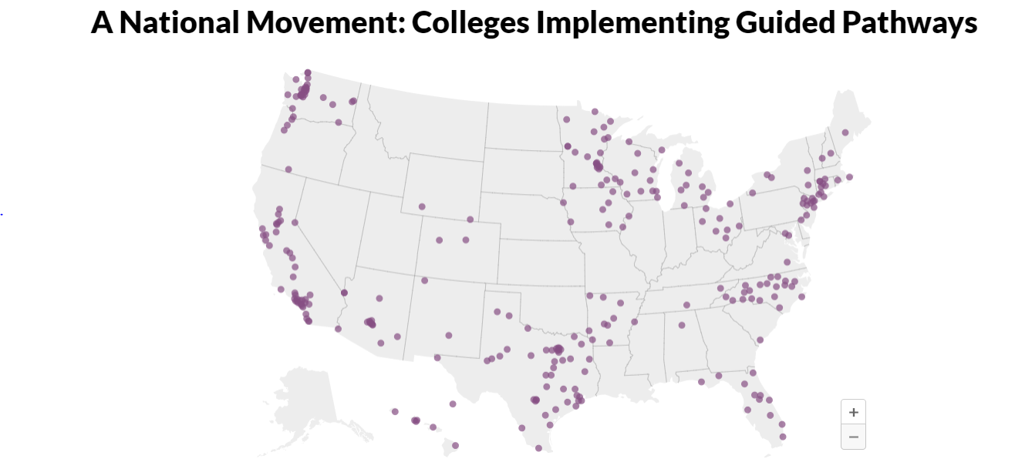
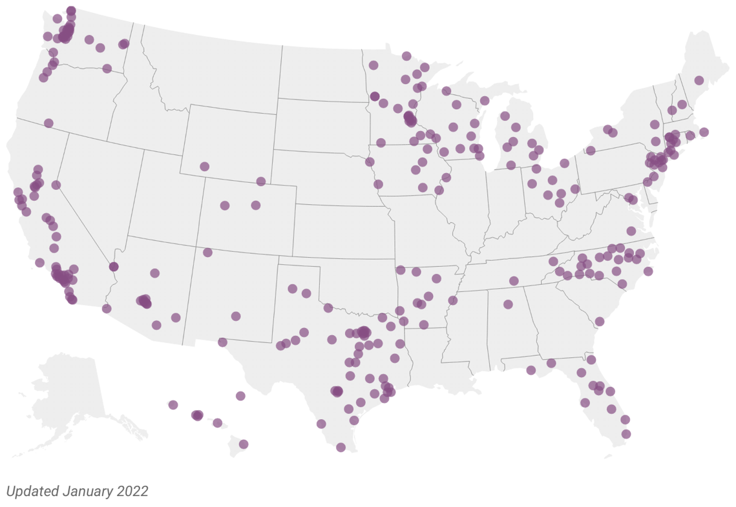
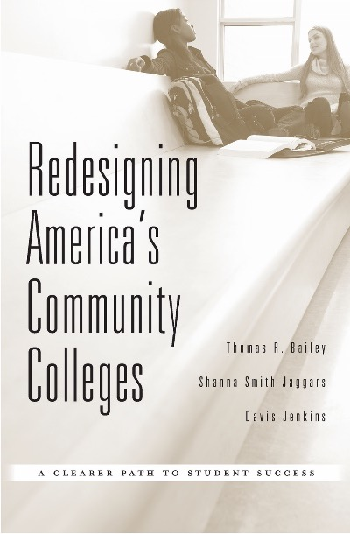
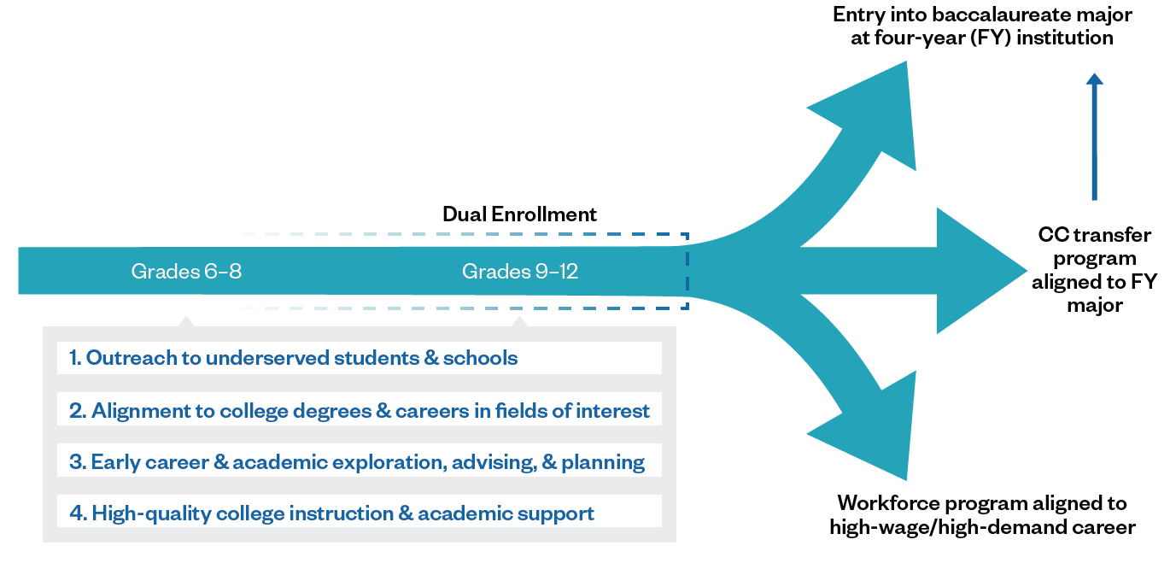
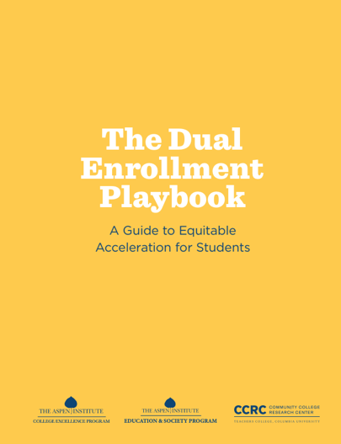
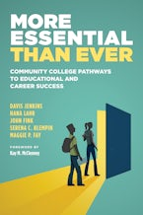
4) High-performing community college partnerships are extending their “guided pathways” reforms to DE
Dual Enrollment Equity Pathways
(DEEP) Framework

Slide 6
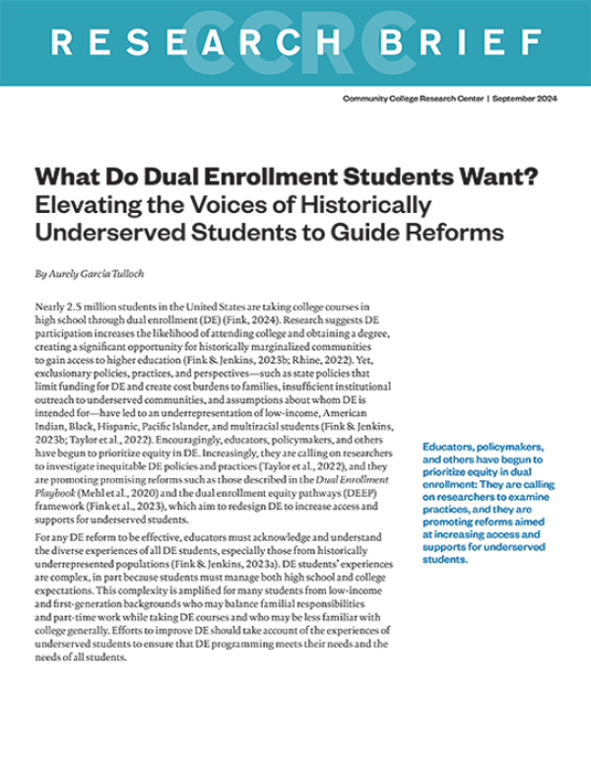
5) Students want more purposeful dual enrollment experiences
What do historically underserved DE students “want” and how can we connect this to DE reform?
Students want know about DE options earlier.
Students want well-informed DE advisors who empower them.
Students want their DE courses to be aligned with career and academic pathways in their fields of interest.
Students want engaging learning experiences in their online courses.
Students want to know how to balance the high school experience and DE coursetaking.
Students want to know how to find scholarships and manage debt to help them attend college after high school.
https://ccrc.tc.columbia.edu/publications/what-do-dual-enrollment-students-want.html

Slide 7
Thank you!

