Slide 1
How Teachers Translate the Science of Reading Into Practice
EWA National Seminar 2025

Slide 2
The science of reading…
“… is a body of basic research in developmental psychology, educational psychology, cognitive science, and cognitive neuroscience on reading, one of the most complex human behaviors, and its biological (neural, genetic) bases. This research has been conducted for decades in the US and around the world. The research has important implications for helping children to succeed, but it has not been incorporated in how teachers are trained for the job or how children are taught.” – Mark Seidenberg

Slide 3
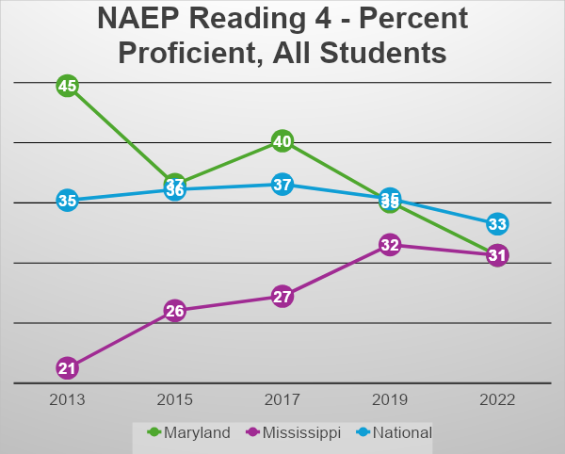
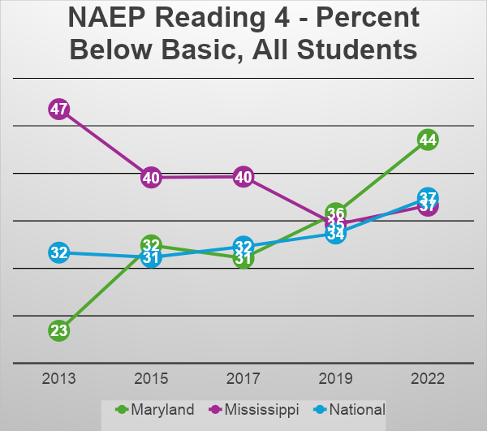
All Students
NAEP Trends

Slide 4
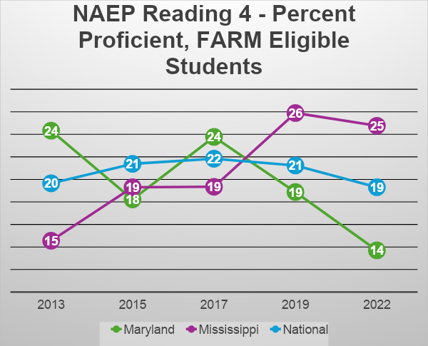
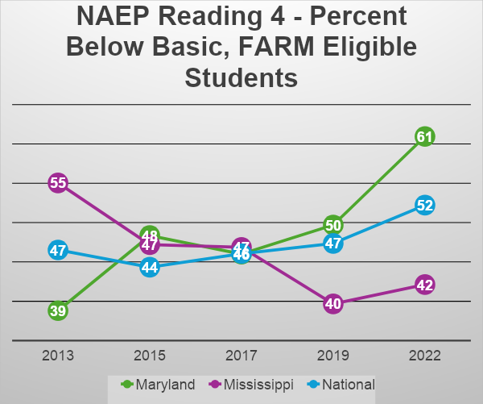
FARM Eligible Students
NAEP Trends

Slide 5
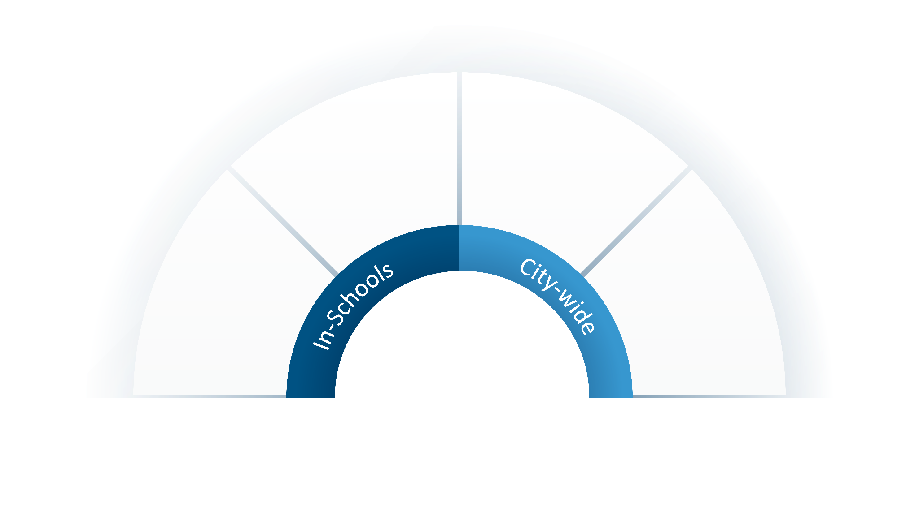


The Process
Teachers improve their instruction and help students improve their literacy levels
Coaches observe, model, and co-plan with teachers
1:1 tutoring for students after school
Coaches work with teachers during the school day
Mentor provides feedback and support

Slide 6
What Material is Covered?
Stages of Reading Development
Theoretical Models of Reading
The Reading Brain
The Struggling Readers Brain
Phonology and Orthography of English
Morphology, Syntax, and Semantics
Principles of Strong Assessment and Instruction and more!

Slide 7
The DC Reading Clinic is Getting Results
+34
Over the past four years, DC Reading Clinic students have consistently shown increased reading proficiency in comparison to students not enrolled in DC Reading Clinic classrooms.
DC Reading Clinic classrooms steadily demonstrate remarkable improvement each school year, significantly reducing the number of students reading below benchmark level and outperforming non-DC Reading Clinic classrooms.
Students enrolled in DC Reading Clinic classrooms are more likely to reach the expected literary standards for their grade level; students that began the school year with well-below standard reading skills had a higher probability of moving up a reading level or achieving their grade level reading skills by the end of the school year.
% point change in students reaching or exceeding reading levels
+23
% point change in students moving out of the well-below reading level

Slide 8
Students are Making Dramatic Progress
70%
33%
of at-risk students were performing below grade level at the beginning of the year
of at-risk students were performing below grade level at the end of the year
The In-School program shows the most success as teachers working with students on a more consistent basis, at a longer capacity, and for the whole academic school year.
On average, Black students showed the most improvement in their reading scores when enrolled in DC Reading Clinic classrooms, compared to other groups.
SOURCE: National Council on Teacher Quality (NCTQ)

Slide 9

“With a background in middle school teaching and then fifth graders - I have often felt ill equipped with less knowledge and strategies to teach foundational reading skills, but the needs continued to present themselves and no more so than this year! I have grown so much more knowledgeable and confident. I feel much more prepared to understand and support the literacy needs of future students.”
“I love the structure of the Lesson Plan! I've already started implementing some of this structure in my Tier I lessons. Vowel Intensive is GREAT, and I use it all the time!”
“This has been the most supportive, intentional support I have EVER received to improve my practice as a teacher.”
“Everyone is amazing! The work you all do is helpful and I would love to see the program expand.”
“The training was highly effective in teaching me strategies I did not even know I needed but have learned are essential to student learning.”

