Slide 1
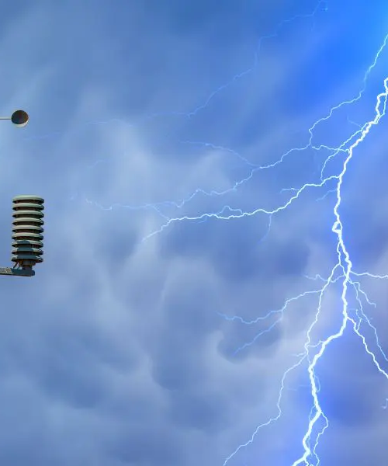

Disaster on the Education Beat
Education Writers Association Conference
Elisa Tomich, Chief Communications Officer
Parkway School District

Slide 2

About Parkway
About 16,000 students
Suburban St. Louis
> 100 languages spoken
About 40 crises this school year

Slide 3
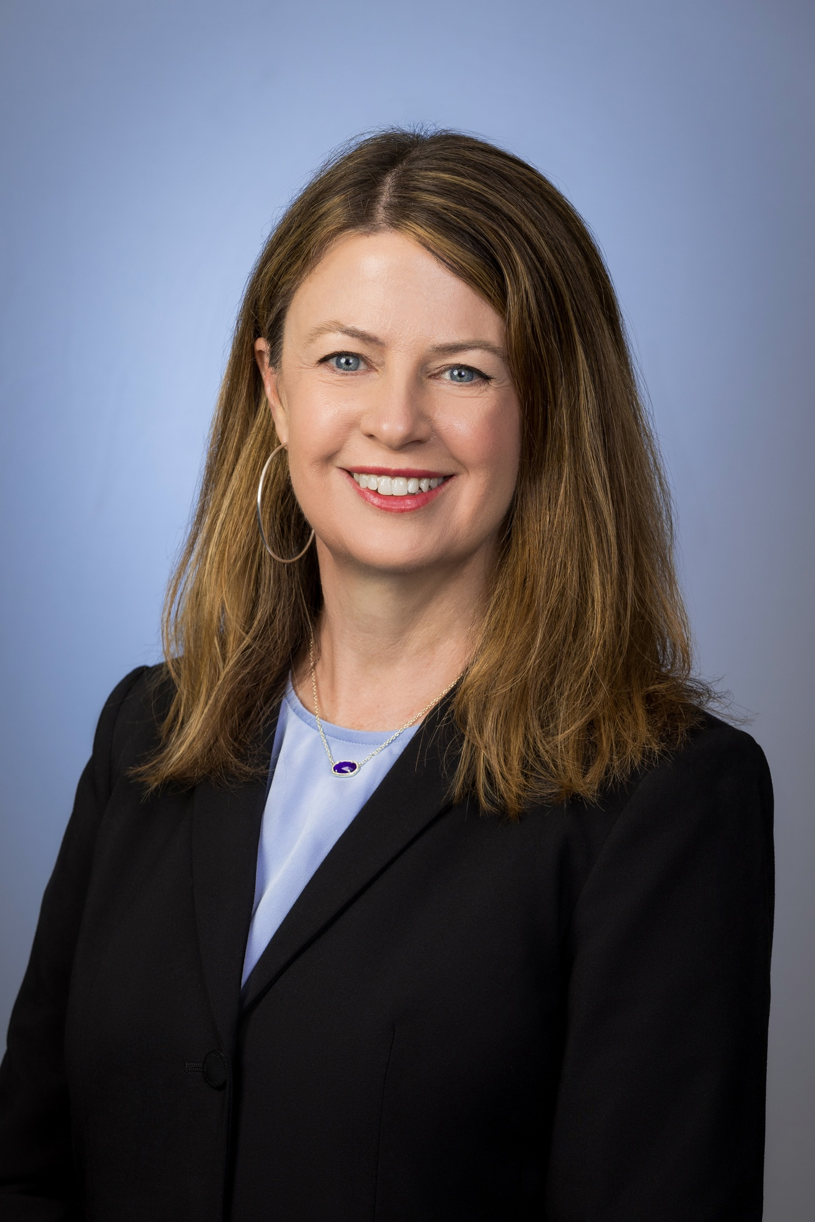
Who am I?
Print journalist for 20 years
Former K-12 reporter for St. Louis Post-Dispatch
Once a EWA regular attendee
Strategic comms for 7 years
Joined Parkway in 2023

Slide 4




Shared Goals in a Crisis
Share accurate, timely information
Anticipate info our community needs
Help people understand what to do
Maintain public trust under pressure
Providing the community with reliable, up-to-date information during a crisis.
Addressing the concerns and information needs of the affected community.
Providing clear, actionable guidance on what to expect or do next.
Being transparent and credible or else lose the community's trust.
By focusing on shared goals, communicators and reporters can work together effectively to support the community during a crisis.

Slide 5


What Is a Crisis?
Disrupts normal operations
Demands immediate response
Any situation that disrupts the regular activities and functions of a school or the district
Any situation that requires an urgent and coordinated response from the school or district to manage the situation
Threatens safety
Potential for reputational harm
Situations that pose a threat to the safety and well-being of students, staff, or the broader community
Anything that has potential to negatively impact the reputation and public perception of a school or district
In summary: any situation that disrupts operations, threatens safety, demands an immediate response, and/or has the potential to cause reputational harm

Slide 6


Types of Crises in Schools
Sudden Crises
Smoldering Crises
Tornado or gas leak, intruder or active shooter, bus accident, social media threat
Neighborhood opposition, staff misconduct, equity concerns, viral rumors
School districts must be prepared to respond effectively to both sudden, unexpected crises as well as longer-term, smoldering issues that can impact operations and reputation

Slide 7
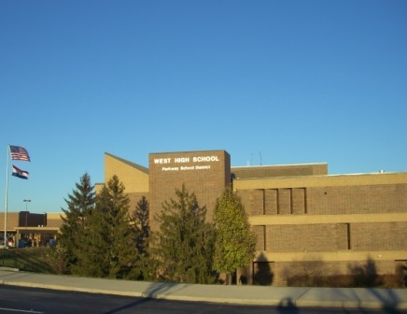
First week of school at Parkway West High
Local police contacted Parkway Security
Bomb threat had been made against West High and West Middle
Caller threatened to shoot up the school
Said his name was Justin
Said he'd drive up in a dark SUV

Slide 8
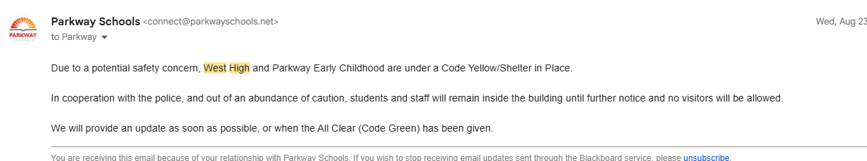

Slide 9
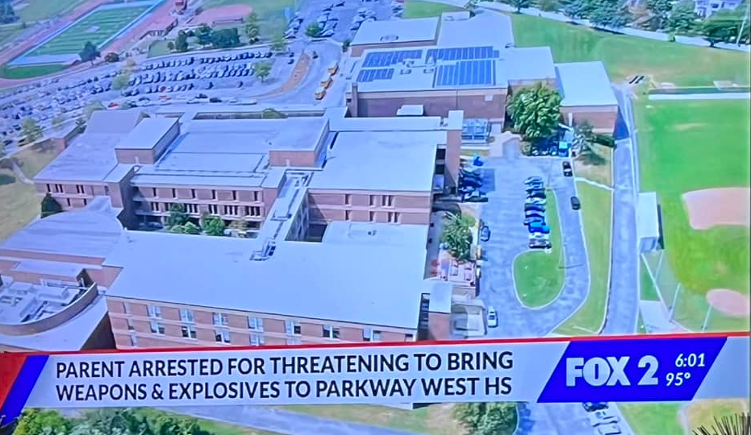

Slide 10
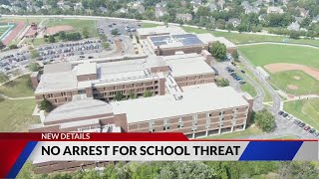
Notes:
Video URL: https://www.youtubeeducation.com/watch?v=gwNY8cjIrWs

Slide 11
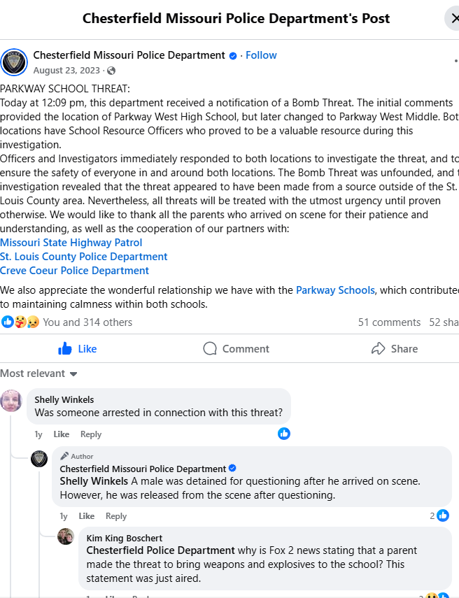

Slide 12
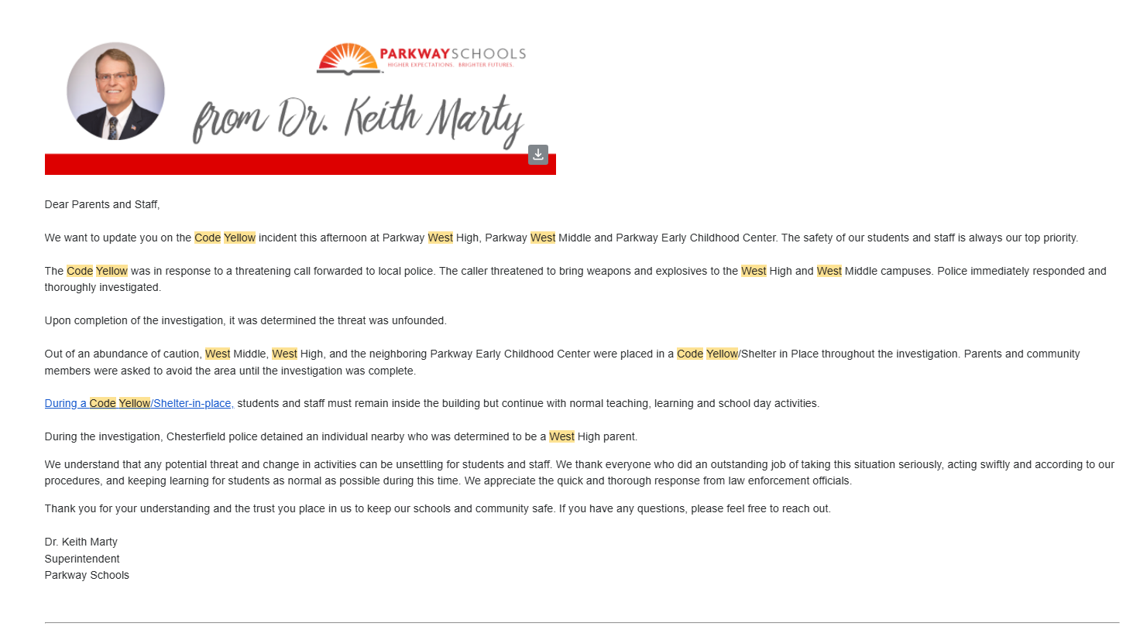

Slide 13
Preparing for Major Crises
Practice what to do
Revise and review plans
Reunification drills
Table top and rehearse reuniting students with families after an evacuation.
Practice emergency procedures to ensure staff and students are prepared.
Continuously review and test emergency plans for various scenarios.
Review and revise communications
Debrief after each crisis and improve
Get feedback from different stakeholder groups impacted during the crisis and use the information to improve.
Prepare pre-written messages and materials to streamline crisis communication.

Slide 14
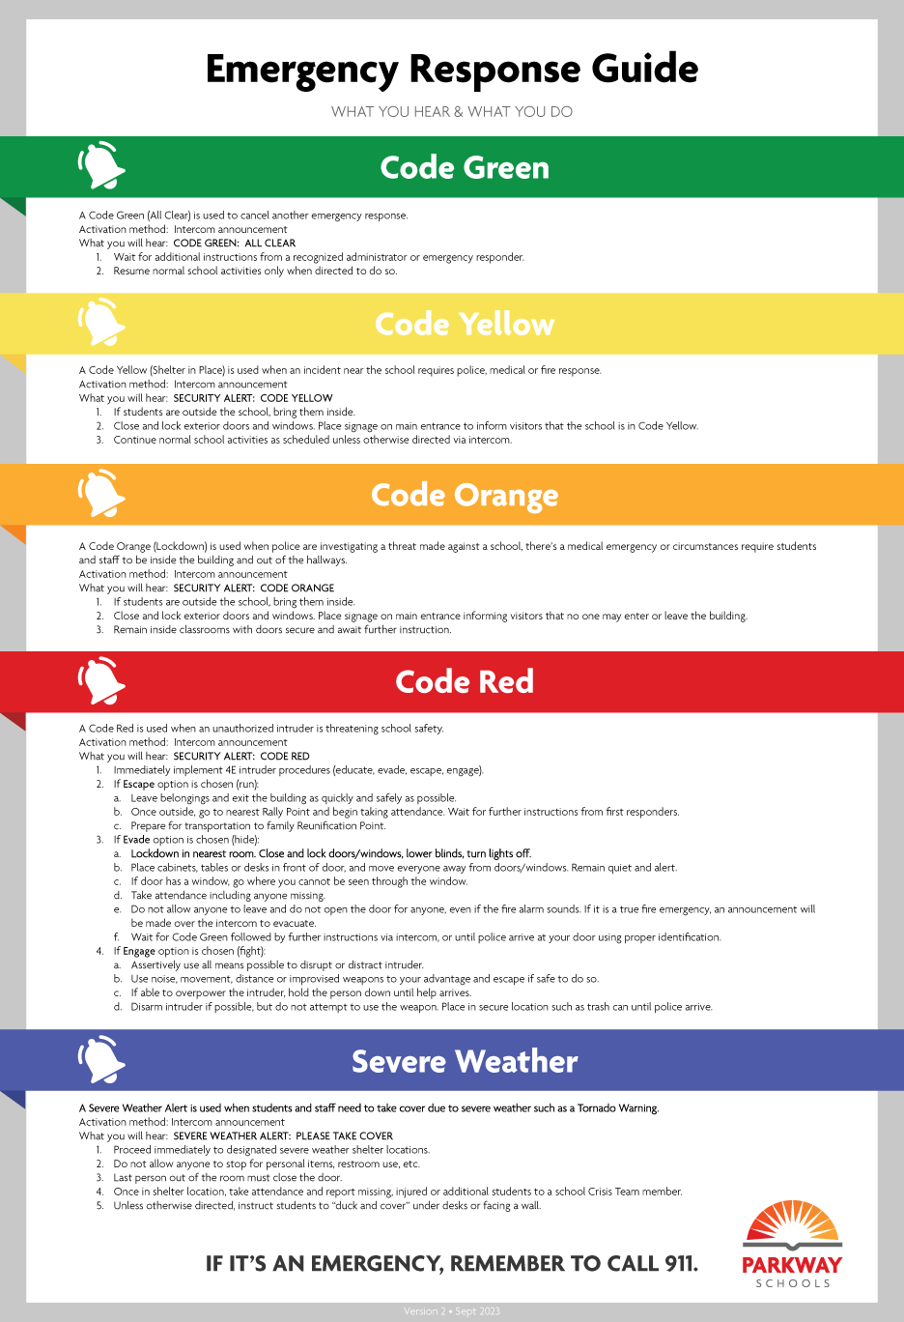
"By failing to prepare, you're preparing to fail"
-- BENJAMIN FRANKLIN

Slide 15
Building Trust Helps When Disasters Strike
Staff: Regular safety training
  Ensures everyone knows we’re on the same page and prepared to respond effectively
Families: Visit PTO meetings
  Establishes open communication and rapport with parents
Families: Safety & Security newsletters
  Regularly share information about how we’re keeping students and staff safe
Police and Fire: Meetings with chiefs
  Twice a year lunches with police and fire chiefs to discuss challenges, trends and crisis response
Police and Fire: Meetings with PIOs
  Cultivate personal connections for better coordination during a crisis
Reporters: Informal meetings
  Coffees and phone conversations to build relationships and context

Slide 16
Inside a Typical Crisis Response
Leadership and comms go to a conference room
  We’re on phones and walkies learning as much as we can to assess the situation.
Some leaders go to impacted school
  Deputy superintendent and others go to support principal in making decisions about buses, answering phones, informing staff.
Coordinate with police, fire, security
  District's security director is working with law enforcement or fire officials to determine what the facts are and providing additional support.
Communicate in waves: staff, families, media
  Prioritizing internal communication before addressing external audiences to maintain trust and consistency.
Monitor and respond to social media
  Monitoring and addressing inaccurate information spreading online in real-time
Update frequently, even if the update is: 'No new information'
  Maintaining open and transparent communication throughout the crisis, even when details are limited

Slide 17





Communicating from the Inside Out
District Leadership, Board of Education
Principals
All staff
Parents
Media and Community

Slide 18



How to get accurate, quotable information
Letter to parents
Letter to staff
School and district social media
.
When school officials aren’t available for interviews, there are other ways to get answers

Slide 19


There's never a bad question, but some we can't answer
FERPA
Open Records Restrictions
Integrity of an Investigation
Family Educational Rights and Privacy Act (FERPA) protects personally identifiable student information.
Whether personnel information is public is often determined by state open records laws.
If something is under investigation, school districts usually don't comment.
Even when we can't answer a question we should still be able to provide information.

Slide 20
Questions?

