Slide 1
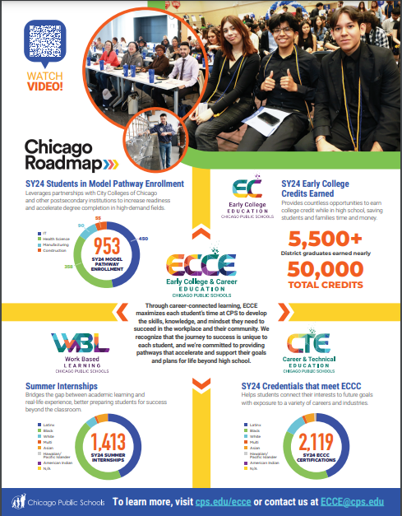
Early College and Career Education maximizes each student’s time at CPS to develop the skills, knowledge, and mindset they need to succeed in the workplace and their community.
We recognize that the journey to success is unique to each student, and we’re committed to providing options that accelerate and support their goals and plans for life beyond high school.
Notes:
MARIA
https://drive.google.com/file/d/10Xn9vxAeTrgRnpsoha3IvqAdF78bVoSB/view?usp=drive_link

Slide 2

Universal Five-Year Goals
THEORY OF ACTION FOCUS | UNIVERSAL PRACTICE GOALS | EVIDENCE OF STUDENT LEARNING AND WELL-BEING
EVERY SCHOOL creates the conditions and implements the practices to drive continuous improvement through an equity lens. | All middle and high school students will have equitable access to high-quality postsecondary opportunities through: college and career readiness instruction advanced coursework career and technical education | 70% of CPS graduates will have earned the equivalent of a semester of college credit or an advanced career credential. We will prioritize accelerated growth for students who are Black, Latinx, English learners, students with disabilities, and students in temporary living situations.

Slide 3





Chicago
Roadmap
Executive Committee
  CPS CEO and CCC Chancellor, and Deputy Mayor for Education
Working Groups
Academic Readiness & Success
Leadership Committee
  Roadmap Leaders from CPS & CCC
Working Groups
Access to High Quality Programs
Working Groups
  Cross-departmental selection of staff within each institution, external partners as needed
Working Groups
Student Advising & Supports
Leadership Committee
Executive Committee
Working Groups
Career Exploration, Experience & Readiness
Working Groups
Transparency, Alignment & Collaboration
Notes:
Peggy
Executive Committee: Meet quarterly/4x year; Review programmatic, fundraising and budget expenditure updates; approvals for budget allotments
Leadership Committee: Meet bi-monthly; Responsible for ensuring timely execution of Roadmap strategies with Working Groups, monitoring data, problem-solving
Working Groups: Meet 1x monthly (more as needed); Primary units for execution of Roadmap strategies

Slide 4
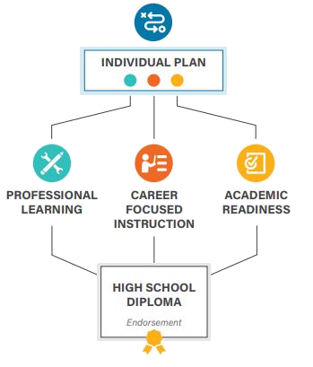
College and Career Pathway Endorsement
A statewide movement to equip students with a multi-faceted set of knowledge, skills, and abilities that allow them to meet the challenges of postsecondary education and career and live healthy, productive lives.
The Postsecondary and Workforce Readiness Act includes a process for school districts to award College and Career Pathway Endorsements to high school graduates.
Students earn endorsements by completing:
individualized learning plans in gr 9-12; AND
career-focused instructional sequence; AND
professional learning opportunities​; AND
academic readiness.
Notes:
Maria

