Slide 1
Public Dollars,
Private Schools:
Reporting on School Choice
May 29, 2025

Slide 2
Enrollment Share by School Sector, 2004-Present

Slide 3
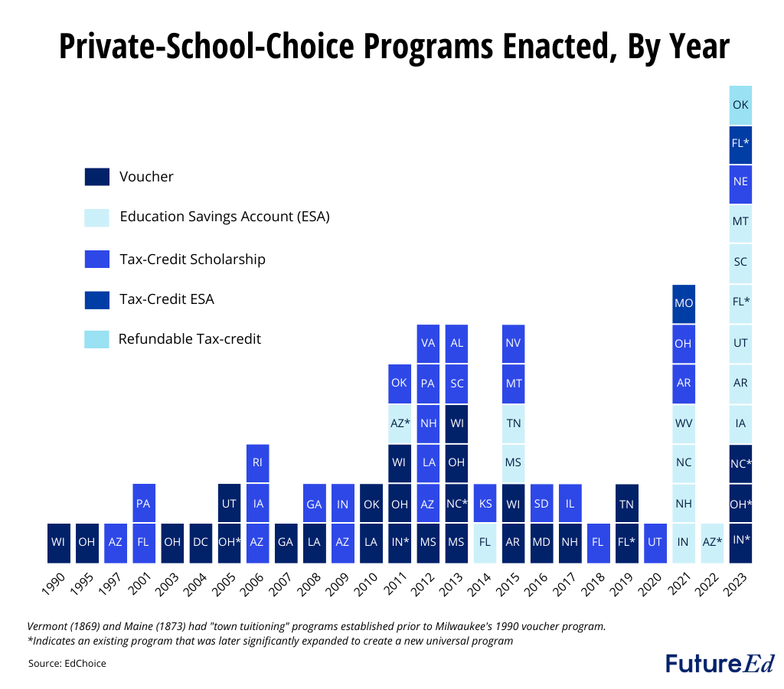
The Rapid Expansion of Private School Choice
Plus: Texas, Alabama, Louisiana, Tennessee, Idaho, Wyoming

Slide 4
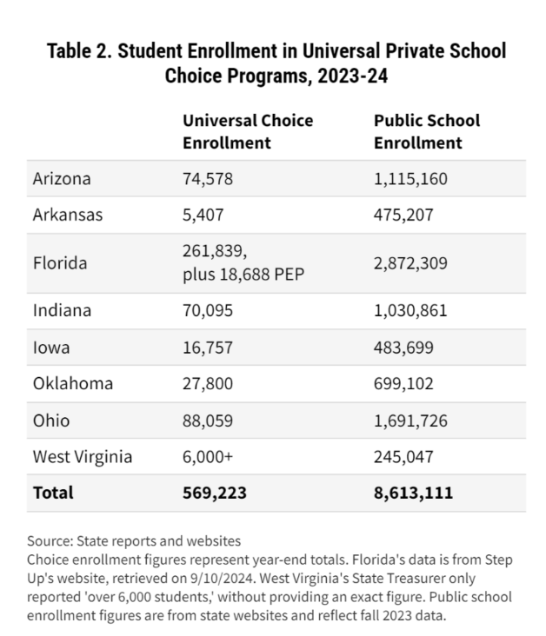
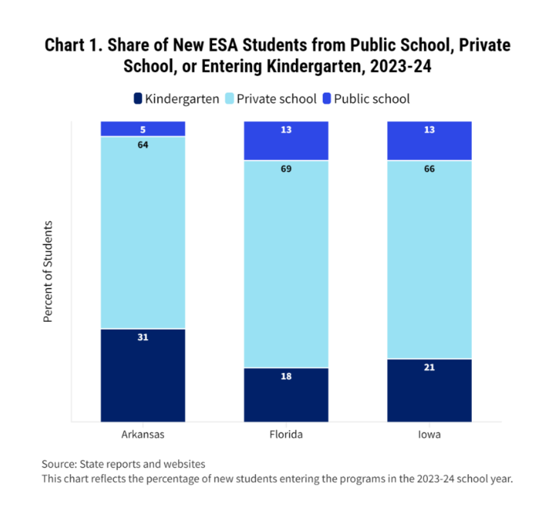

Enrollment Trends

Slide 5
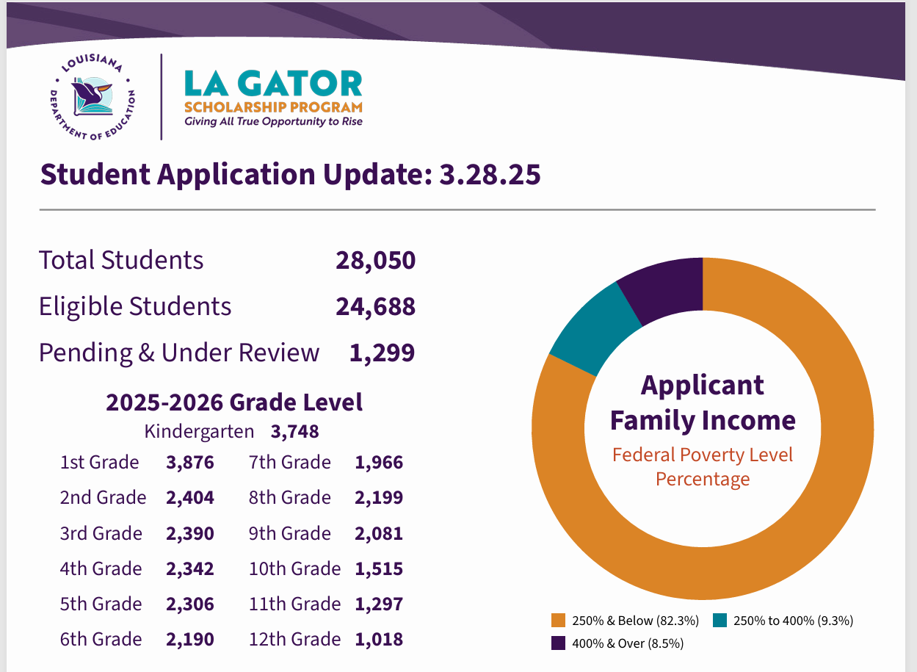
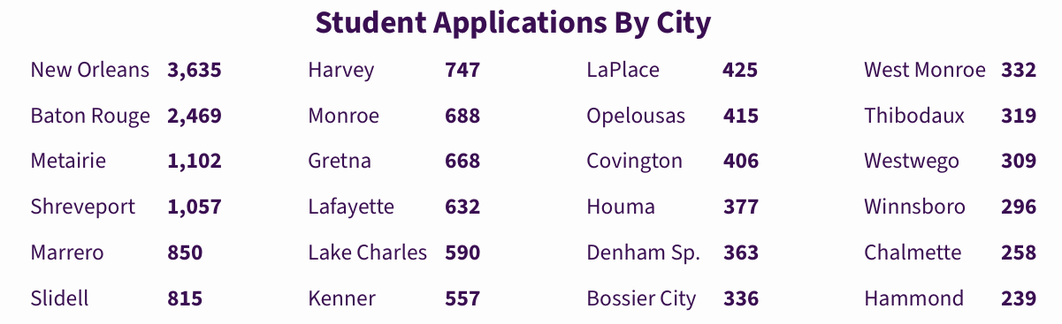
Emerging data on enrollment: Louisiana
Louisiana student enrollment:
+ 586,000 in public schools
+ 91,000 students in charter schools

Slide 6
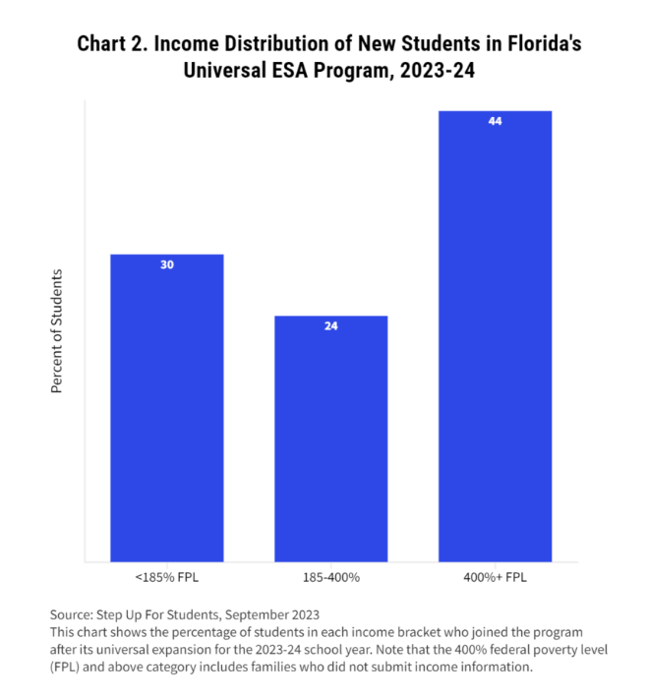
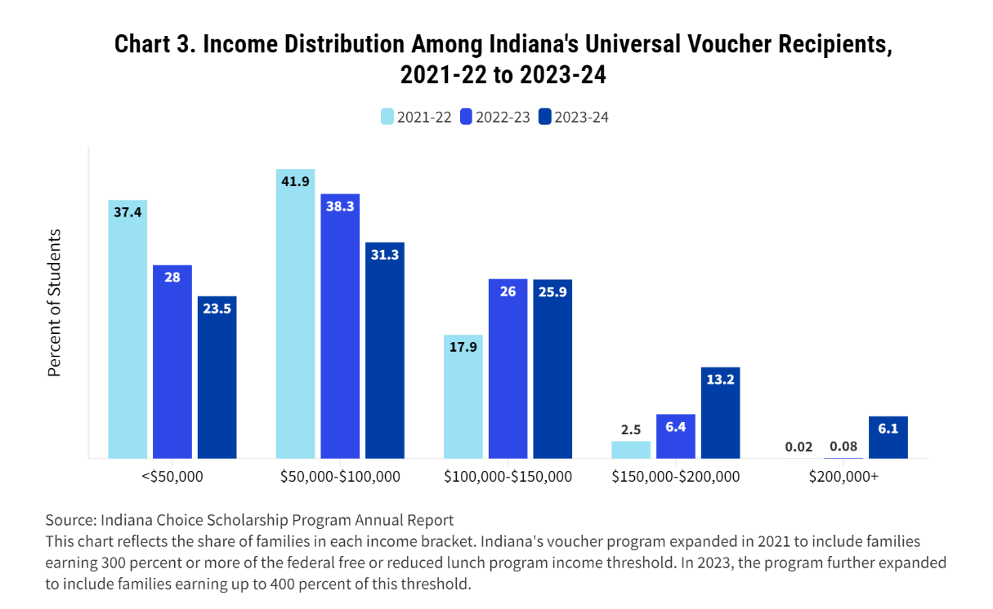
Participant Income Levels Vary
Notes:
400% FPL for family of 4 is $128K

Slide 7
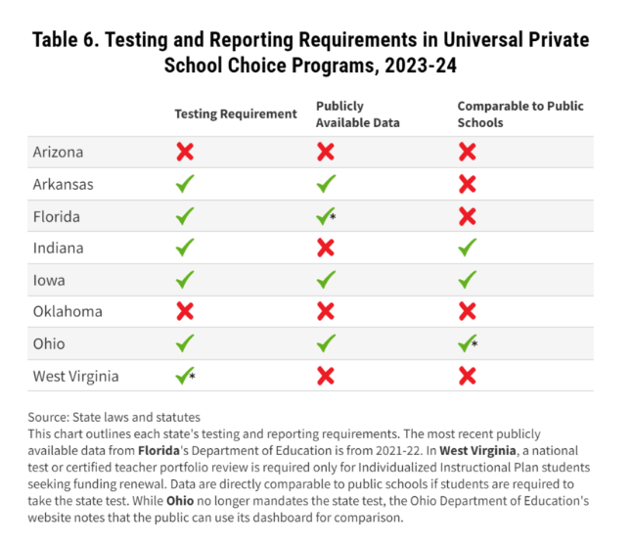
Difficult question: Do these programs “work”?

Slide 8
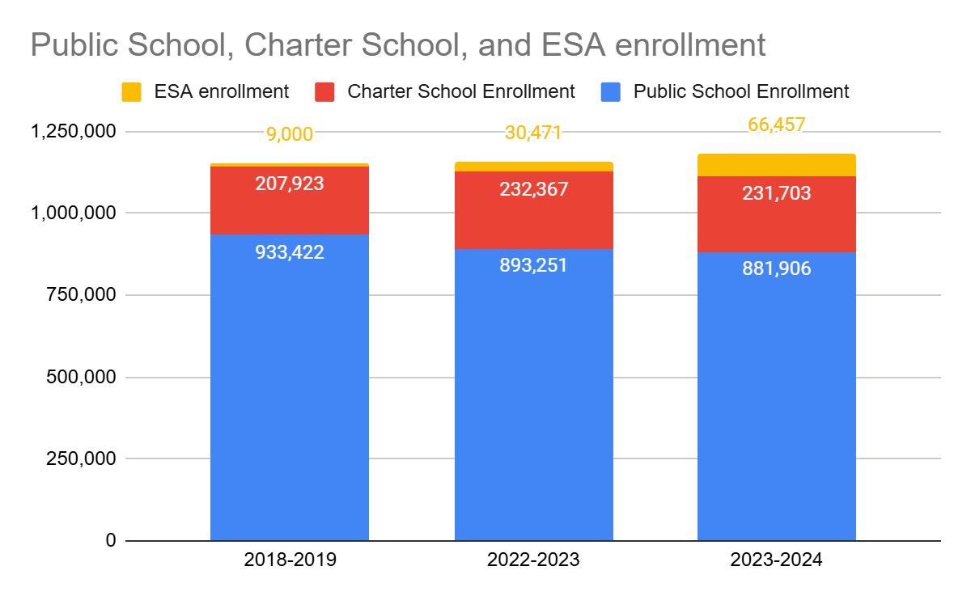
Arizona: All the choices
Tuition or fees at qualified school: 65%
Tutoring & teaching services: 13%
Tuition or fees for online program: 7%
Fall 2024: 79,593 students using an ESA. 57% previously enrolled in public school.
We don’t yet have the public school/charter school numbers for the current year.

Slide 9
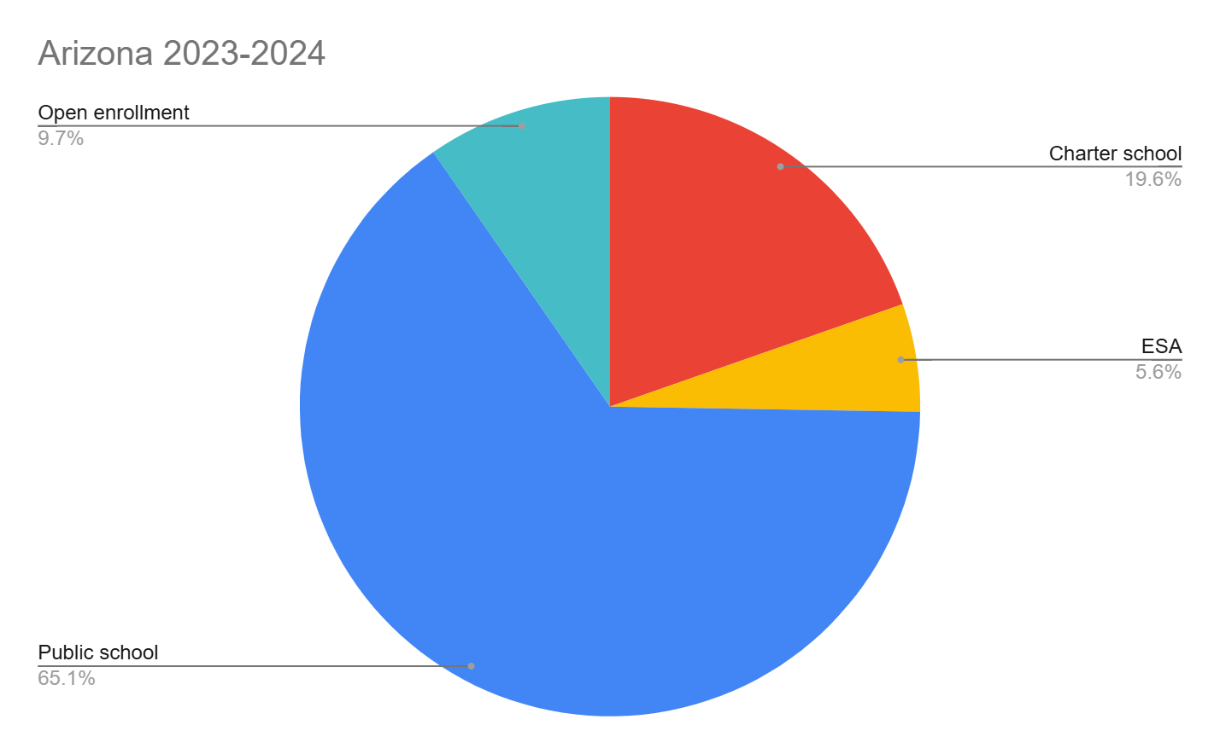
Arizona: How families are slicing the pie

Slide 10
Thank you!
Liz.cohen@50can.org

