Slide 1

Big Local News
biglocalnews.org
@BigLocalNews

Slide 2


Empowering journalists with data, tools and collaborations
Big Local News

Slide 3



Based on campus
at Stanford University
Notes:
Founder Cheryl Phillips came to Stanford with the idea of Big Local and built the Stanford Open Policing Project as a pilot to see if the idea could work. We launched the platform at the NICAR conference in 2020.

Slide 4










Who we are
Faculty, students and
professionals
Notes:
Ten people on are team, working on collaborative data and storytelling projects, tools and platforms.
We’re in the process of hiring more engineers and folks to help us with collaborative new projects.

Slide 5
Big Local News
Platforms to share data and collaborate on news projects
Collects local data to discover the regional or national patterns
Goes after data sets that are hard to obtain because they’re kept in disparate, scattered locations by multiple jurisdictions
Creates and supports stories that yield impact
Notes:
Much of what we do is free to access and use by all journalists and public.
We also have a paid membership program, and a number of our members are themselves journo support oganization such as the NYT Fellowsip program and Rural News Network, which brings additional levels of engagement such as training and data services such as tip bots.
.
It’s possible that you might already be a part of one of these organizations, so please reach out and talk to us. But today, we’ll focus on the free stuff that might be useful in your own work.
Handing off to my teammates to tell you more about our work. As you go, hoping you’ll introduce yourselves and provide an overview of your role on the team, with an eye toward helping folks who want to connect on particular topics or projects.

Slide 6
The Platform

Slide 7
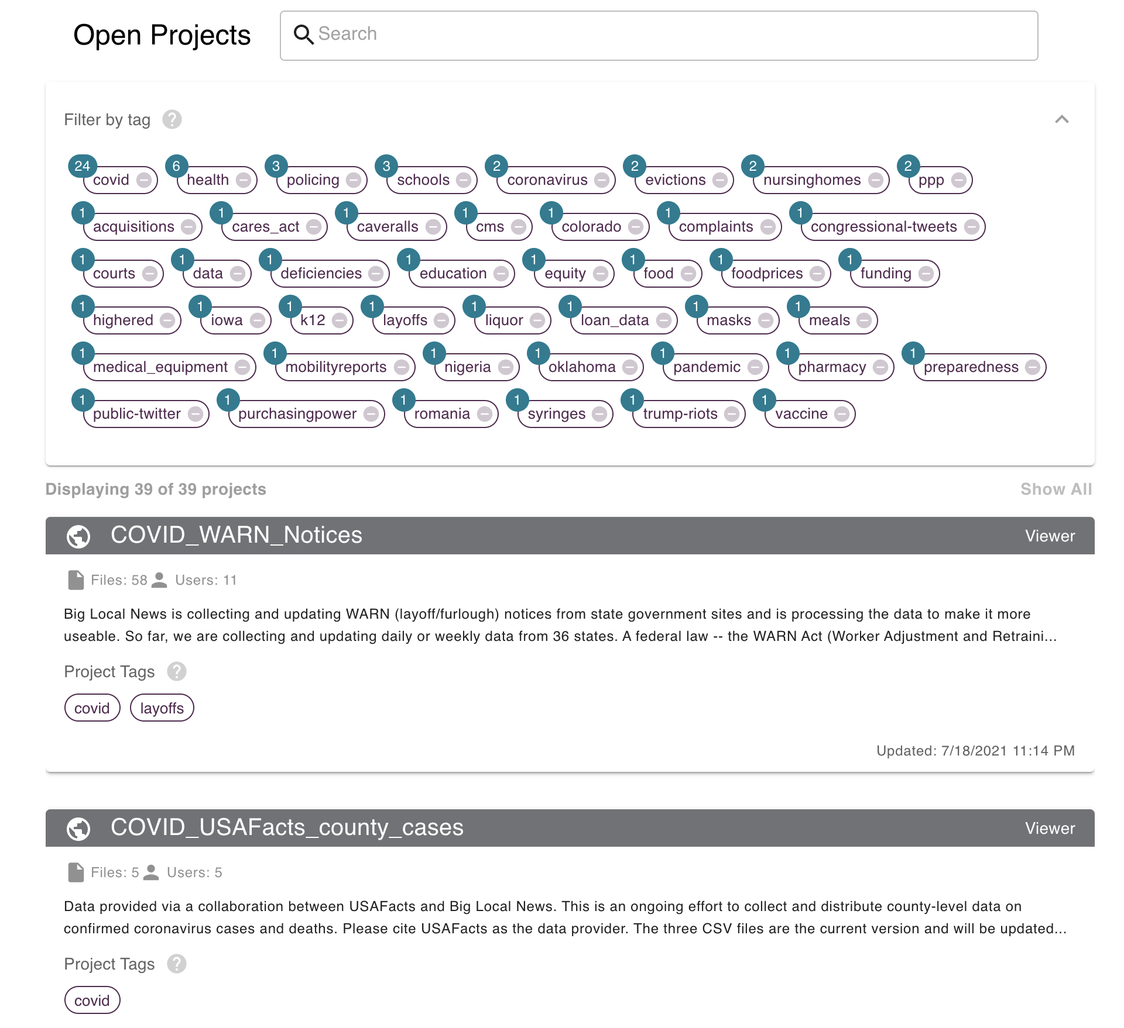
biglocalnews.org
> 4,700 users
471 journalism projects with more than 4,700 data files
100 projects open to all platform users: data on Census, nursing home staffing, overdose deaths, policing, pharmacy deserts, layoffs and more.
Notes:
SLIDE: Intro to Big Local, to be created by Big Local visualizing whatever would be helpful in intro!
Speaker: Cheryl

Slide 8
Collecting & Rescuing
Vanishing Data

Slide 9

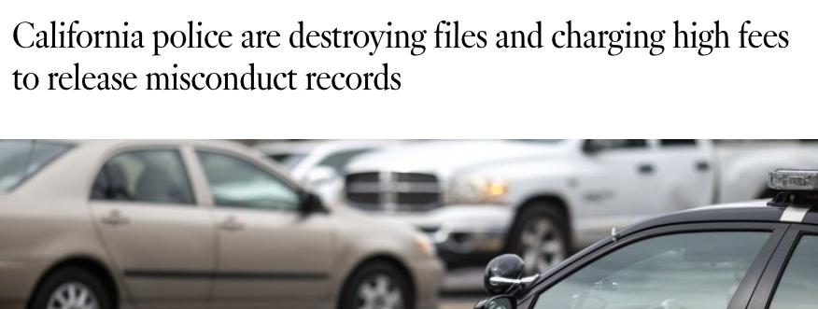
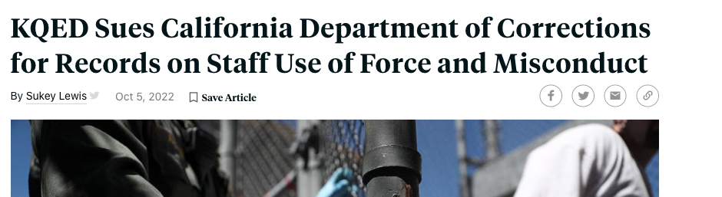
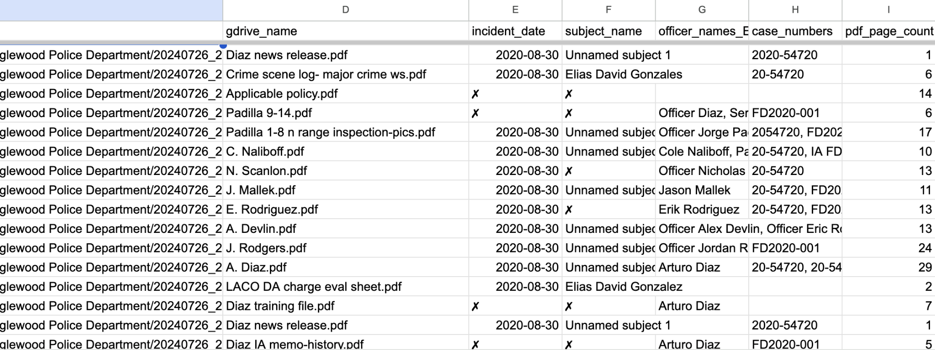
Law Enforcement Accountability
With UC Berkeley, we are archiving and publishing (soon!) case files related to law enforcement misconduct and use of force across California
Notes:
In 2019 for the first time records in California about officers who seriously injured or killed people, sustained findings of sexual or dishonest misconduct, and the internal investigations into those incidents, became requestable. Another law expanded requestable records to include sustained findings of excessive force, prejudice and unlawful search and seizure.
Grabbing this as frantically as we can
Working with Berkeley
BIDS working with LLM to do entity extraction from case files
Prioritizing QA and working environments
Statute of limitations
Framework with clean-scraper
Links @ end of slideshow
github urls
CLEAN
WARN
civic-scraper
court-scraper

Slide 10
Federal data collection efforts
What BLN and volunteers have collected
Federal Storm Events Database
2 dozen CDC datasets on vaccination coverage for adults and children for COVID, RSV, flu; some weekly data, some cumulative; also for Nursing homes, pregnant individuals; deaths due to COVID-19. COVID NIS-ACM data from RespVaxView (COVID-19, flu, and RSV vaccination dashboards) page on CDC.
NCEI NOAA daily summaries archive dataset
All data in EPAs PFAS Analytic Tool, documentation related to PFAS regulation
CDC SVI (2020)
US Foreign Assistance Data + Data Dictionary
CDC SVI: Social Vulnerability Index
USA Spending database
Office of Personnel Management Employment Data
Federal Contracts
U.S. Energy Information Administration (EIA) Residential Energy Consumption Survey (RECS) Data

Slide 11
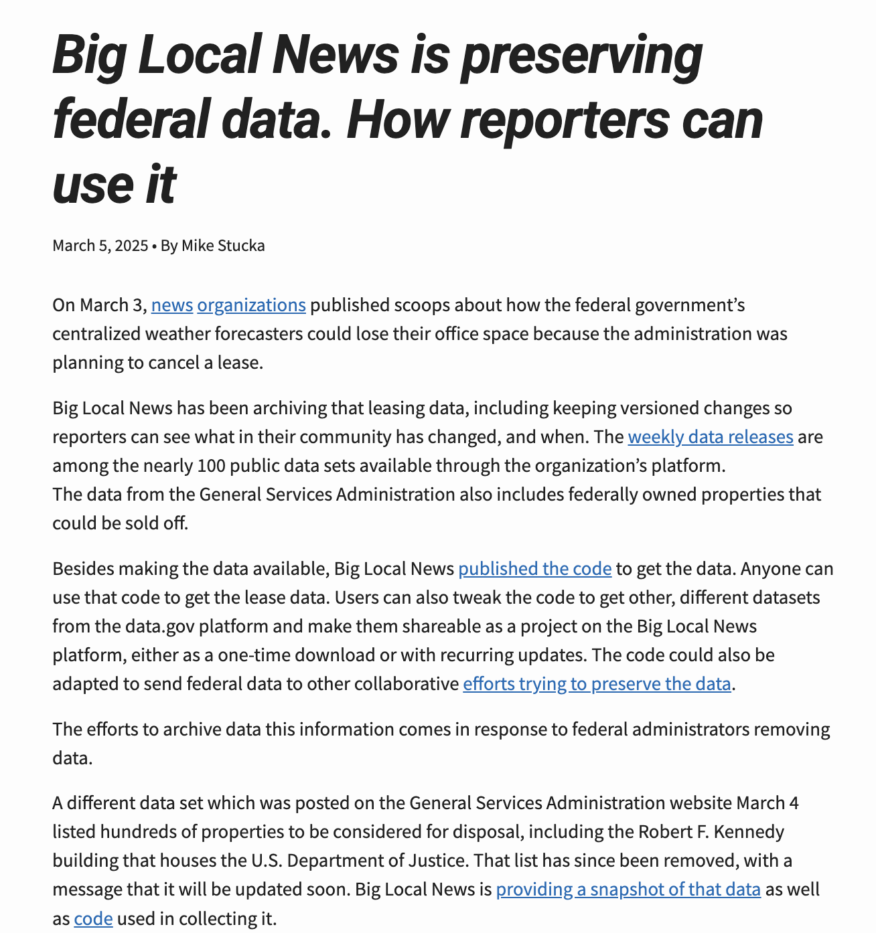

Slide 12
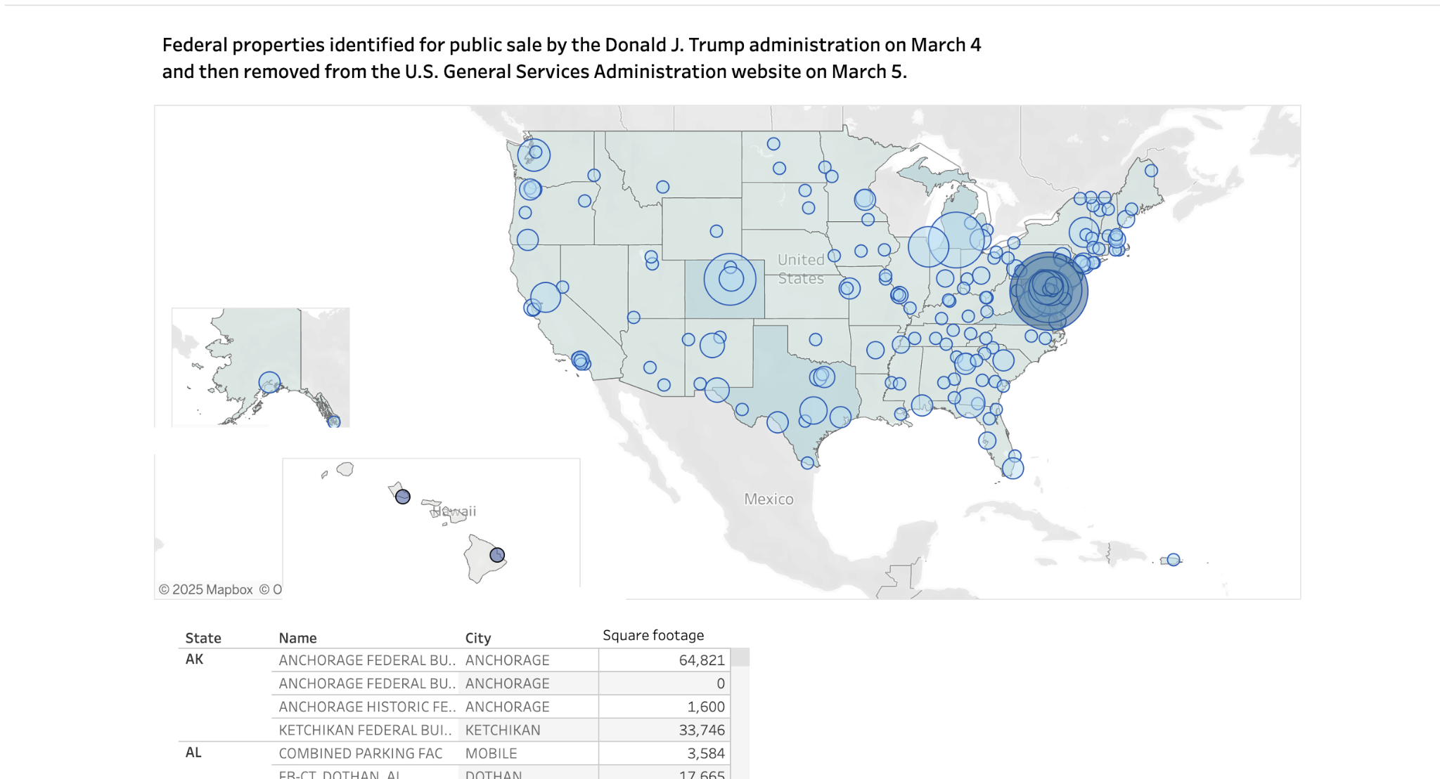

Slide 13
Key Datasets for Education Reporters
Federal Contracts Cancellations: Big Local News has been tracking federal contract cancellations in a dataset that’s updated daily with code released freely.
Federal Audit Clearinghouse Data: contains information from audit reports submitted by entities (typically state and local governments, non-profits, and tribal organizations) that spend $750,000 or more in federal funds in a fiscal year.
Layoffs: notifications are sent several times daily to news organizations participating in Big Local News’ Data+ program > This data is also updated daily as an Open Project in the BLN platform.

Slide 14

Collaborations
Lead to:
Data
Training & Story Recipes
Tools
News Detection
Embeddable Resources

Slide 15
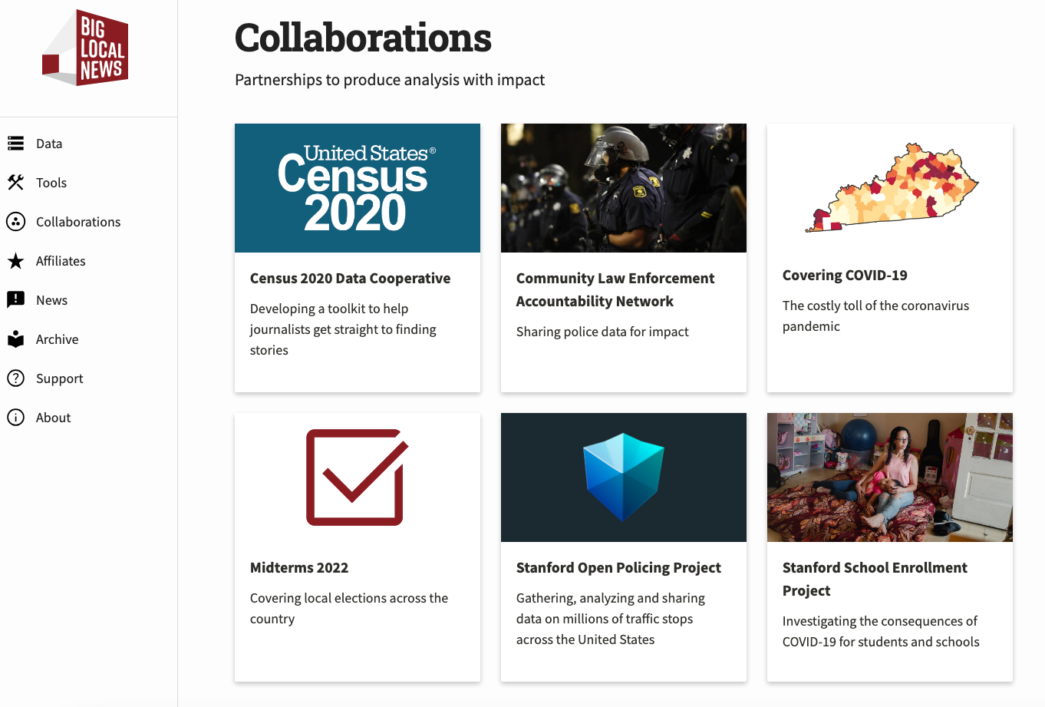
Collaborations
Partnerships to produce analysis with impact

Slide 16
National data collaboration details the impact of proposed nursing home changes, pressures lawmakers to invest more
February 13, 2024 • By Alana Rocha, INN’s Rural News Network
Rural nursing homes across the country have about two years to comply with new federal staffing requirements meant to improve the frequency and quality of one-to-one care that residents receive.
Care facilities already struggle to recruit and retain skilled workers. Most of those facilities are nowhere near able to comply with the new federal minimums — a reality revealed through a recent collaborative reporting project from INN’s Rural News Network and other partners.
The project, “Falling Short: Rebuilding elderly care in rural America,” combined on-the-ground reporting from seven rural newsrooms with data analysis support and visualizations from USA TODAY and Big Local News (BLN) at Stanford University. Support from the National Institute for Health Care Management (NIHCM) made the project possible.
https://biglocalnews.org/content/news/2024/02/13/national-data-collaboration-nursing-homes.html

Slide 17
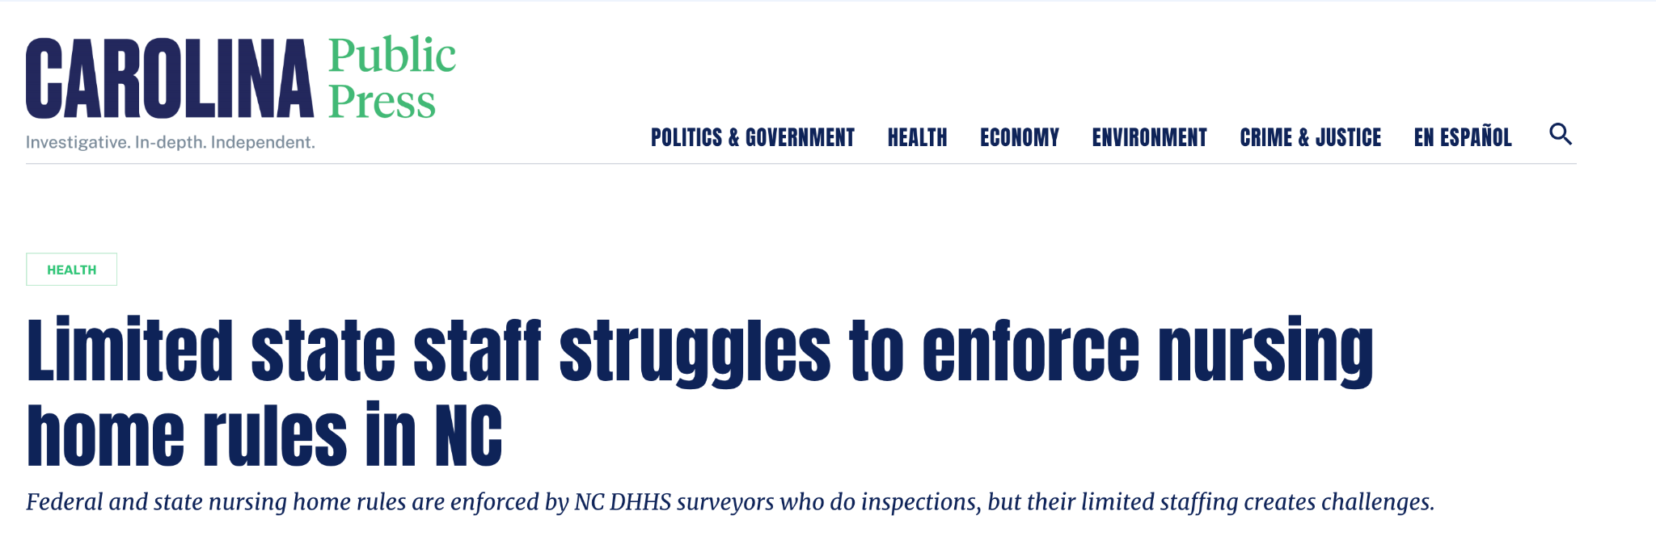
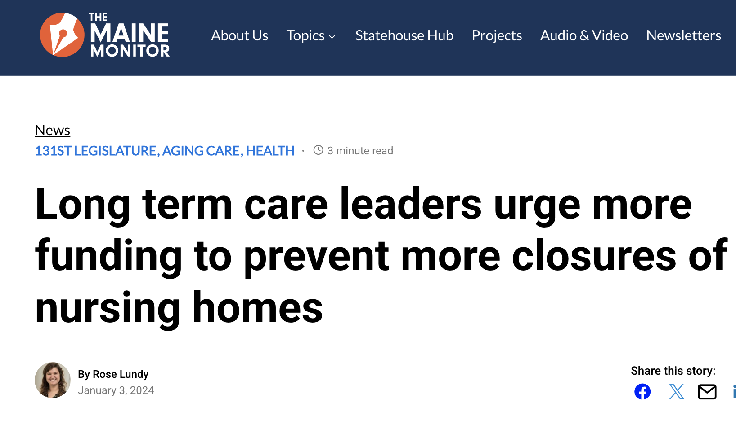
INN’s Rural News Network
Nursing Homes Staffing Levels
Notes:
We collaborate with INN’s Rural News Network to provide data resources and training that empower local newsrooms. Last year, we led a data-driven project that shed light on nursing home staffing shortages and the impact of new federal regulations. BLN provided the data, built a story recipe and organized a web seminar to help journalists translate complex data into meaningful stories around the country.

Slide 18
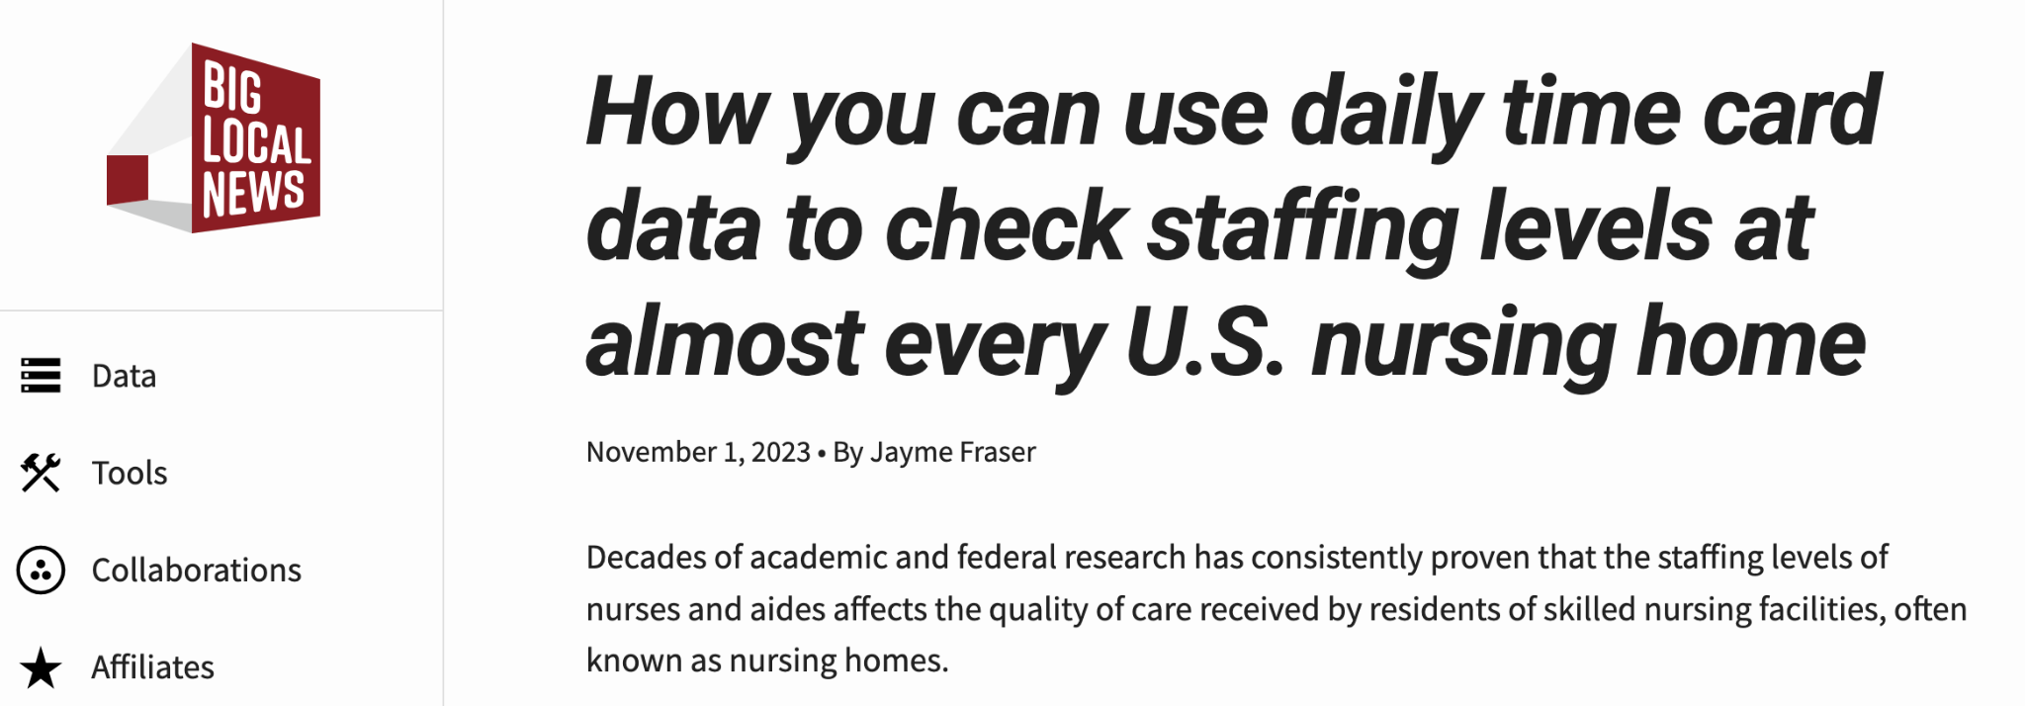
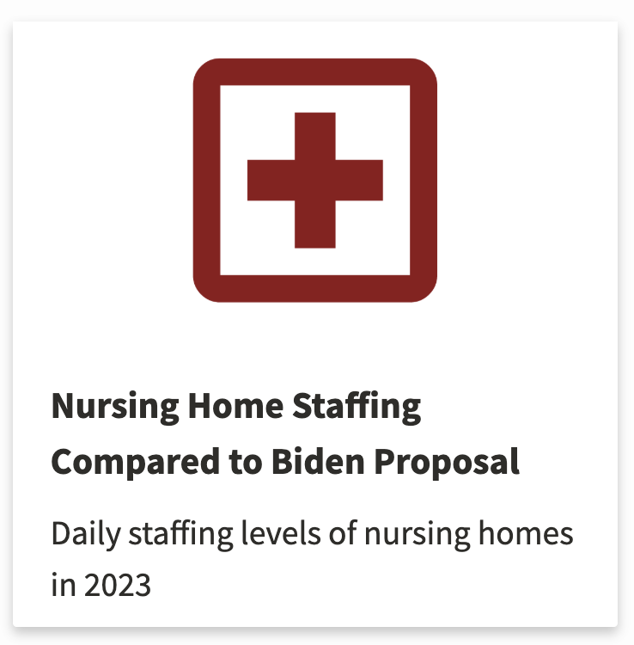
INN’s Rural News Network
Nursing Homes Staffing Levels
Notes:
The data has been archived at the Stanford Library, ensuring open access for everyone. Additionally, our story recipe is available on our website, providing reporters with a step-by-step guide to uncovering similar stories.

Slide 19
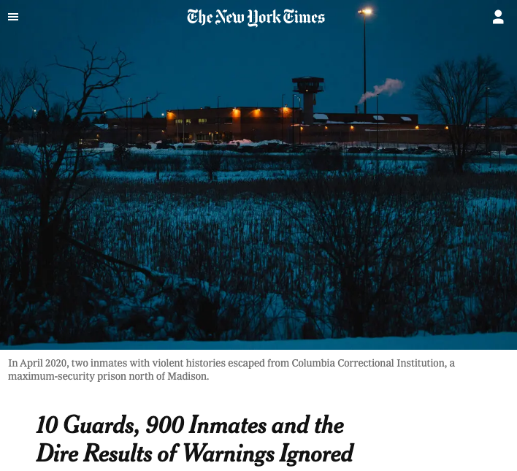
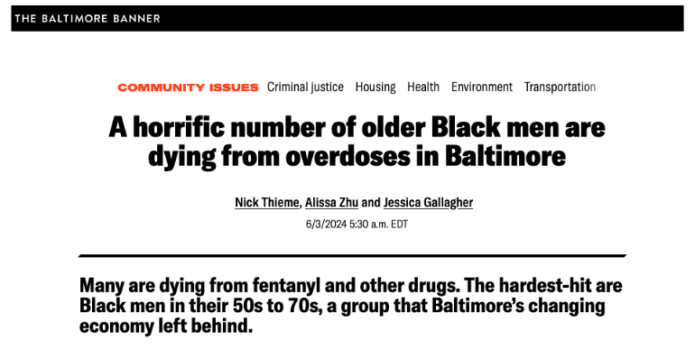
New York Times
Local Investigations Fellowship
Notes:
School enrollment:
Pandemic impact on school enrollment
There is national data NCES, but there is a time lag
Wanted to measure by school, district, race, grade, etc.
Minimum was enrollment by district/school, grade, race/ethnicity
Got 33 states (70,000 schools)
Mix of downloadable data files and public records requests

Slide 20
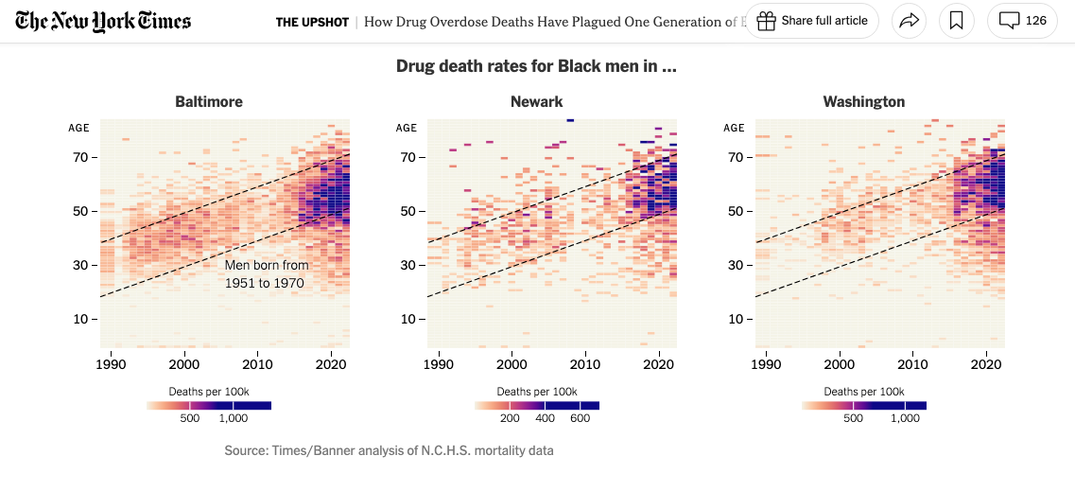
Overdose deaths
Notes:
School enrollment:
Pandemic impact on school enrollment
There is national data NCES, but there is a time lag
Wanted to measure by school, district, race, grade, etc.
Minimum was enrollment by district/school, grade, race/ethnicity
Got 33 states (70,000 schools)
Mix of downloadable data files and public records requests

Slide 21
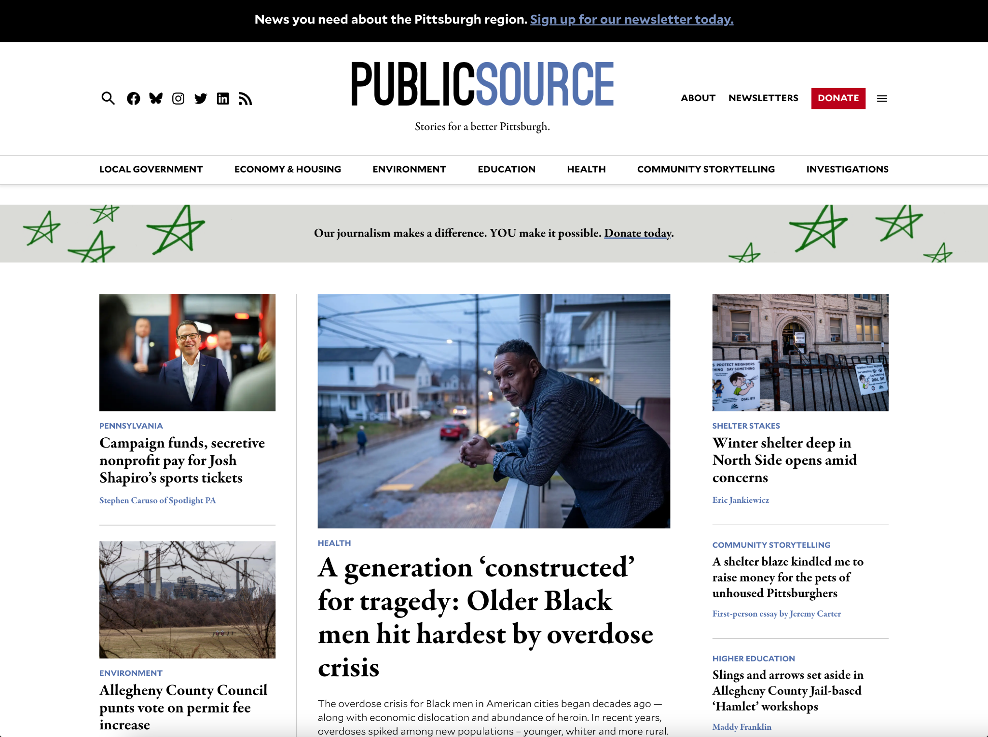

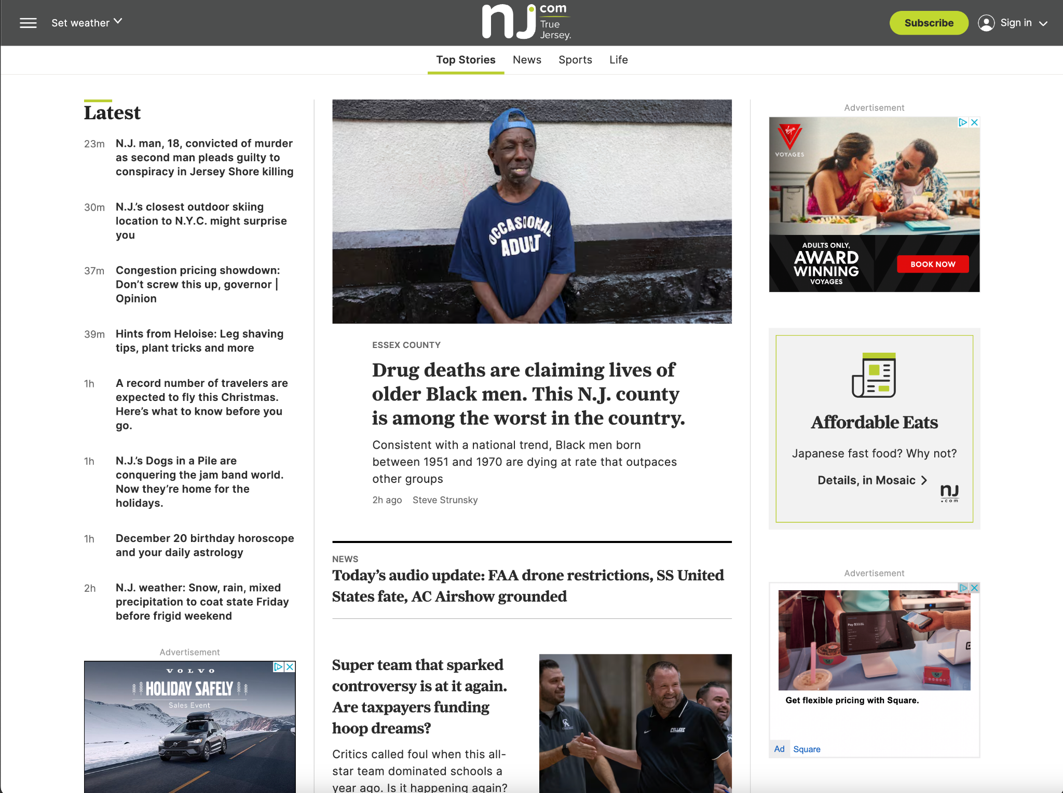

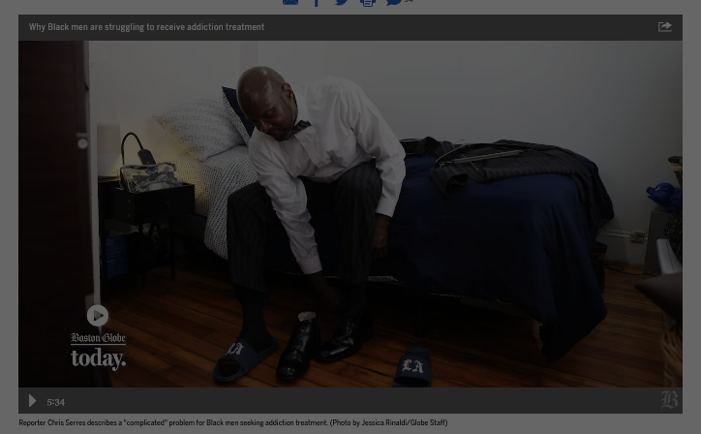

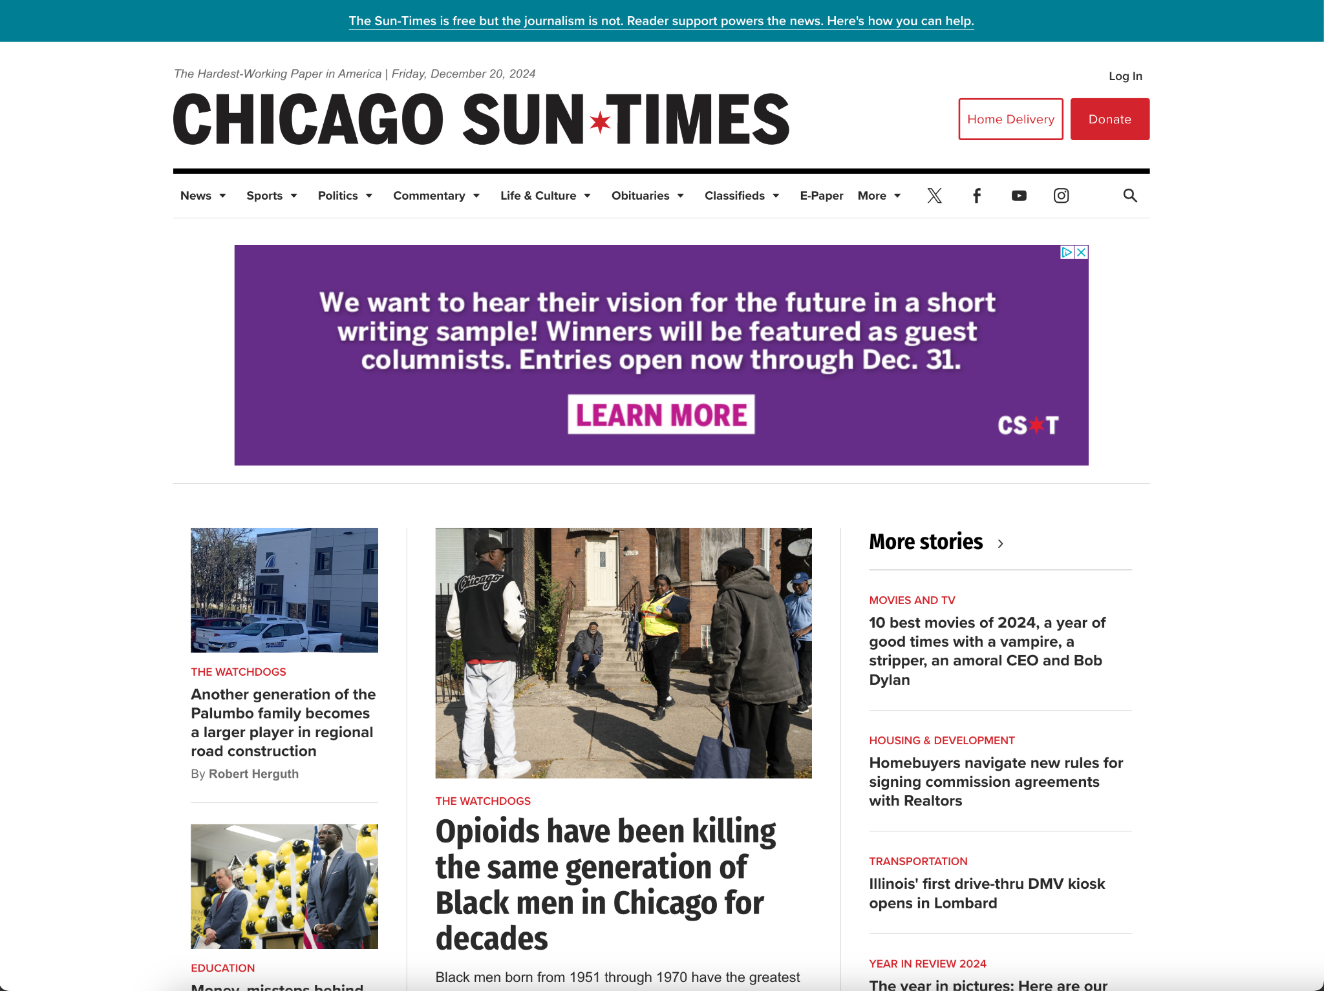
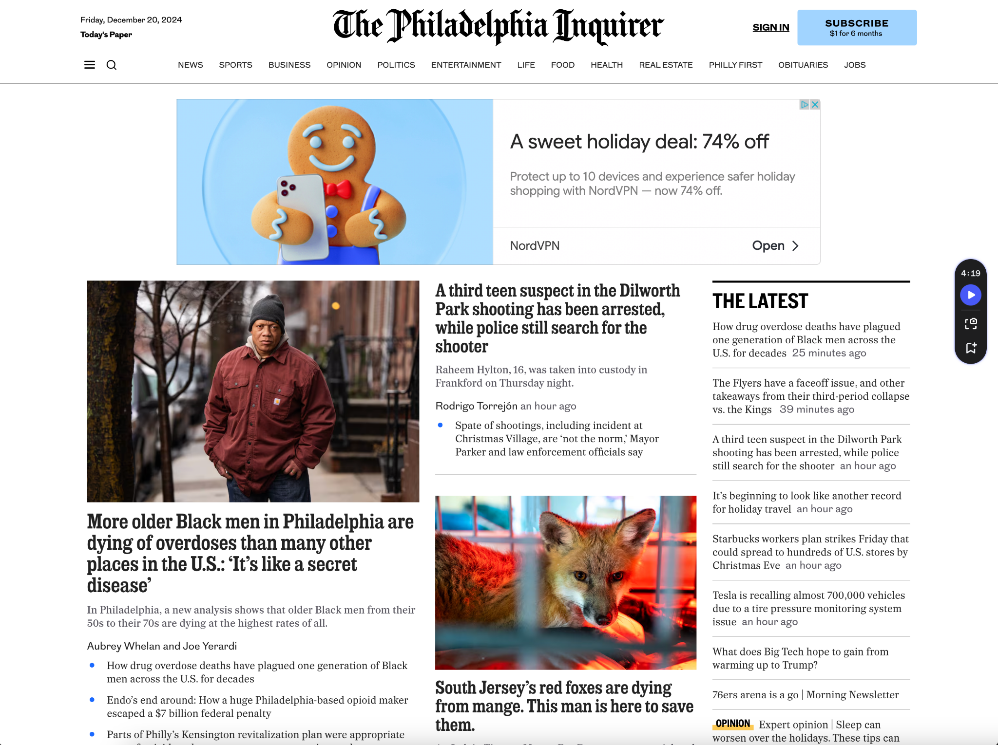

Slide 22
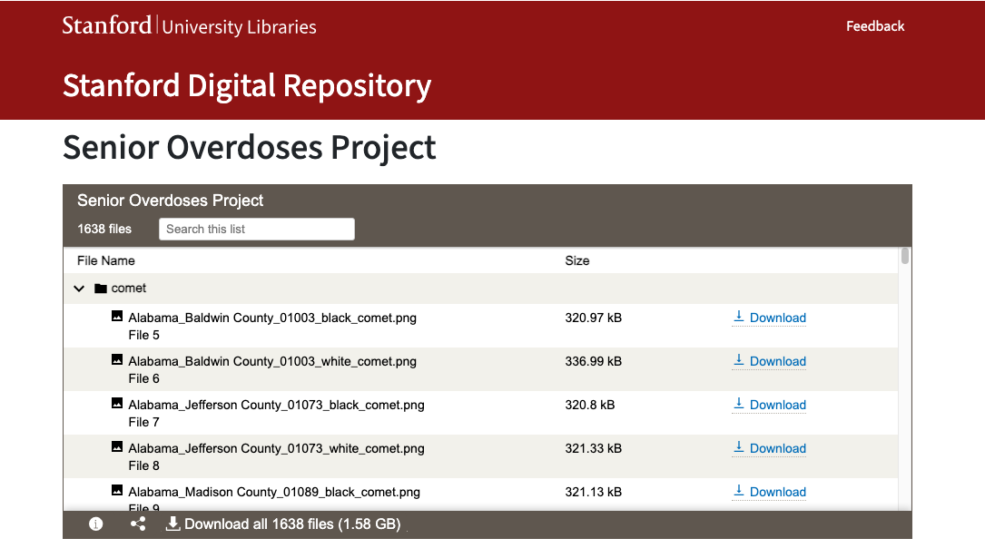
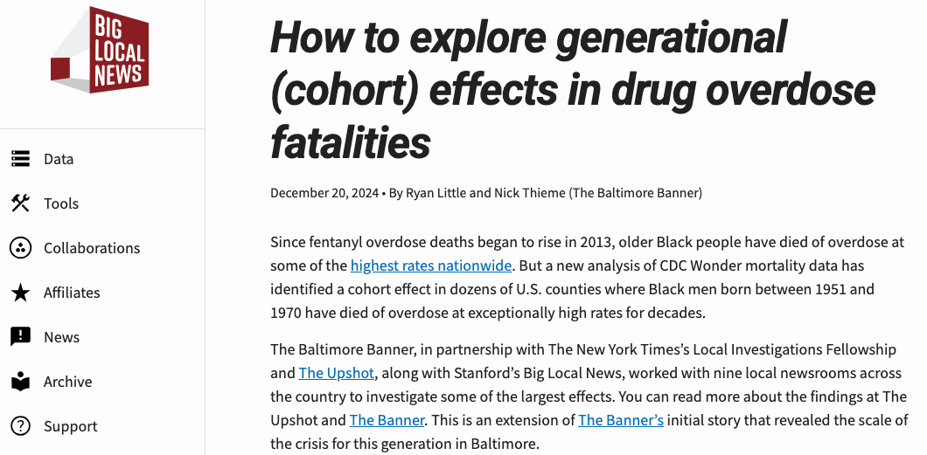
Overdose deaths - data
Notes:
School enrollment:
Pandemic impact on school enrollment
There is national data NCES, but there is a time lag
Wanted to measure by school, district, race, grade, etc.
Minimum was enrollment by district/school, grade, race/ethnicity
Got 33 states (70,000 schools)
Mix of downloadable data files and public records requests

Slide 23
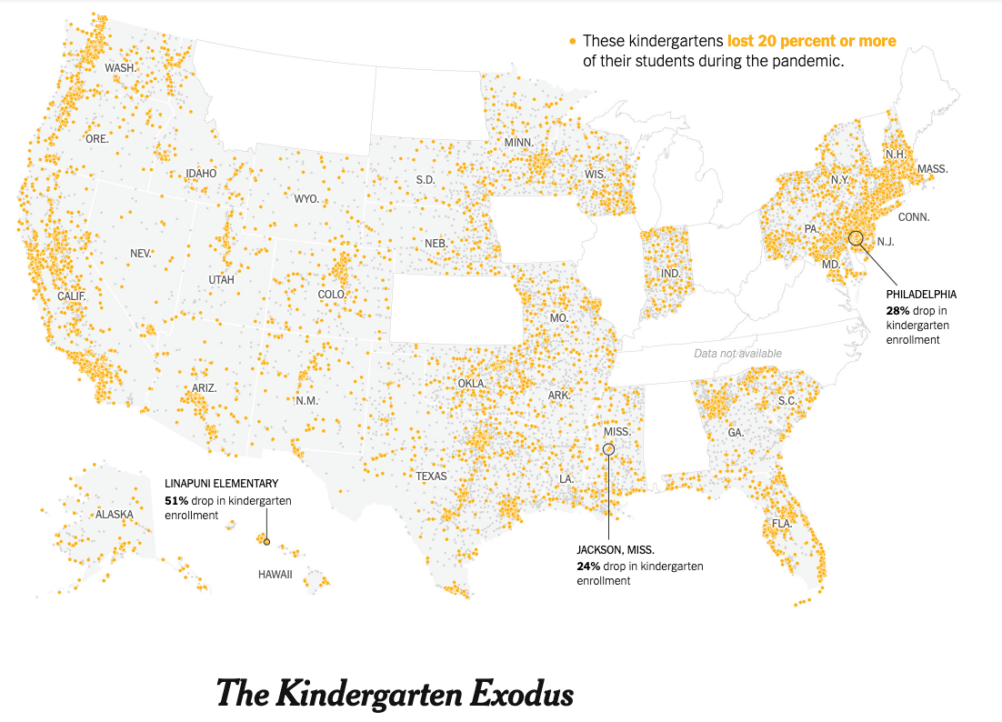
School Enrollment
Notes:
School enrollment:
Stories: NYT was one of our partners
They looked at school-level data
The impact on kindergarten, especially in low-income neighborhoods

Slide 24

School Enrollment
Notes:
School enrollment:

Slide 25
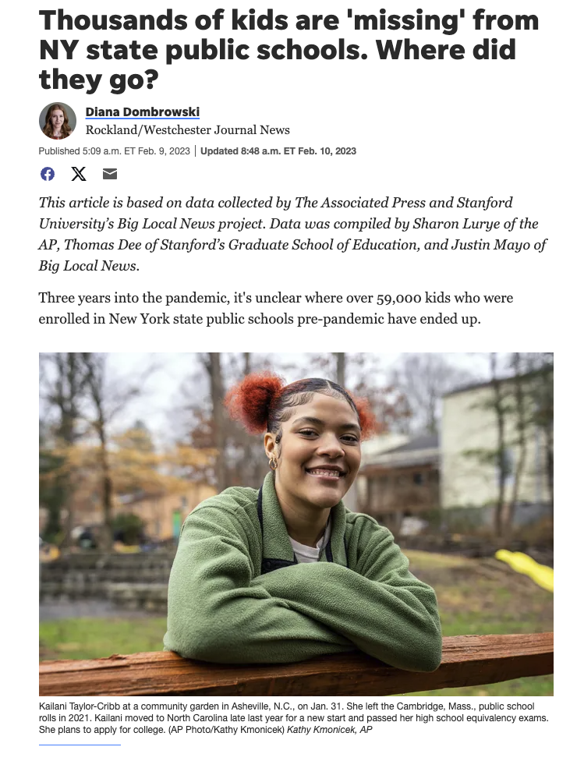
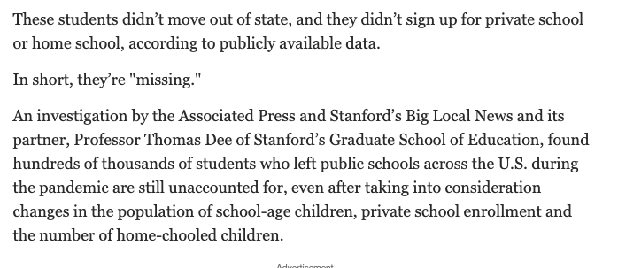

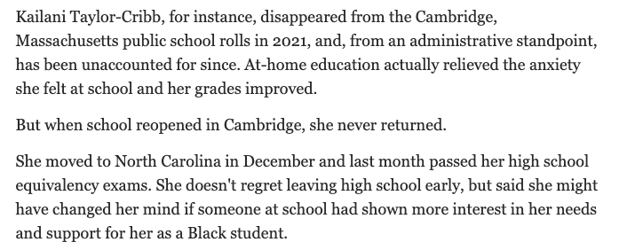
https://www.lohud.com/story/news/education/2023/02/09/60000-kids-missing-from-nys-public-schools-since-pandemic-ap-finds/69885642007/

Slide 26
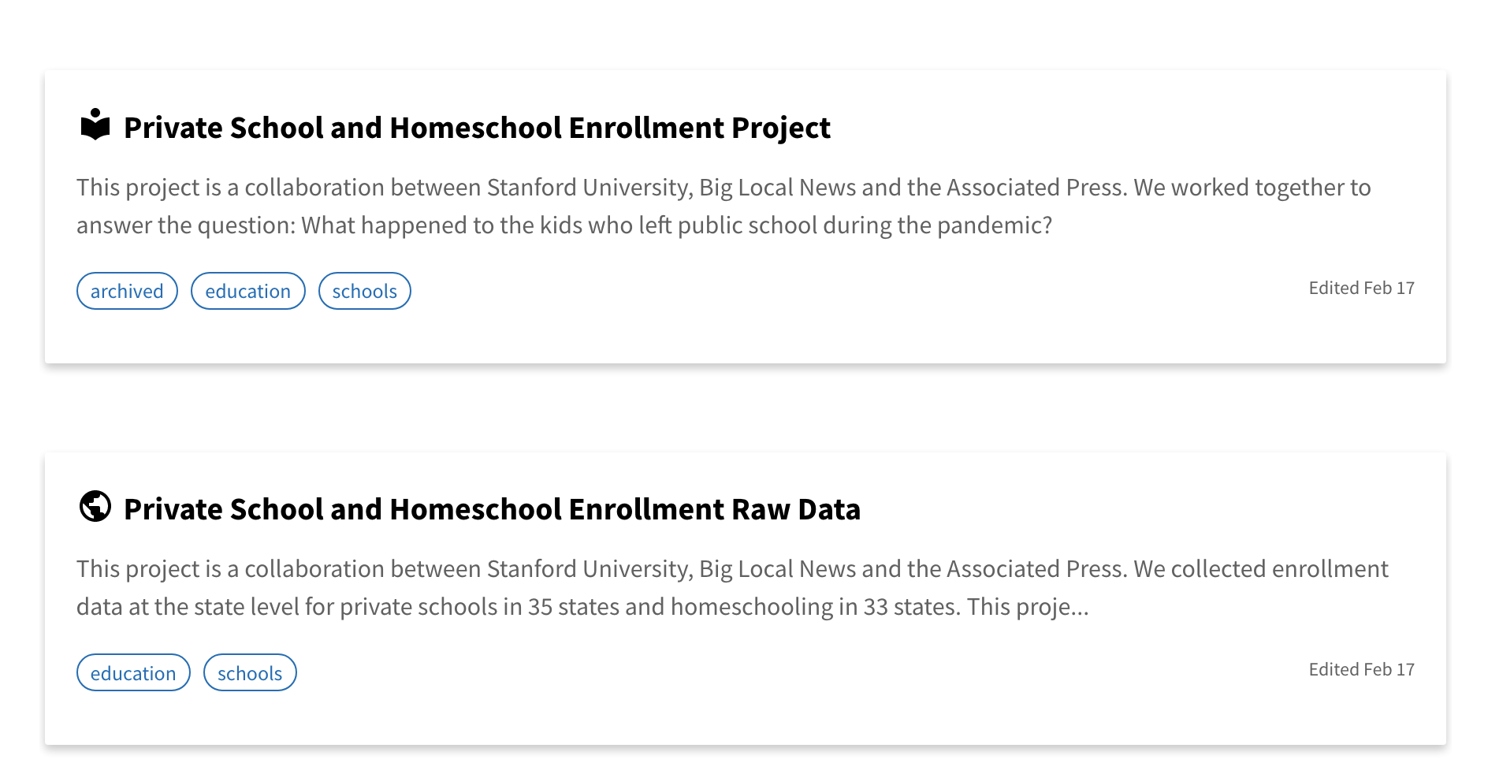
School Enrollment
Notes:
School enrollment:

Slide 27
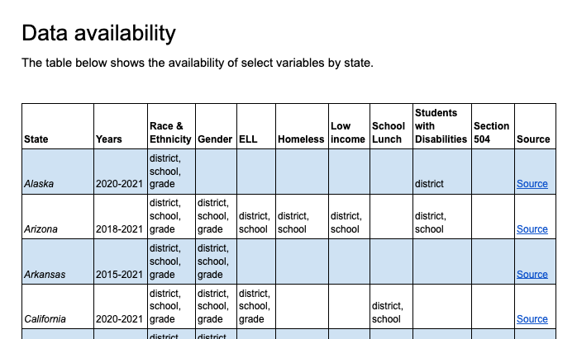
School Enrollment
Notes:
School enrollment:
Pandemic impact on school enrollment
There is national data NCES, but there is a time lag
Wanted to measure by school, district, race, grade, etc.
Minimum was enrollment by district/school, grade, race/ethnicity
Got 33 states (70,000 schools)
Mix of downloadable data files and public records requests

Slide 28
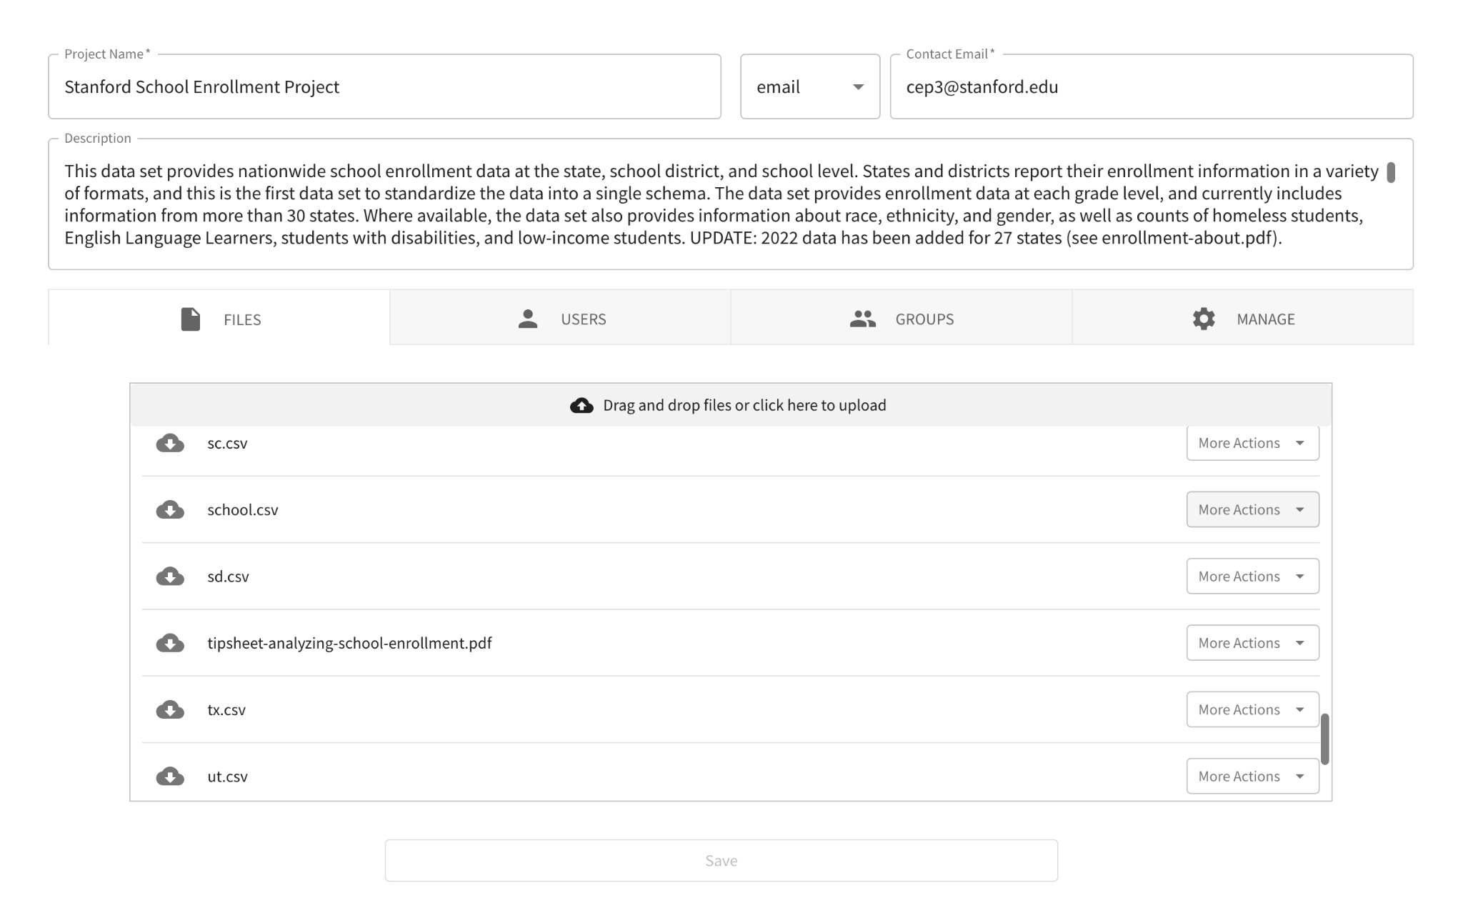
School Enrollment
Notes:
School enrollment:

Slide 29
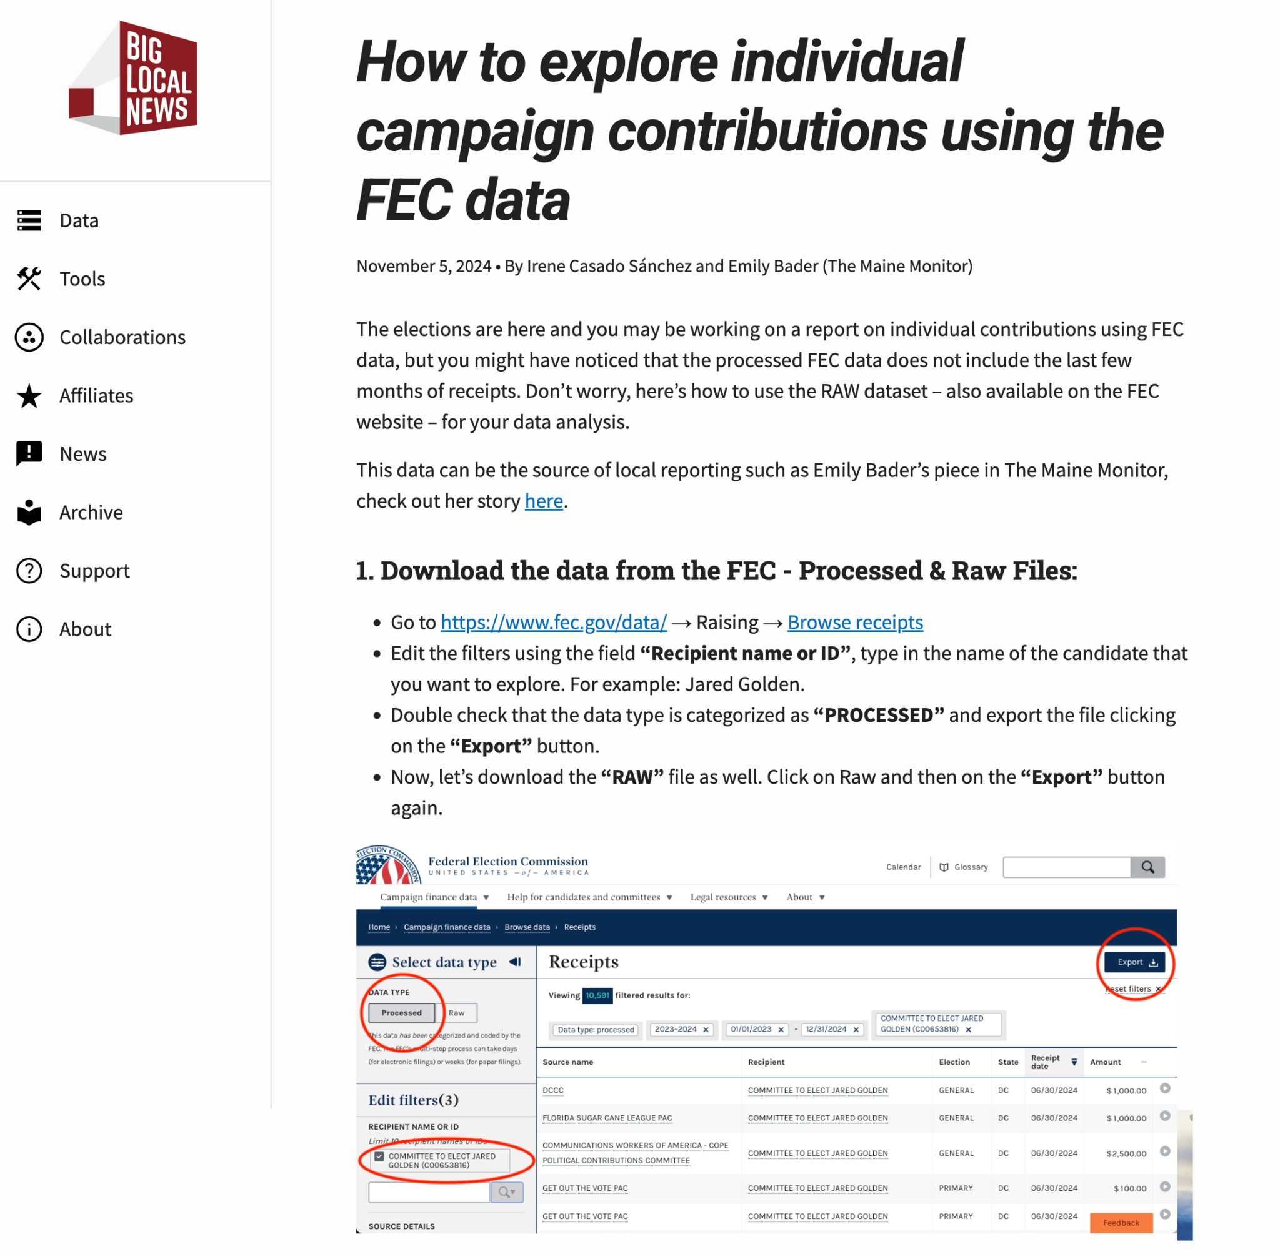

Story Recipes

Slide 30
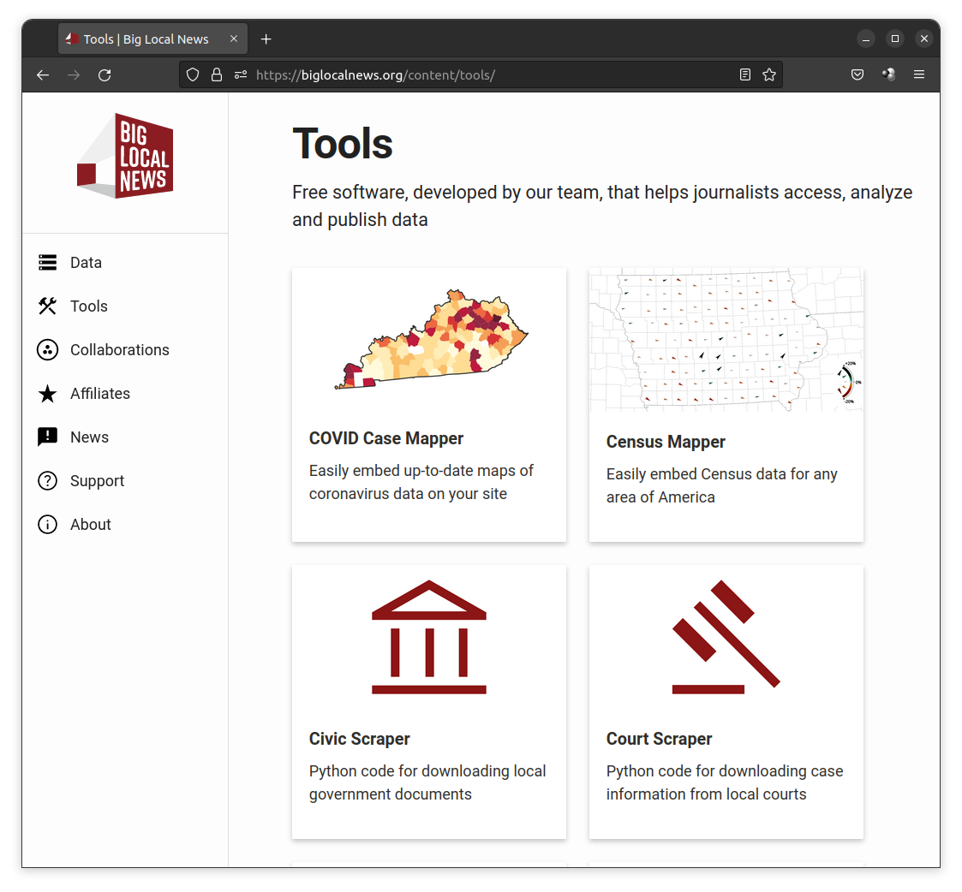
Tools
Free software that helps journalists access, analyze and publish data

Slide 31
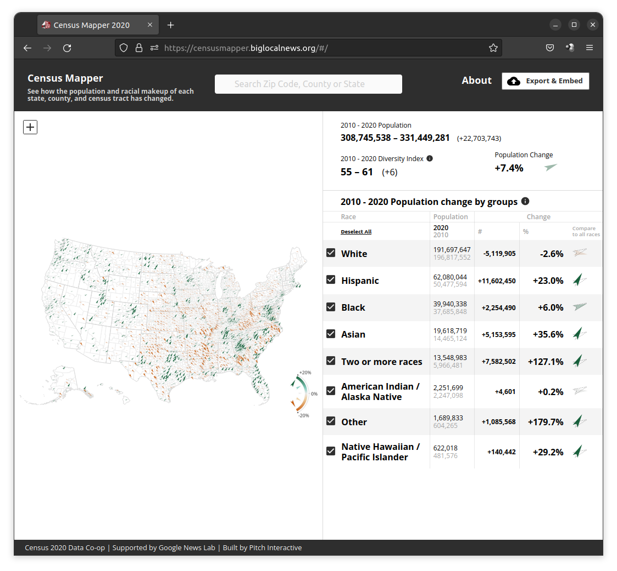
https://censusmapper.biglocalnews.org
Census data for any area
in America. Embeds for your CMS.

Slide 32
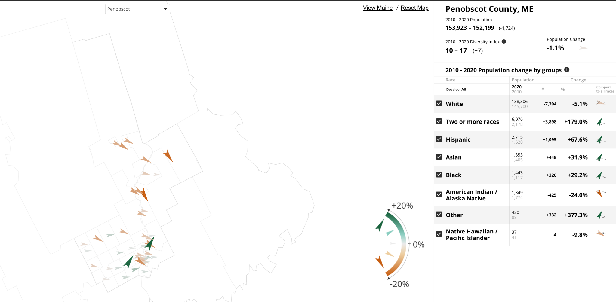

Slide 33
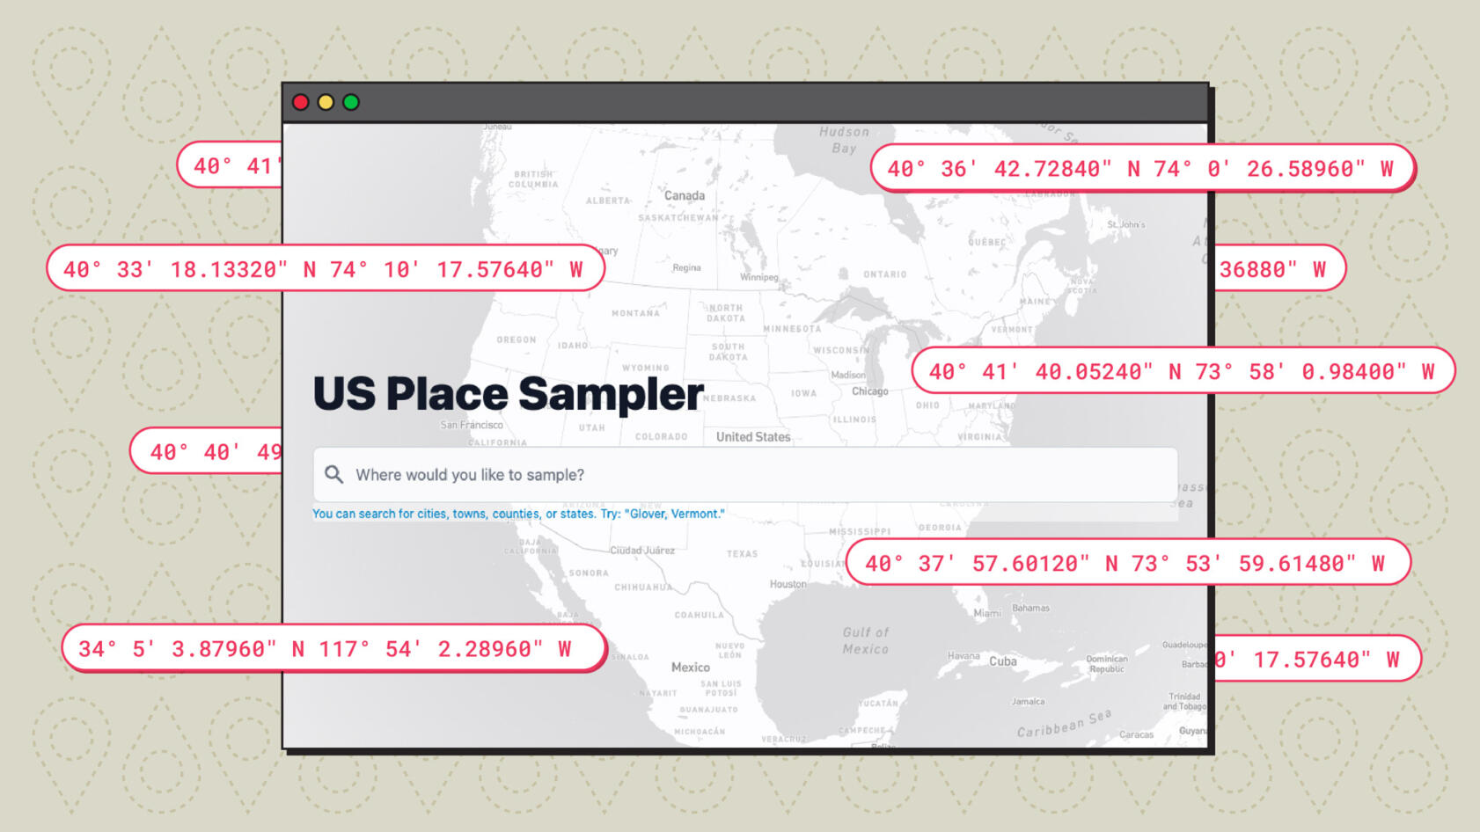
U.S. Place Sampler
Draw a random sample of addresses from anywhere in the country.
With Leon Yin & Aaron Sankin, The Markup. Image: Gabriel Hongsdusit
Notes:
200 Addresses from OpenAddresses

Slide 34

U.S. Place Sampler
Solves one of the challenges in access-to-broadband reporting
Notes:
200 Million Addresses from OpenAddresses

Slide 35
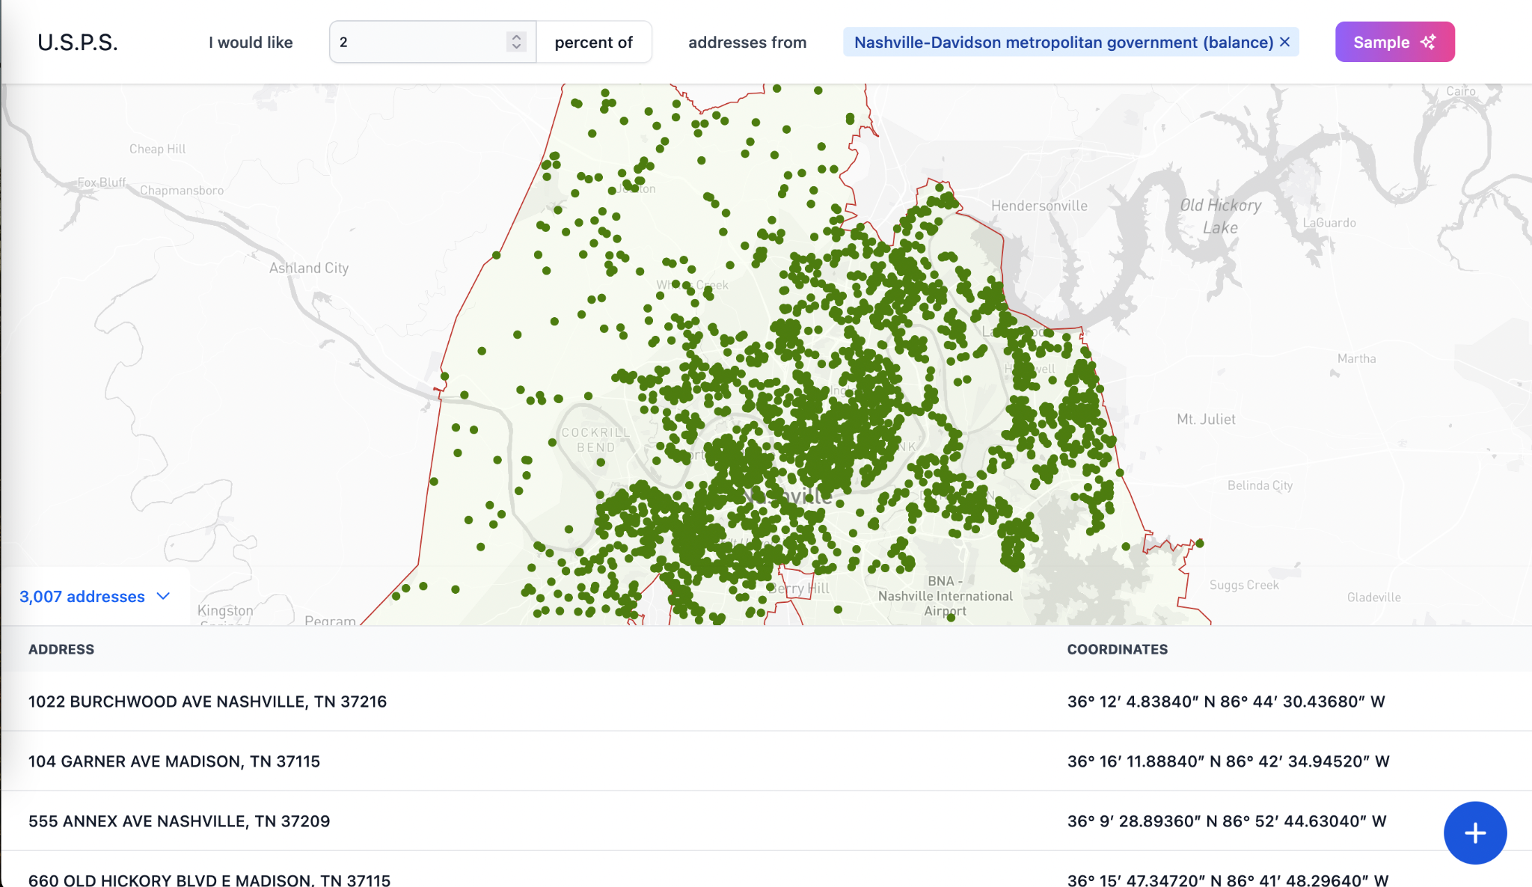
U.S. Place Sampler
https://usps.biglocalnews.org/
Notes:
200 Million Addresses from OpenAddresses

Slide 36


Big Local News
&
BillTrack50

Slide 37
BLN & BillTrack50
Bills introduced, with map and table view
Big Local News is going to be embedding a widget displaying information about bills introduced in the past week - a map view as well as a table view as a tool for anyone to use, free for anyone.
Analysis of legislative actions
Run data analysis on completed legislation for your state, using the downloaded csv files in the BLN platform, free for anyone at biglocalnews.org.
BLN Data+ news detection service for members
Legislation outcome tracker will send notifications by state about the final stage of every bill and whether it was passed, vetoed, veto overridden, or signed/enacted/adopted.
Notes:
Big Local News (BLN), in partnership with Bill Track 50, is developing a free, embeddable widget that will allow journalists, news organizations, and the public to easily access and interact with legislative data. This tool aims to make it simpler for reporters to track important bills, monitor legislative changes, and incorporate real-time policy updates into their reporting.
Open Data Access and Analysis: The data collected through this initiative will be freely available on the BLN platform, where users can download CSV files for further analysis or explore the information directly using Datasette, a powerful open-source tool for querying and visualizing structured data. This makes it easier for journalists to spot trends, compare legislation across states, and report on policy changes that impact their communities.
Exclusive Resources for Data+ Members: BLN also offers additional benefits for journalists and newsrooms who are part of its Data+ program. Members receive customized alerts and notifications tracking the status of specific bills, enabling them to stay ahead of legislative developments relevant to their beats. This feature ensures that reporters can quickly identify key moments in a bill’s lifecycle—such as committee hearings, amendments, or final votes—and respond with timely coverage.
By combining free, public-facing tools with exclusive newsroom resources, BLN and Bill Track 50 are working to democratize access to legislative data, ensuring that local journalists have the support they need to produce impactful, data-driven accountability stories.

Slide 38
BLN Data+ & BillTrack50
Big Local News Data+ members have access to Paid BillTrack50 resources
Tap into the BillTrack50 API
News detection – stay up to date with legislative actions by your state rep or senator
Contact staff within an office
Deploy widgets that allow your readers to follow along

Slide 39
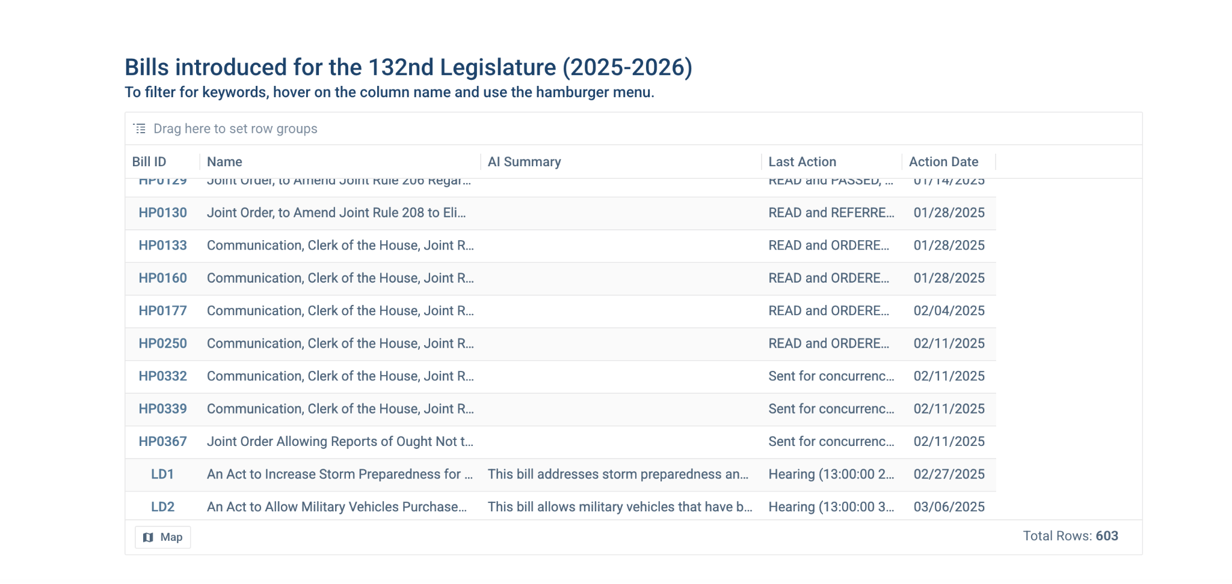
BillTrack50

Slide 40
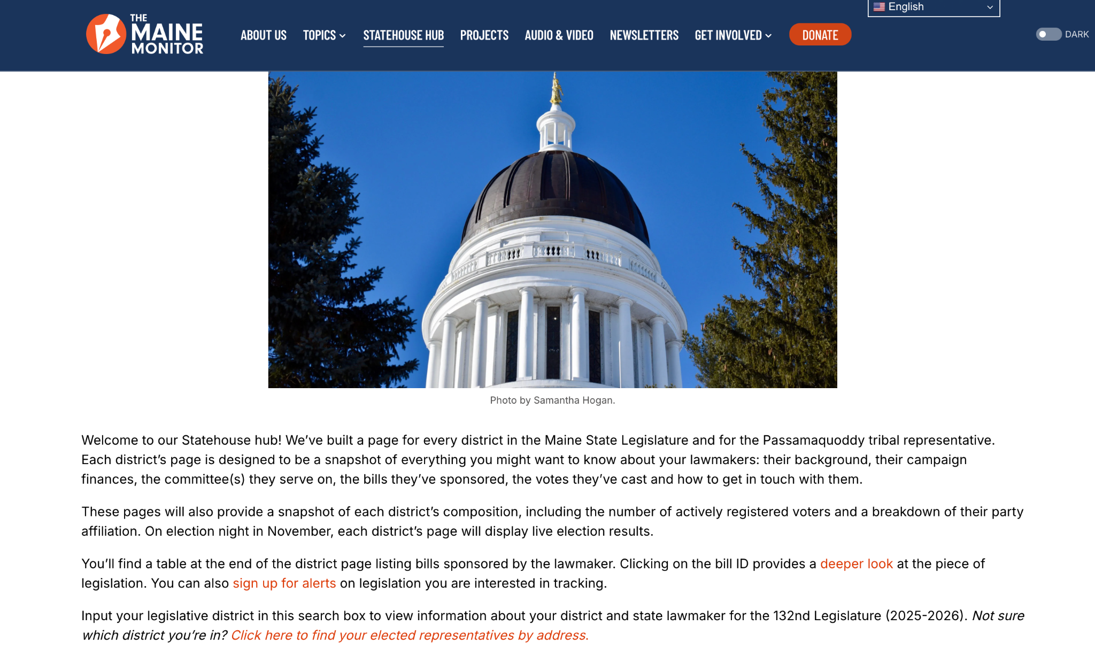
BLN + BillTrack50 Resources
Notes:
Bills introduced, with map and table view
Big Local News is going to be embedding widgets displaying information about bills introduced in the past week - a map view as well as a table view as a tool for anyone to use, free for anyone.
Analysis of legislative actions
Run data analysis on completed legislation for your state, using the downloaded csv files in the BLN platform, free for anyone at biglocalnews.org.
BLN Data+ news detection service for members
Legislation outcome tracker will send notifications by state about the final stage of every bill and whether it was passed, vetoed, veto overridden, or signed/enacted/adopted.
COLLABORATION EXAMPLE: The Maine Monitor built a section on their website where readers can look up their state lawmaker and quickly find all of that information in one place. They use BillTrack50 to embed a table of all legislation sponsored by a particular lawmaker that shows a summary and where it is in the legislative process. Then, they show readers how they can set up BillTrack50 alerts on bills they are interested in.

Slide 41
Alerts
Note: The alert systems are exclusive to Data+ members, but the data is free for all BLN users.

Slide 42

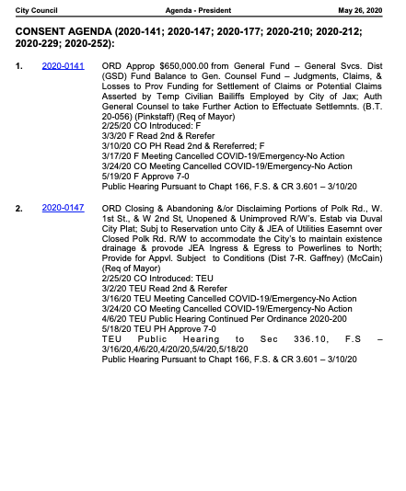
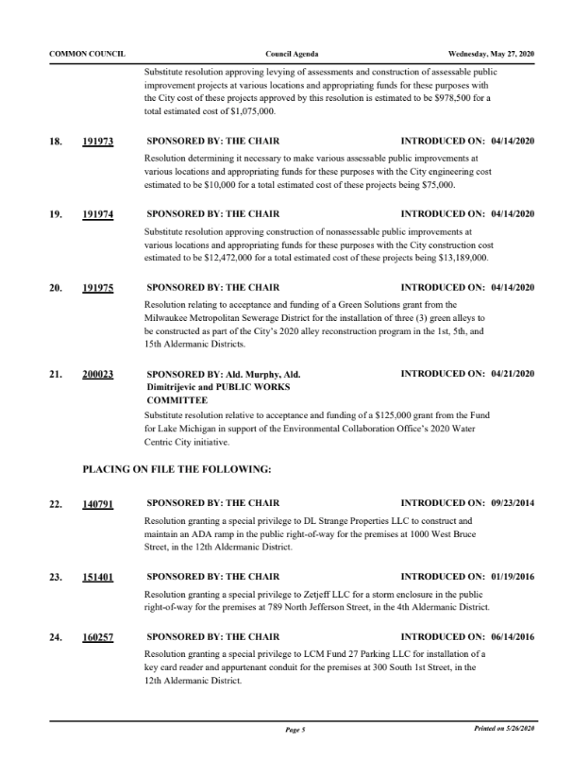
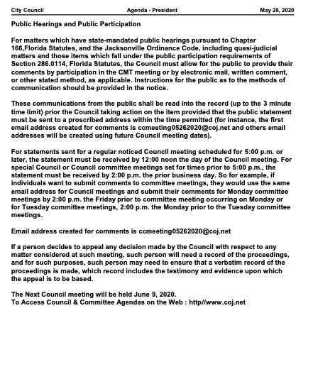
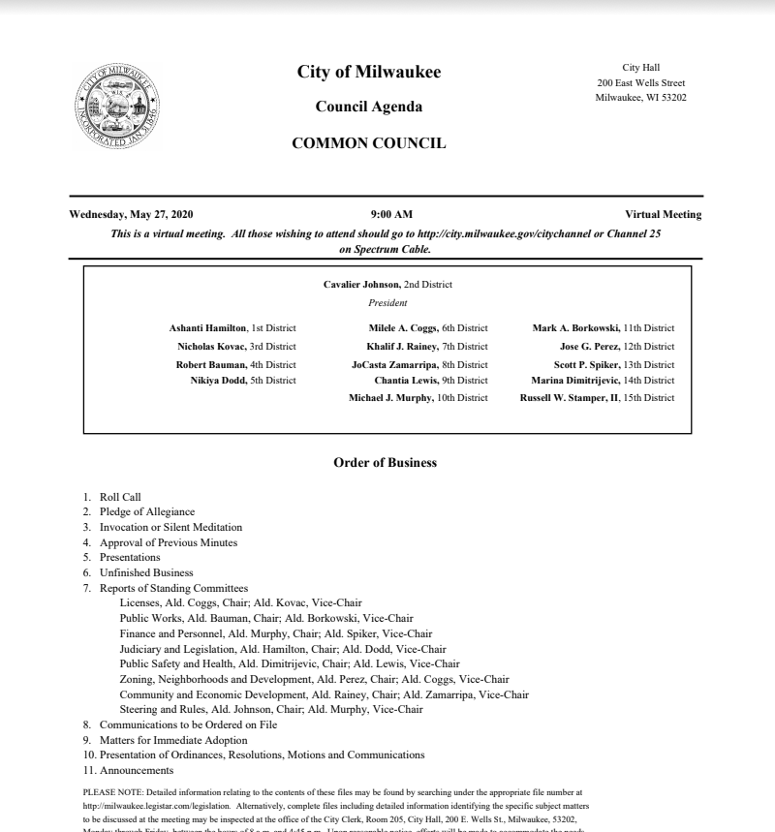
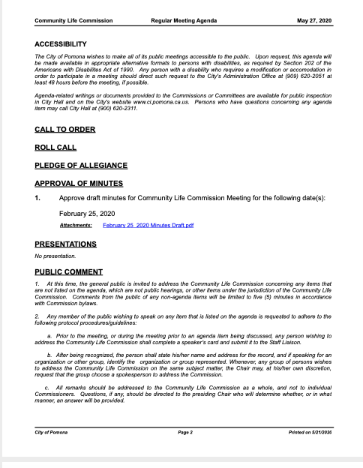
Agenda Watch
Observing public meetings is a critical tool of local watchdog reporting.
Monitoring and attending them is time-consuming.

Slide 43
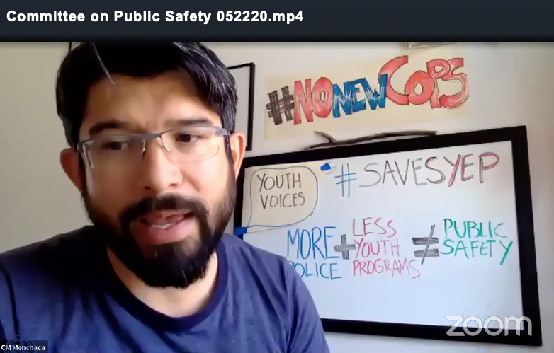
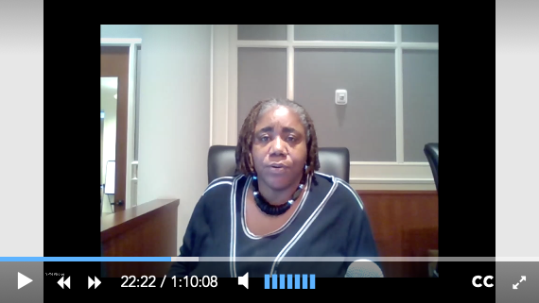
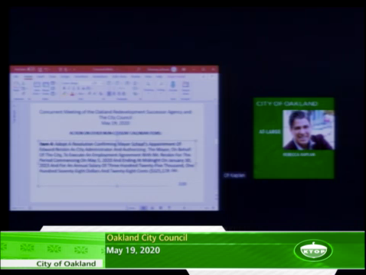
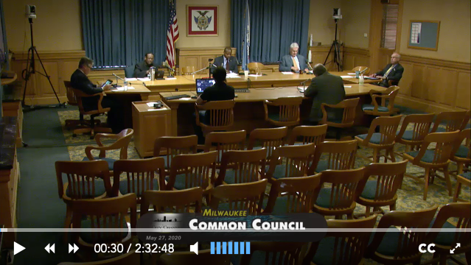
Agenda Watch
Public agencies post documents and video recordings from meetings online.
Scraping at scale.
Extend newsroom reach through search and alerts
Notes:
From left: Recent public meetings held using video conference software in New York City, Jacksonville, Florida, Oakland, California and Milwaukee, Wisconsin.

Slide 44
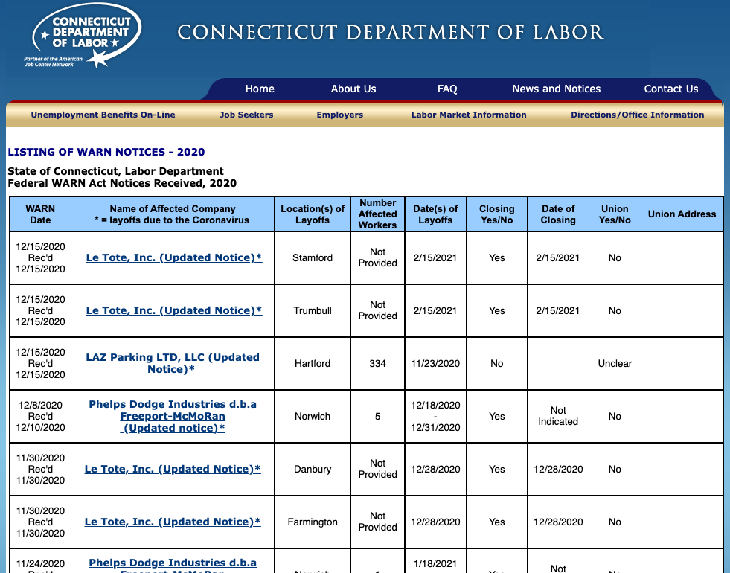
Layoff Watch
Notes:
WARN (Worker Adjustment and Retraining Notification Act):
Another effort that came out of the pandemic.
Wanted to look at how pandemic layoffs were impacting different states
This is almost entirely a scraping project.
Example of CT page with table of data… but data came in all formats: excel, html, csv, etc.

Slide 45
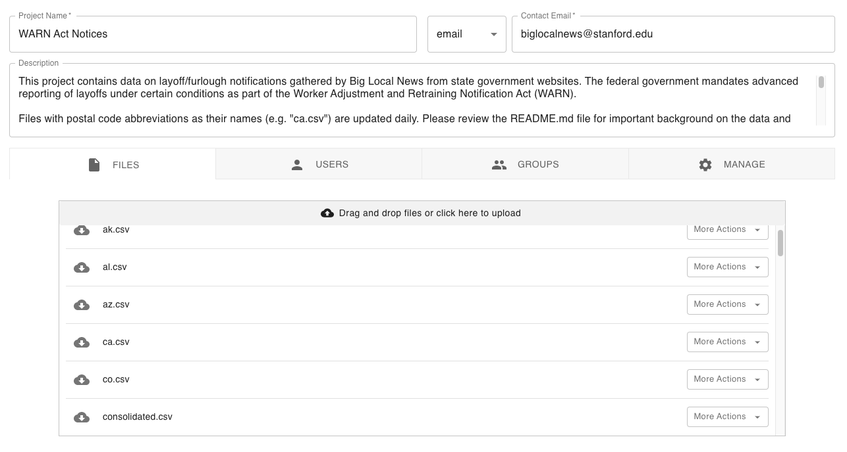
Layoff Watch
Notes:
WARN (Worker Adjustment and Retraining Notification Act):
This is working with our BLN platform to share the CSV output data.
Users can download each state or a consolidated file (also via API)
The other cool thing is this is totally open sourced and we are getting collaborators adding their own scrapers to the repository. Up to 36 states.

Slide 46
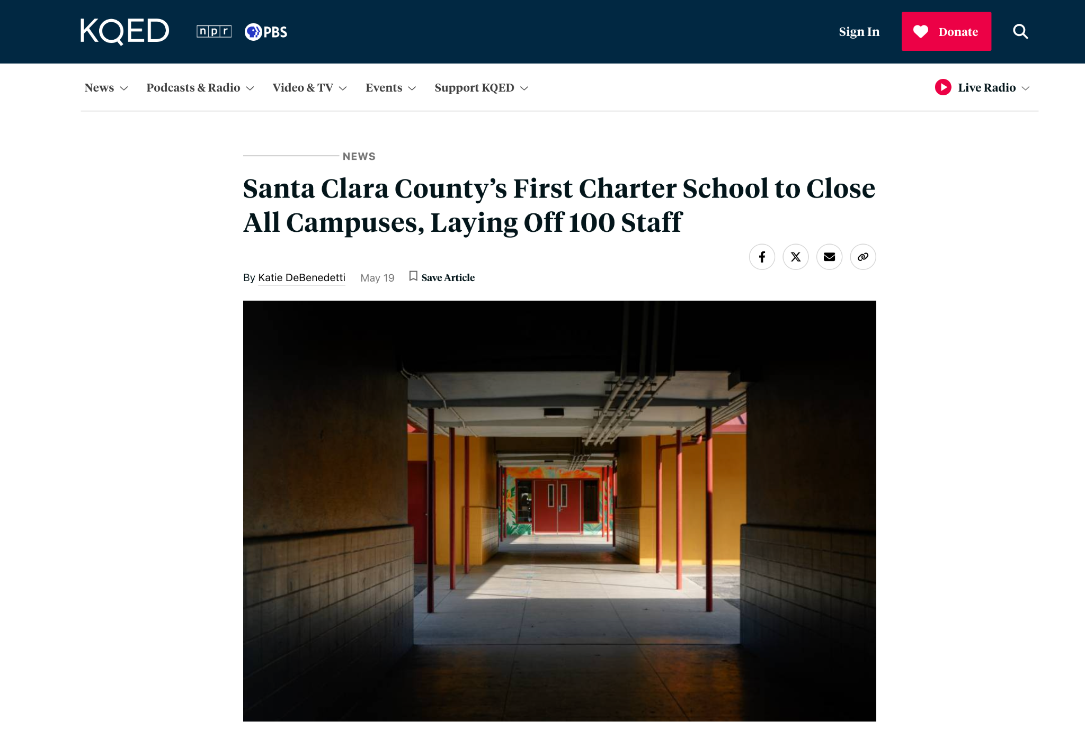
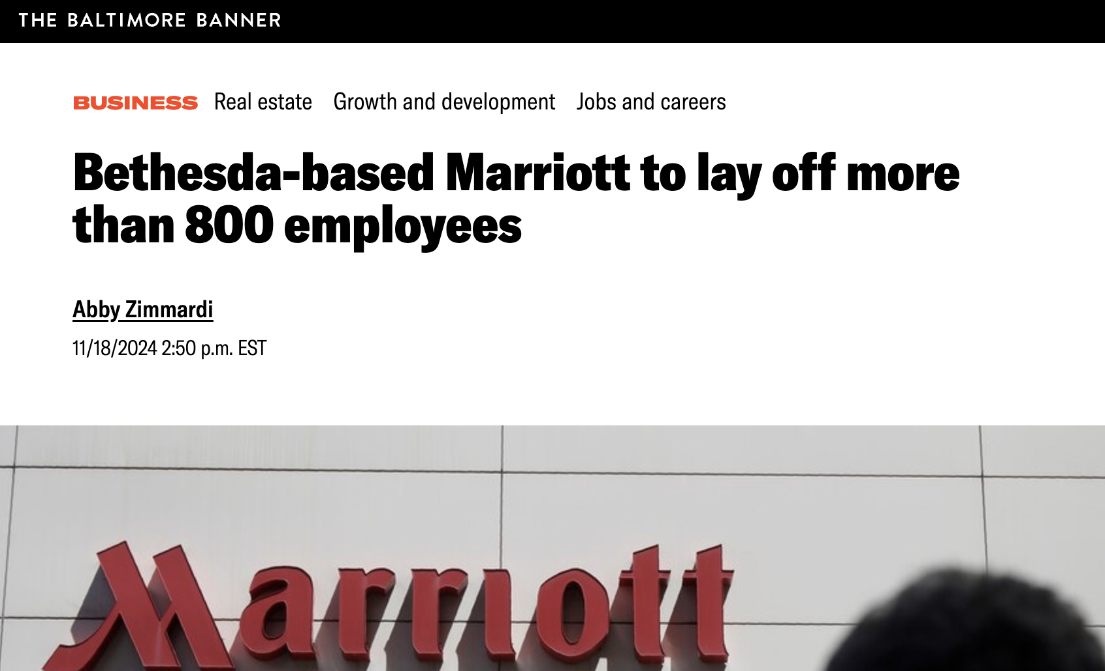
How newsrooms use WARN Notices
Notes:
WARN (Worker Adjustment and Retraining Notification Act):
This is working with our BLN platform to share the CSV output data.
Users can download each state or a consolidated file (also via API)
The other cool thing is this is totally open sourced and we are getting collaborators adding their own scrapers to the repository. Up to 36 states.

Slide 47
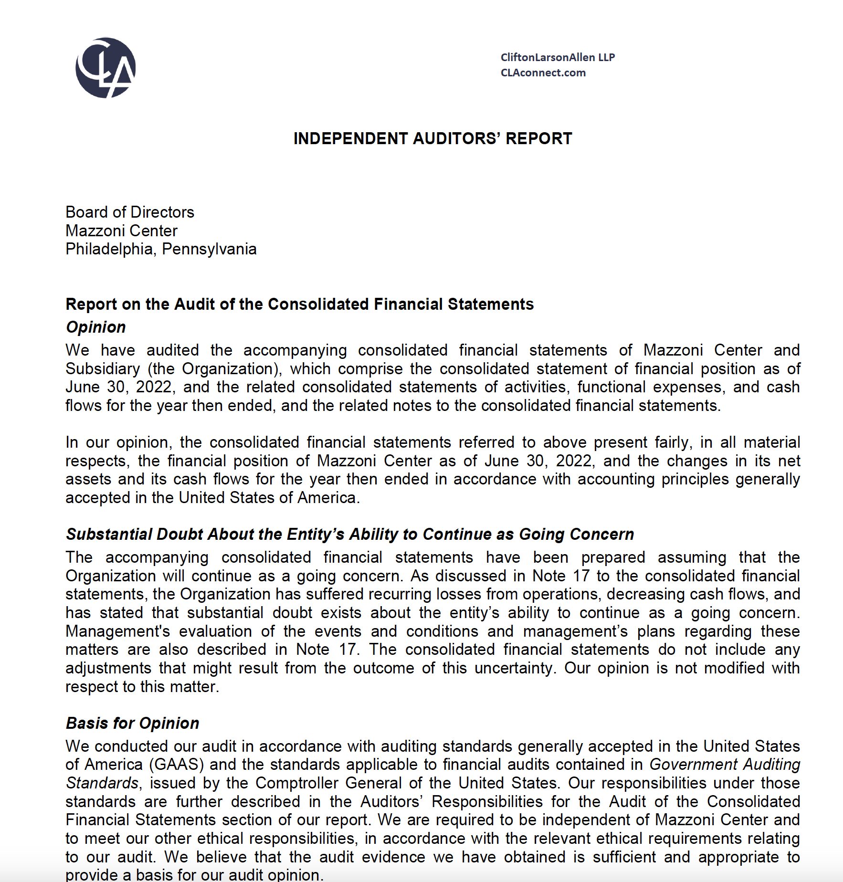

Audit Watch
Mazzoni Center - going concern letter
Notes:
WARN (Worker Adjustment and Retraining Notification Act):
Another effort that came out of the pandemic.
Wanted to look at how pandemic layoffs were impacting different states
This is almost entirely a scraping project.
Example of CT page with table of data… but data came in all formats: excel, html, csv, etc.

Slide 48




Slide 49

Slack Alert Example

Slide 50


Slide 51
Big Local News
Questions?
We also have quarterly open office hours over Zoom!
cep3@stanford.edu
biglocalnews@stanford.edu

