Slide 1
Reporting on Tribal Colleges
Matt Krupnick, independent journalist
matt@mattkrupnick.com

Slide 2
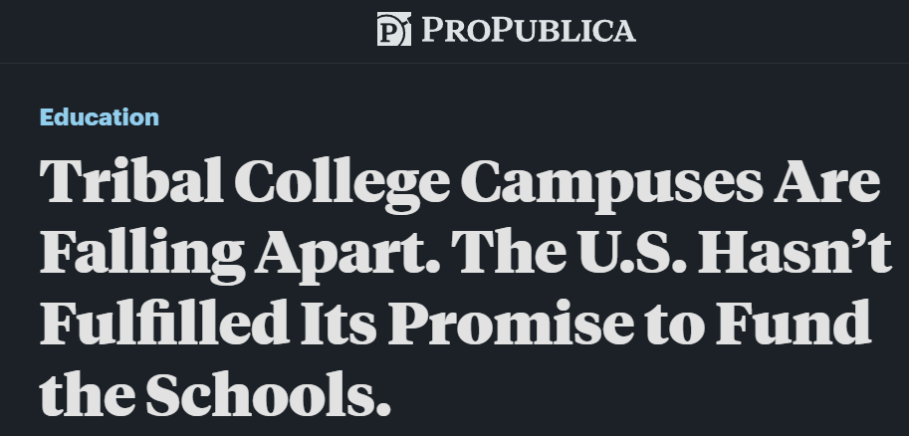


Slide 3
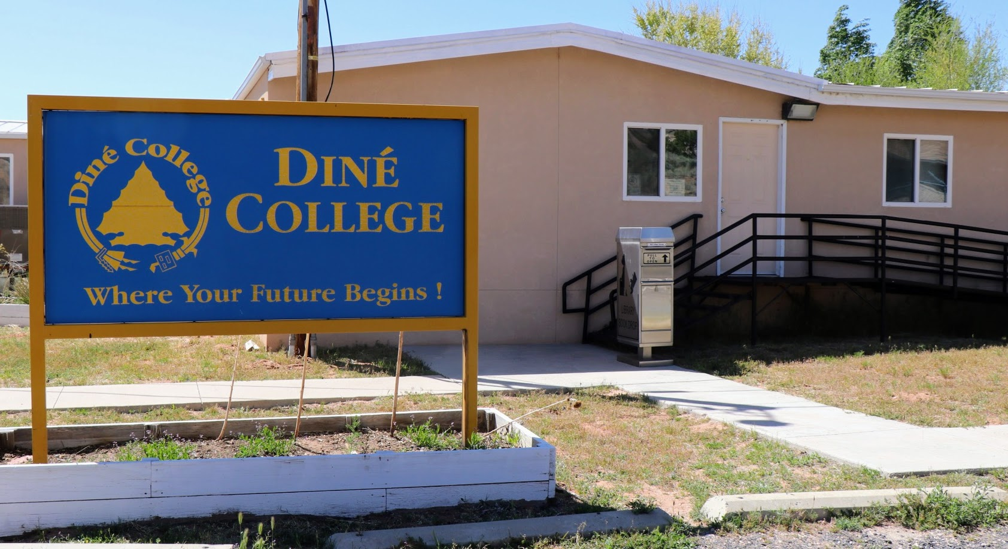
How I became interested in tribal colleges

Slide 4
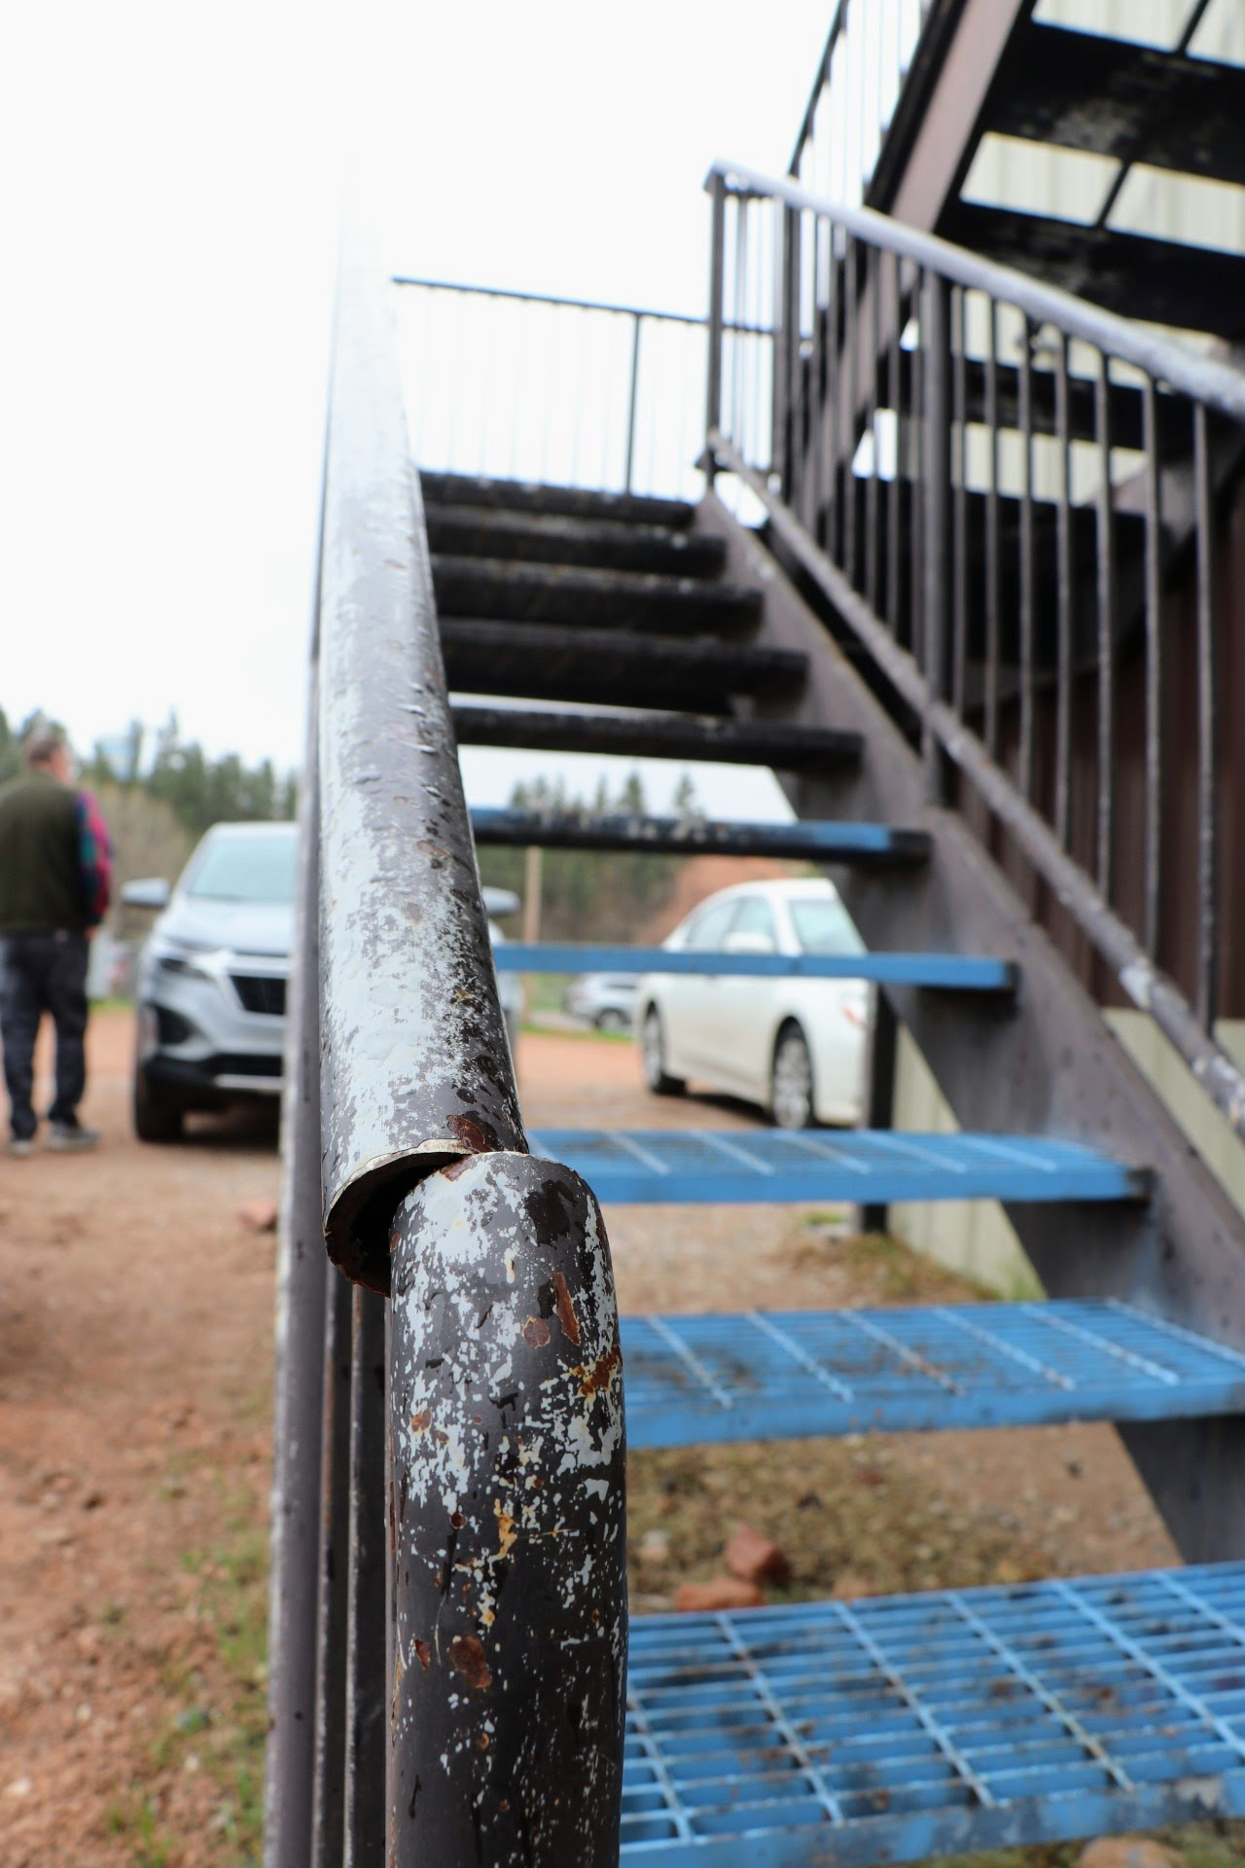
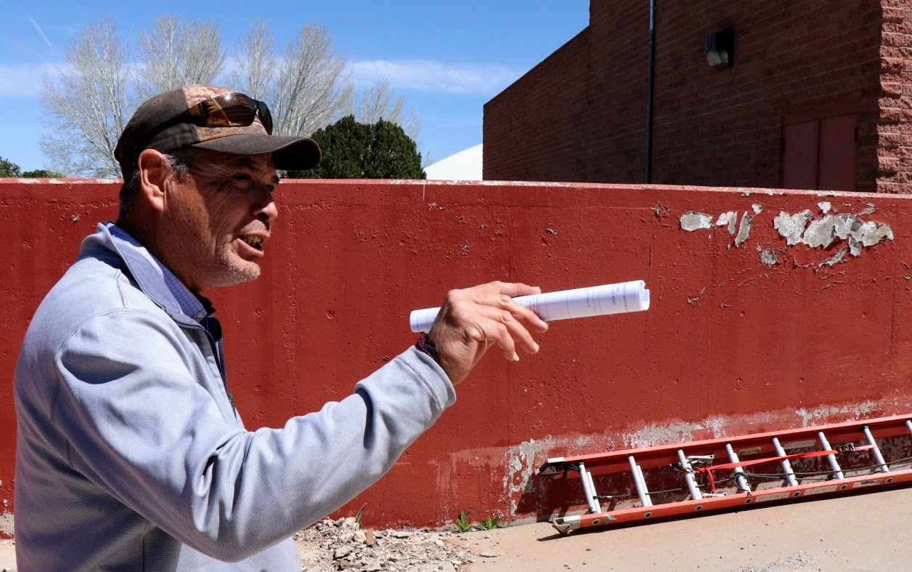
Where I visited
Oglala Lakota College (South Dakota)
Little Big Horn College (Crow reservation, Montana)
Chief Dull Knife College (Northern Cheyenne, Montana)
Diné College (Navajo Nation, Arizona)
Tohono O’odham Community College (Arizona)

Slide 5

ROADBLOCKS
Engagement
Tribal college leaders
Congress
START
Bureau of Indian Education
Everyone’s lack of knowledge

Slide 6
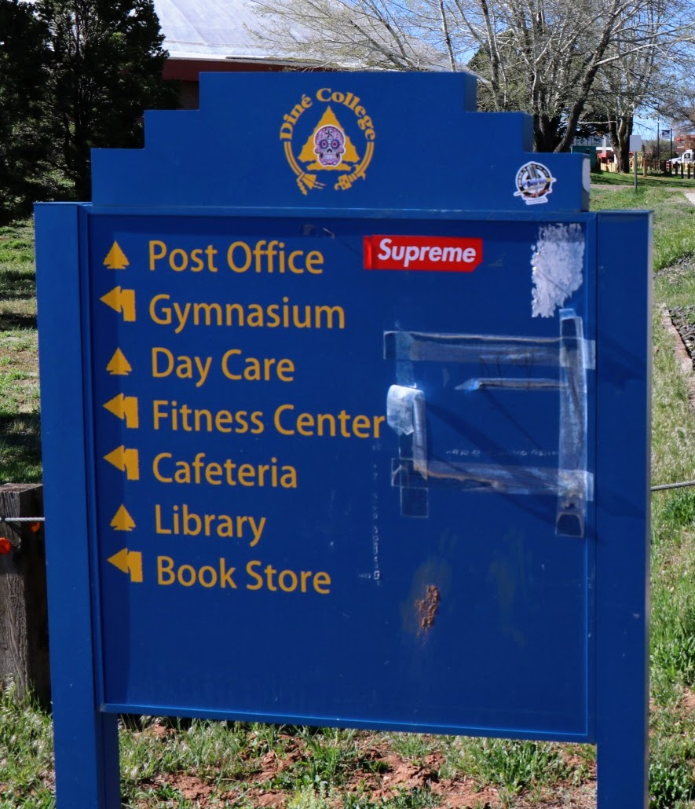
What did I learn?
Why did that water pipe burst? (Start local and build)
Tribes sometimes don’t know about TCU challenges
Tribal colleges aren’t used to media attention
Remote locations bring specific challenges
Washington disconnect

Slide 7
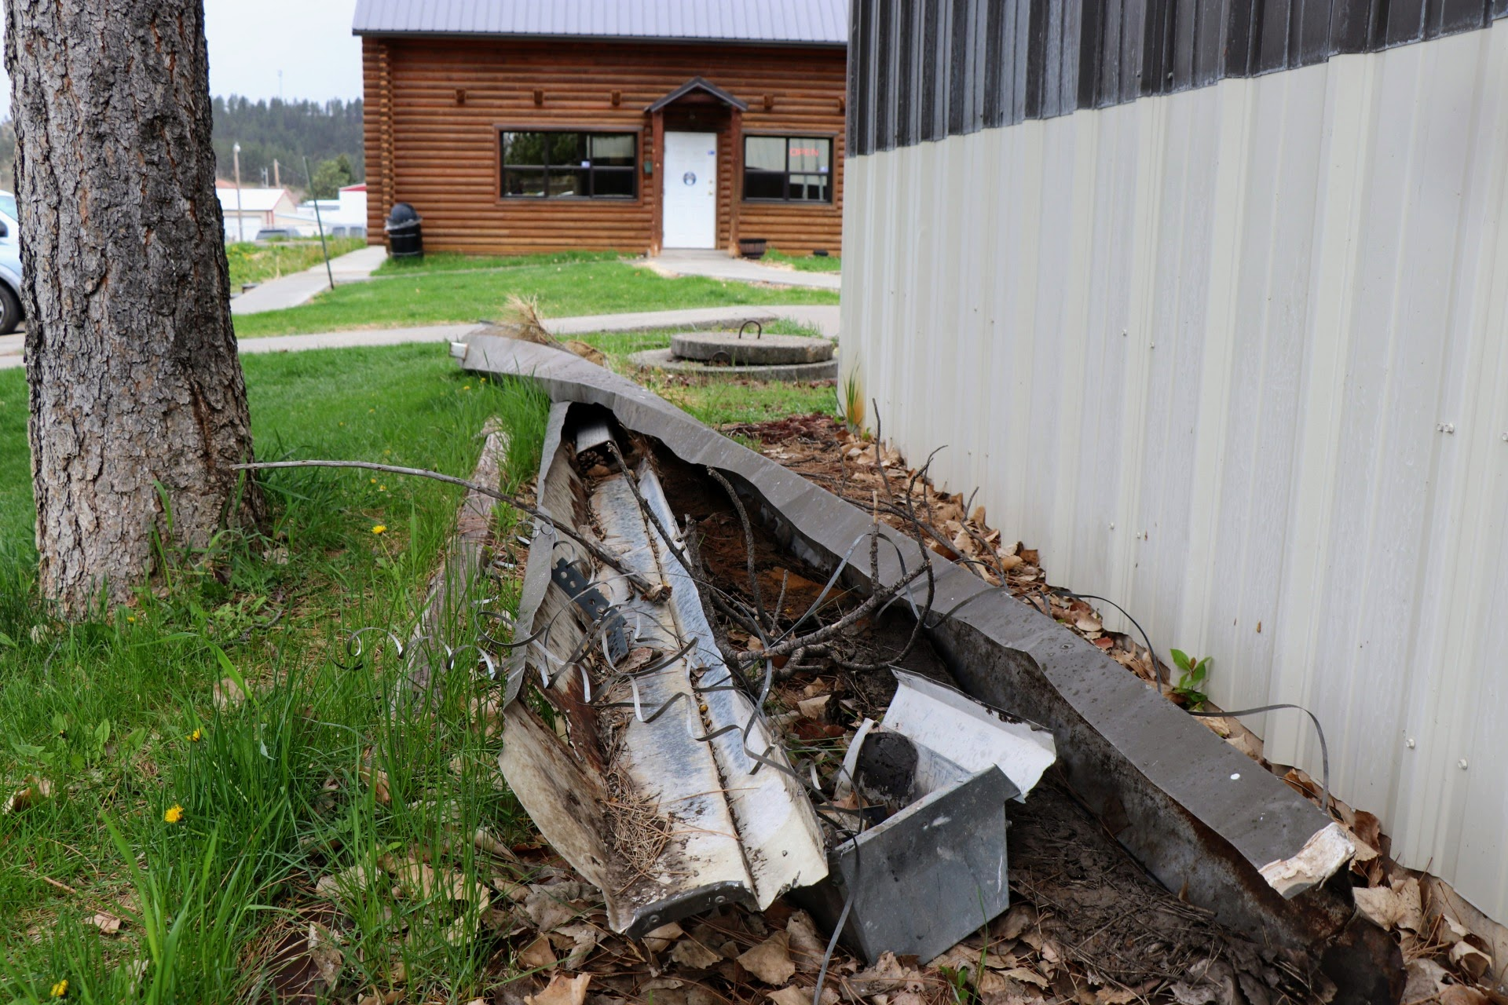
Story ideas:
Effects of grant cuts on tribal communities
What can tribes and states do for tribal colleges?
Tribal colleges as a community hub (water, culture, etc.)
How do TCUs attract faculty?
Construction challenges

Slide 8
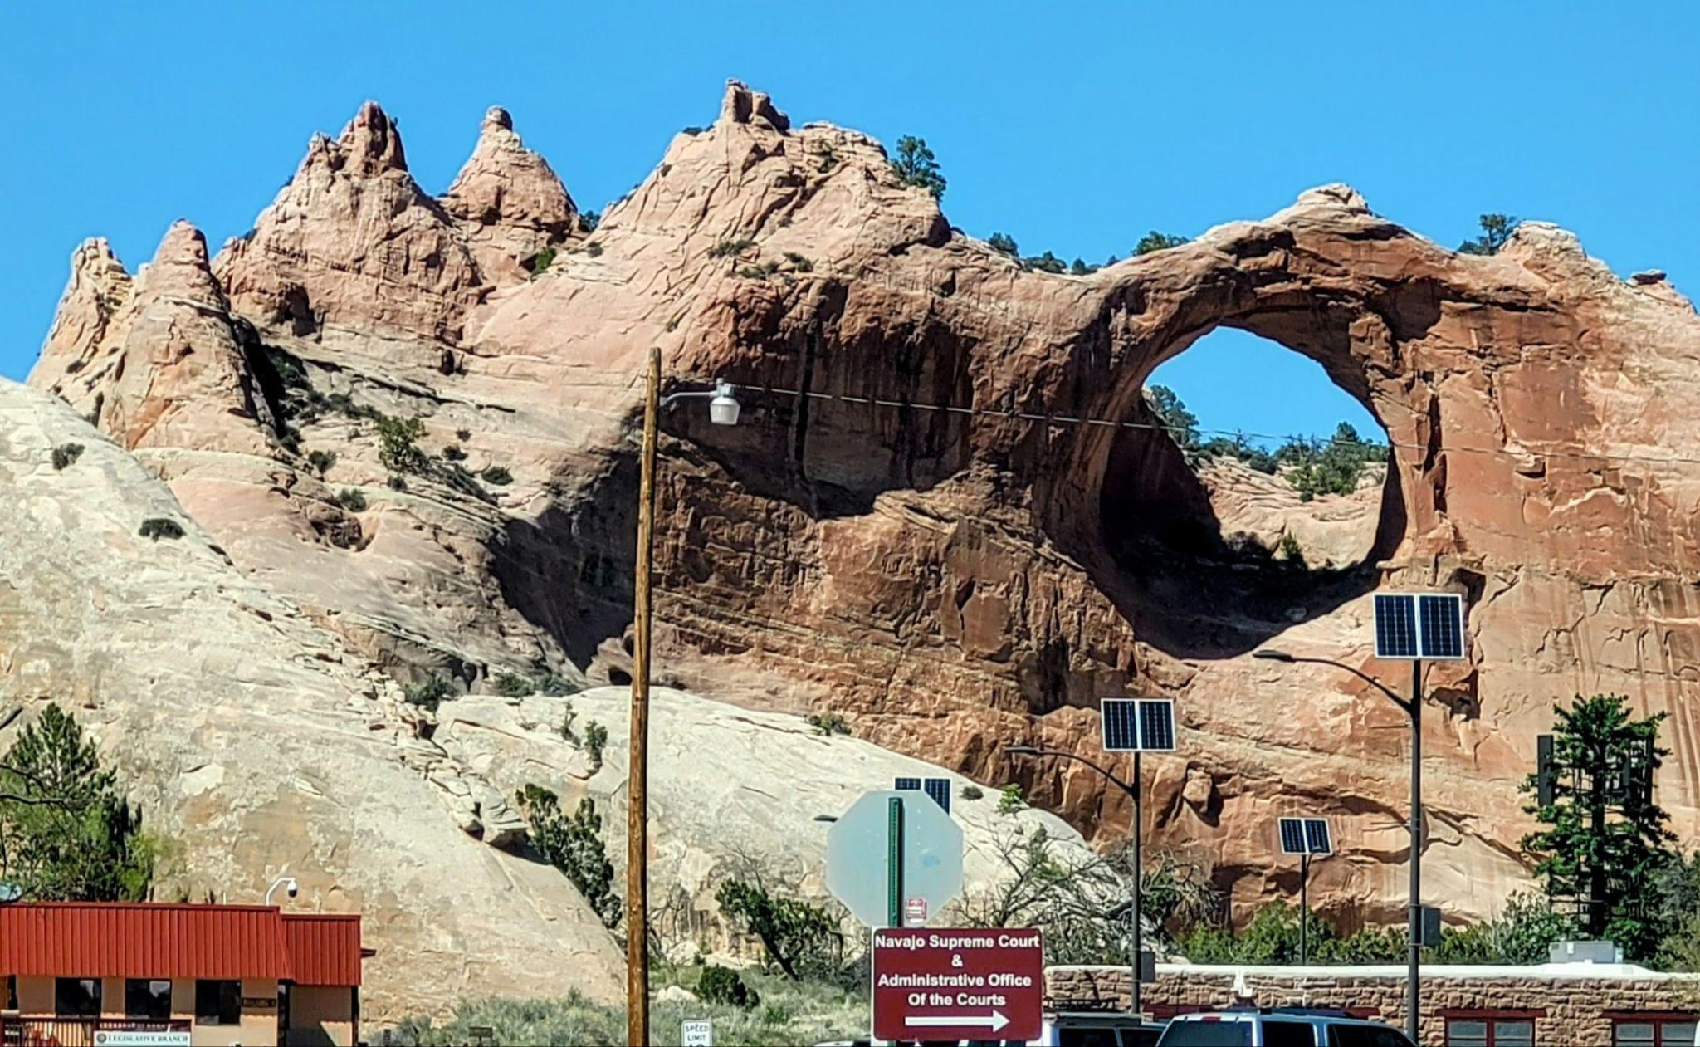
Thanks!

