Slide 1
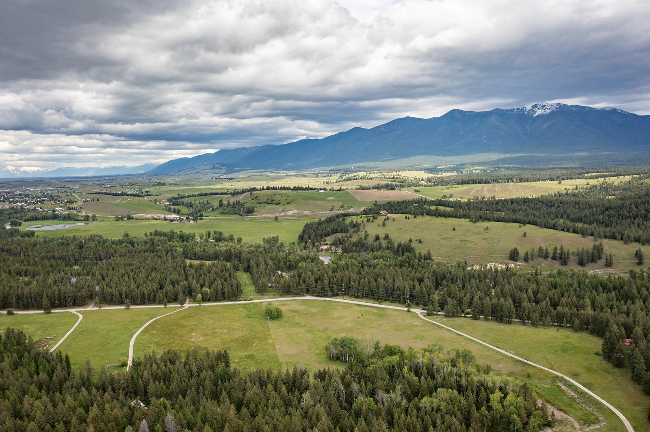
The Rural College Project
Denali Sagner
Education Writers Association National Seminar
May 30, 2025

Slide 2
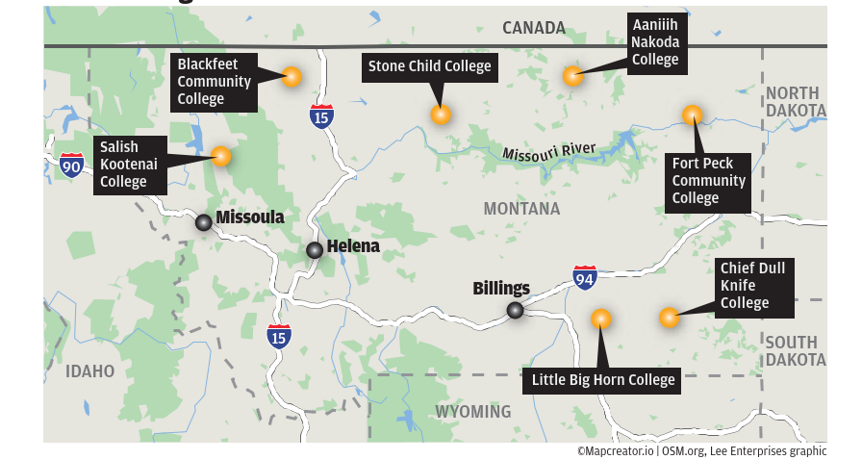
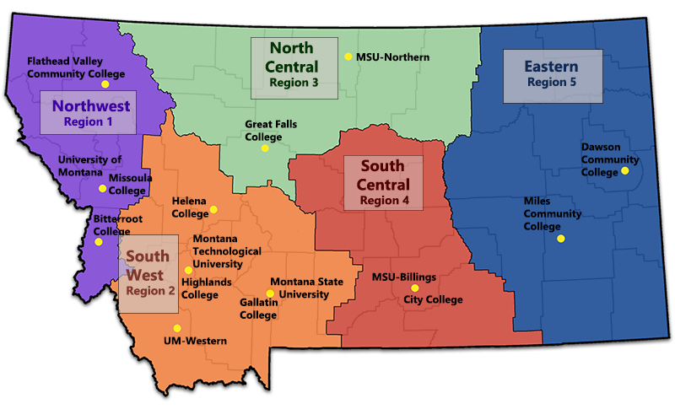
Courtesy of Lee Montana Newspapers
Courtesy of the Montana University System (MUS)
Notes:
*What brought you to this story?
“The state’s rural nature creates a thorny paradigm for high school graduates: travel far away from home to seek higher education, or forgo the post-secondary experience entirely?” –– beyond basic features, there had been little coverage of the challenges and successes faced by these institutions.
It is a paradigm that has pushed talented adolescents out of their communities of origin, and has left others without career training as the state’s economy changes rapidly –– what are colleges doing to curb this drain?
I saw the EWA opportunity –– huge deal working in small newsroom where resources are limited, really allowed me to expand the possibilities of what I could pitch and could do

Slide 3
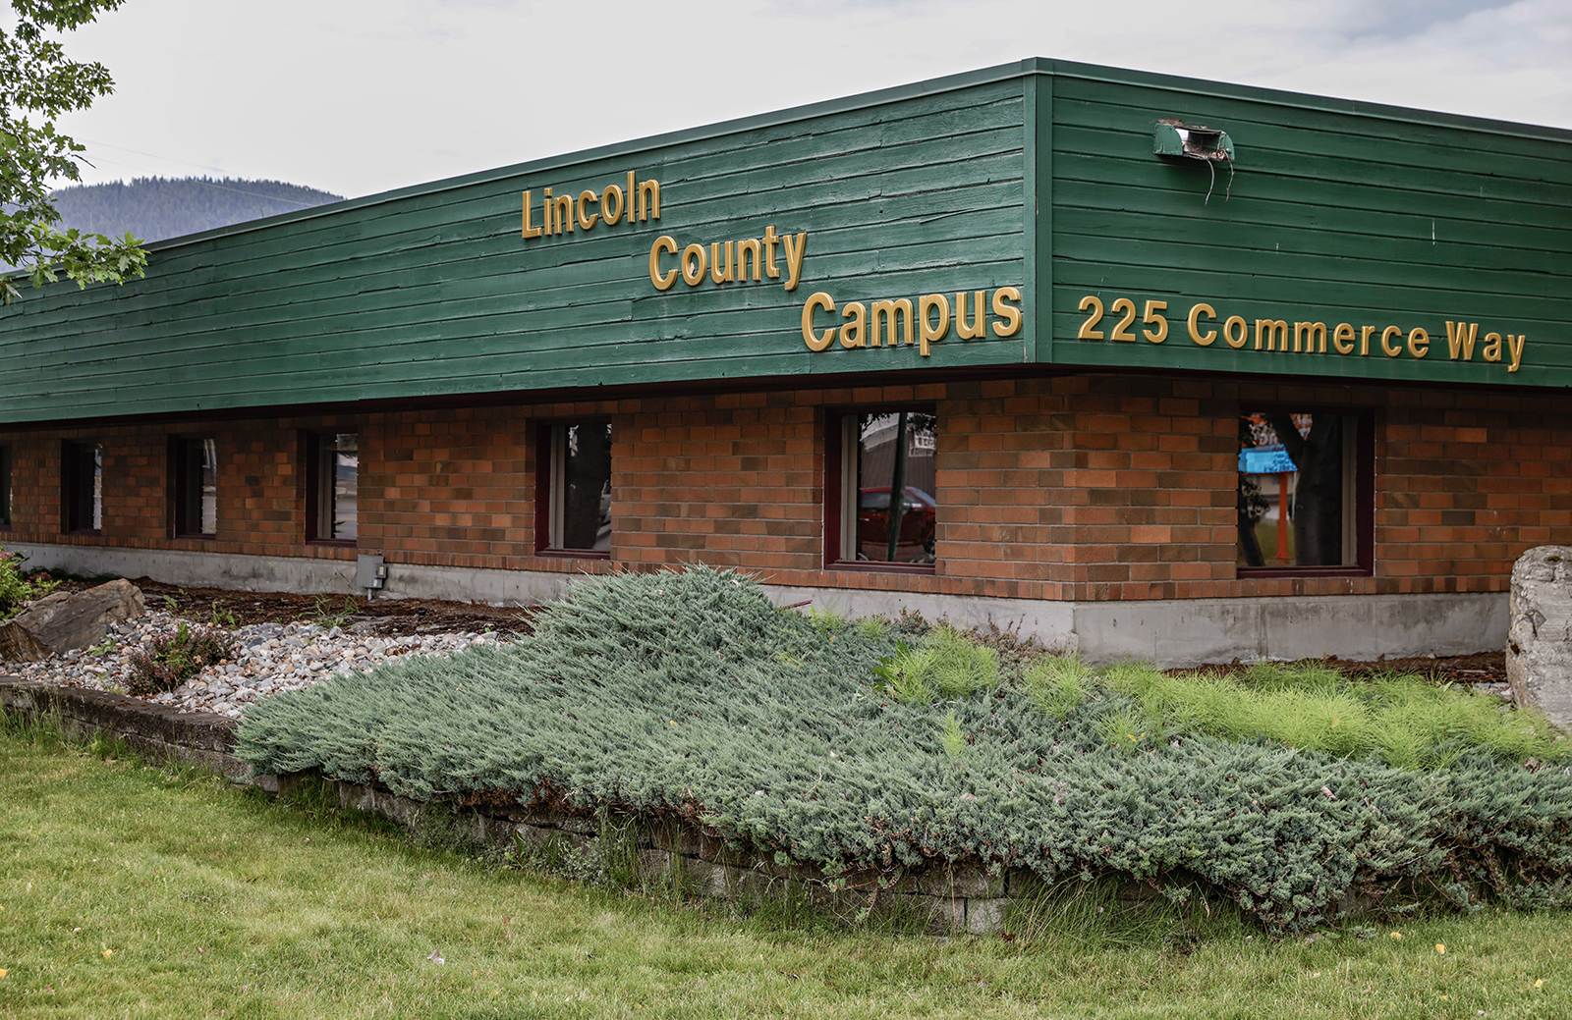
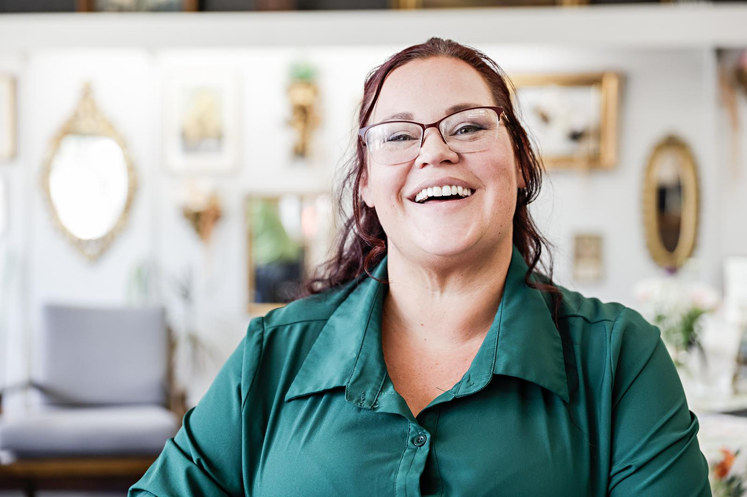
Top – Flathead Valley Community College’s Lincoln County Campus. Bottom – Tabitha Viergutz, Libby community officer for the LOR Foundation, and an alumna of FVCC’s Lincoln County Campus. By Hunter D’Antuono (Flathead Beacon).
Notes:
How did you do this story?
Started with big questions and interviews. A benefit of the fellowship was that I had the bandwidth to drive to these rural communities, pay for gas, take time out of my day. More structure may have been better, but it allowed me to build trust and begin to build a plan.
Dig through the archives. What has been covered? What hasn’t? How does the history of this place inform its present?
Work with editors to come up with a story plan – really zeroing in on what is interesting and feasible.
Going through lots of rounds of editing, streamlining, making a plan.
Coming up with a plan for branding and release –– When would the stories go up? How would we promote them? What would the name be? Etc.

Slide 4
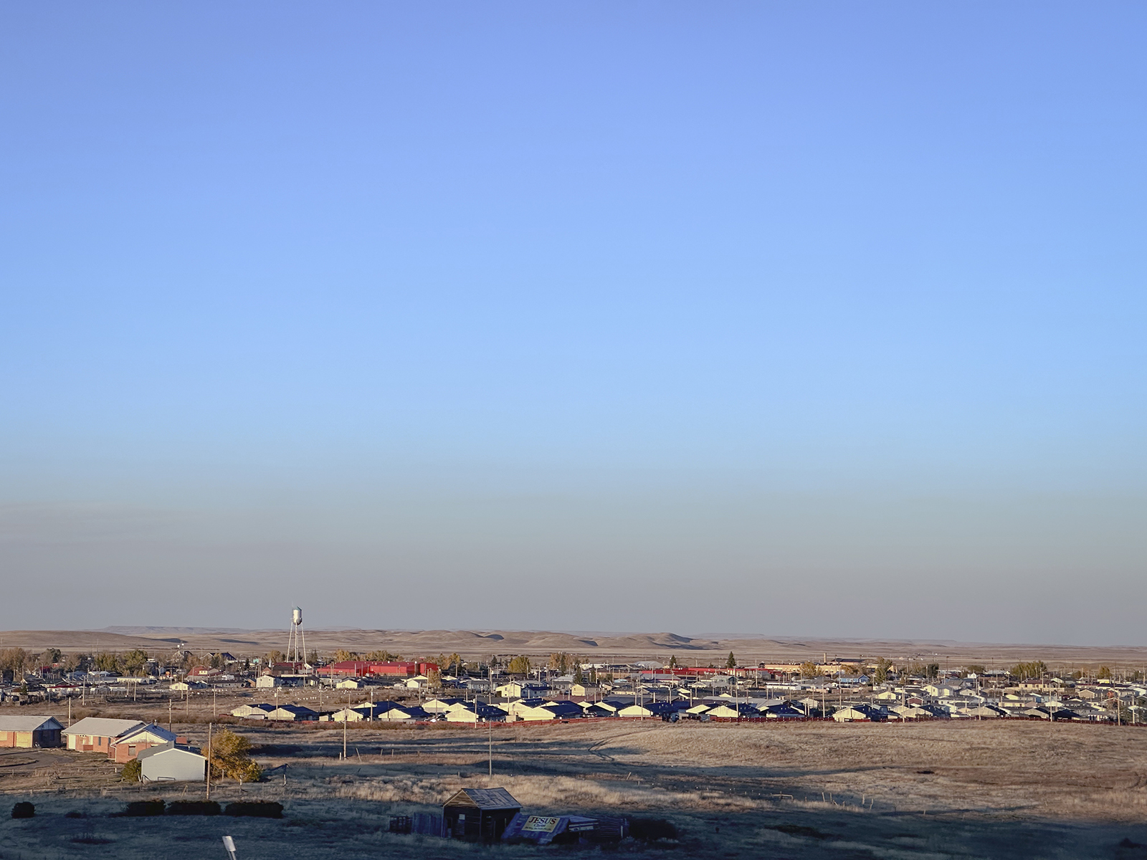
“Data are not neutral—they are shaped by people’s decisions about which data matter, how they are collected, and how they are analyzed and shared. And data have been used against people of color and other marginalized communities, from historical redlining practices to modern biases in hiring algorithms. Even when data aren’t used to intentionally harm, they are often created and analyzed without input from the people at the heart of the issues being studied.”
– Urban Institute, Elevate Data for Equity Project
Blackfeet Community College. By Whitney Snow for the Flathead Beacon
Notes:
*Where did you find useful data or research?
Small town reporting -- showing up with no interviews scheduled and just driving around and people will start pointing people out to you.
When you’re working in rural communities / with underserved communities in general, we’re beginning to understand the notion that “data” isn’t necessarily fair for everyone.
Numbers ARE helpful -- but they may look different. May not see a 15% increase in certificate achievement or a chart that shows an increase in 400 students with bachelor's degrees in 10 years, but you may meet five students whose lives have been changed by programs.
Oral history, in-person conversations, site visits –– helped add meaning in spaces where there was not so much data.

Slide 5
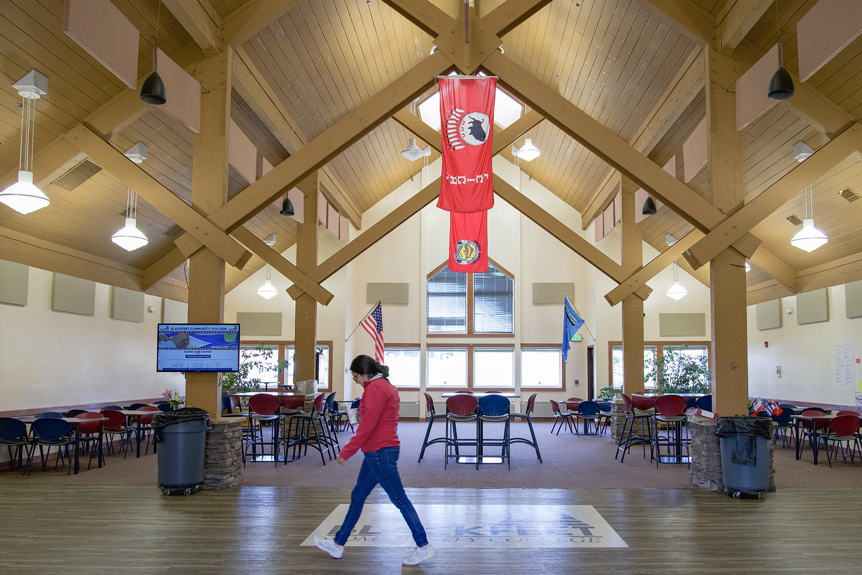
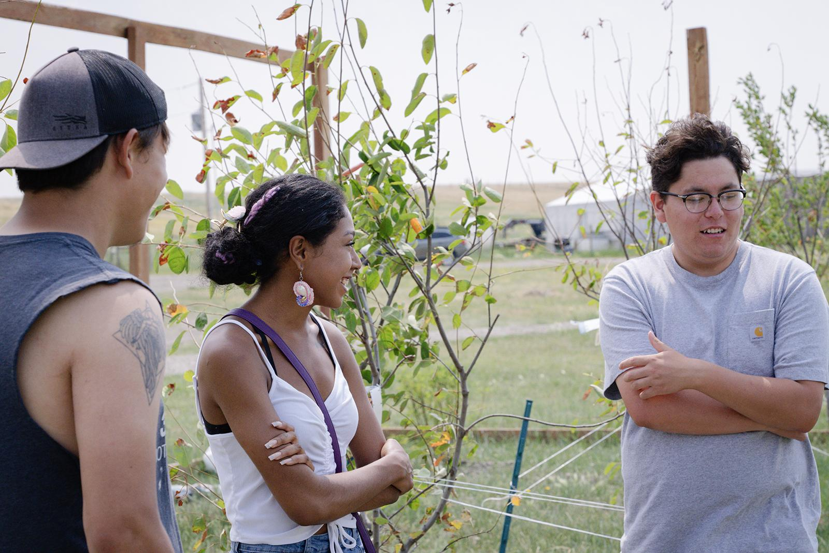
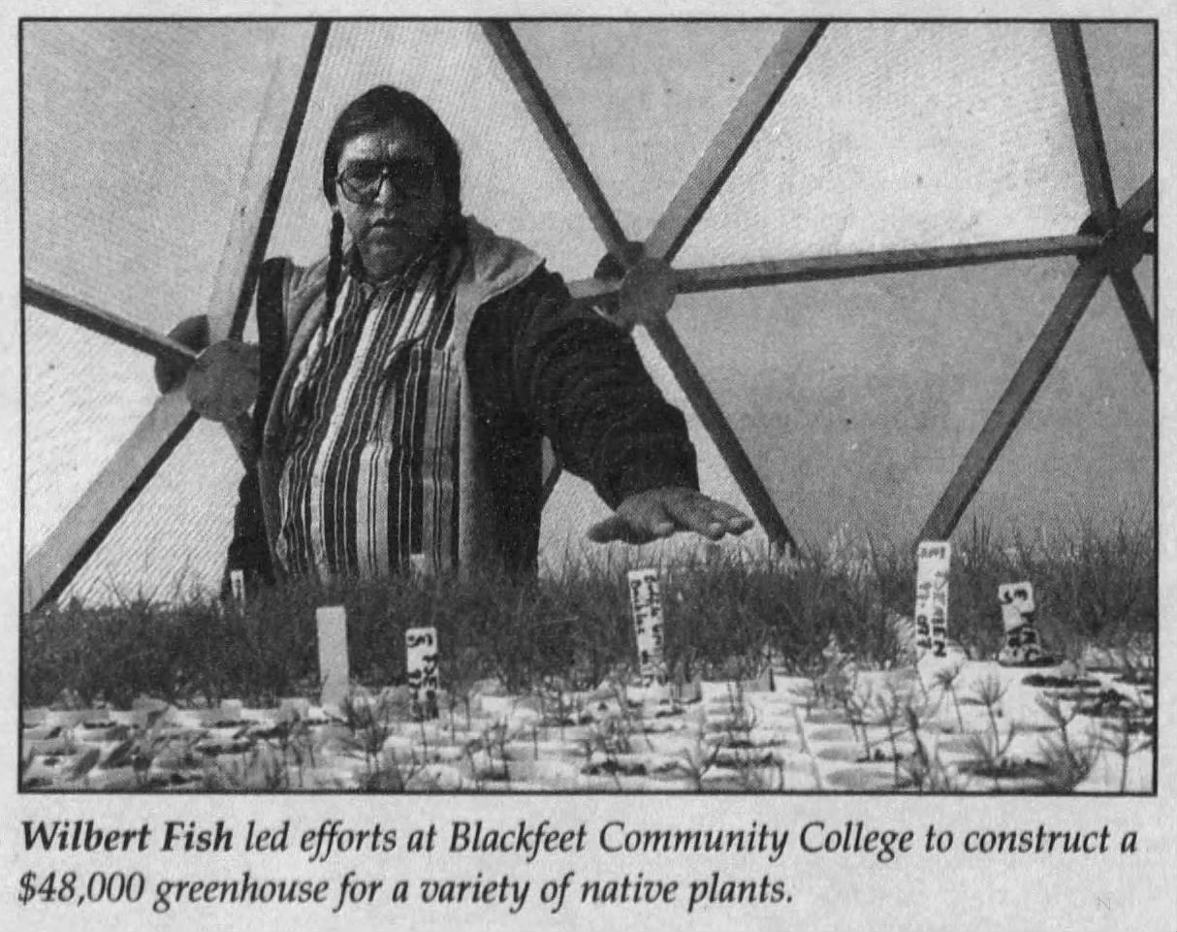
Top photos – Blackfeet Community College and BCC students by Whitney Snow, bottom photo Wilbert Fish, ethnobotanist and Montana State University extension agent, pictured at Blackfeet Community College in 1999 in The Missoulian.
Notes:
What were some of the roadblocks you encountered in your reporting and how did you overcome them? If you could tackle this topic again, what might you do differently?
Covering a vast expanse, easy to bit off more than you can chew.
For those in small newsrooms, you have the blessing and the curse of having a lot of independence. Those decisions about what gets included and what doesn’t are often left up to you.
Would sometimes go out in the field and be so excited about talking to sources, I would come back with a notebook dump and not have a clear path to a story.
Understand your expectations. Set reasonable goals.

Slide 6
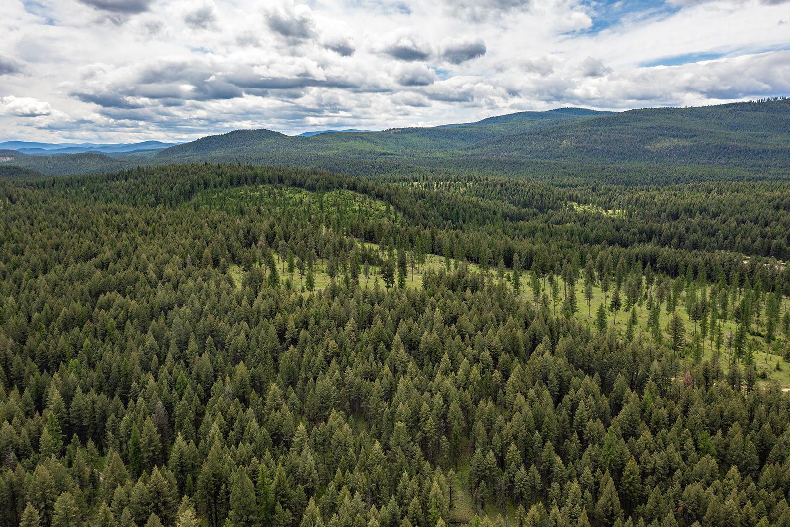
Notes:
*What are some story ideas for local reporters who might be inspired by your work, but also be juggling multiple deadlines or limited resources/time?
I think the number one story is how the federal government’s cuts and downsizing are going to impact colleges, especially those that receive a lot of federal funding like tribal colleges.
It’s important to lean into that work and to make sure you’re continuing to tell other stories.
So much of what we all hear writing about marginalized communities –– rural communities, Native communities, etc. –– is that the narrative is always negative. There are amazing programs, educators to be highlighted. Don’t shy away from the challenges and controversy and make sure to highlight the positive.
Covering rural communities –– there’s a value in embedding with people from those communities. Photographers, writers, editors. Helps build trust.
Ongoing question –– community colleges have historically provided really strong trade education. But, the nature of our economy is changing so rapidly –– this problem is especially acute in deindustrializing communities like in the Rust Belt, part of the west and the south. How are local colleges adapting to train students for this new world?

