Slide 1
This Hartford Public High School grad can’t read. Here’s how it happened.
How I did the story;
Start Here

Slide 2
Summary
In case you missed it;
Aleysha Ortiz is a 19 year old graduate from a public high school in Hartford, CT.
She alleges that the school district never taught her skills, including reading, writing or basic math.
Because of her inability to write, she was recording all of her lessons to get through school. She also recorded her meetings with district officials who had admitted she wasn’t taught these skills.
Ortiz has since filed multiple lawsuits against the city, board of education and school district.

Slide 3
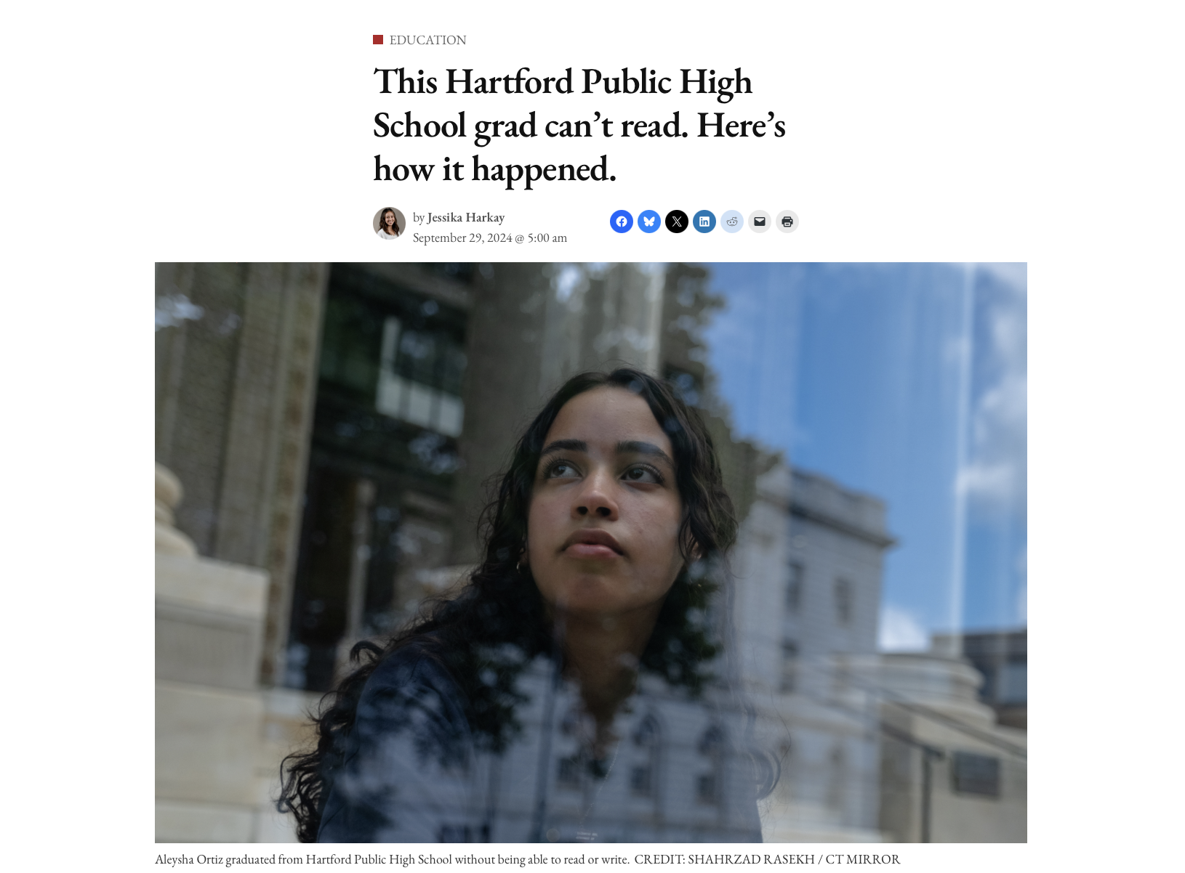

Slide 4
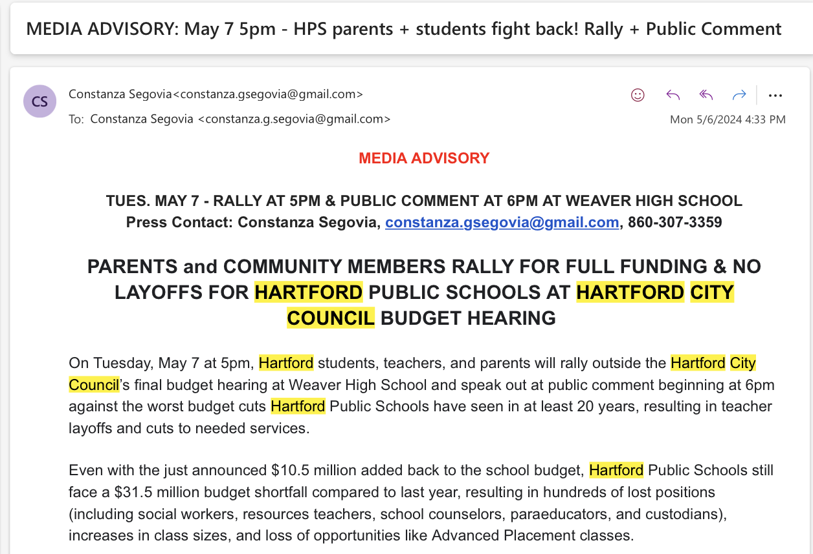
How I found Aleysha
I was at a local city council meeting in May 2024 for a school budget story I was working on when a student spoke during the public hearing. She had the whole auditorium in tears by the end of her speech.
Aleysha Ortiz spoke about the school system failing, abandoning and leaving her behind. For a teenager to speak so strongly about her education, I knew there was more to her story.

Slide 5
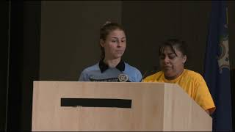

Slide 6
The reporting process
I chased after Aleysha when she left the auditorium, and afterward we met more than a handful of times in the following months.
In our first sit-down she told me she was never taught how to read or write, despite begging to learn these basic skills. In these conversations, we also talked about systemic racism, the opportunity gap in Connecticut education and the shortfalls of special education.
Aleysha provided a binder full of education records and documents from her PPT meetings, but amazingly enough also had hours of district officials admitting in recent months that her IEP was never followed and wasn’t drafted correctly and that they didn’t understand how she had gotten so far without any intervention.
During my reporting, I learned her story is one of possibly many in the state. Aleysha hopes to become a lawyer, superintendent or journalist one day, but her journey forward will be a long and difficult one.

Slide 7
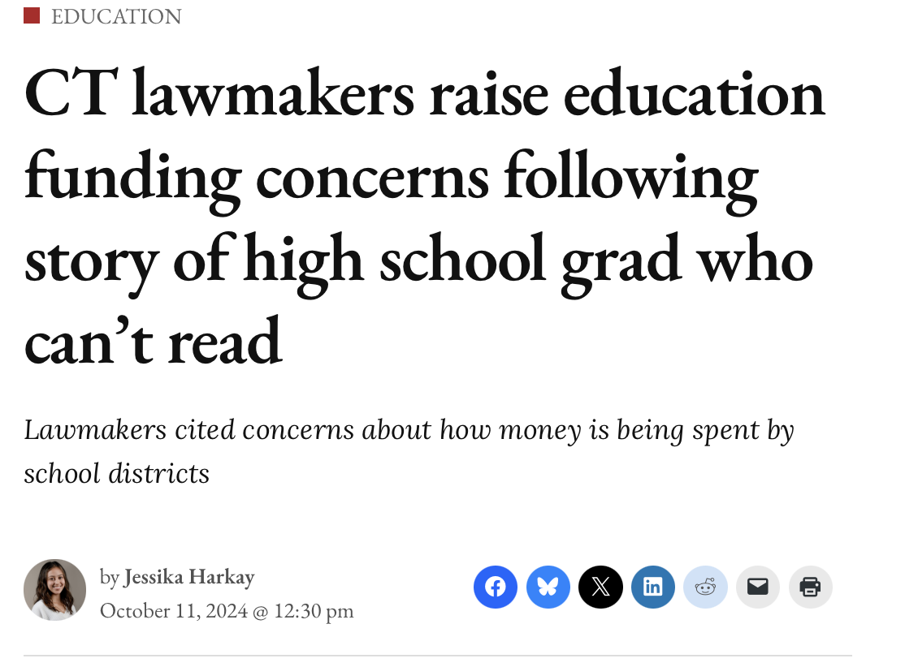
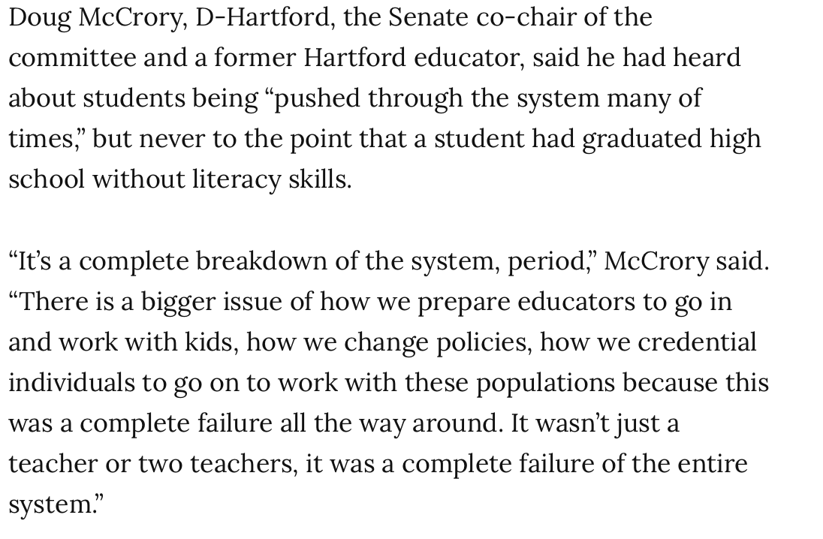
Follow ups from the initial story
Second lawsuit filed
Immediate response from state legislature calling for several education reforms, particularly when it comes to oversight of public school funding and teacher training
Ongoing investigation from state Department of Education

Slide 8
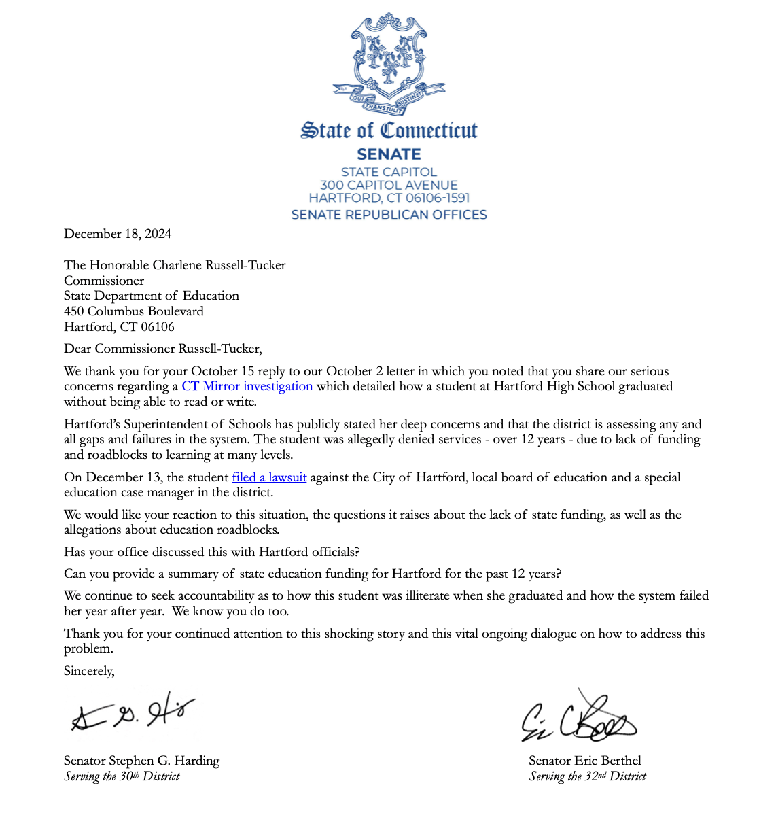
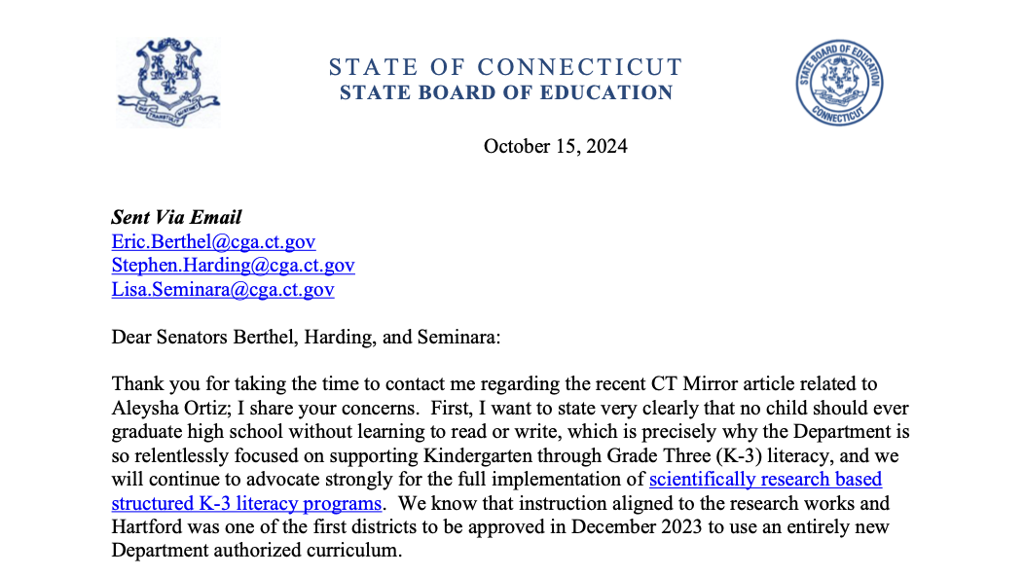

Slide 9
My 5 tips & tricks

Slide 10
Gaining trust with young sources
Biggest thing from this story; the importance of representation and diversity in our newsrooms
Explain the process and let them ask questions
  Remind them it’s OK if they don’t want something printed
Speak to a young source how you’d want someone to approach one of your loved ones
Not every meeting has to go into the story
  The annoying advice to make interviews feel like a conversation

Slide 11
Be on the ground somewhere, anywhere

Slide 12
Trust your gut
I wasn’t the only reporter in that room, but I was the only one to chase after Aleysha
If something feels weird or wrong, ask around. If it’s off to you, it’s probably off to someone else.
Sometimes there’s nothing there, but most of the time you’ll find something useful; whether it’s an experience to ground and humanize a story, a source for the future, a connection to someone else who may help or a future story idea

Slide 13
If it’s happening one place…
it’s pretty likely that it’s also happening somewhere else

Slide 14

Lawyers can be your best friend
Develop relationships with education lawyers who:
  Can flag when something interesting comes through
  Can also provide broader context to how common the issue is

Slide 15
Thank you!
Questions, thoughts or let’s connect;
  jessikaharkay@yahoo.com
  970-401-1960

