Slide 1
Incorporating data into everyday reporting
Christopher Huffaker
education data reporter, Boston Globe
huffaker@globe.com / 412-265-8353

Slide 2
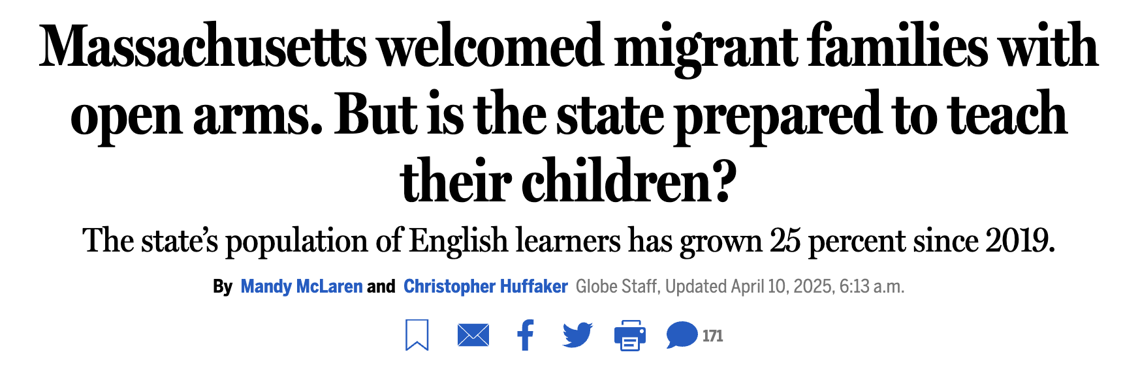
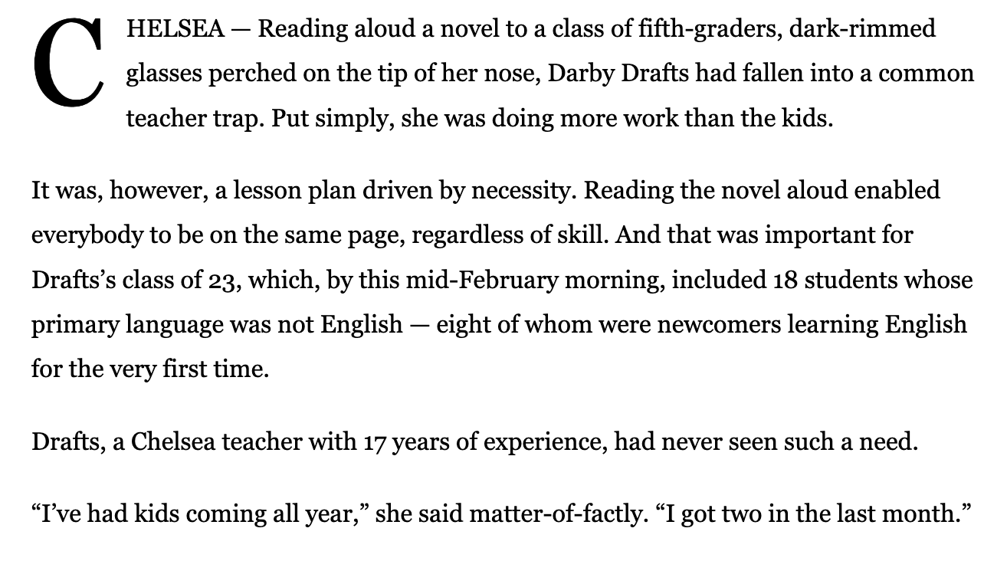
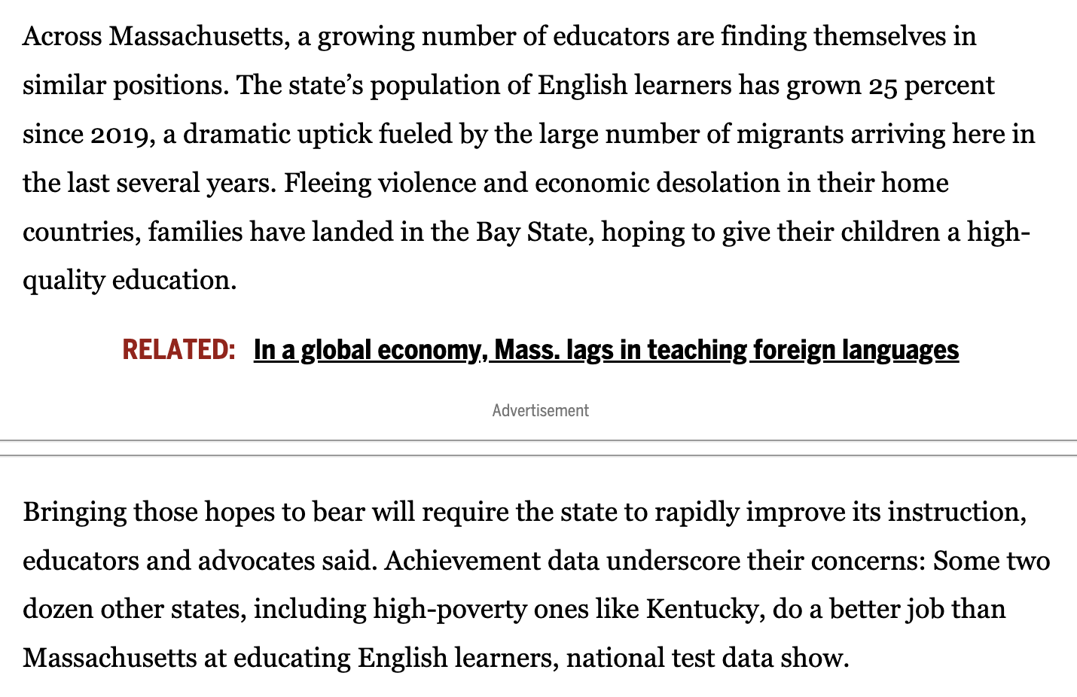

Slide 3
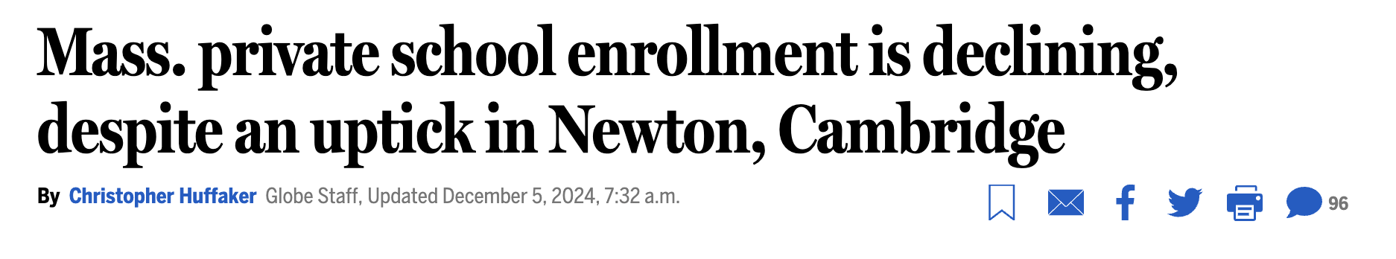
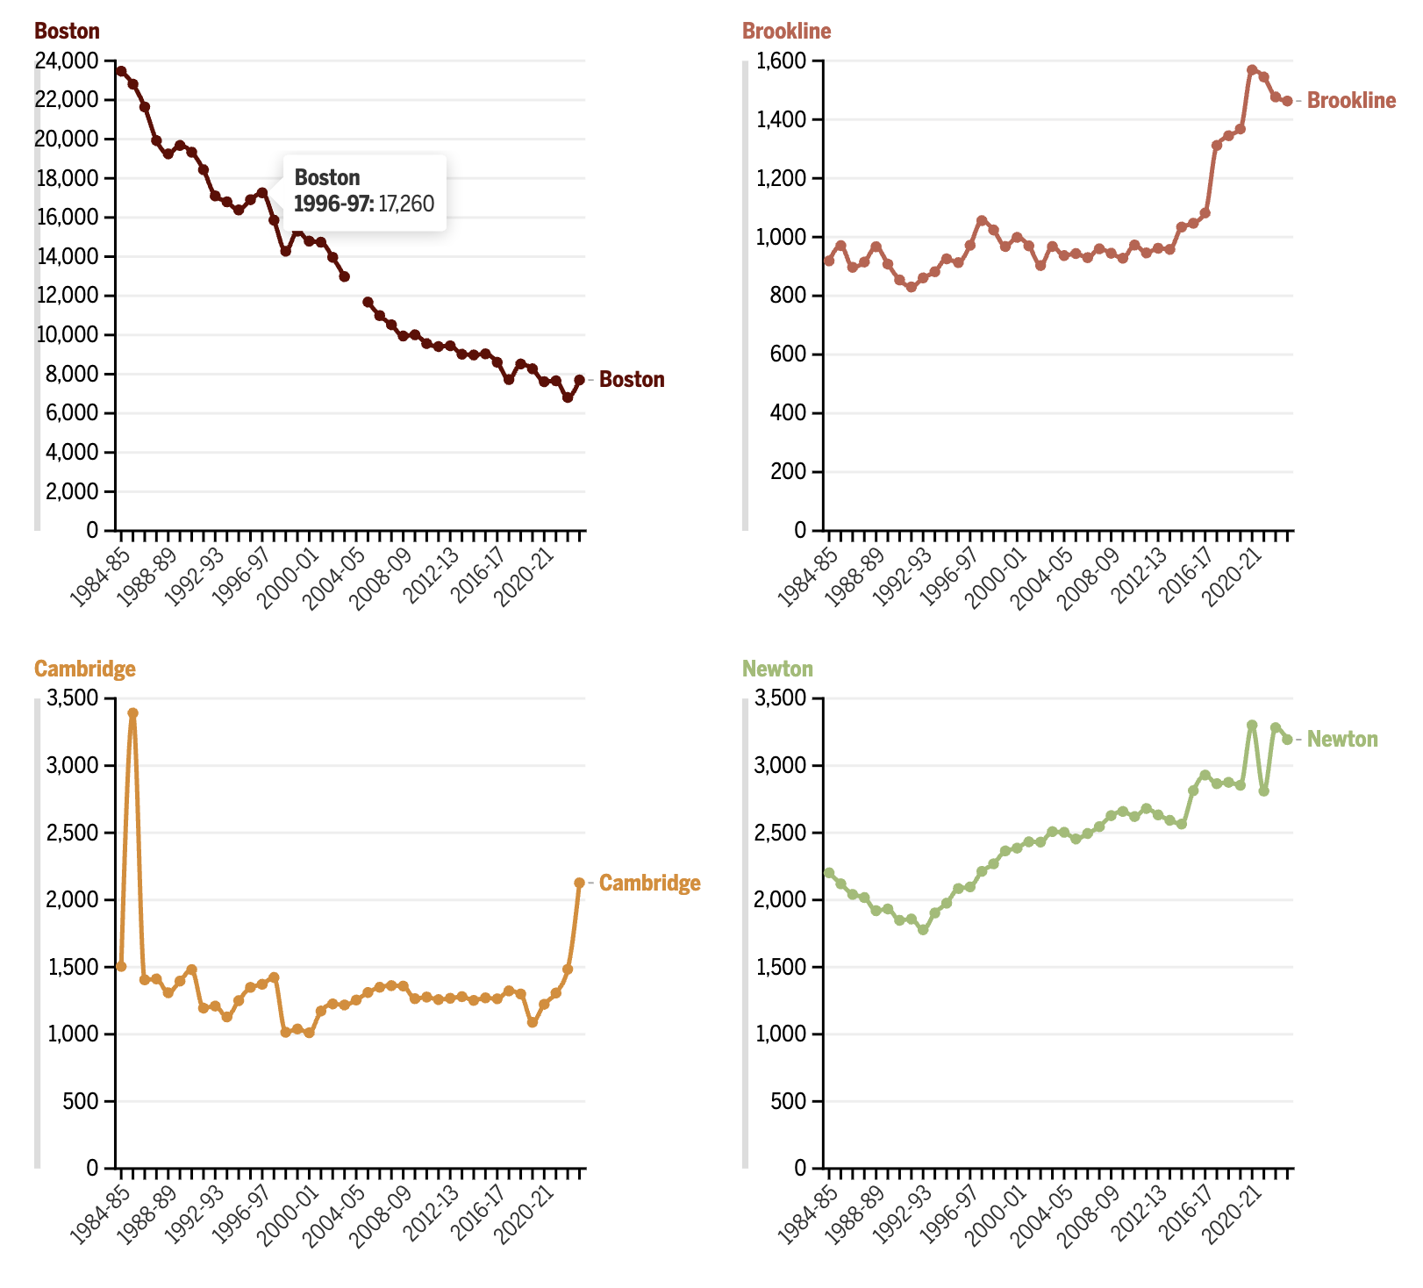
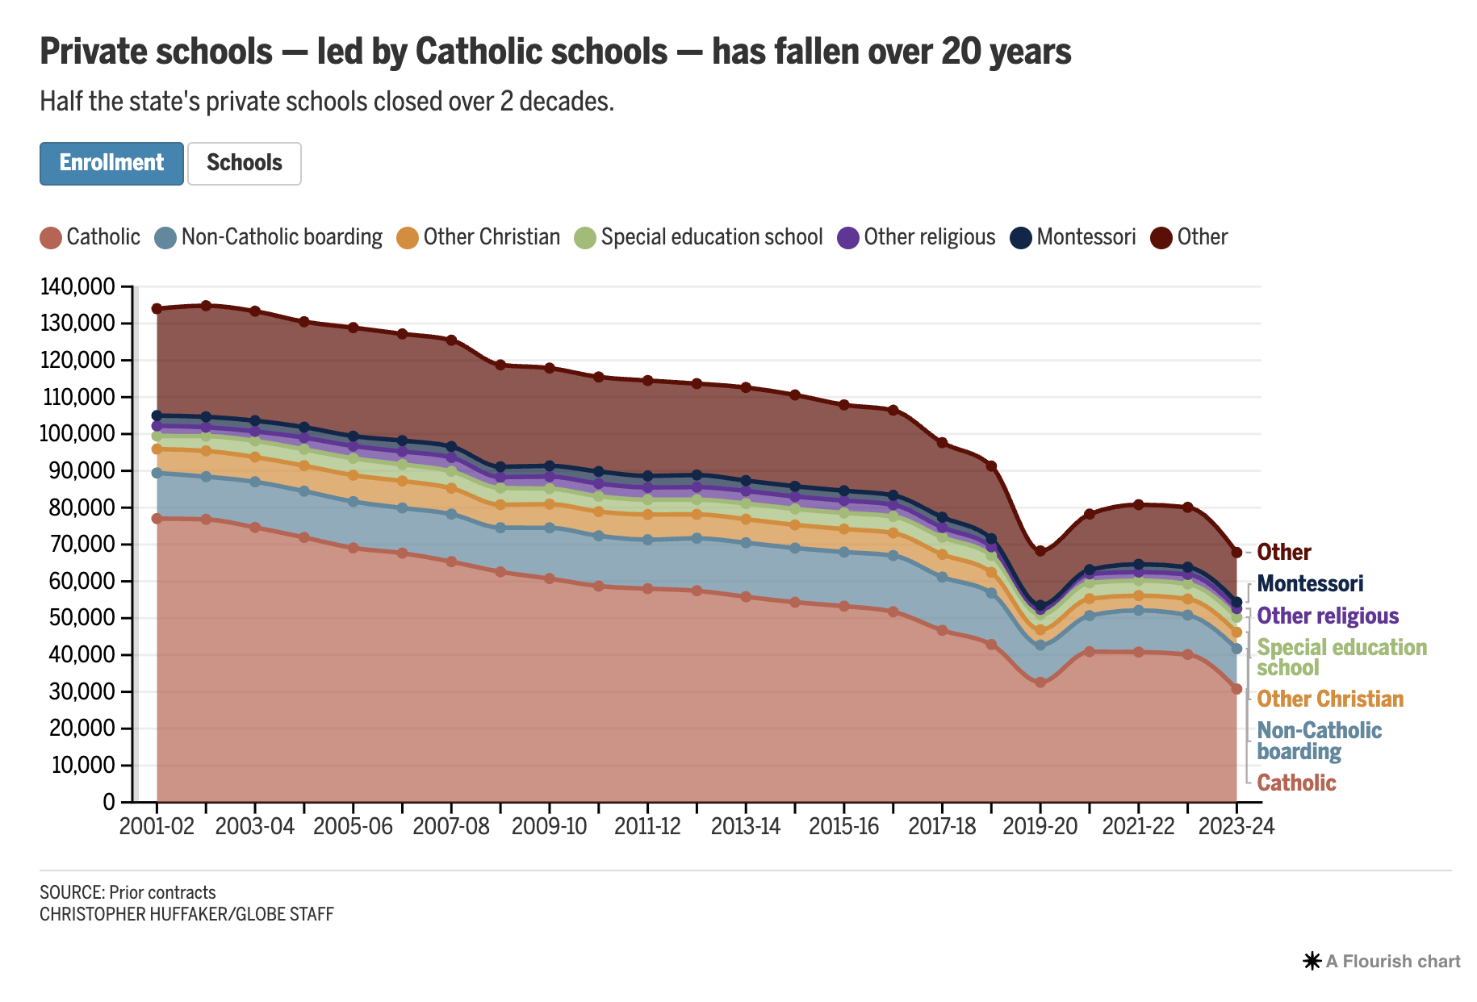

Slide 4
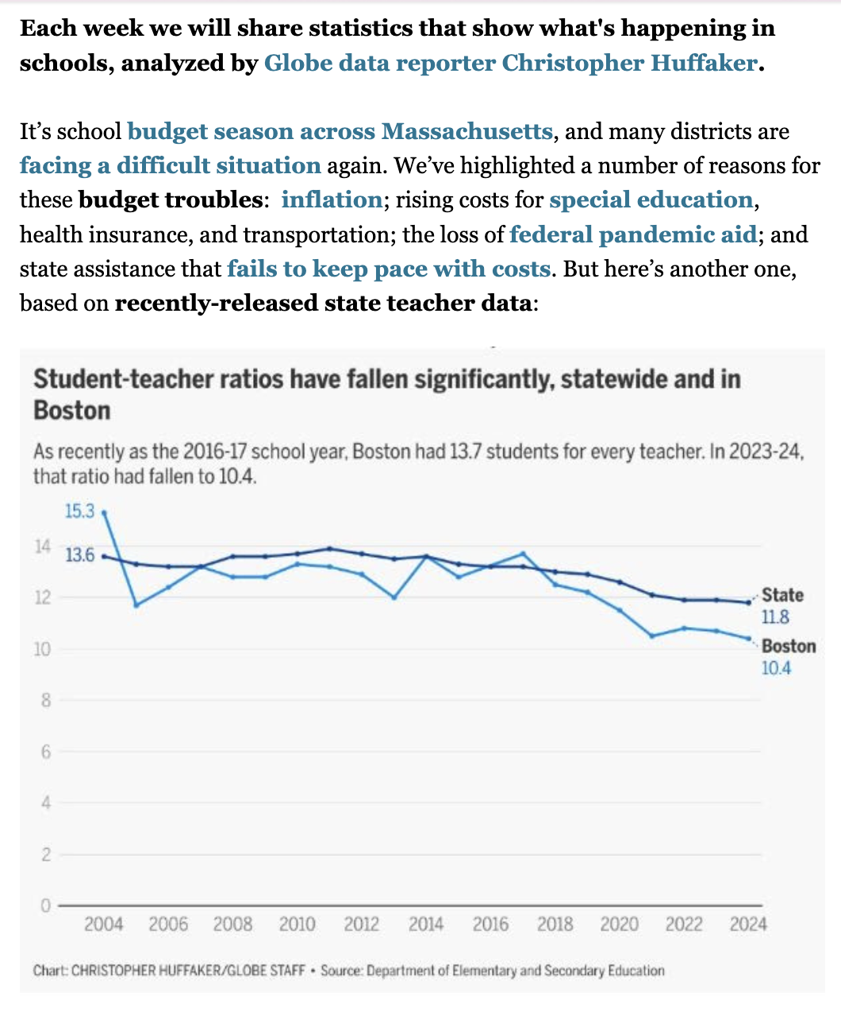
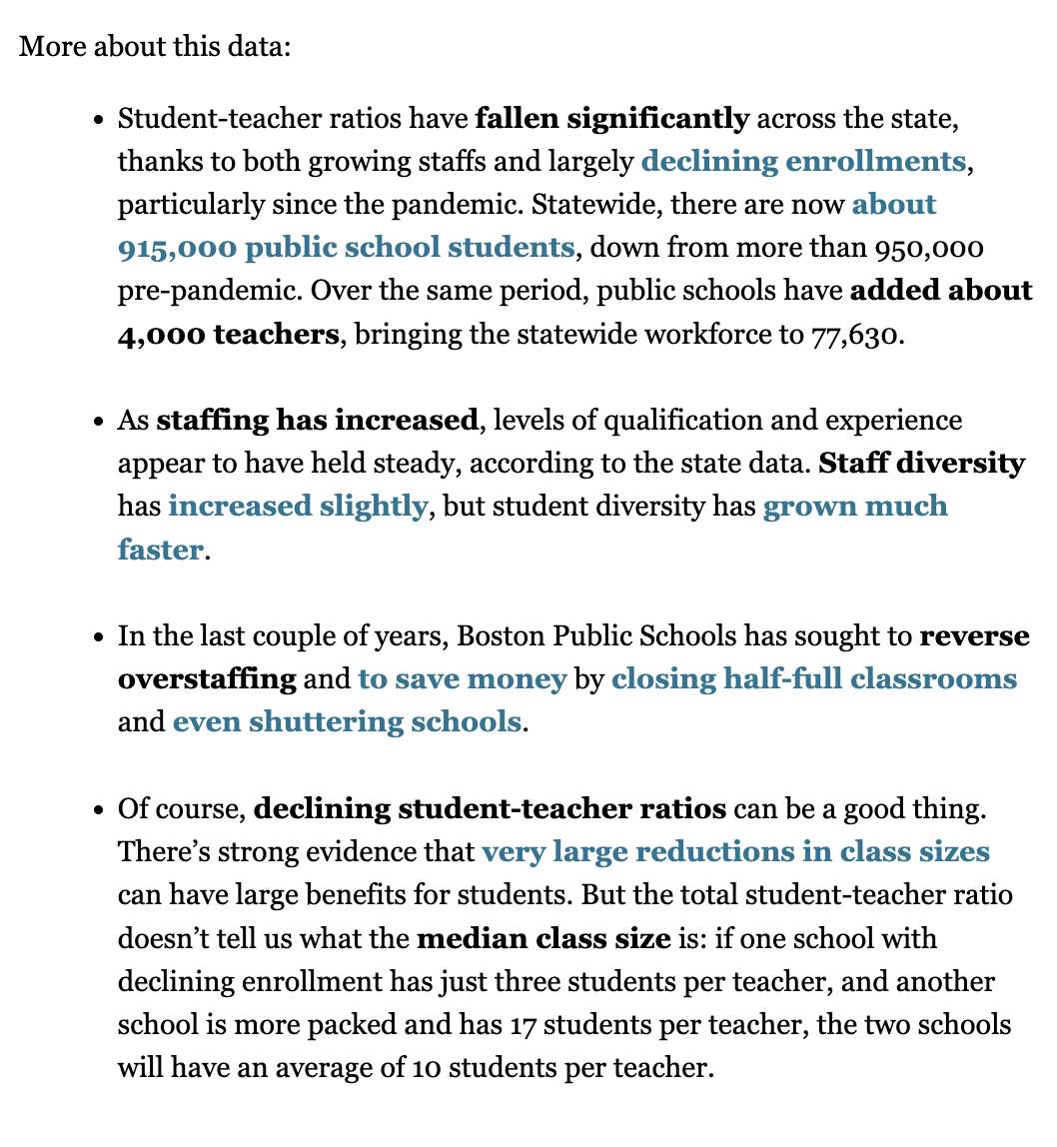

Slide 5
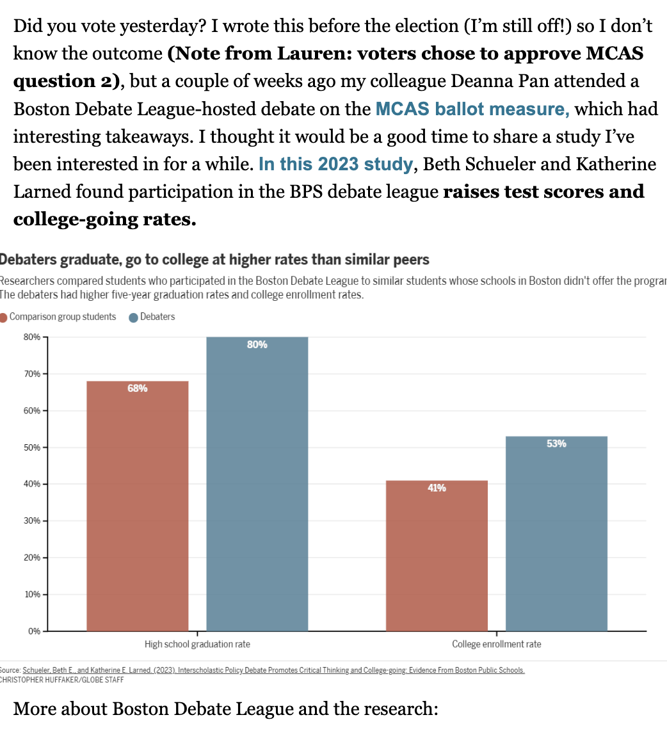
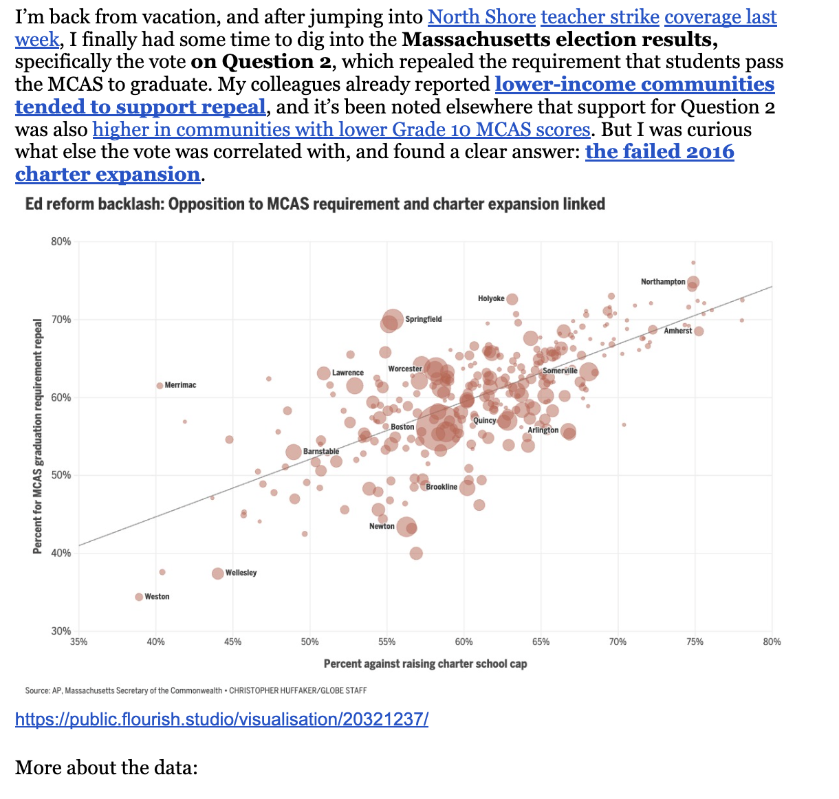

Slide 6
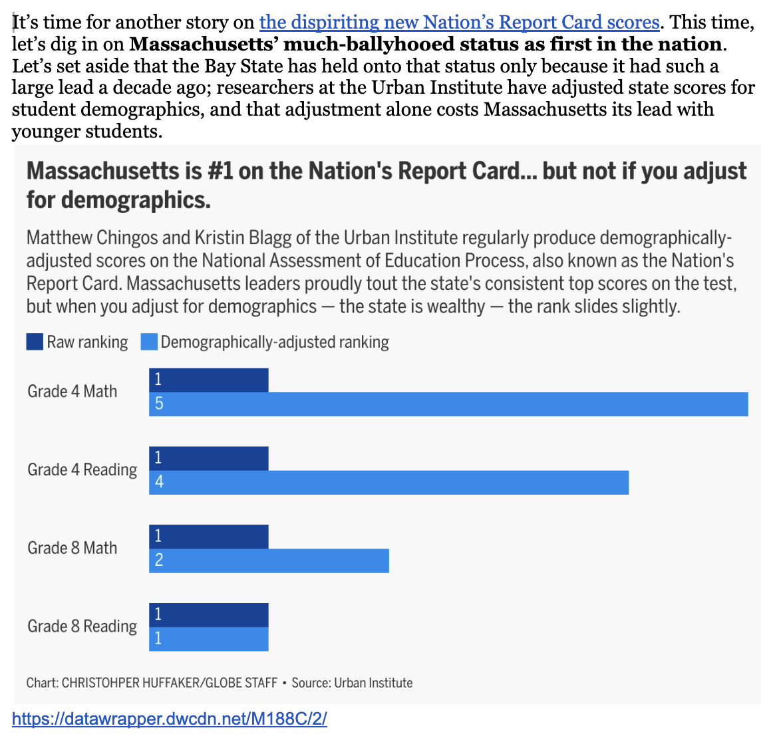
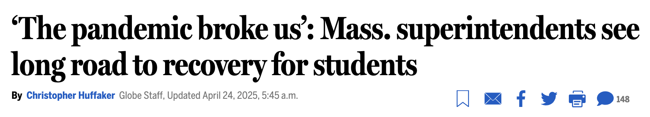
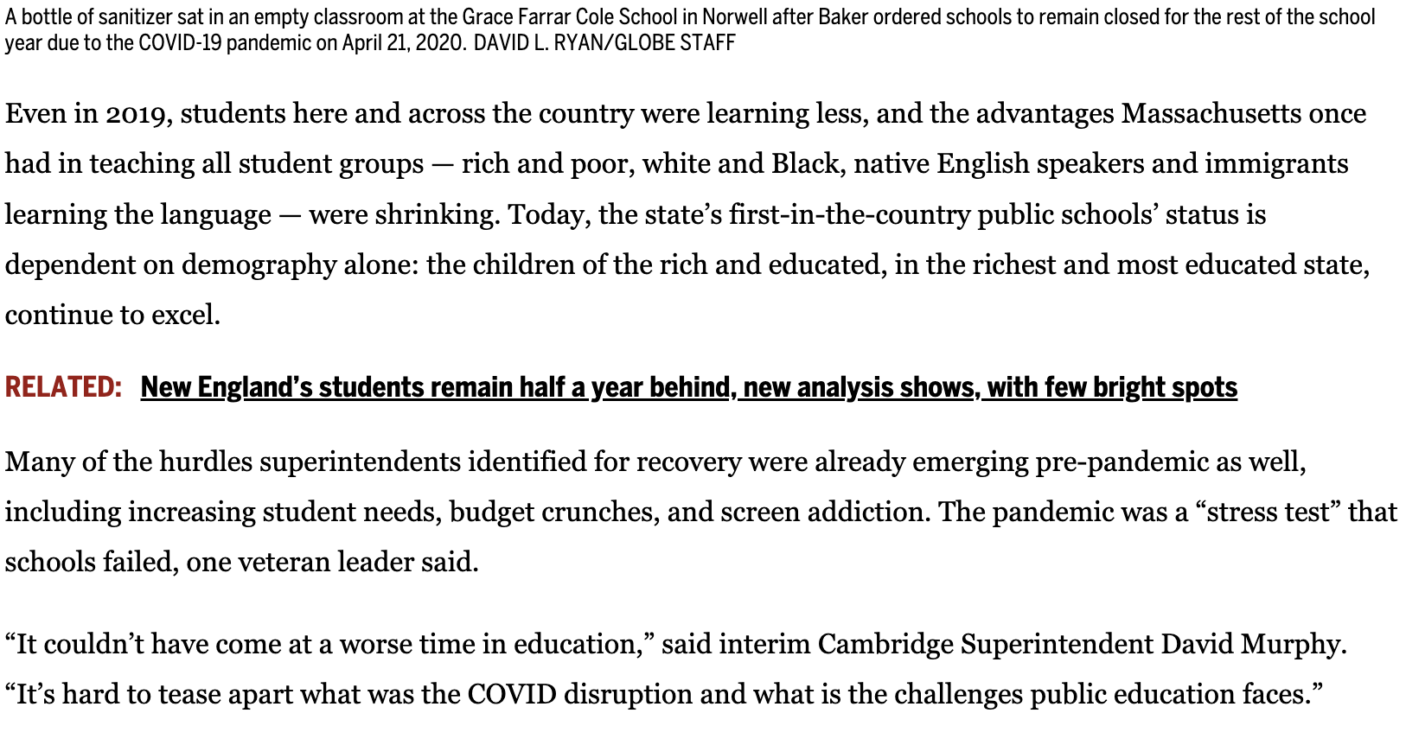
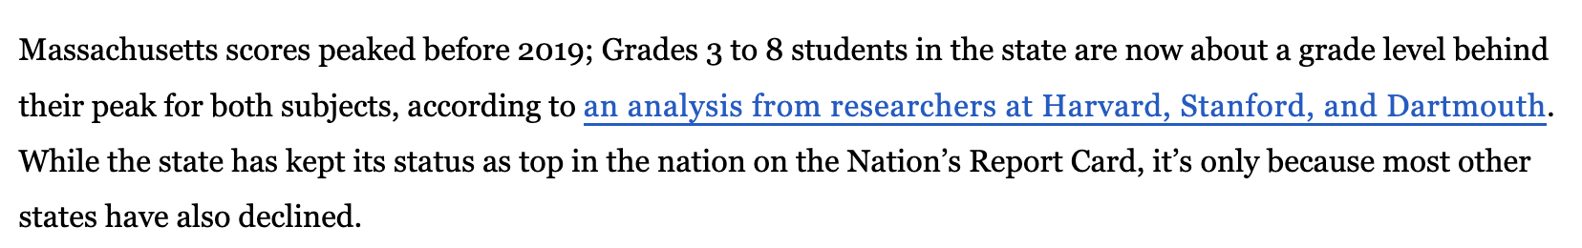
February 12
April 24
…

Slide 7

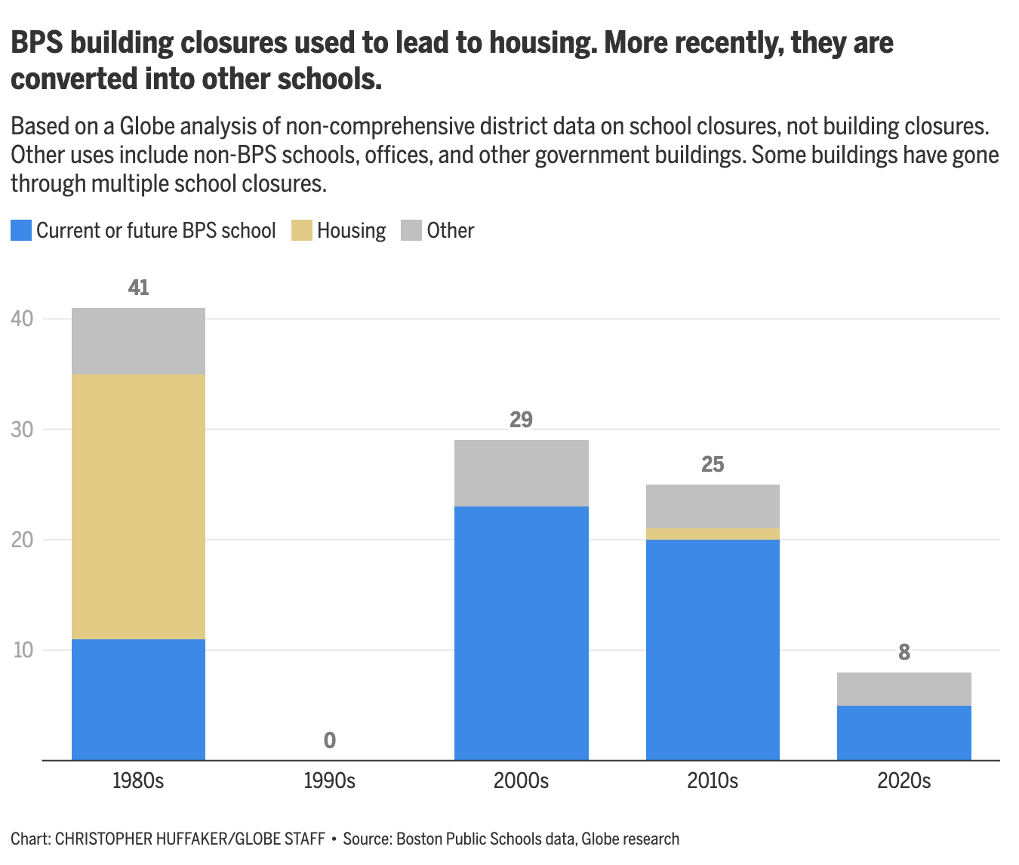
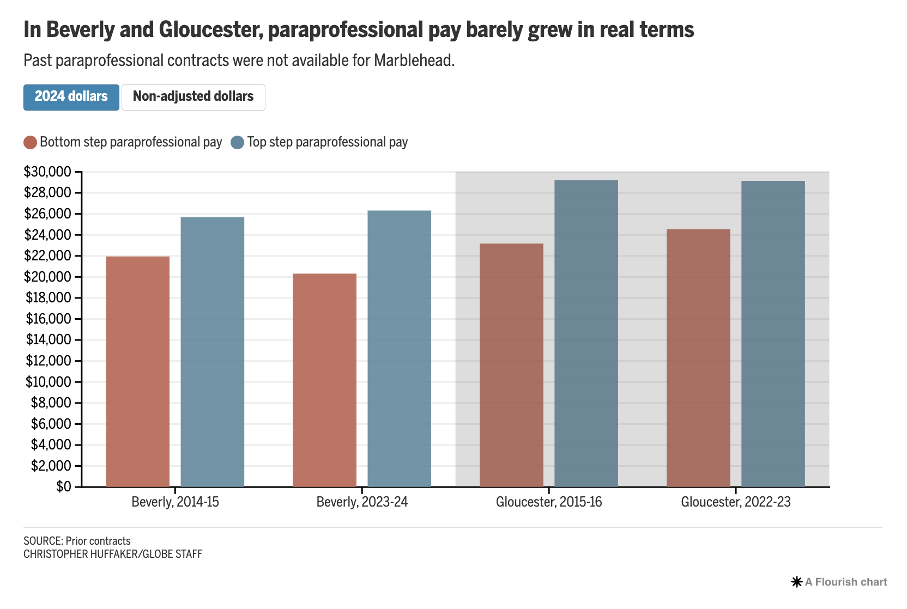

Slide 8
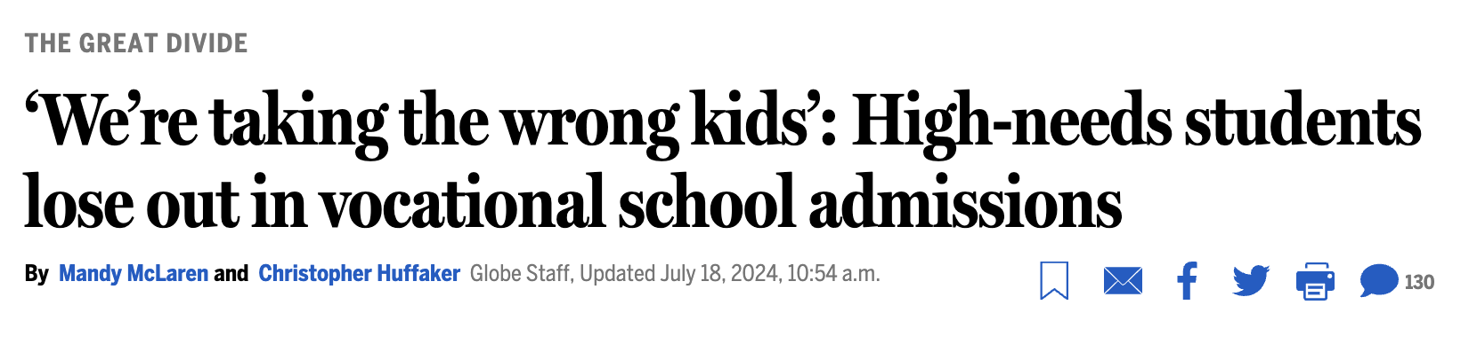

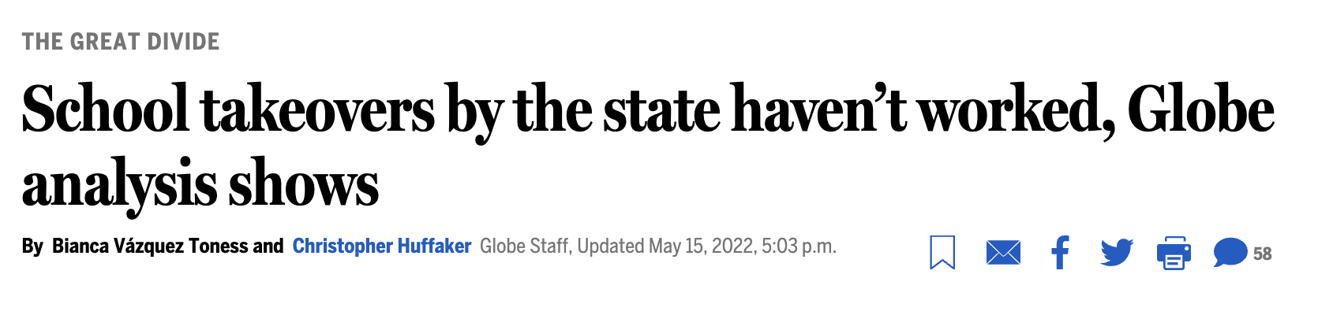

Slide 9
Technical stuff
Some tools I like
Python (Pandas mostly. Playwright for scraping.)
Csvkit
Google sheets (you really can do most things with a pivot table)
Tabula
OpenRefine
Flourish -> Datawrapper
Asking a newsroom developer for something more complicated
Some resources I like
NCES (pray for it)
My state’s education department website
EdWorkingPapers
NBER digest
FRED
Reading other, better, education reporters who are interested in similar things
EWA!

