Slide 1

Intro to using data in your reporting
Francisco Vara-Orta
IRE/NICAR

Slide 2
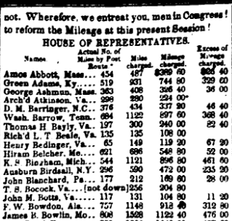
Computer-assisted reporting without computers
The New York Tribune was using data to investigate mileage reimbursements for Congress… in 1848!

Slide 3
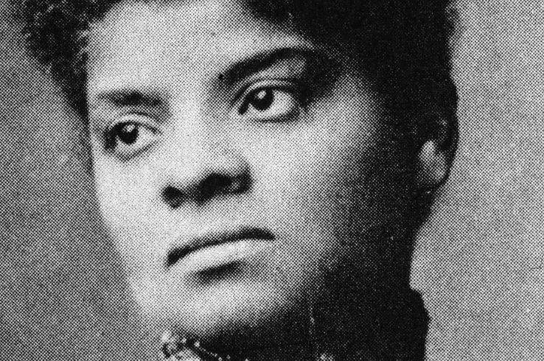
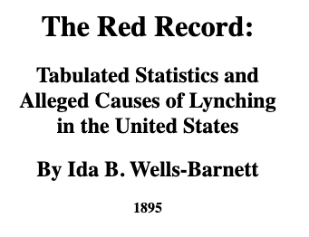
1895: Ida B. Wells
A data journalist long before given credit by industry
Won a Pulitzer Prize in 2020
posthumously
National investigative journalism association now named after her

Slide 4

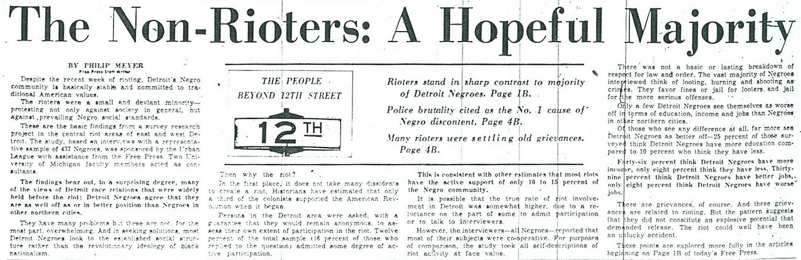

Roots of data journalism
1967 Detroit riots
1973 book

Slide 5
History of NICAR
1989: The Missouri School of Journalism established the Missouri Institute for Computer-Assisted Reporting (MICAR)
1993: Investigative Reporters and Editors, also based at the school, took over operations of MICAR. It was renamed the National Institute for Computer-Assisted Reporting. First NICAR conference is held in Raleigh.

Slide 6

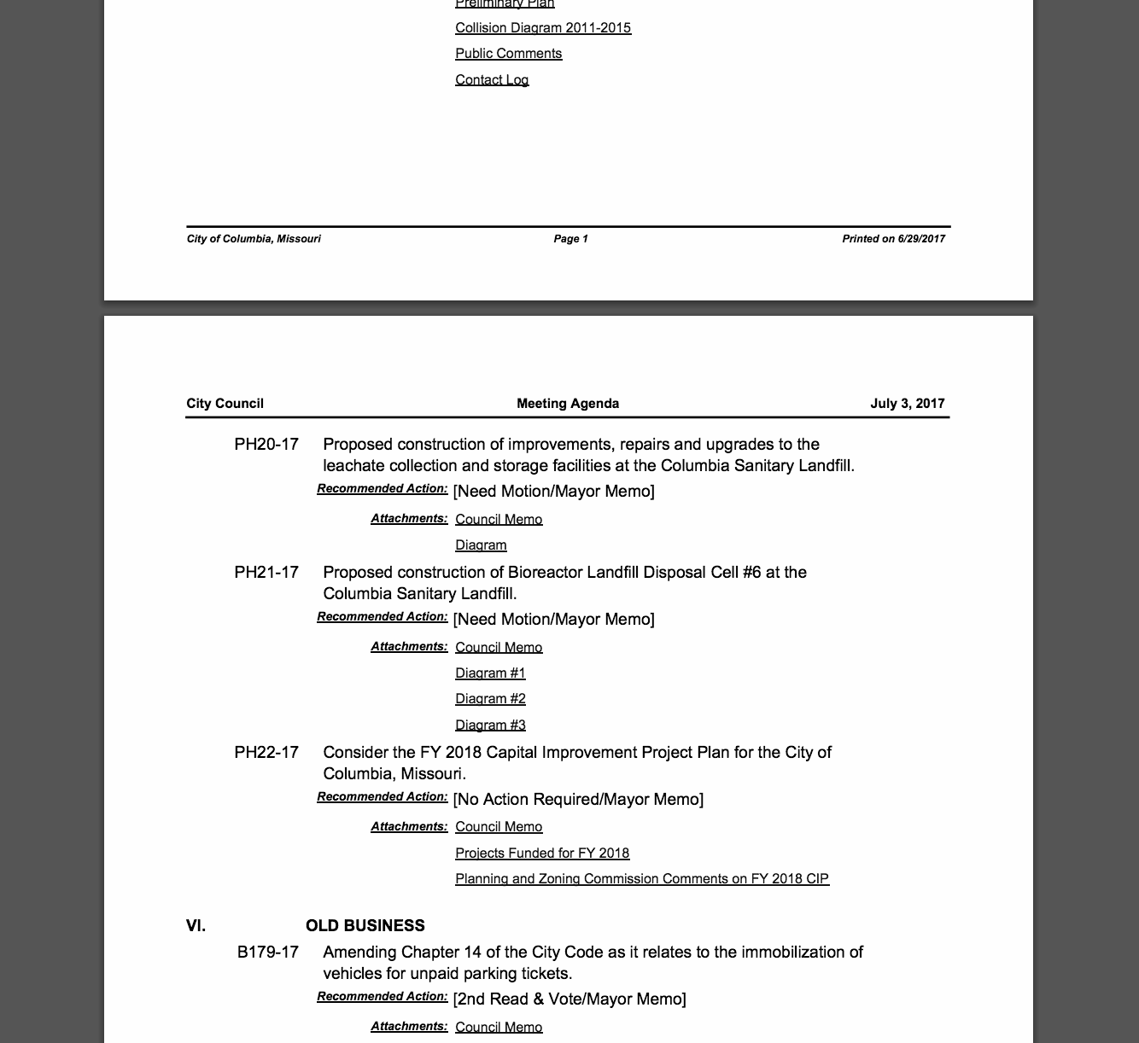

Traditional reporting toolbox
Interviews
Documents
Observations

Slide 7
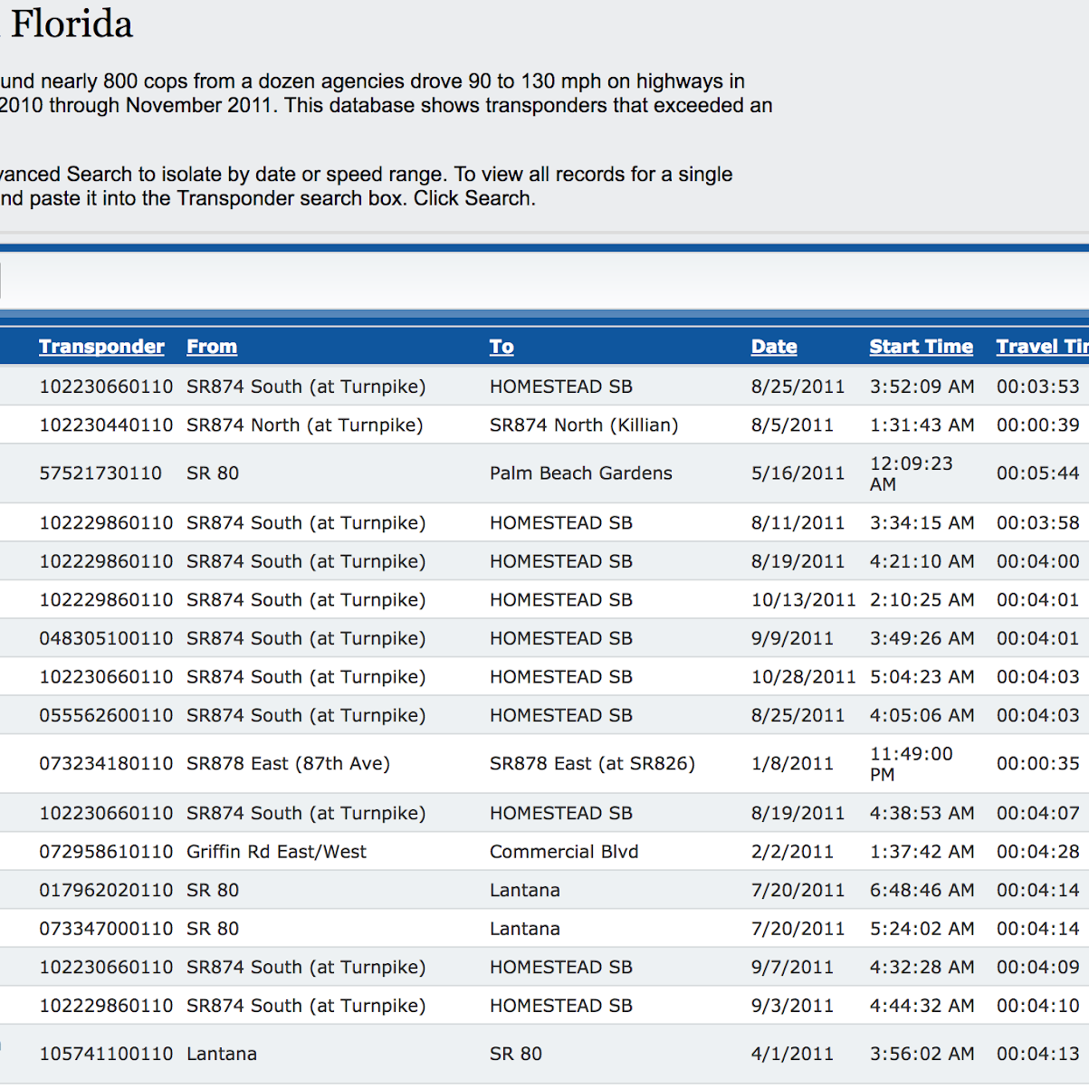
Computer-assisted reporting toolbox
Interviews
Documents
Observations
Data
Notes:
"Now, I looked out there and saw a bunch of snow -- National Weather Service data can tell you that it was the most snow that fell in one day in Allentown"

Slide 8
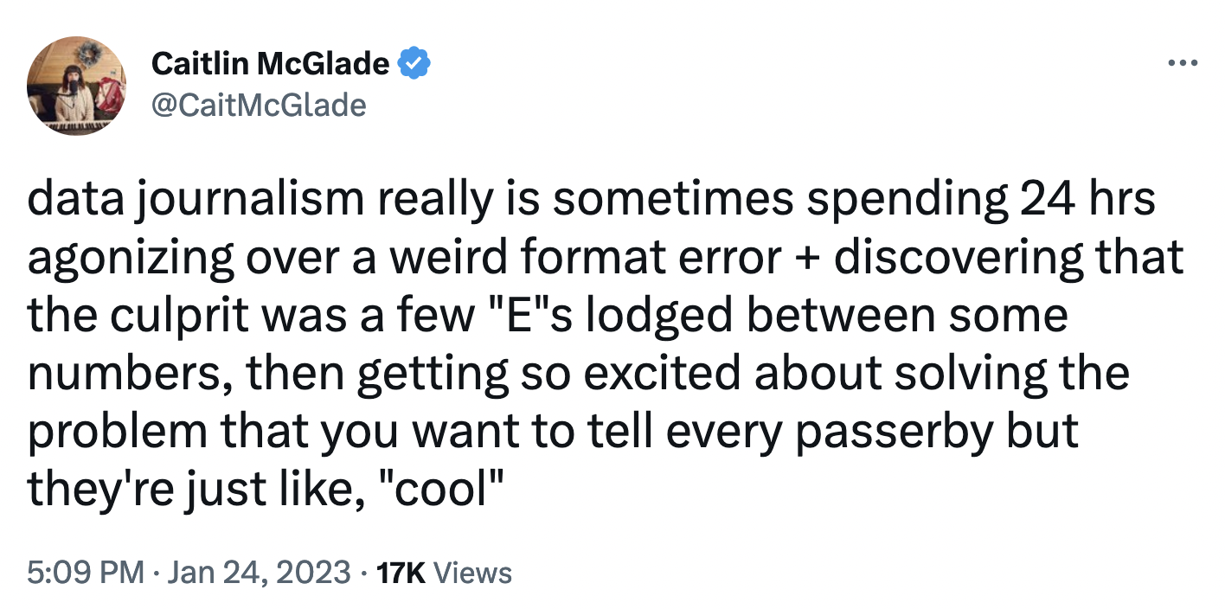

Slide 9
Thinking of the next day story after breaking news

Slide 10

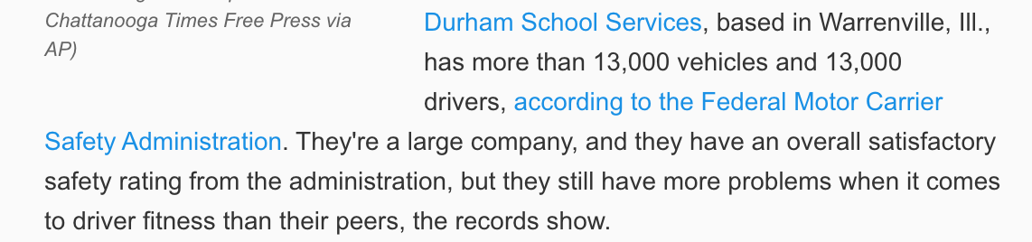
Notes:
Just one day after a bus crash that killed five children, The Tennessean in Nashville used data to examine a bus company’s safety records.
Using data from the Federal Motor Carrier Safety Administration, the newspaper discovered 300+ accidents, 142 resulting in injuries.

Slide 11



Documents = data

Slide 12
Data: Not a silver bullet!
A dataset is a source like any other -- you need to understand where it’s coming from, its limitations, etc.
Analyzing data can help you answer the what questions, not always the why questions
Doesn’t replace notebook- and telephone-assisted reporting

Slide 13
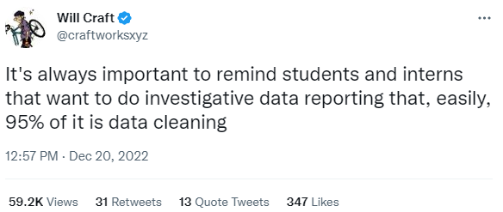

Slide 14
Key concepts before you
get started analyzing

Slide 15
What is unstructured data?

Slide 16
Structured vs. unstructured data
Unstructured: “The city of Spearfish, South Dakota, U.S., has 11,547 people. In Toronto, Ontario, Canada, the population is about 2.7 million. In Sydney, New South Wales, Australia, more than 5.3 million people live there.”

Slide 17
What is structured data?

Slide 18
Structured vs. unstructured data
Unstructured: “The city of Spearfish, South Dakota, U.S., has 11,547 people. In Toronto, Ontario, Canada, the population is about 2.7 million. In Sydney, New South Wales, Australia, more than 5.3 million people live there.”
Structured:
City | State | Country | Population
Spearfish | SD | USA | 11547
Toronto | ON | CAN | 2731571
Sydney | NSW | AUS | 5312163

Slide 19
Data concepts
Sorting: Arranging records from largest to smallest, A-Z, etc.
Filtering: Zooming in to look at a subset of your records
Cleaning: Standardizing text values, fixing typos, reshaping data to make it easier to use

Slide 20
Data concepts
Grouping and aggregating: Putting your records into groups based and comparing some value among the groups
Visualization: Creating charts, maps and other visualizations to spot patterns or tell stories

Slide 21





Example of grouping

Slide 22
chocolate no chocolate

Slide 23
Fruit flavored no fruit

Slide 24
Presenting your findings

Slide 25
Presenting your findings
Write how people talk, not how computers talk
🚫 “The population increased by 32.8374 percent.”
✅ “The population grew by about one-third.”
TIP: If you feel the urge to push up your glasses after reading your sentence aloud, you might need a rewrite. 🤓

Slide 26
Avoid false precision
It’s a rare that you need to report numbers out to the nth decimal place.
Use language that fairly characterizes your general level of certainty about your findings:
“At least” / “As many as”
“More than” / “Less than”
“We were able to identify …”
Notes:
Example: Running an enterprise join to find the overlap between campaign donors and people who got property tax breaks.

Slide 27
Presenting your findings
Don’t make a big deal out of small changes, or of small populations.
Don’t lard your copy with numbers -- be judicious and let tables, graphics, etc. do the heavy lifting

Slide 28
Presenting your findings
Don’t make your audience do math in their heads
Relate the numbers to what is relevant in people’s lives, such as how much more the typical reader would pay when taxes are increased
Use commonly understood units to make numbers more understandable: “Forty cents of every dollar given to the campaign was spent on Facebook ads.”

Slide 29

Put your numbers in context

Slide 30
Tools of the Trade
(How do you start the CAR?)

Slide 31
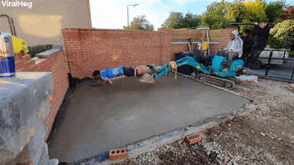
The spreadsheet is the best building block for data journalists

Slide 32
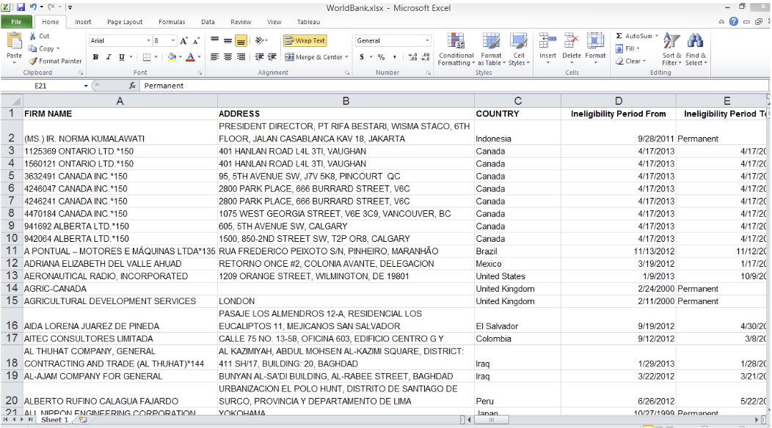
Spreadsheets
Notes:
This may be the underpinning of all data journalism.

Slide 33
The tools you can use
Microsoft Excel $$$
Microsoft Access $$$
Google Sheets
Tableau Public
$$$ indicates a cost is involved.

Slide 34
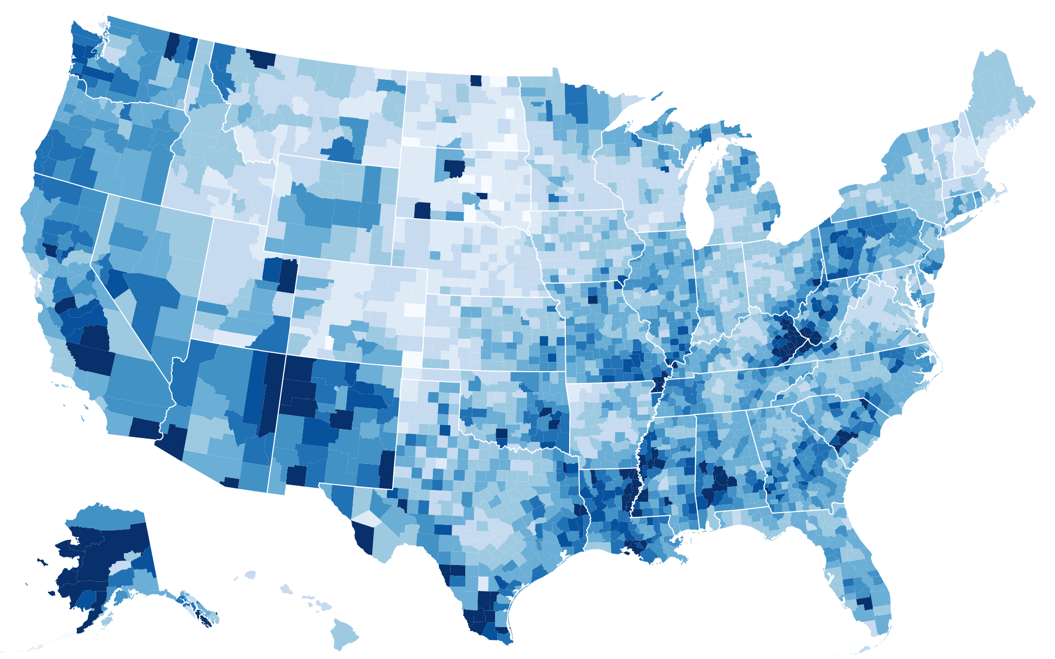
Maps & Data Visualization

Slide 35
The tools you can use
Quantum GIS
ArcGIS $$$
Tableau
Datawrapper
Flourish
Carto
Tableau, Datawrapper, Flourish and Carto are great for displaying data. QGIS and ArcGIS are geographic information system software.

Slide 36
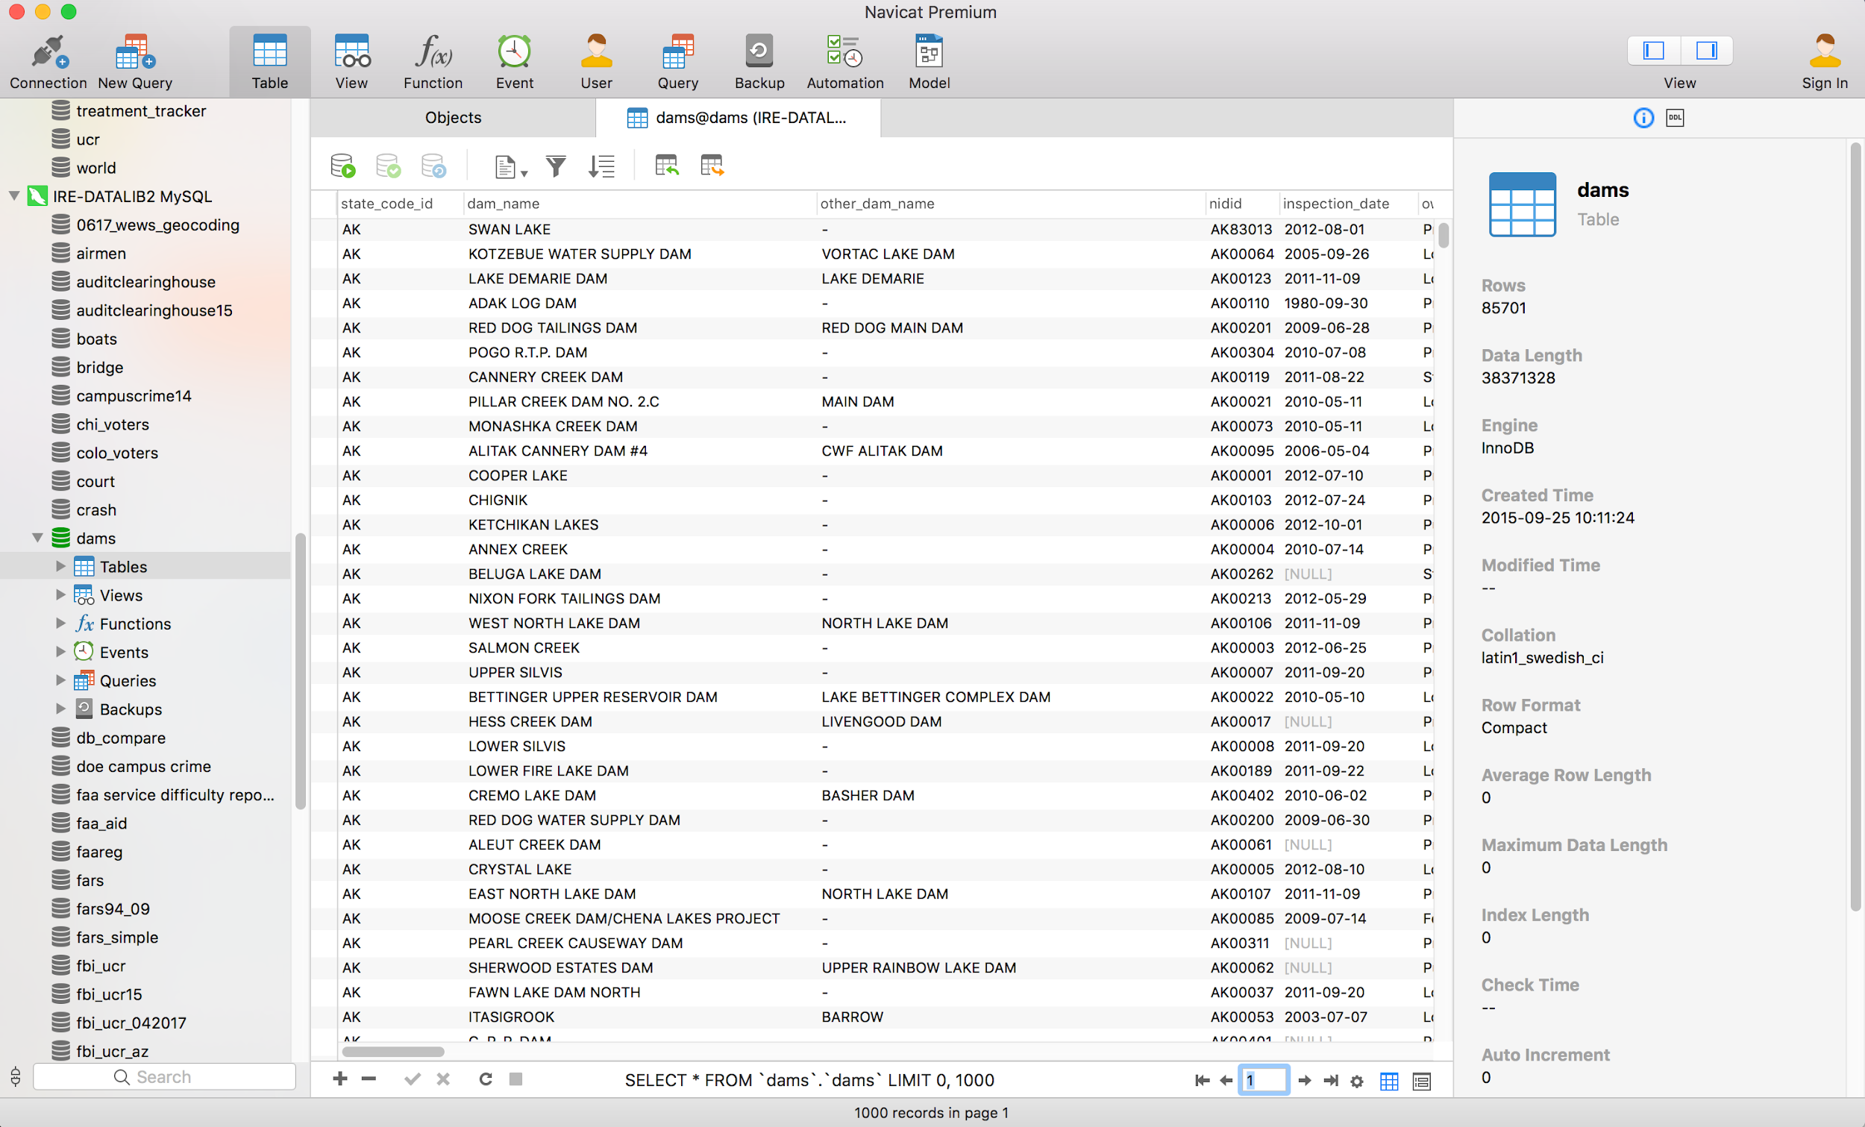
Database Manager

Slide 37
The tools you can use
Microsoft Access $$$
MySQL
SQLite
PostgreSQL
Some popular interfaces for MySQL, SQLite, PostgreSQL
SQLyog
SQLite Manager
Navicat $$$

Slide 38
Intermediate: Database Manager
Useful when:
You have relational data -- a group of data sets intended to go together
You are doing an enterprise join to examine the overlap between two seemingly unrelated data sets (“Are there any sex offenders on the school district’s employee roster?”)
You have more data than can fit in a spreadsheet

Slide 39
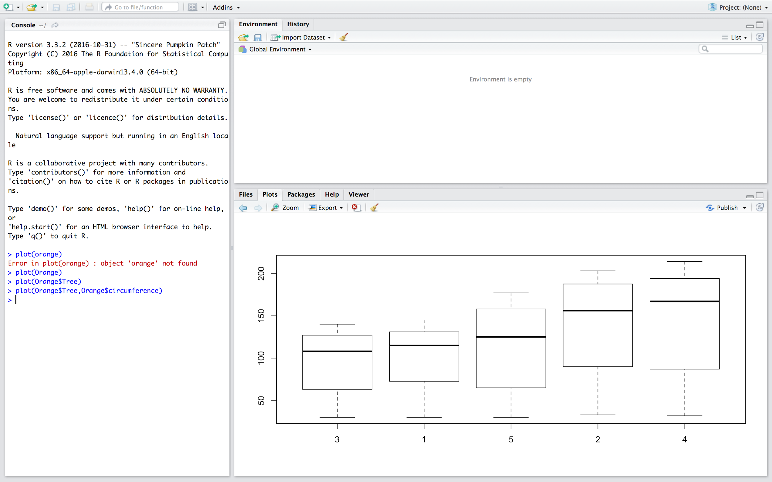
Statistical Software

Slide 40
Advanced: Stats and coding
Useful when:
You need to run complicated statistical tests to answer your journalism question
You have a newsroom problem that only coding can solve (e.g. scraping a complex website)
You want to build a highly customized data visualization

Slide 41
The tools you can use
RStudio
SPSS $$$
SAS $$$
Microsoft Access $$$

Slide 42
Data visualization does not have to be complex

Slide 43
Software for building data viz
Tableau
Datawrapper
Flourish
D3.js
Highcharts
ChartistJS

Slide 44
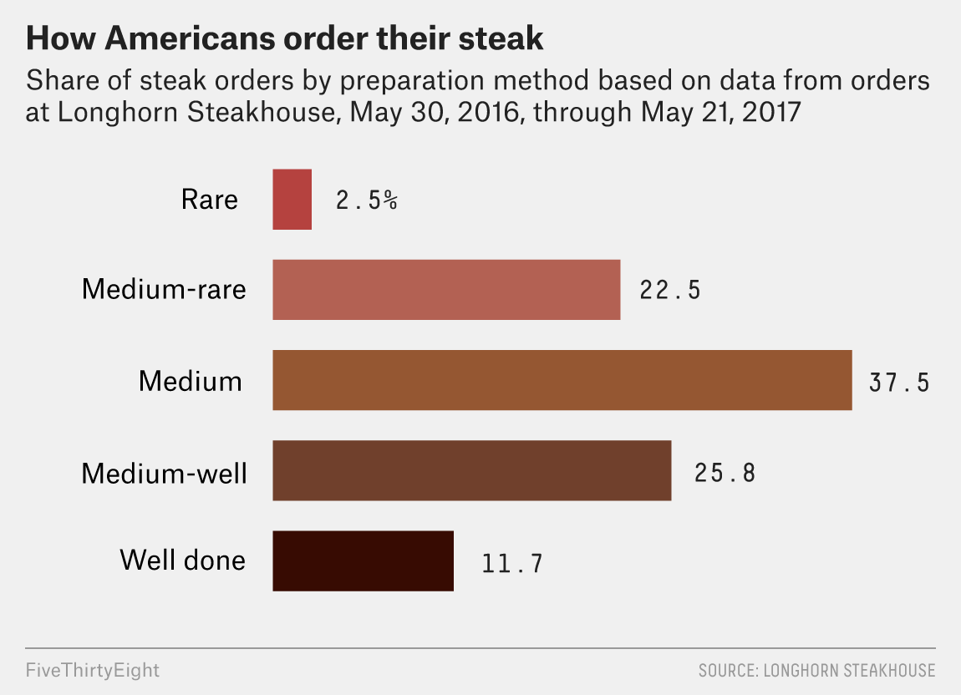
Bar charts
Great for showing simple counts and percentages.

Slide 45
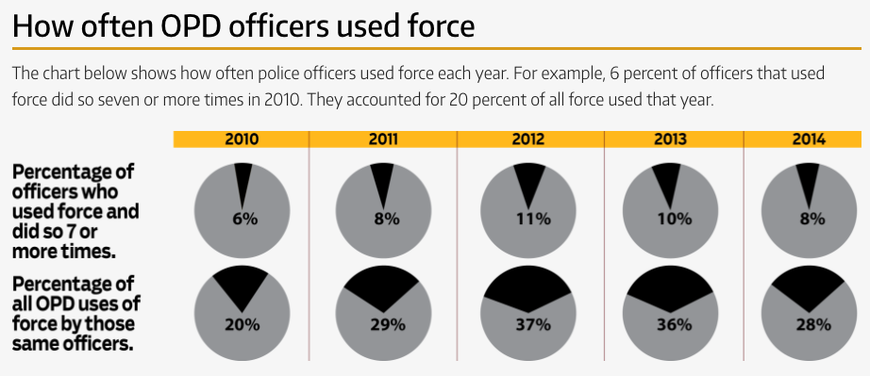
Pie charts
Better for showing percentages rather than counts only.

Slide 46
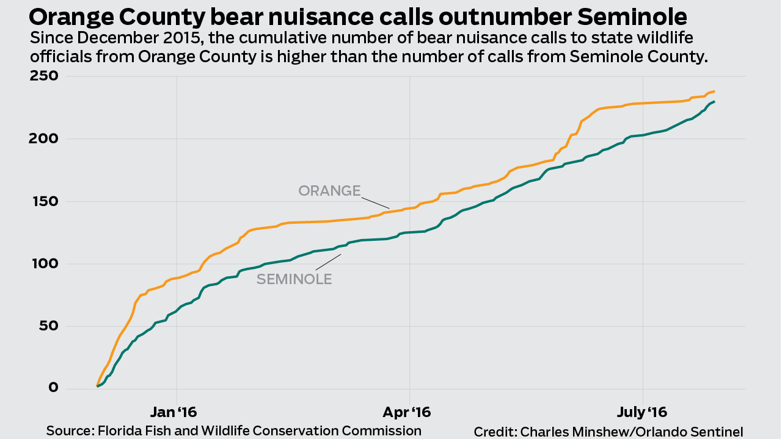
Line charts
These are great for showing data over time.

Slide 47
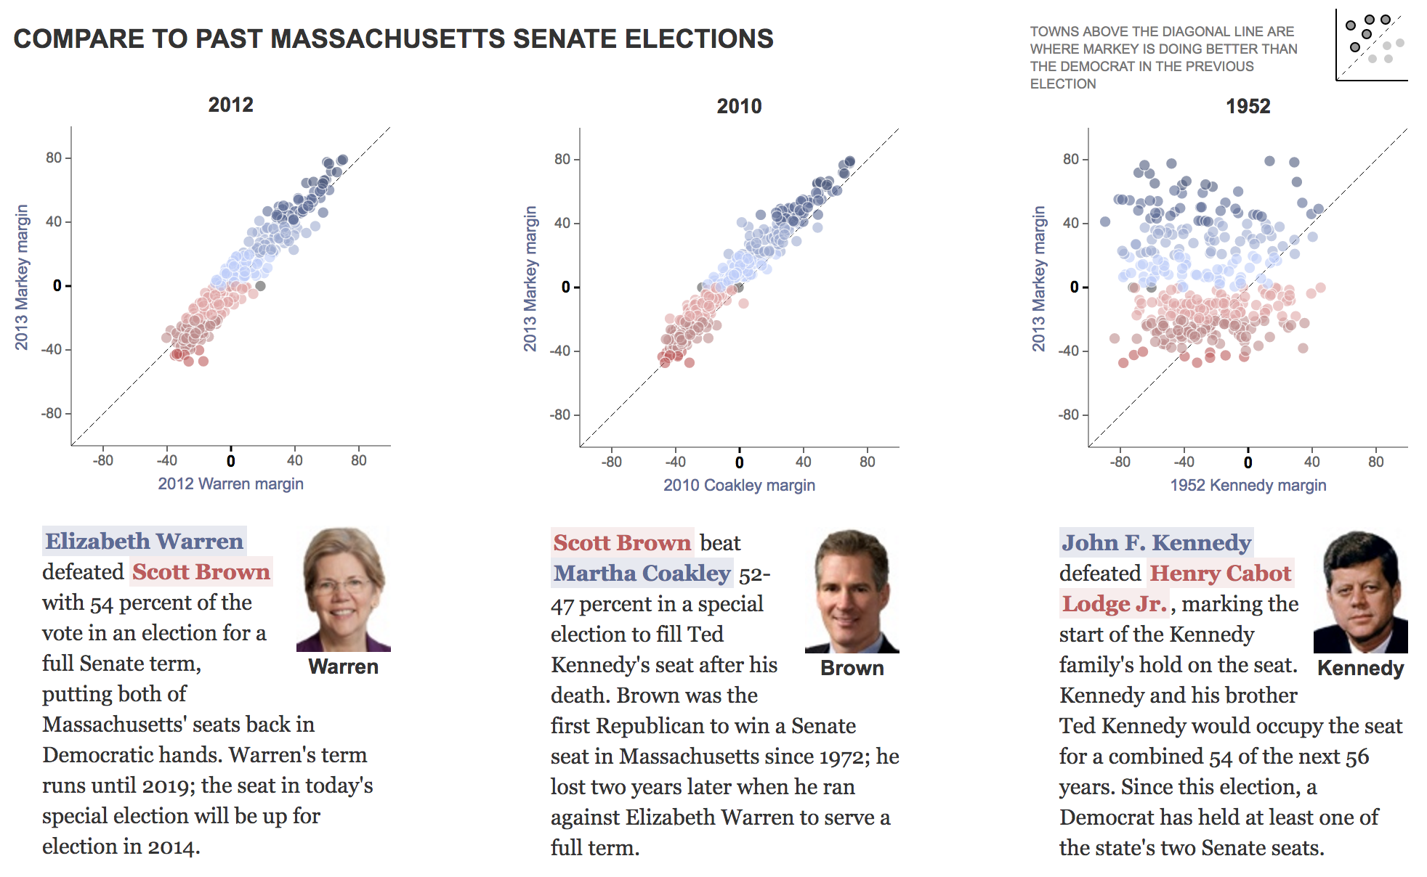
Scatter plots
Notes:
Scatter plots are great for showing relationships between two different variables. In this case, showing margin of victory in 2013 Massachusetts US Senate election to previous senate elections. In this case, the two variables help show a performance value.

Slide 48
Keep it simple!
Less is more.

Slide 49
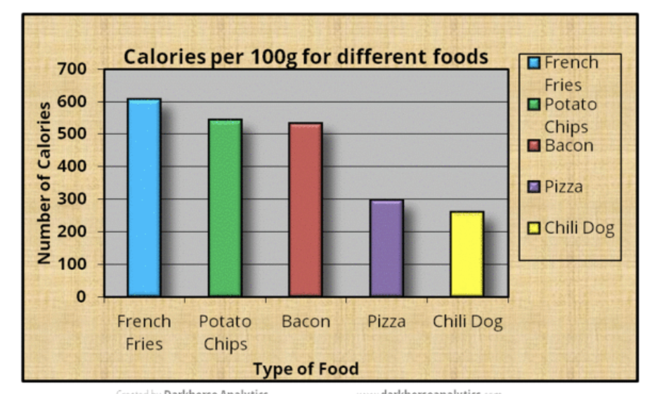
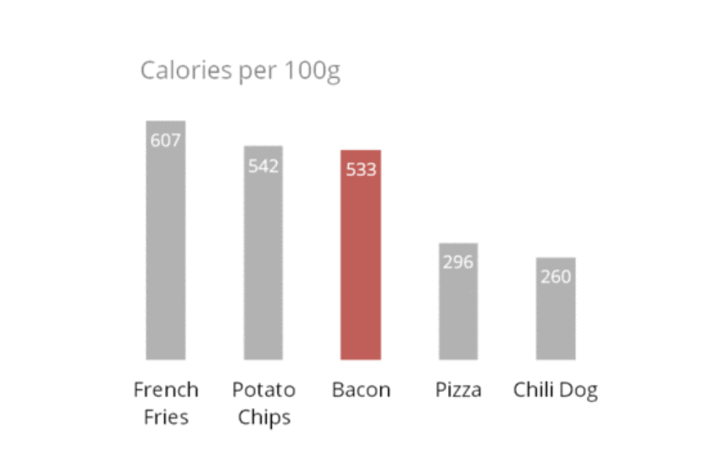
Before
After

Slide 50
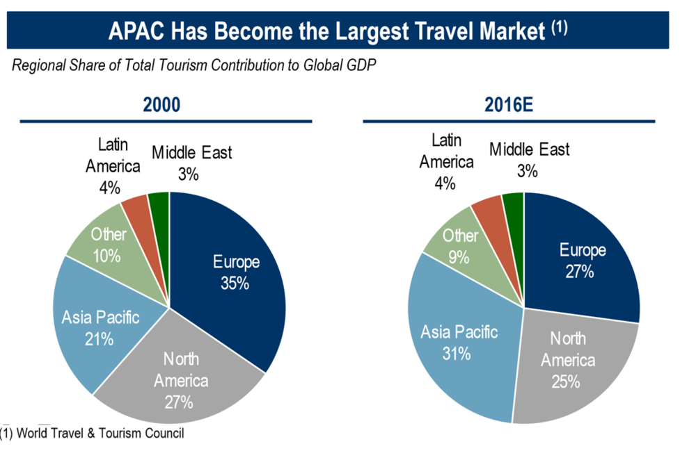
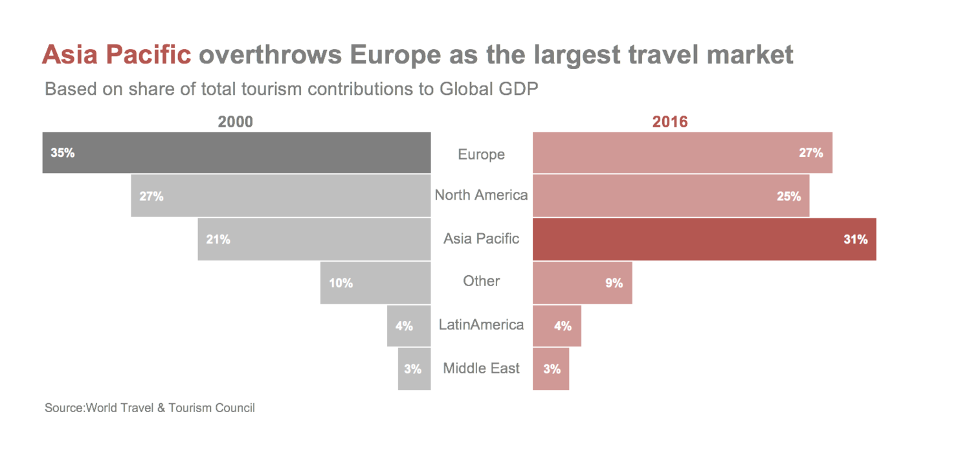
Before
After

Slide 51
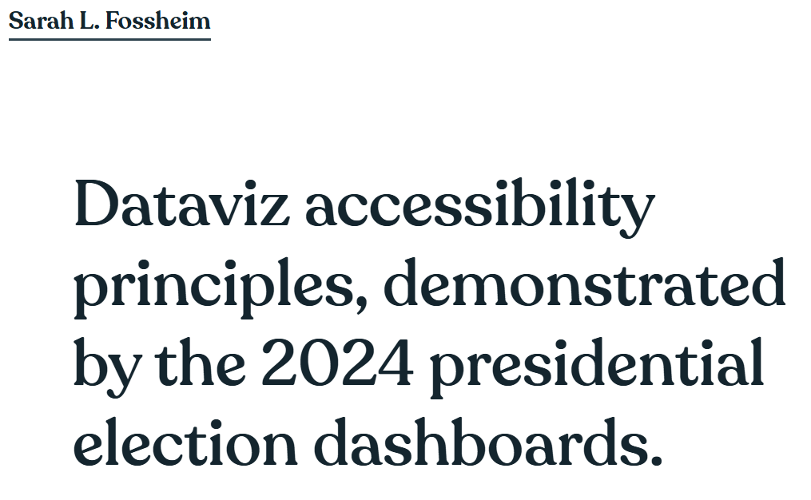
Making sure it’s accessible
“In 2020 I reviewed the dataviz accessibility of the US presidential election results (spoiler: it was bad), and in 2023 I did the same with the dashboards used for the Norwegian government elections. So naturally, I had to inspect the accessibility of this year's US election graphs as well.
Just like in 2020, I discovered quite a lot of accessibility issues for all of the dashboards. Most of these were the type of issues I frequently encounter when doing dataviz accessibility audits and reviews. For example: content that's not zoomable, interaction that's not available for keyboard users, insights that don't get communicated to screen reader users, lacking text alternatives, semantic errors, or missing explanations.”
A 2024 WebAIM study: 96% of tested home pages had accessibility issues, with an average of more than 56 errors per page.

Slide 52
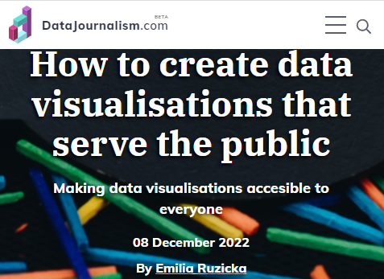
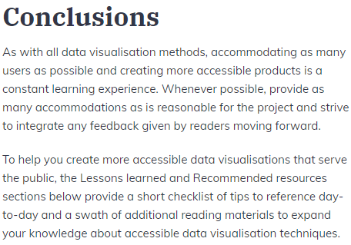

Slide 53

Join IRE
Member benefits include:
Thousands of tipsheets
  Including templates on
how I did the story
Exclusive databases
Newsletters with latest offerings
Member listservs
Fellowships & scholarships
IRE Journal subscription
Premium reporting tools
http://bit.ly/JoinIRE
Professionals/Academics: $75/year
Early Career: $50/year
Students: $25/year
(Student members can retain this rate 1 year after graduation!)

Slide 54
Get presentation here:
francisco@ire.org

