Slide 1













Investigating Special Education
Mandy McLaren

Slide 2
IDEA
01.
Prior Knowledge
FAPE
02.
Let’s check in!
40%
03.

Slide 3
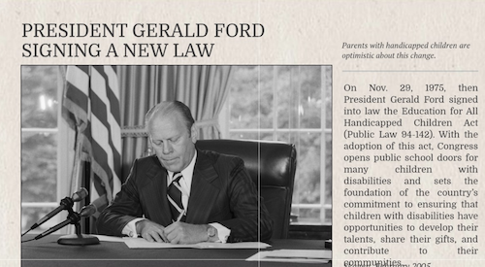
The Promise
Under the 1975 Education for All Handicapped Children Act (known today as the Individuals with Disabilities Education Act), public schools for the first time had a legally-binding duty to educate disabled children, providing instruction and therapies to meet their individual needs. Robust federal funding was promised.
If only Congress had followed through. Instead, it cheaped out.

Slide 4
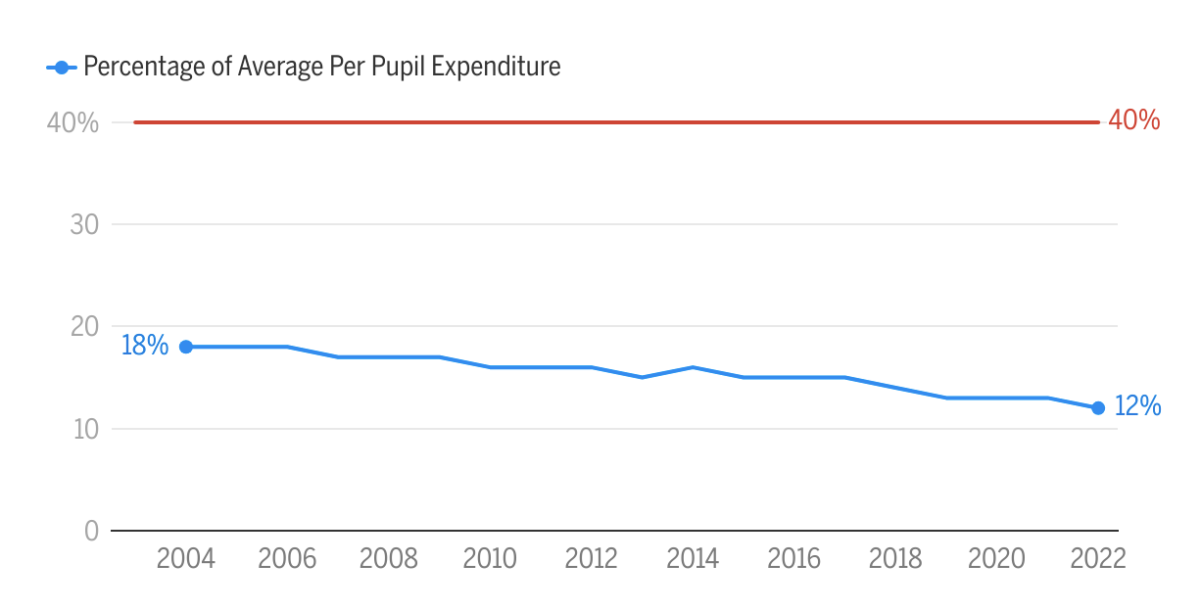
Reality...
Nearly every investigation you do into special education is affected by this!

Slide 5
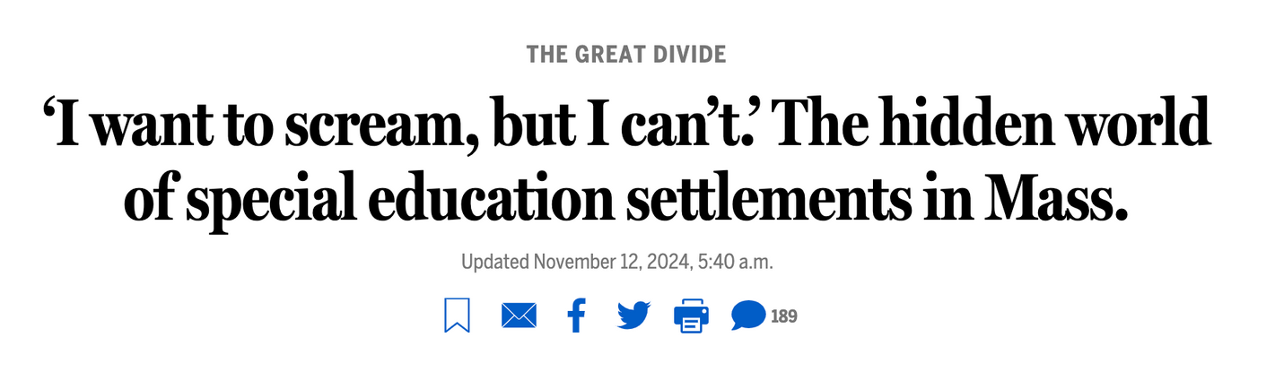
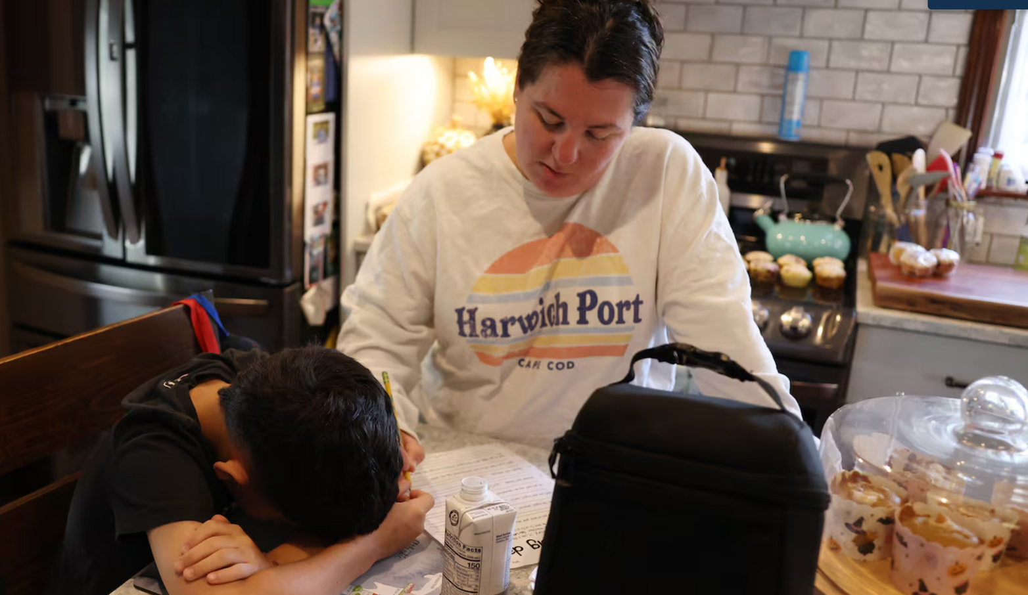

Slide 6
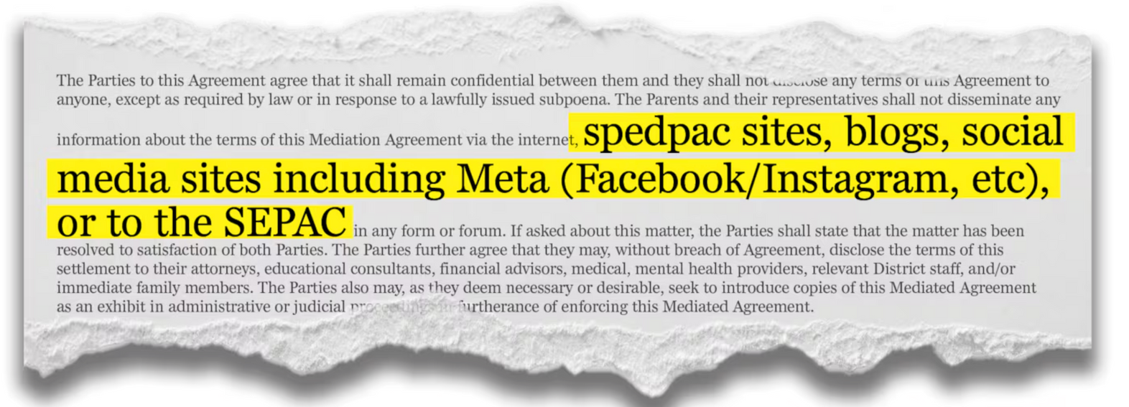
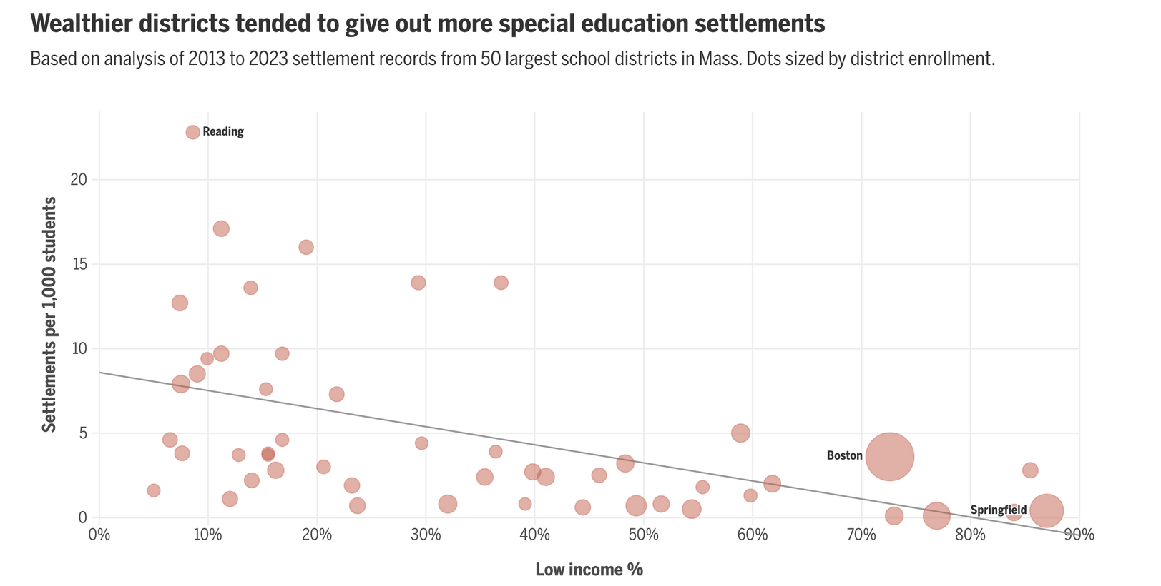

Slide 7
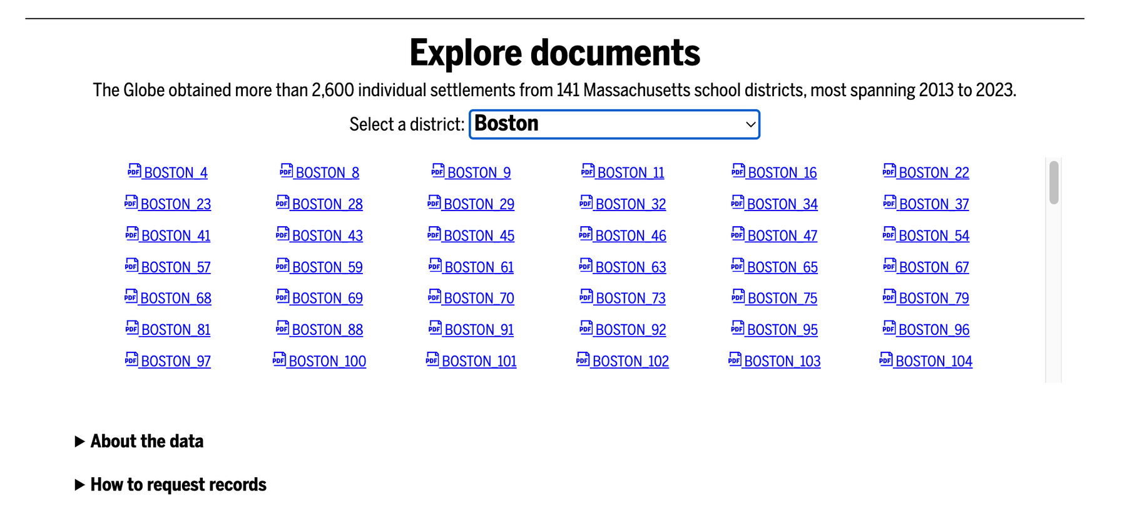


Slide 8


The promise unkept: How Congress failed America’s disabled students
LMK your email address if you want me to send you my next story :)

