Slide 1


EWA
Who Is (and Isn’t) Going to College: Using Data In Reporting
May 31st 2025
Nicole Smith
Nicole.Smith@georgetown.edu

Slide 2
Setting the national context
Demand
Over the past half century, postsecondary education has taken on an increasingly important role in career preparation in the United States, with profound effects on the life experiences of young adults.
Having a college credential has become both more valuable in the labor market and more expensive, with much of the burden falling directly on students and their families.
Postsecondary education and training beyond high school has become the sole arbiter of upward economic mobility in American. Our research shows that close to 72% of all jobs will require postsecondary education by 2031, up from 68% in 2021 and 32% in 1983.
Supply
A sharp drop in the number of high school graduates starting around 2025.
Triggered by the decline in birth rates following the 2008 financial crisis.
Impacts enrollment in postsecondary institutions, especially in the Northeast and Midwest.
Notes:
For one, the fastest growing industries require workers with disproportionately higher education levels compared to industries with slower growth. Furthermore, occupations as a whole are steadily requiring more education as tasks within occupations become more complex.

Slide 3
Key Drivers
2008 Recession → Fewer Births
Aging Population
Out-Migration from key regions
Competition from alternative education pathways
High school graduate numbers projected to decline from 2025 to 2037.
Greatest impacts expected in the Northeast and Midwest.
Some states may see increases due to demographic shifts.

Slide 4
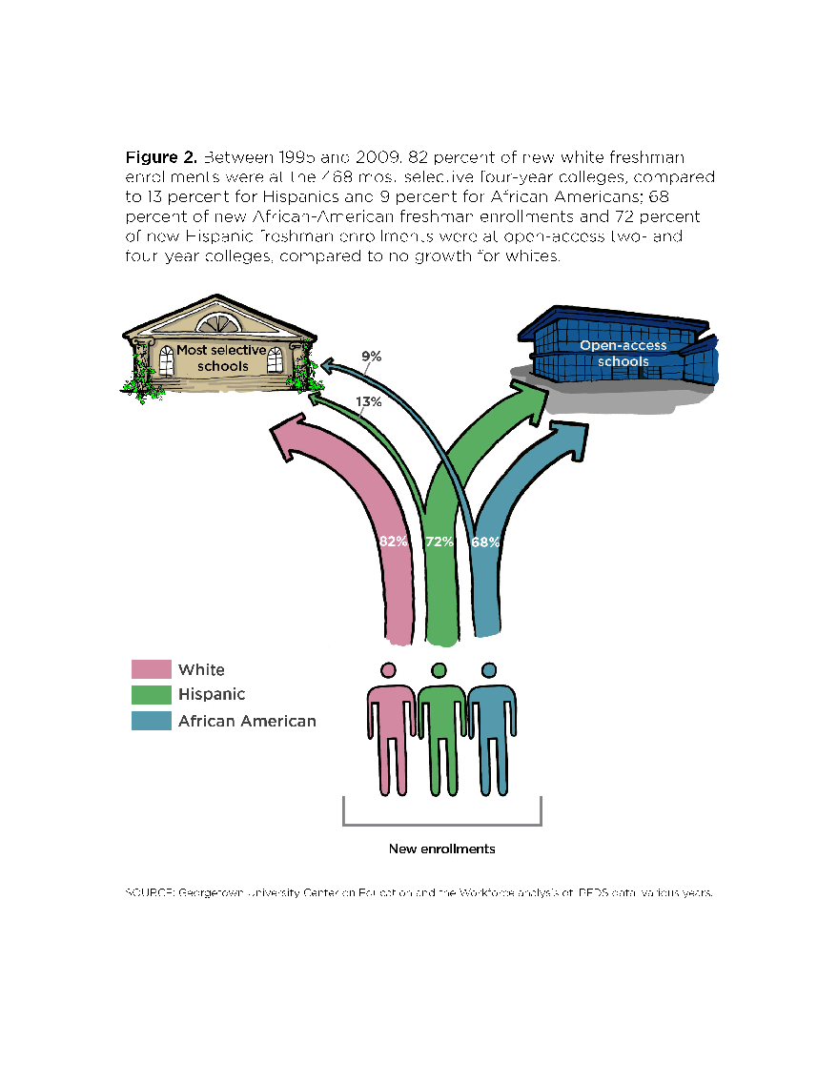
  The vast majority of white freshmen are going to the 468 most selective four-year colleges.
  African American and Hispanic freshmen on the other hand are primarily attending under-resourced two- and fou-year colleges.
SOURCE: Georgetown University Center on Education and the Workforce
analysis of IPEDS data; various years.

Slide 5
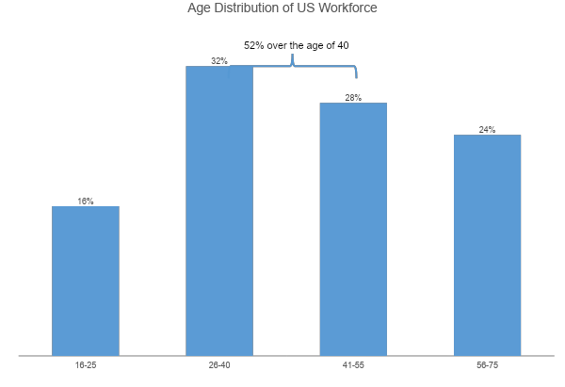
Notes:
Jobs with substantial workers over the age of 40 are at higher risk of retirement.

Slide 6
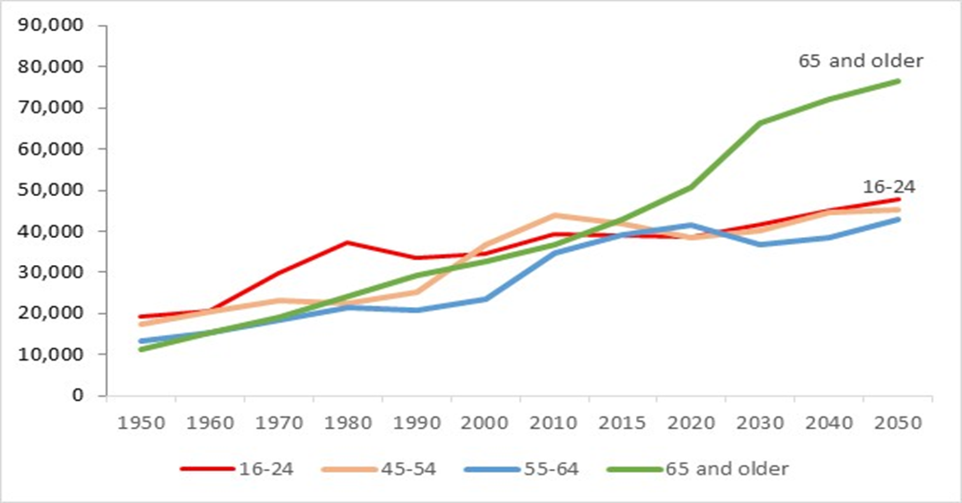
Americans aged 65 and older are an increasing
share of the population

Slide 7
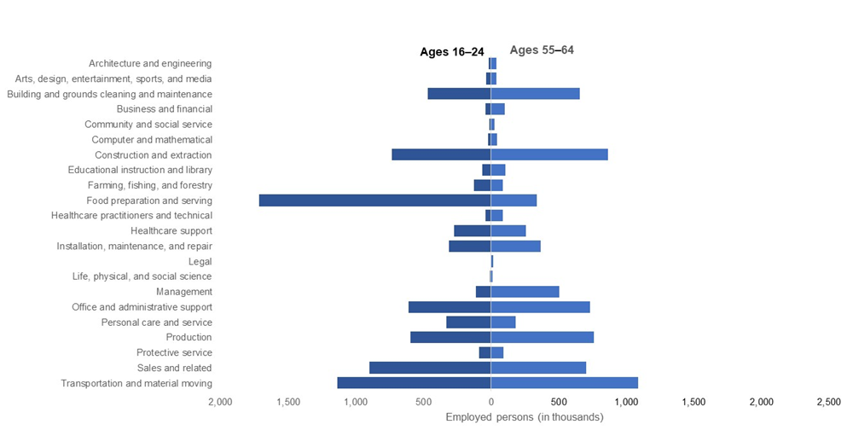
Occupational distribution of income and outgoing workers with a high school diploma or less

Slide 8
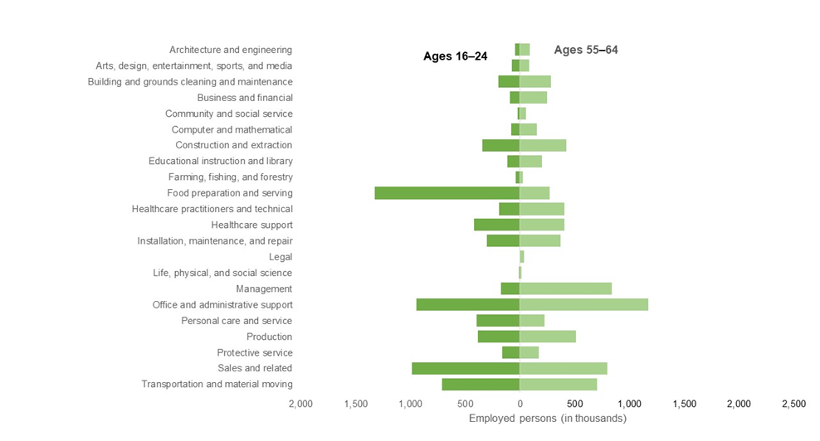
Occupational distribution of income and outgoing workers with some college and or an Associate’s degree

Slide 9
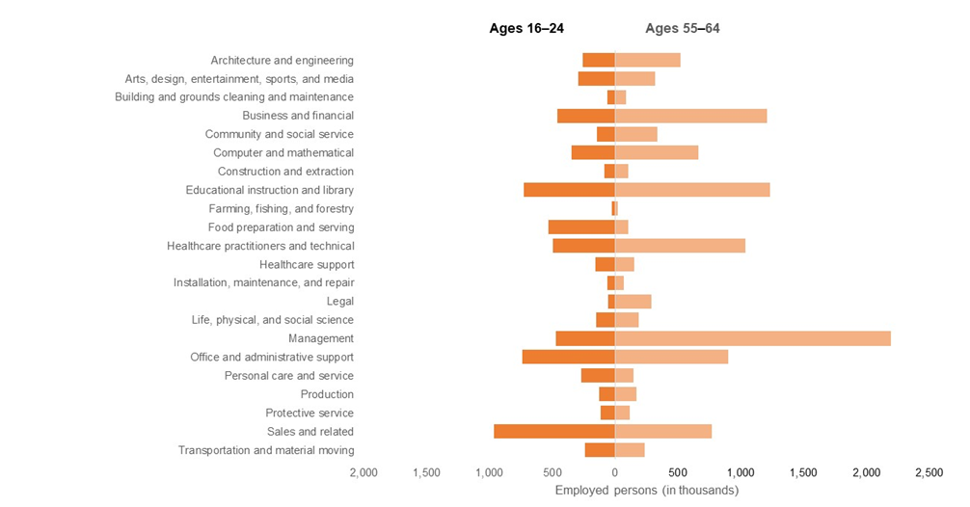
Occupational distribution of income and outgoing workers with a Bachelor’s degree or higher

Slide 10
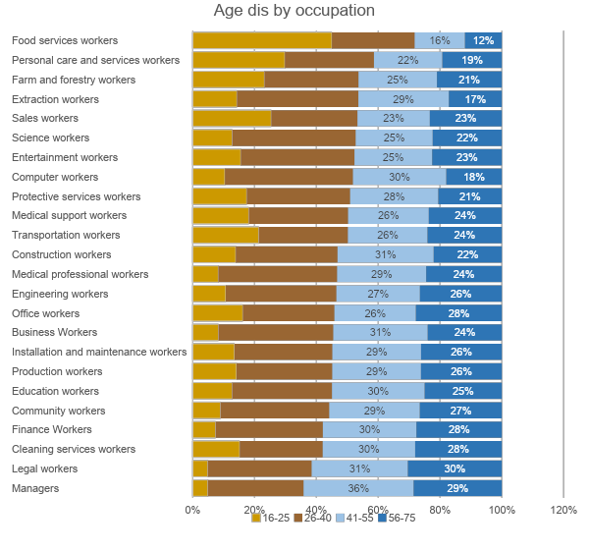
Notes:
By occupation… age distribution is not surprising.

Slide 11
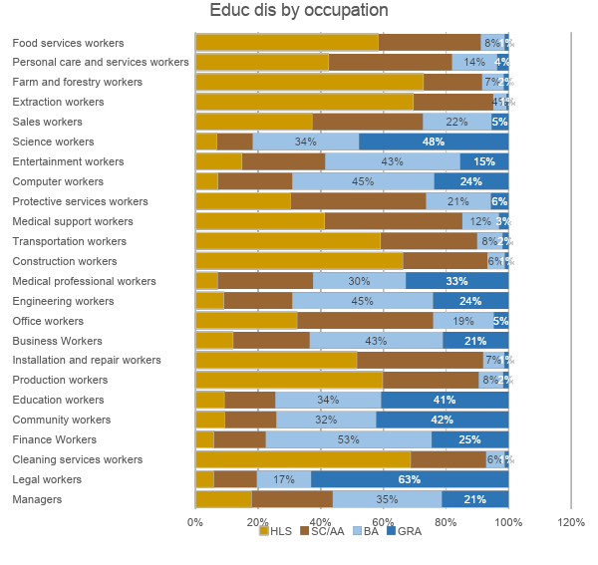
Notes:
By education, age distribution is not surprising.

Slide 12
NCES – National Center for Education Statistics
• IPEDS, Projections, Digest
• https://nces.ed.gov
National Student Clearinghouse Research Center
• Real-time enrollment, persistence, mobility
• https://nscresearchcenter.org
U.S. Census Bureau
• ACS, Population Projections, Demographics
• https://www.census.gov/data.html
Georgetown University / Brookings / Urban Institute
• Contextual reports linking demographics & policy

