Slide 1
Reporting on Threats to International Students
EWA National Seminar | May 30, 2025

Slide 2
Panelists
Deirdre Fernandes
Reporter, Boston Globe
Ashley Mowreader
Reporter, Inside Higher Ed
Jeff Young
Freelance journalist
Sarah Brown (moderator)
Senior Editor, Chronicle of Higher Education

Slide 3
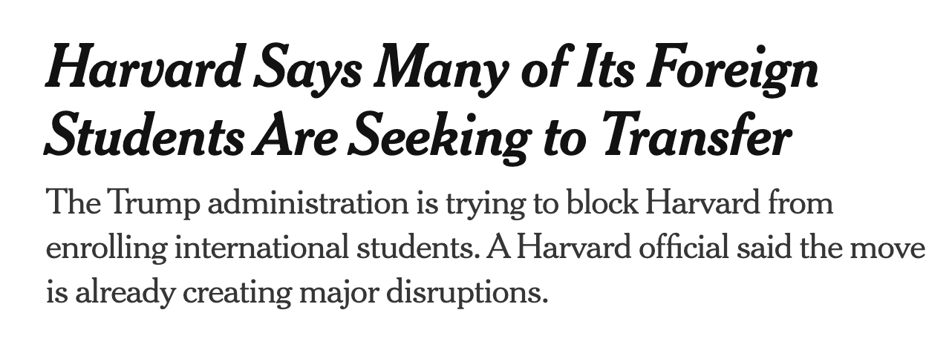
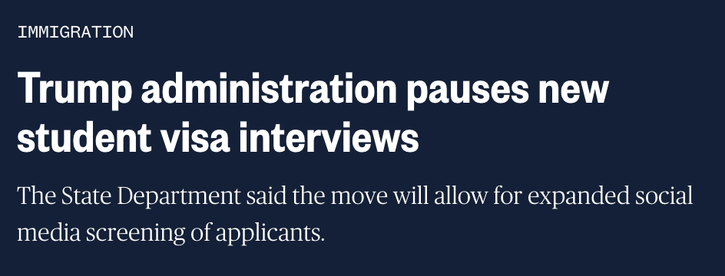
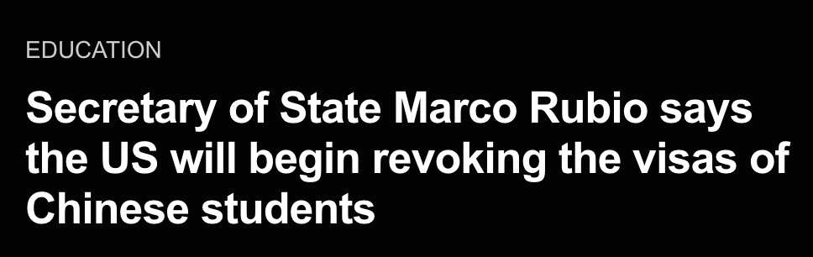
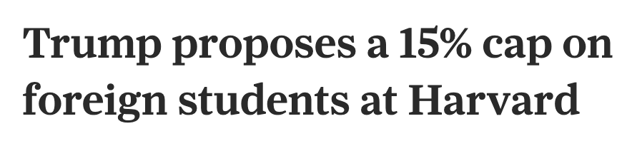
Why we’re having this conversation

Slide 4
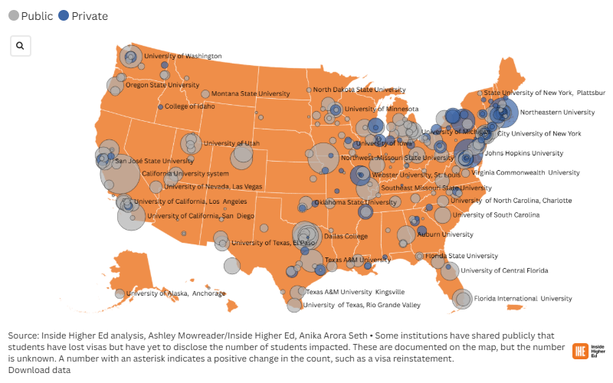

Tracking International Student SEVIS Revocations
aka “the map”

Slide 5
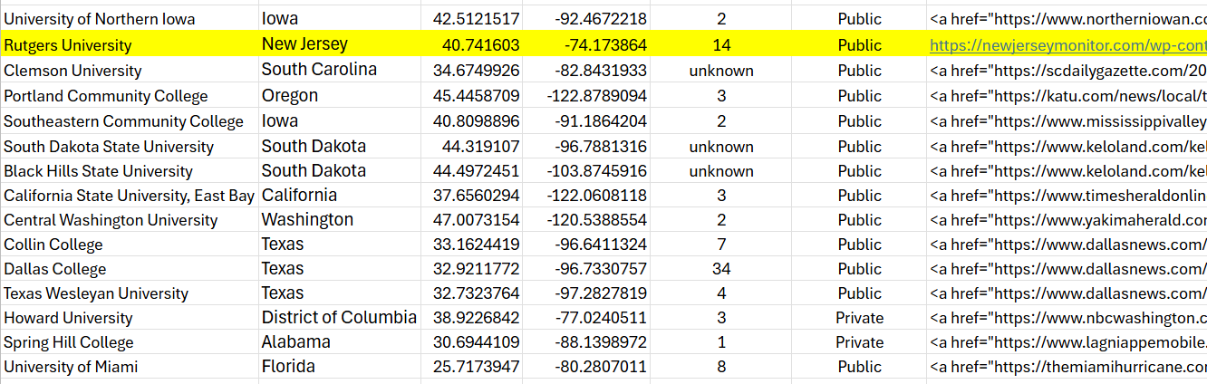
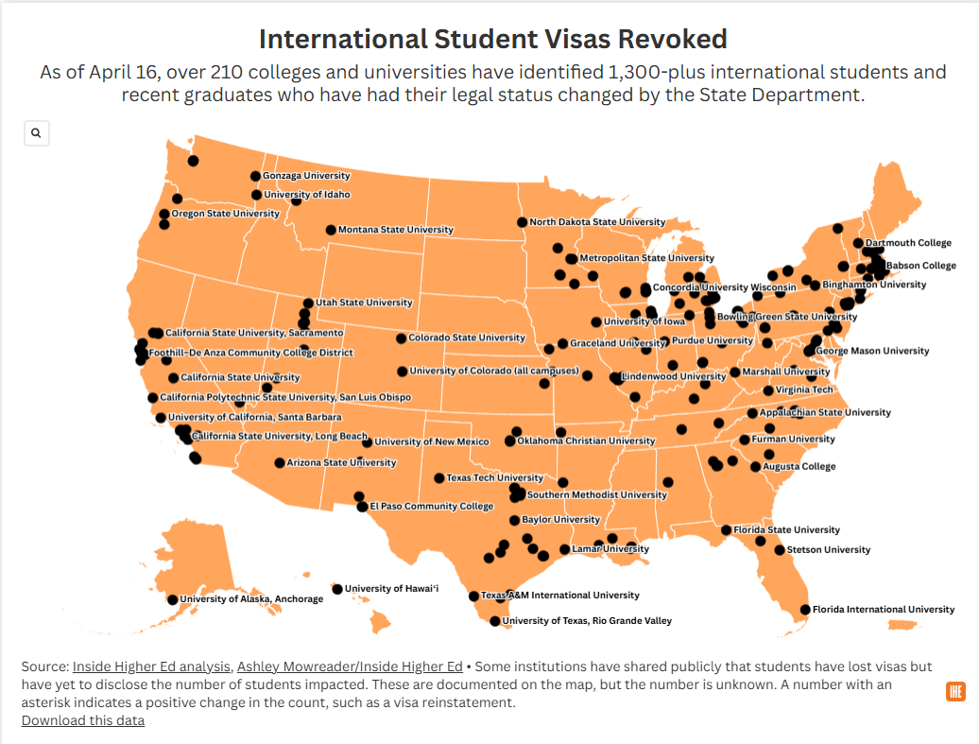
Making the map
Excel
Flourish
Some basic html

Slide 6
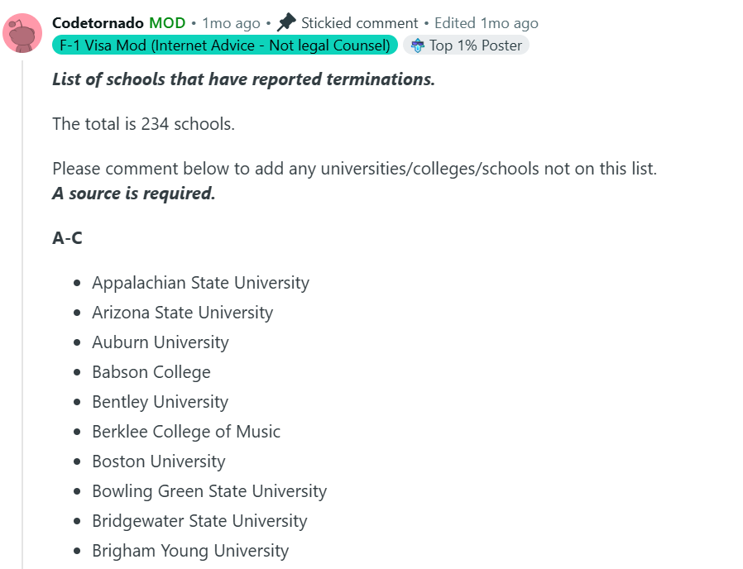
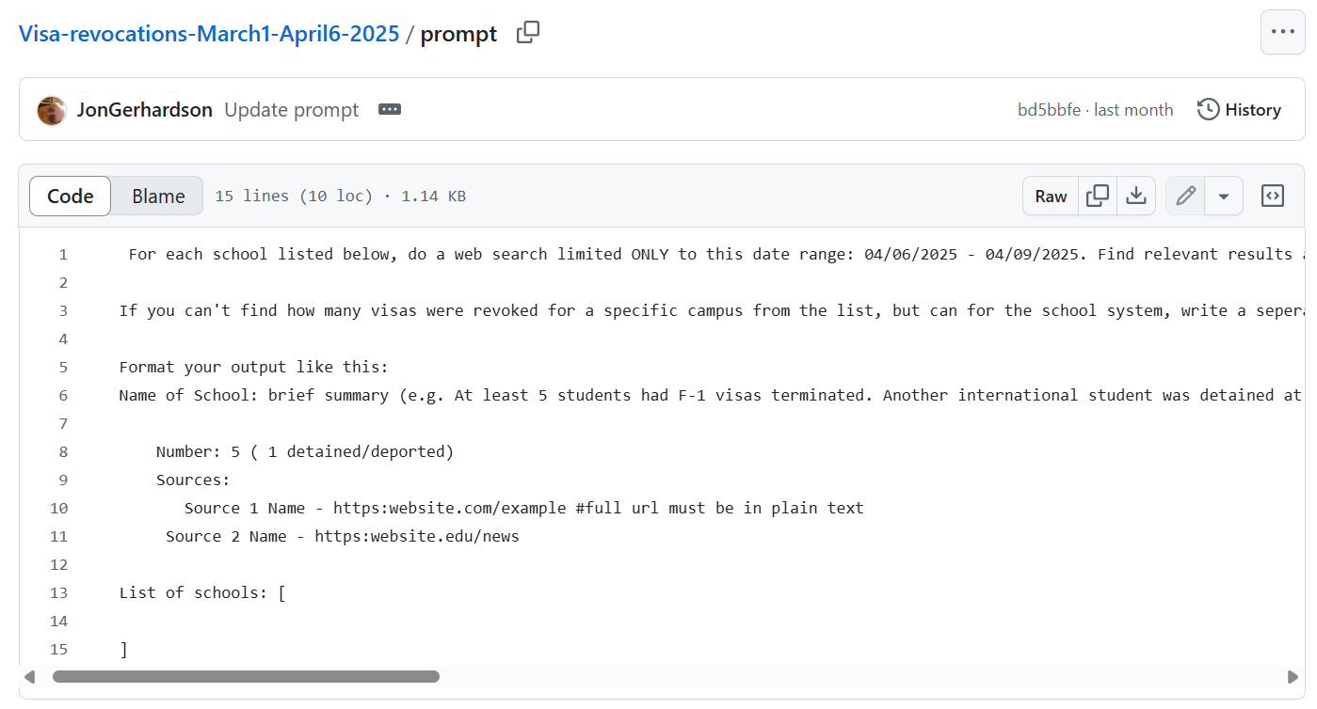
Sourcing the map
Google alerts
Twitter lists
Google Gemini*
Reddit
Tips

Slide 7
Expanding the map & other editorial questions
Determining how often to update the map and who was responsible for the map
Determining what qualified as verified information (lawsuits, university notice, student paper)
Being selective with language (SEVIS status vs visa)
Making data publicly accessible vs behind a paywall
Determining how to signal re-instated visas
Questions?
ashley.mowreader@insidehighered.com

Slide 8
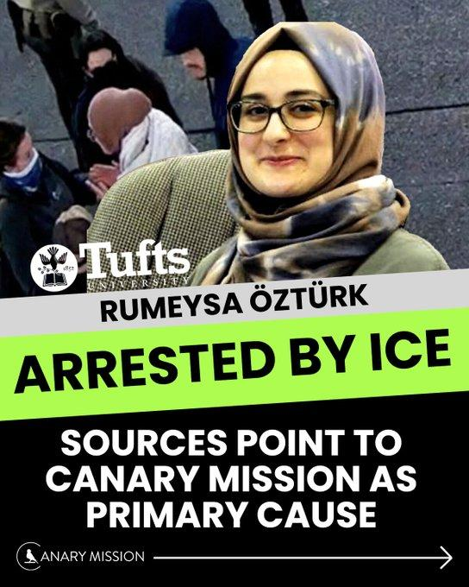
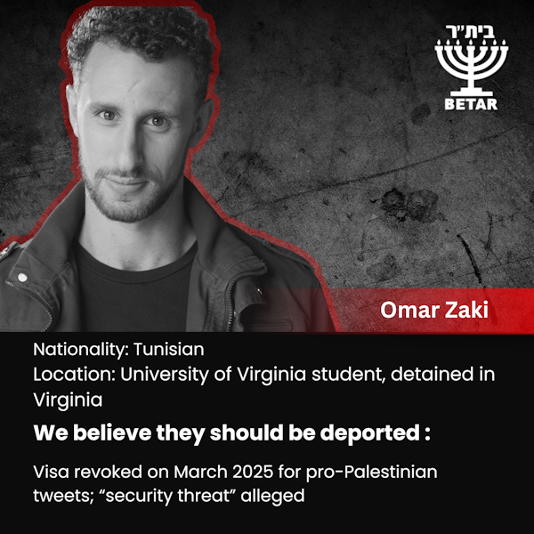
Activists have been targeted by extreme pro-Israel groups
-
Many were claiming credit online
But some of the most aggressive groups worked in the shadows.
Used 990s, courts documents, business records, to try and identify them and the people behind them.

Slide 9
The challenges
How much credit to give these organizations??
It’s a murky space. Are these groups squelching free speech or fighting anti-semitism?
We looked deeper in Betar’s claims.
We reported what we knew.
  We relied on court documents filed by the detained students who blamed Canary Mission and Betar posts for their arrests.
  We showed how questionable Betar’s information was and how their founder was well-connected but their fundraising was paltry.
  And talked to people who were impacted by having their names and photos on these sites.

Slide 10
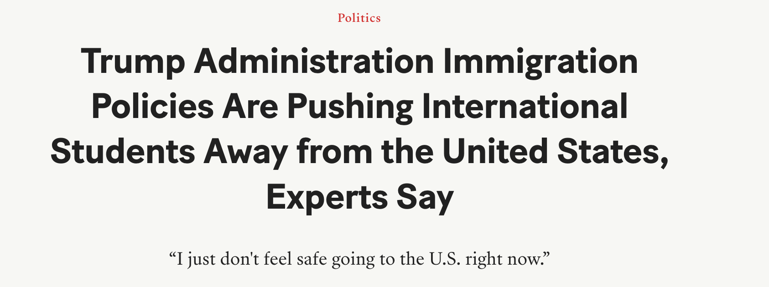
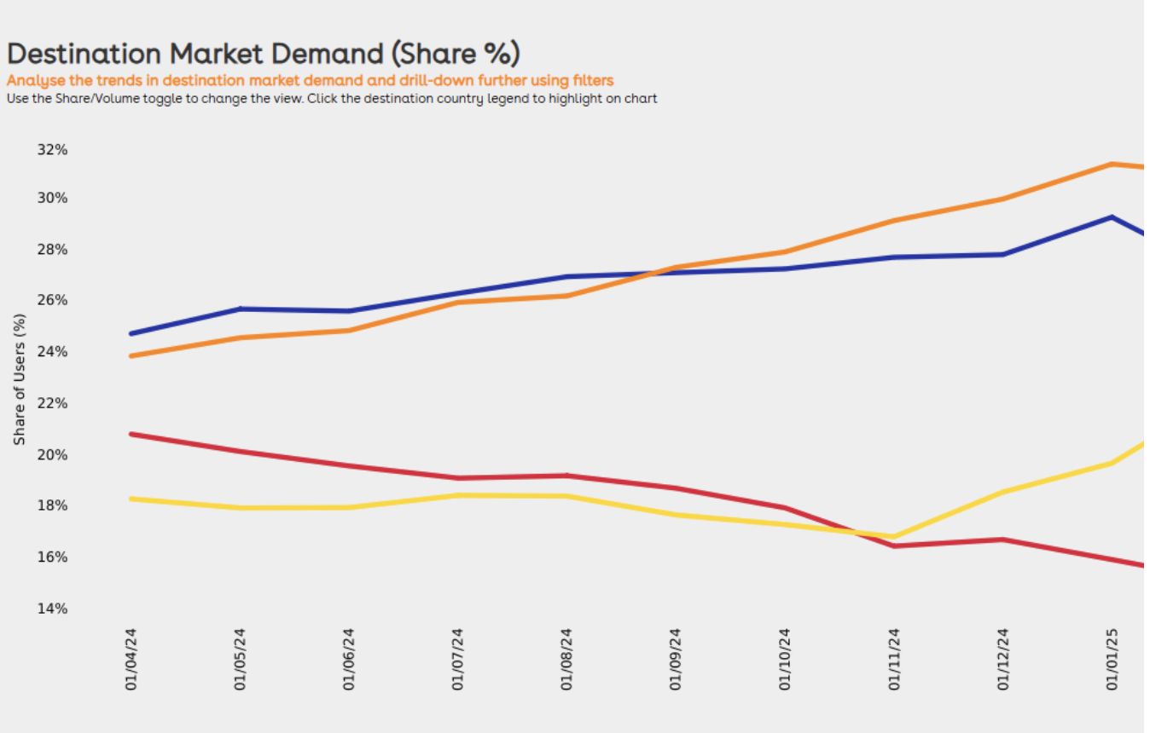
Approach
• Try to get any data on international college student enrollment for this cycle.
• Include the voices of international students on how these Trump administration actions are impacting their interest in being on a U.S. campus.
• Goal: Show don’t tell the psychological impacts of these policies on students and their families. (Prayers, misinformation, fear, confusion)

Slide 11
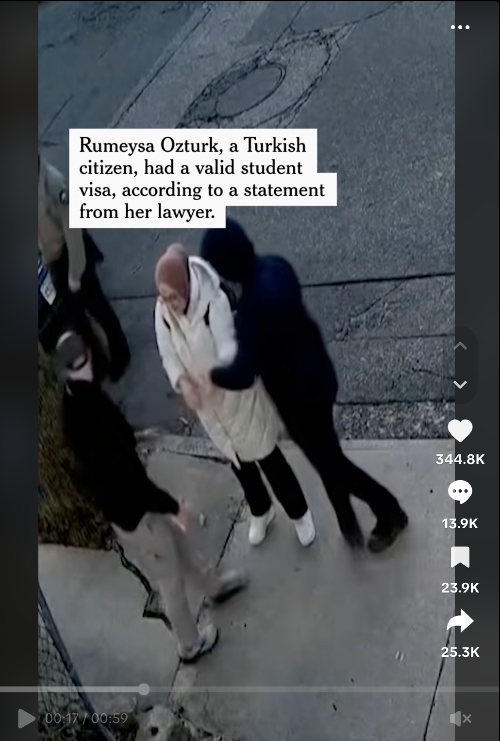
• Arrest video of Rumeysa Ozturk quickly resets image of studying in America.
• Timing of the crackdown happened just as international students were making final decisions on where to enroll, and as students were studying for final exams.
• New developments were coming faster than the news cycles could keep up.
• Officials never clarified what new visa standards are, moving to sense of “discretion.”

Slide 12
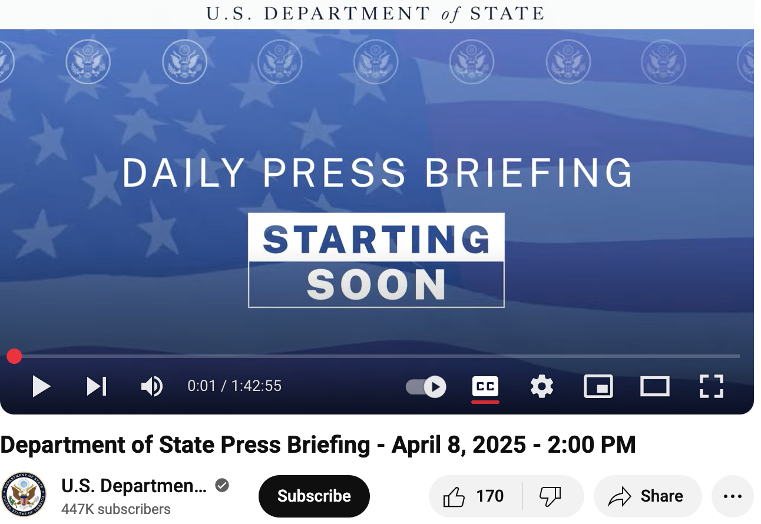
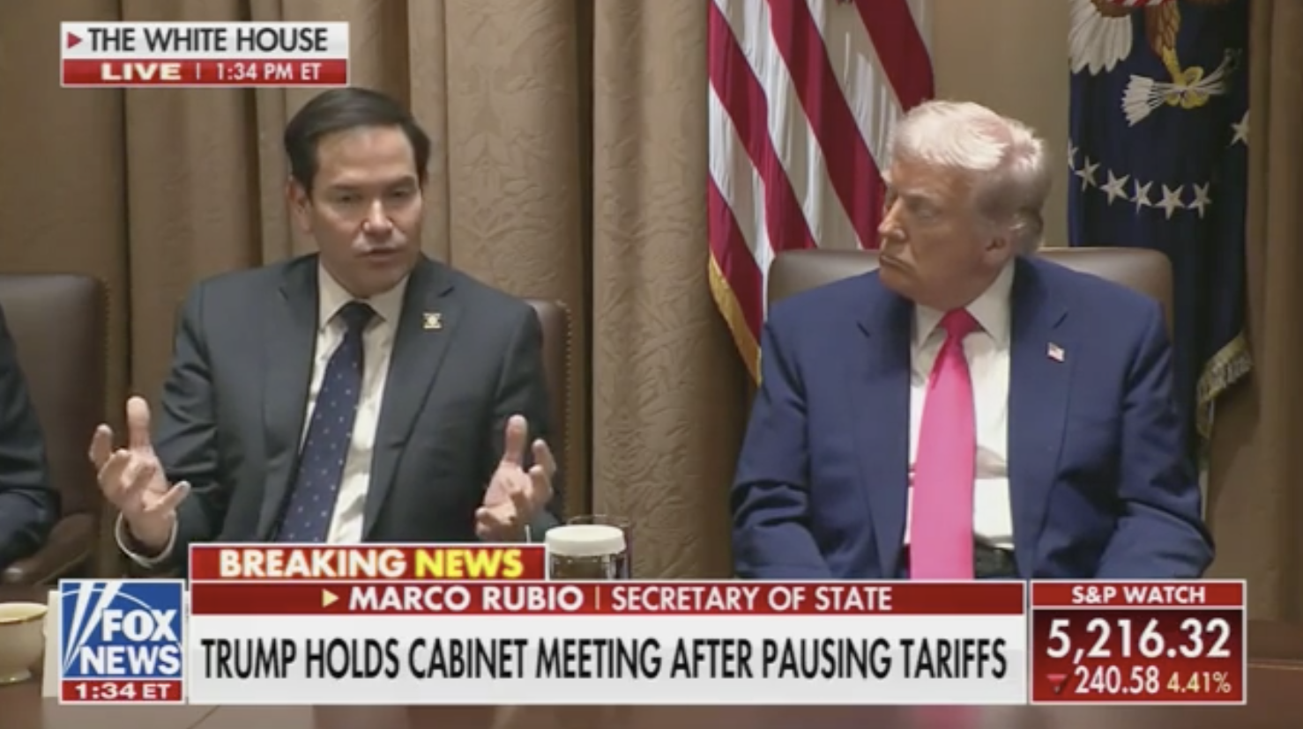
Challenges
• How to fairly present the government’s argument when officials say they don’t have to explain anything?
• How to get a sense of enrollment impact when most college officials declined to comment?
• How to honor anonymity of student sources while giving rich details of their experiences?

Slide 13
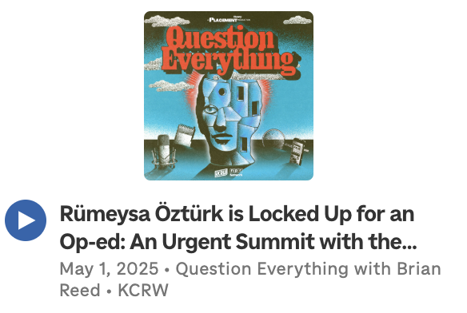

Resources
• Question Everything podcast episode at Tufts University featuring student newspaper editors who published the Rumeysa Ozturk op-ed.
• Recent episode of The Disagreement podcast where a scholar from a conservative think tank squares off with an Atlantic staff writer on the legality and impact of campus deportations.

Slide 14
Questions?

