Slide 1
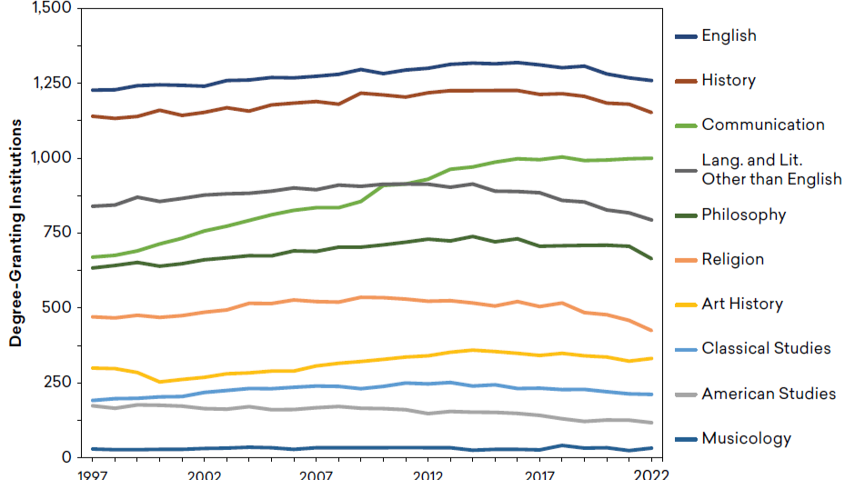
Context: The Decline in Humanities Majors

Slide 2
Career Opportunities for Humanists: Vast but Vague
The challenge: it’s not that humanities graduates have fewer opportunities, far from it. The challenge is, rather, that humanities career pathways are so vast & open-ended. This is why it is crucial to start exploring early and often!
But this is not as exceptional as it might seem. The whole notion that a college major is a credential that determines your professional path is false!
Most folks (70%+) don’t do work directly related to their college major! This doesn’t mean that major is not relevant.
Employers don’t care about major; they care about your skills, passions, and experiences; you learn the job on the job
These arguments are reinforced by NACE/Career services
Notes:
The Human adventure, the existential journey... Humans crave certainty and security. To give an example from religious studies, the Buddha taught that this obsessive, compulsive search for security Was not only in vain, but actually the cause of our suffering. The reality is that nobody knows how their career will unfold. This isn't any less true for the people who study the most clearly useful hard-headed things, like engineering. Study has shown that within 5 to 10 years of graduating. Many who study as engineers pursue alternative types of roles. When you look at it this way, we who study the humanities and other liberal arts disciplines are simply embracing the reality that it is the open-endedness of our lives and careers.

Slide 3
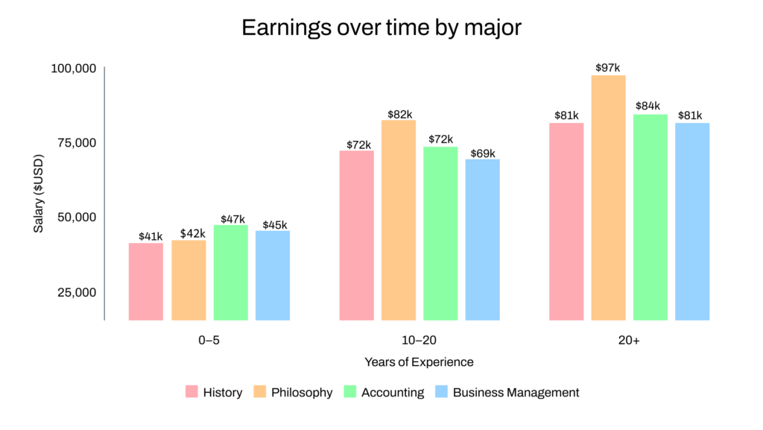
Career Success: Playing the Long Game

Slide 4
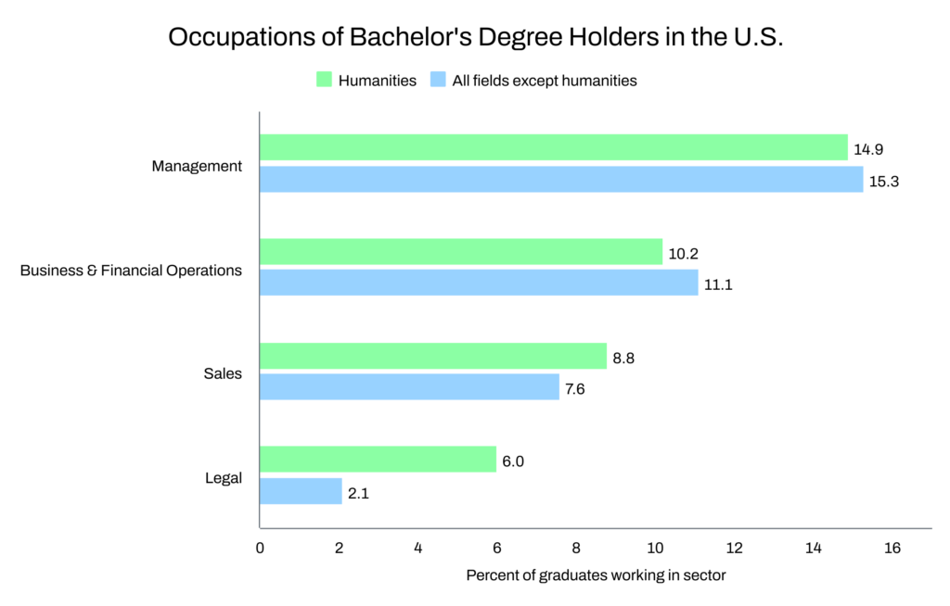
Career Opportunities for Humanists: Vast
Employed across a wide variety of sectors
>25% of those earn humanities bachelor’s degrees but do not pursue graduate degrees make >$100,000/year
Roughly as likely as other graduates to work in management, finance, and sales

Slide 5
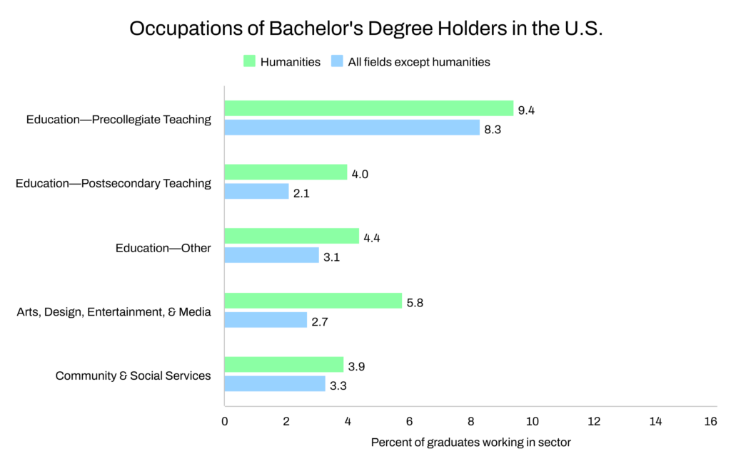
Career Opportunities for Humanists: Vast
Overrepresented in nonprofit education sectors
Entry-level salaries are low, but earnings rise over time
Highly rewarding with high levels of overall job satisfaction
Income is a poor measure of someone’s contribution to society

Slide 6
Season 2: “Do Good and Do Well"
Name | Profession | Undergraduate Major
Debo Adegbile | Civil/Human Rights Lawyer | Government/African Studies
Colin Rosemont | NEH/CA Humanities-funded filmmaker | Cultural Anthropology
Emma Haberman | Food Relief Work @ World Central Kitchen | Art History, French
Tom Grosheider | Physician on Navajo Reservation | Social Studies
Lauren McCraney | Founder, Woven Women Collective | Religious Studies/Museum Studies/Anthro
Hannah Hethmon | Podcast Producer for Museums/Cultural Orgs. | English
Brandon Williams | Philanthropic Consultant/Community Development | African American Studies
Walter Cabal | Values-Driven Designer/Maker/Writer | Philosophy

Slide 7
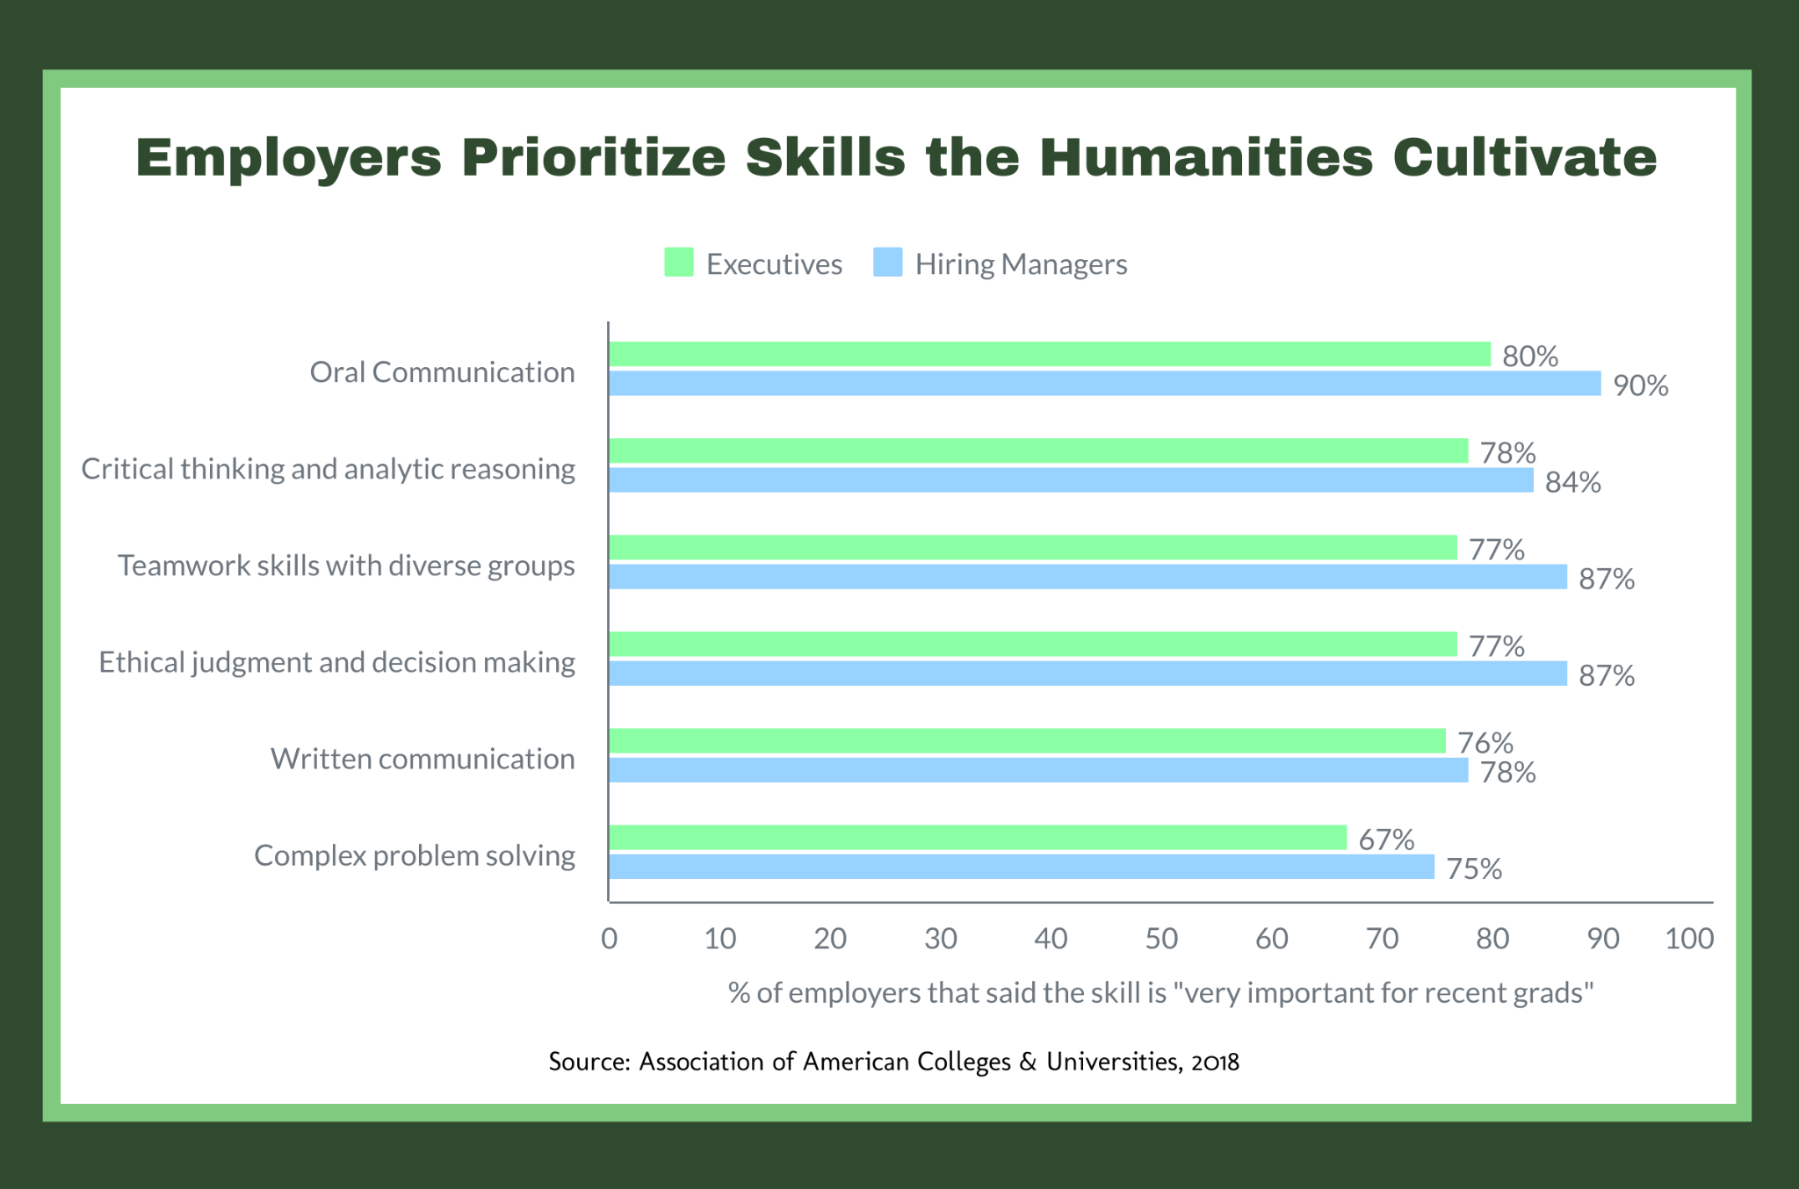
Valued Skills

Slide 8
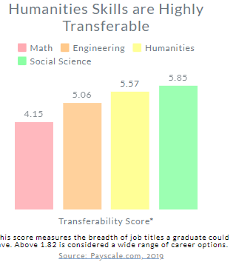
For most, career success depends not on their mastery of the specific content they studied in college but rather on their capacity to acquire new knowledge and skills on the job. Studies show that humanities majors excel at this. Why? Because the skills honed in the humanities and humanistic social sciences are more broadly adaptable than those from a technical education.
Notes:
Something similar is happening in the world right now as layers of givenness are peeled back with startling speed. So what I'm saying is probably on some level obvious those of y'all coming up amidst all of that. Nothing is given. We're all going to have to bob and weave. Experts predicted 21st century workers are going to have to be prepared to navigate more dramatic upheavals in the nature of the workforce than anything the previous generations have experienced. That's already been happening of course with the pandemic etc.

Slide 9
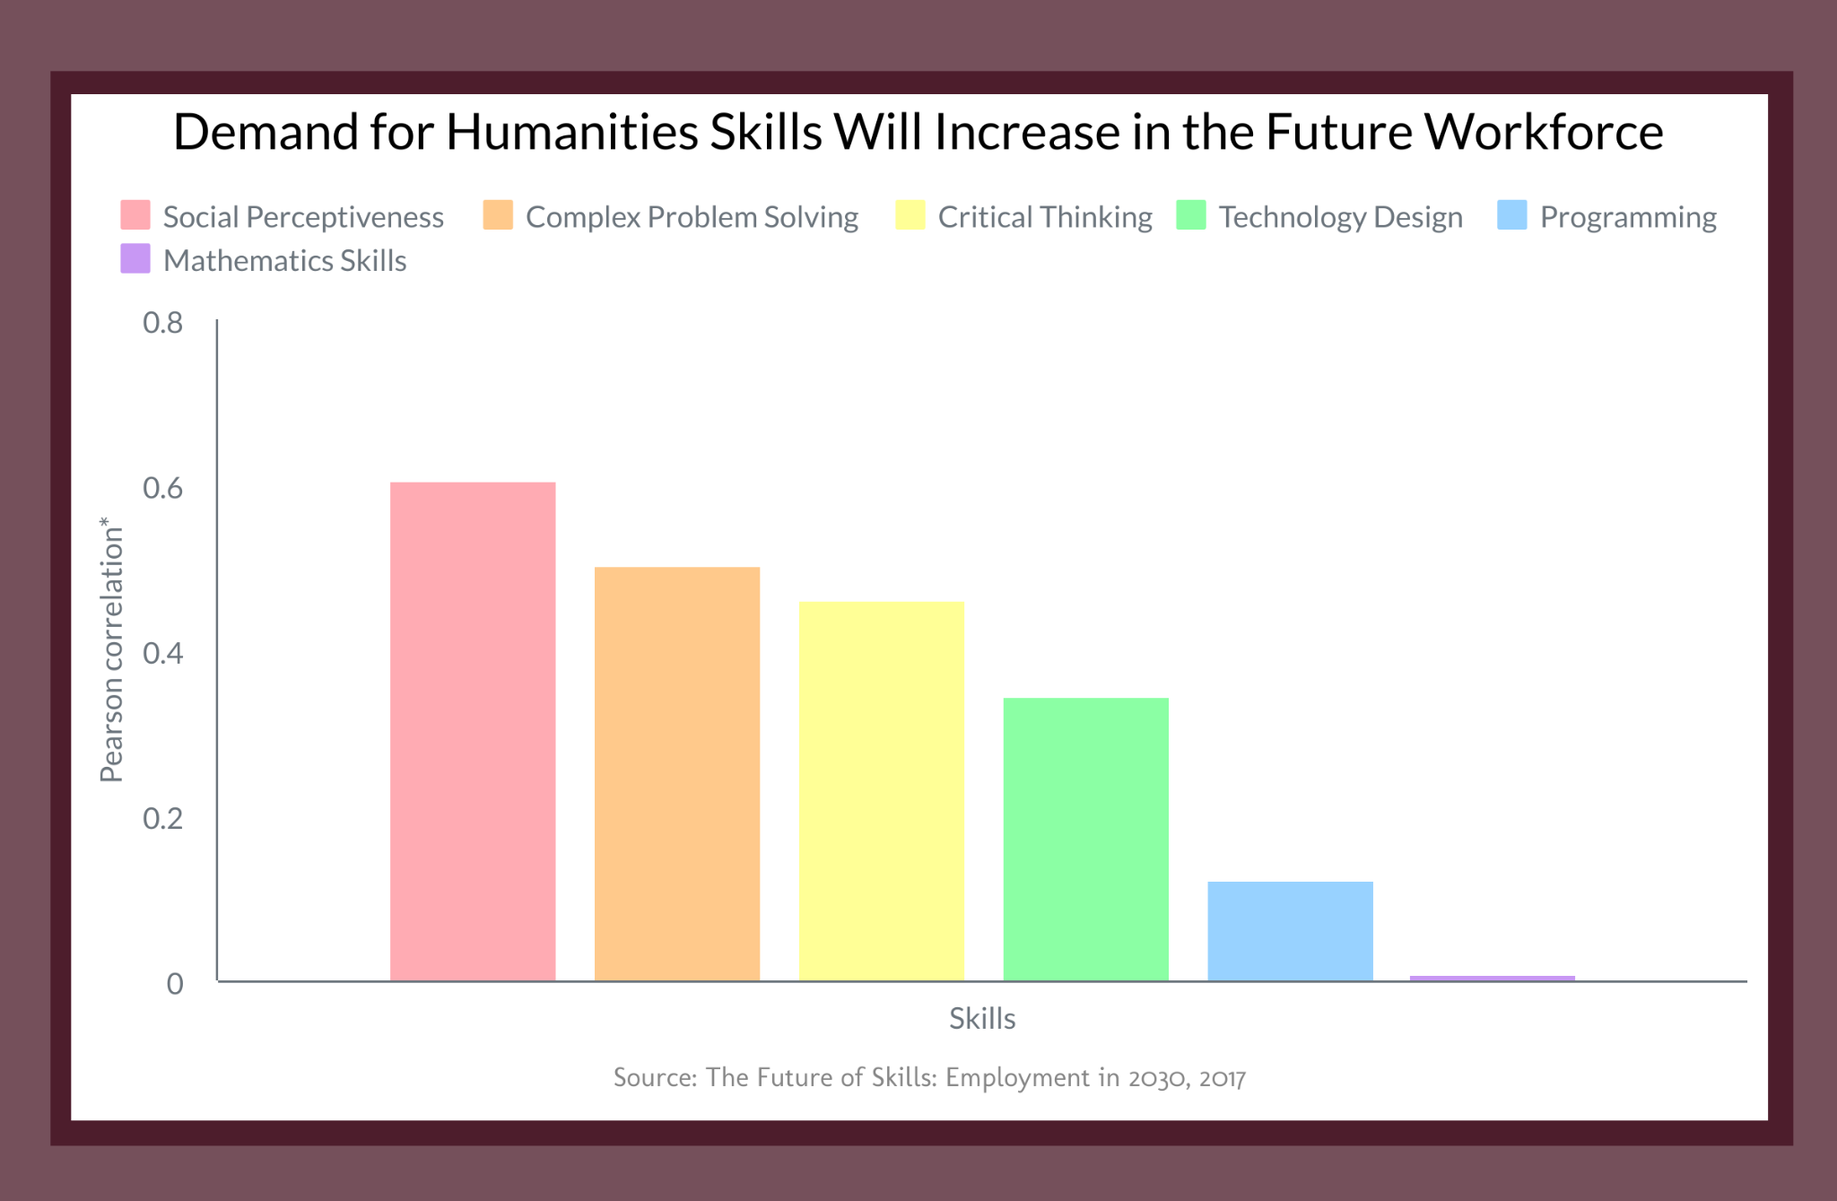
Future of Work: Human Skills
Notes:
Non-humanities focused organization making forecasts about skills that will be needed

Slide 10
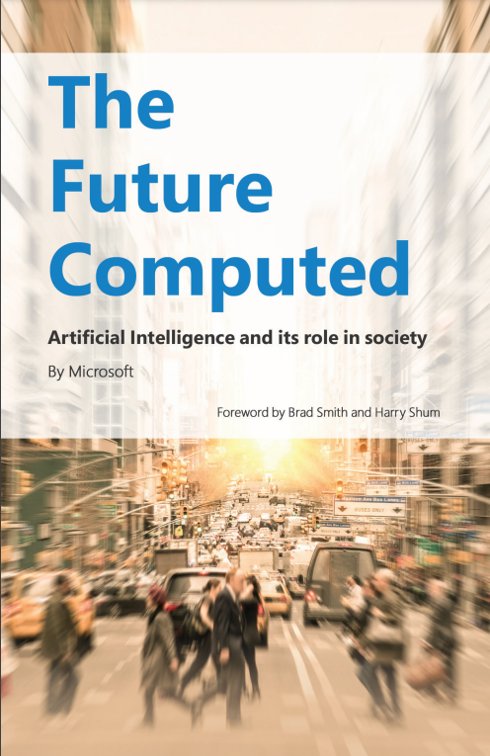
Future of Work: Human Skills
“As automation and AI take on tasks that require thinking and judgement, it will become increasingly important to train people—perhaps through a renewed focus on the humanities—to develop their critical thinking, creativity, empathy, and reasoning.”

