Slide 1

Data from the Educational Opportunity Project
www.edopportunity.org
We’re measuring educational opportunity in every community in America.

Slide 2
Data from edopportunity.org
Educational Opportunity Explorer:
  School and district test score data. 2009-19 (pre-pandemic)
Education Recovery Explorer:
  District test score data, 2019-2024 (pre-post pandemic)
School and Neighborhood Segregation Explorer:
  School and residential segregation data, 1990-2022

Slide 3
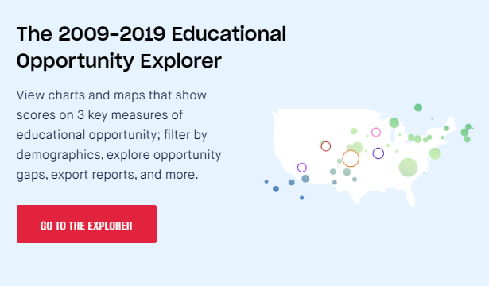
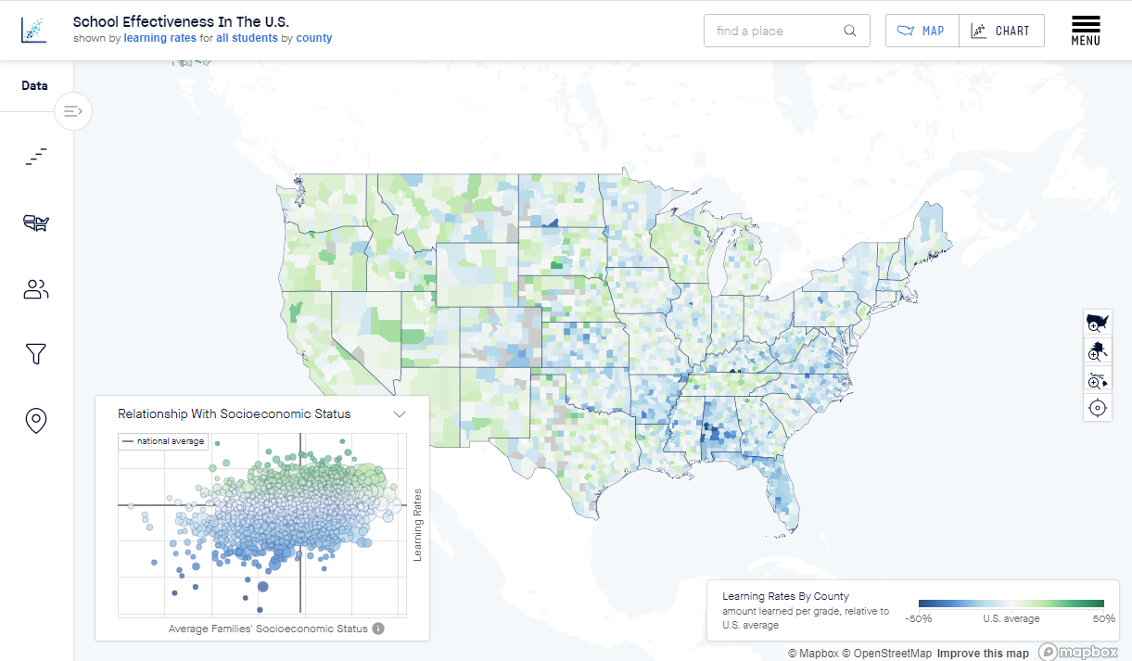
www.edopportunity.org/explorer
SEDA 5.0 contains nationally-comparable data on average achievement, learning, and trends in achievement
  11 years of data (2009-2019)
  70,000+ schools, 13,000 school districts, 3,000+ counties, and more!
  Estimates by subgroup, subject, grade, & year
  Demographic and socioeconomic data from CCD, ACS, and other sources

Slide 4
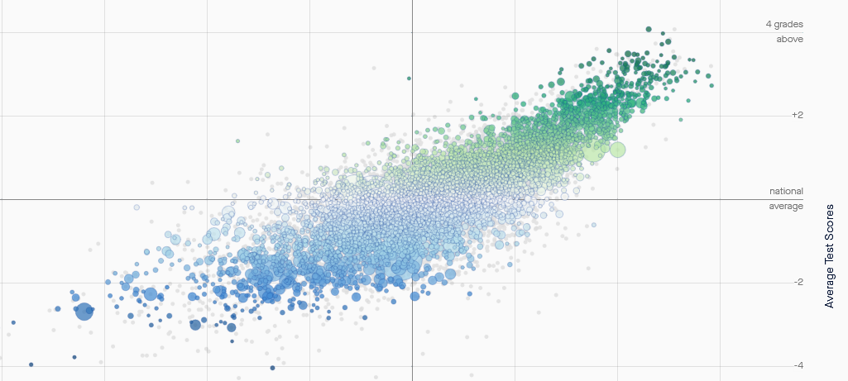
Steubenville, OH
Notes:
https://edopportunity.org/opportunity/explorer/#/split/none/districts/avg/ses/all/3.15/37.7/-94.63/

Slide 5
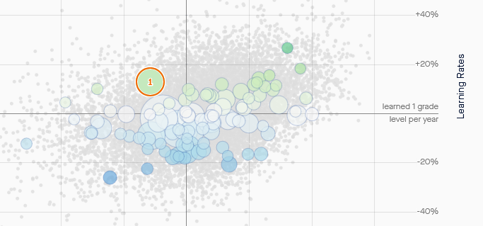
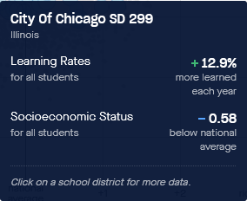

Slide 6
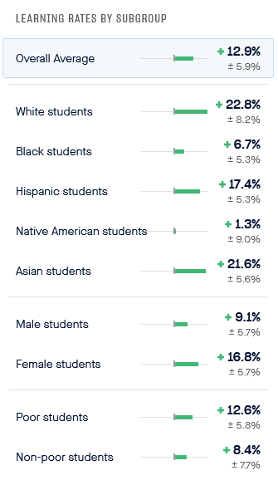

Slide 7

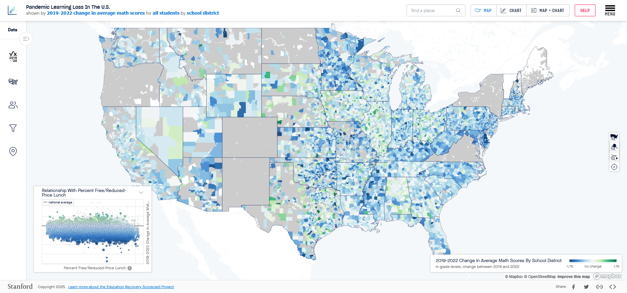
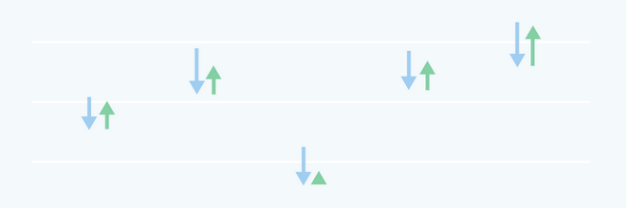
www.edopportunity.org/recovery
SEDA 2024 contains nationally comparable data on average achievement and changes in achievement from 2019 to 2024
  6 years of data (2019, 2022-2024)
  8,000+ school districts (data from 43 states)
  Estimates available by subject & year (and subgroup in most states)
  Demographic data from CCD

Slide 8
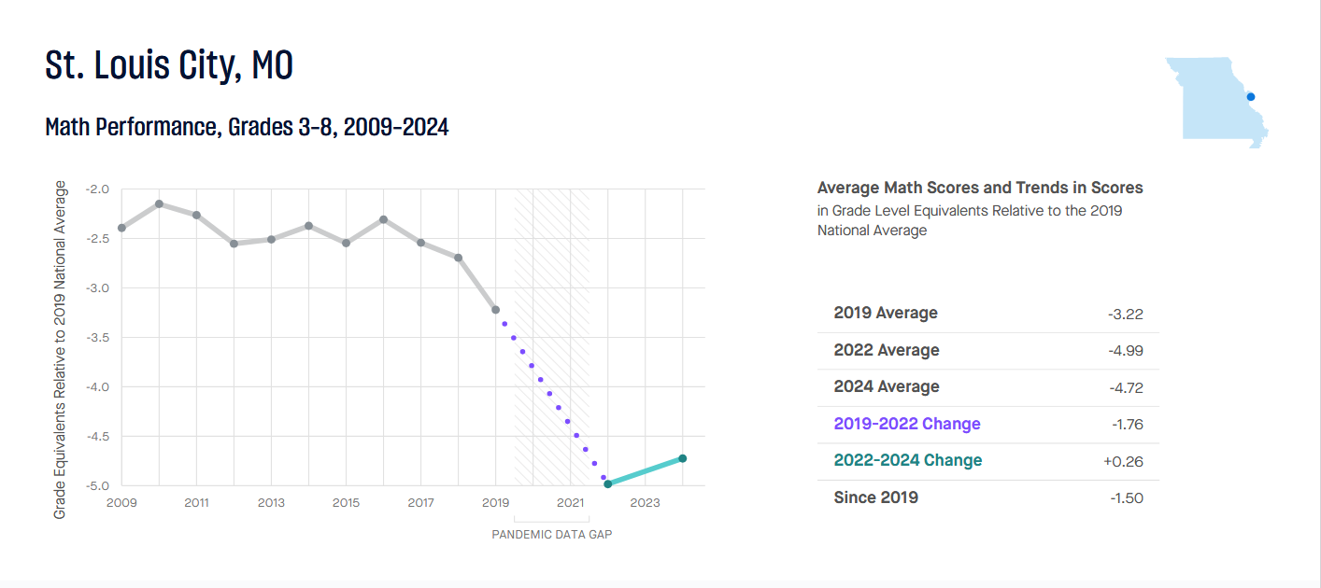

Slide 9
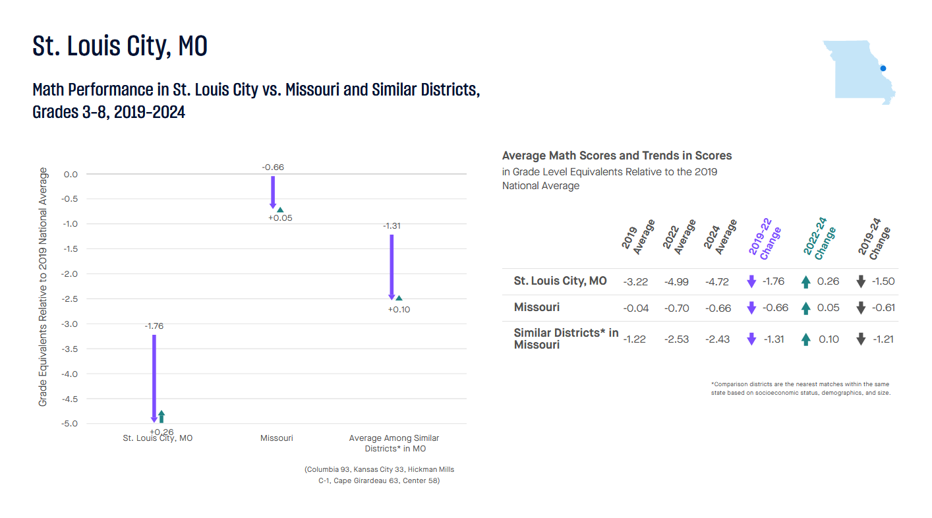

Slide 10

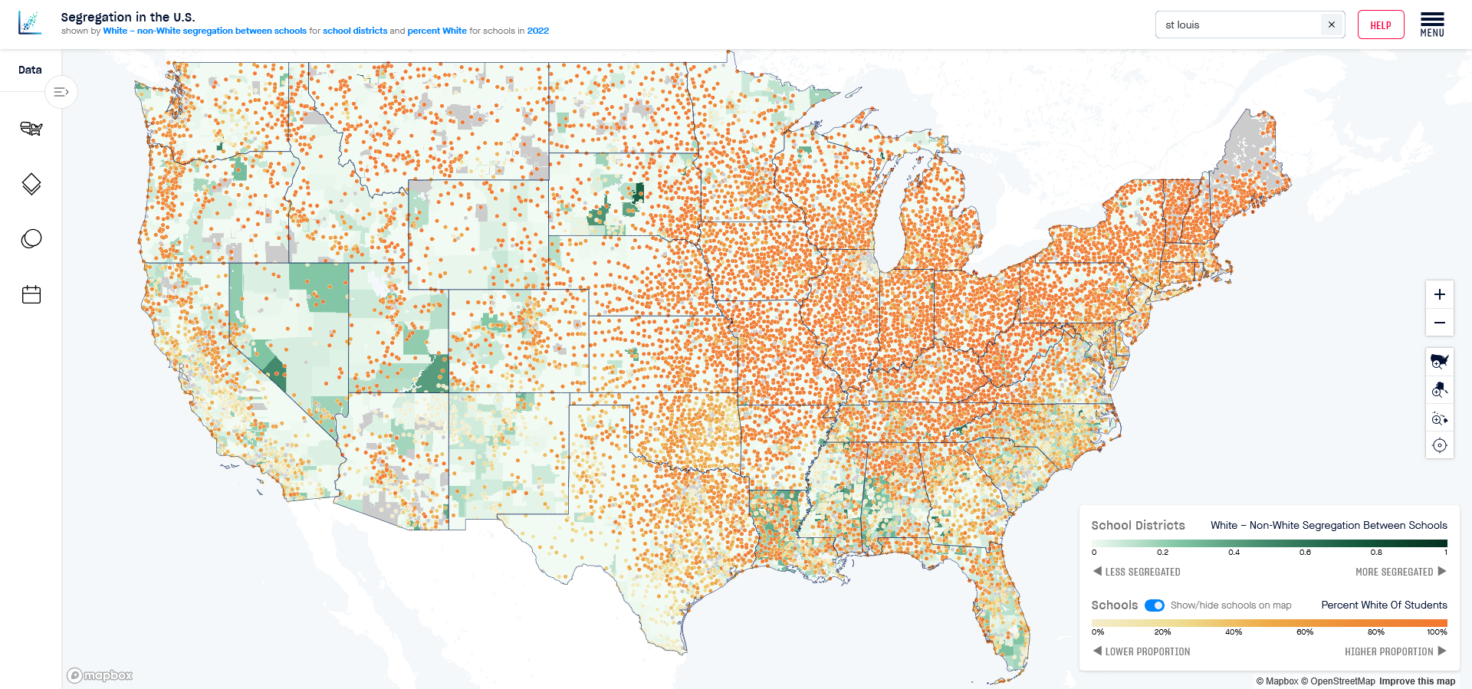
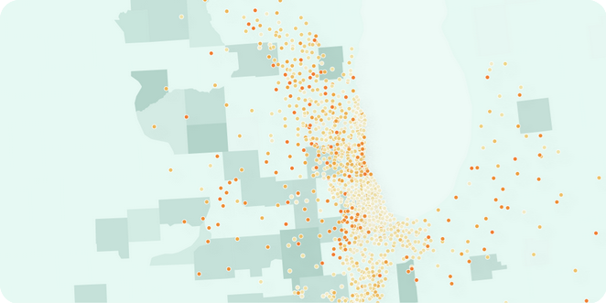
www.edopportunity.org/segregation
Segregation Tracking Project contains data on school and residential segregation
  3+ decades (1990-2022)
  By school district, county, metropolitan area, and state
  Racial and economic composition and segregation

Slide 11
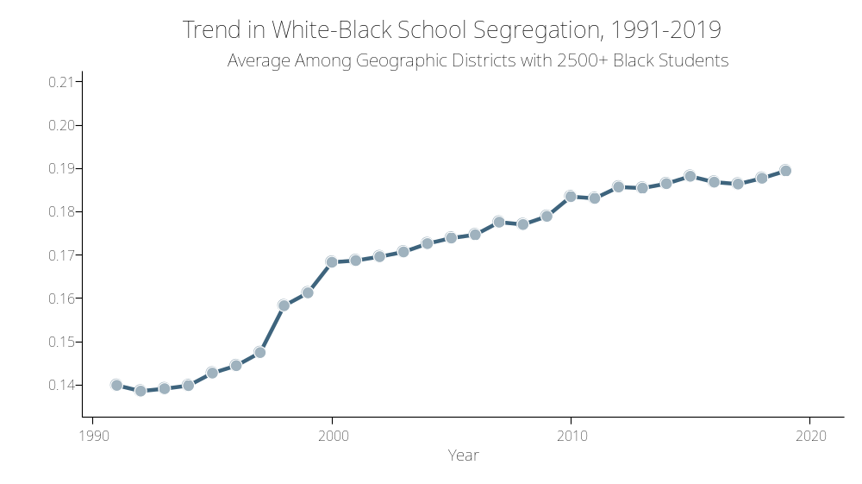

Slide 12
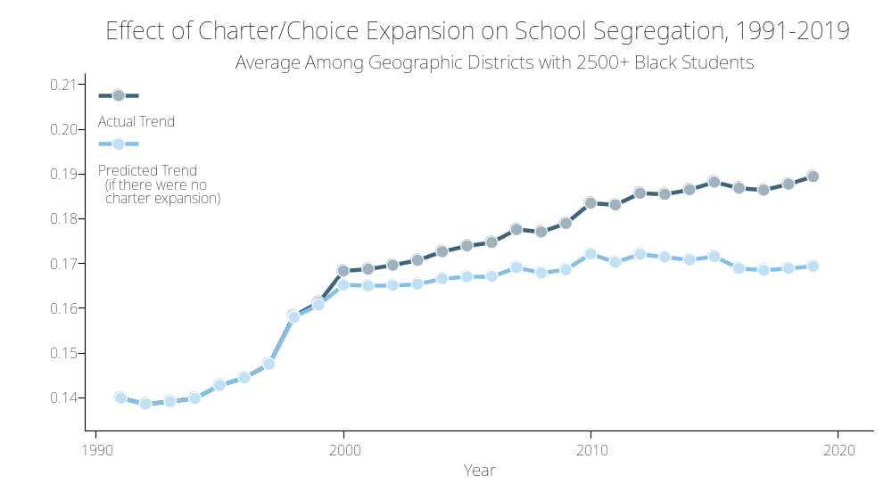

Slide 13
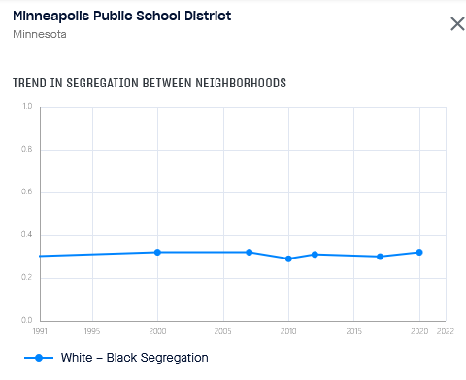
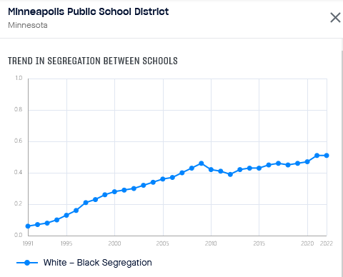
Minneapolis School District
School segregation is rising while residential segregation is stable

Slide 14
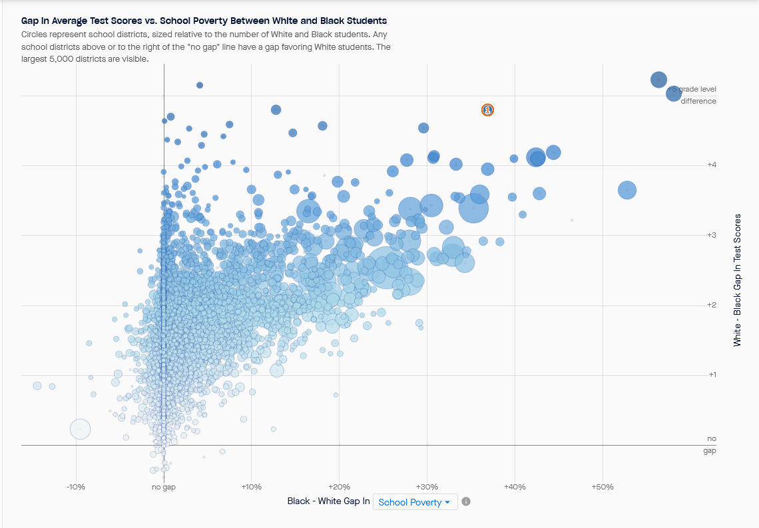

Slide 15
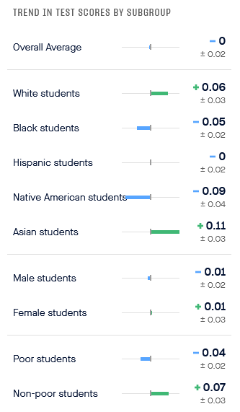

Slide 16
Data/website features
Data are harmonized over time and place (especially important for comparing test scores)
Search for any place (school/district/county/metropolitan area/state).
Downloadable customized pdf reports for each district.
Compare educational outcomes to those in similar places.
HTML code to embed interactive view of website in your outlet’s website.
All data downloadable in Excel format.
Email sedasupport@stanford.edu to get help from our team.
Repository of select research papers (ours and others) based on these data.

Slide 17
New data coming later this summer
Updated segregation data (through 2023-24 school year)
New estimates of the rate of improvement of each school district in the country, 2009-2019
  Improvement here is not improvement in test scores, but improvement in the average learning rate

Slide 18
Other good education data sources
Urban Institute Data Portal
Zelma
Education Recovery Scorecard
EDGE
Opportunity Atlas
Federal data sets: NAEP, CCD, EDGE, CRDC, IPEDS, NPSAS…
  Most are likely to be maintained, though quality is a concern

Slide 19
Other resources
Learn more about the SEDA data and how to use it in our AERA PEERs Data Hub Presentation: https://www.youtube.com/watch?v=DfZW1ixxDQ8
Reach out to our team directly: sedasupport@stanford.edu

