Slide 1



Slide 2
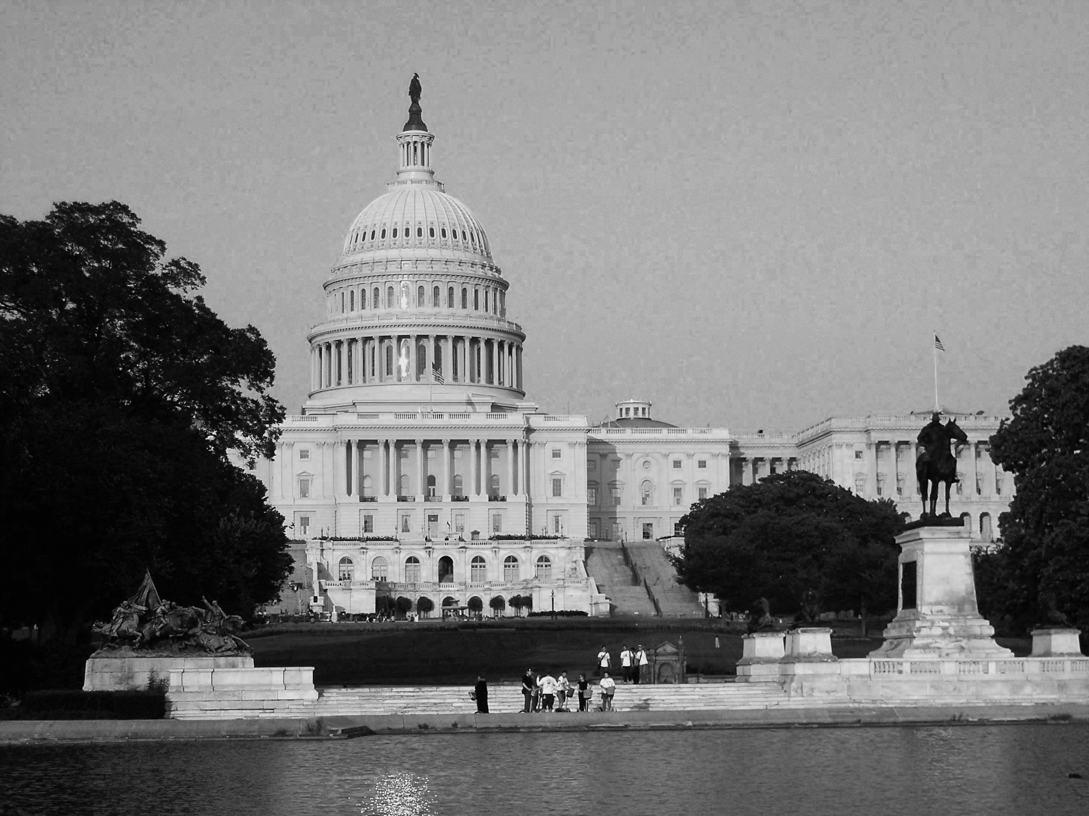



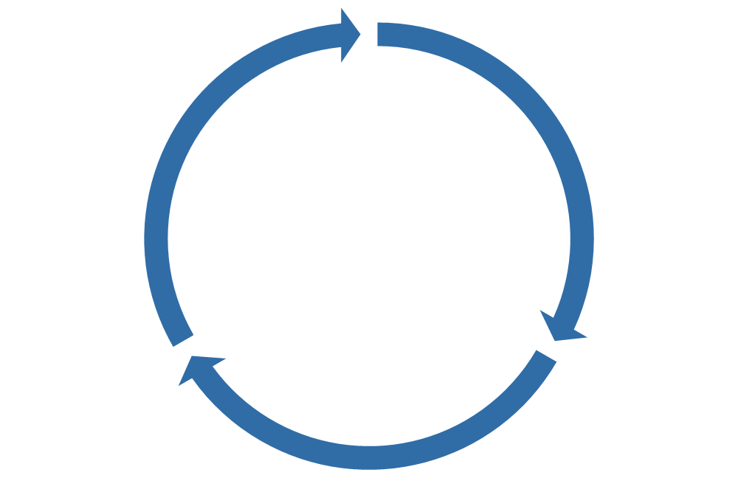

Zaentz Initiative Overview | Major Initiatives
The Early Learning Study at Harvard (ELS@H)
The Zaentz Professional Learning Academy
Groundbreaking research to drive policy and practice
Large-scale, longitudinal study now in its 7th year
A new model of professional learning for leaders around the world
15,000+ enrollments across the US and around the world
Saul Zaentz
Early Education Initiative
The Zaentz Fellows Program
Zaentz Policy Academy
Tools to build systems so that all children, families, and educators
have what they need to thrive
Zaentz Navigator launched in 2023; 180+ participants enrolled in online and on-campus policy programs
Training graduate students to spark change
60+ fellows across diverse contexts and early education sectors
← Communications Work, Innovation Challenge →

Slide 3

Zaentz Navigator: What Is It?
The Zaentz Navigator is a user-friendly, interactive, and innovative digital tool that helps reporters like you learn how cities, counties and states across the country are working to improve early education and care.
Shares state, city and county policy strategies and innovations across 5 key categories: Infrastructure + Systems, Dedicated Funding Streams, Cost Estimation for Subsidies, Expansion, and Workforce.
Describes the contexts in which these policy strategies and innovations have been implemented, including state, city and county demographics, political landscapes, early education program information, early education workforce data, and funding sources and streams.
Links the policy strategies and innovations to findings from a groundbreaking statewide study of early education and care.

Slide 4
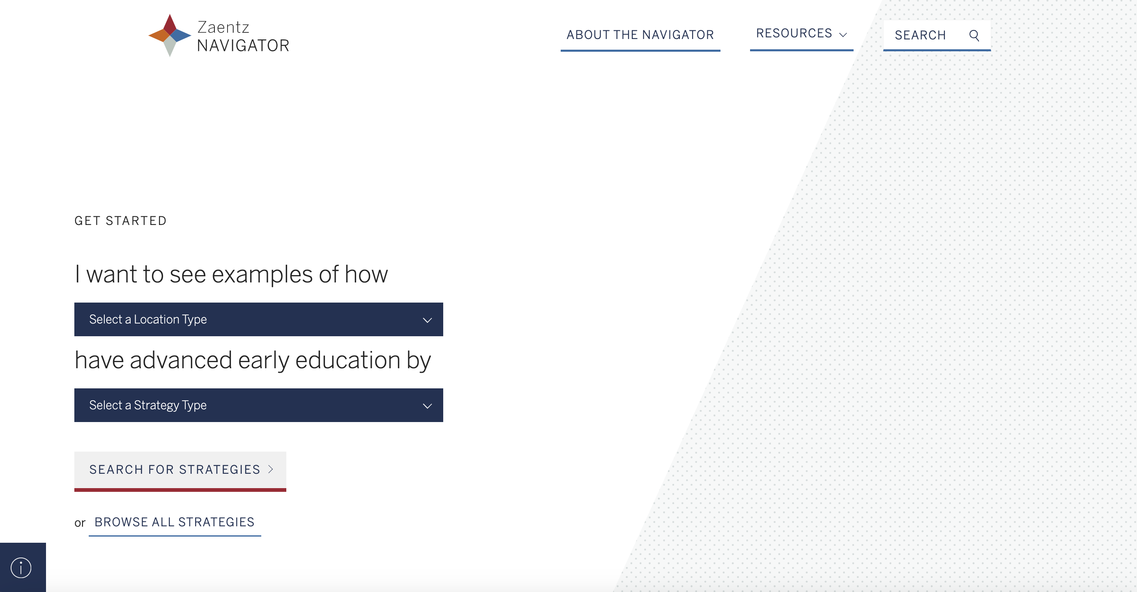
Zaentz Navigator Home Page
The homepage lets you build a sentence with specific search criteria:
Choose Location Type: Search for strategies at the state-, city-, or county-level or search all three location types.
Search by Strategy Type: Choose one of five key categories: Infrastructure to Support Early Ed. Systems, Dedicated Funding Streams, Cost Estimation for Subsidy Rates, Expansion and Workforce
Notes:
Choose whether you'd like to search for strategies at the state-, city-, or county-level, or search in all three location types
AND
2. Search for policy strategies in one of five key categories: Infrastructure to Support Early Childhood Systems, Dedicated
Funding Streams and Financing, Cost Estimation for Subsidy Rates, Expansion, and Workforce;
You can also bypass the sentence builder and browse all policy strategies and innovations.

Slide 5
Sample User Pathway
City Strategies
Dedicated Funding Streams | Taxes

Slide 6
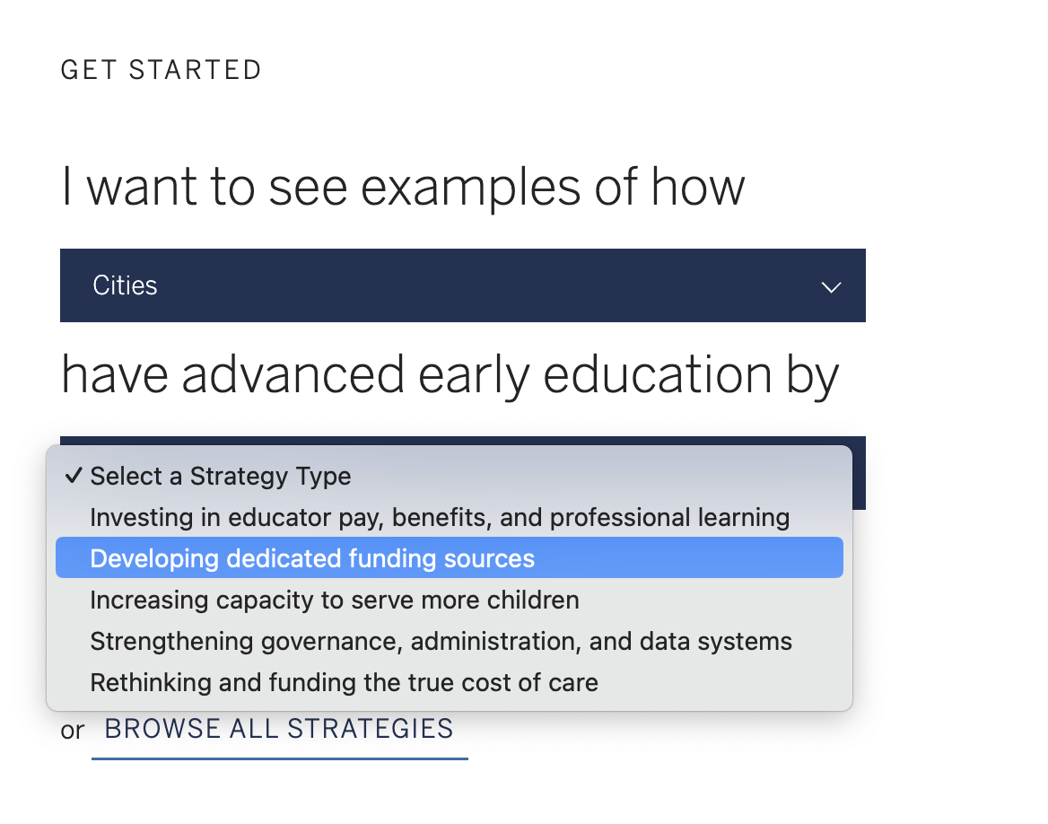
Zaentz Navigator: Sample User Pathway
If you were interested in learning more about strategies for developing dedicated funding sources to improve early childhood education, you
would select the second option in the strategy type dropdown menu.

Slide 7
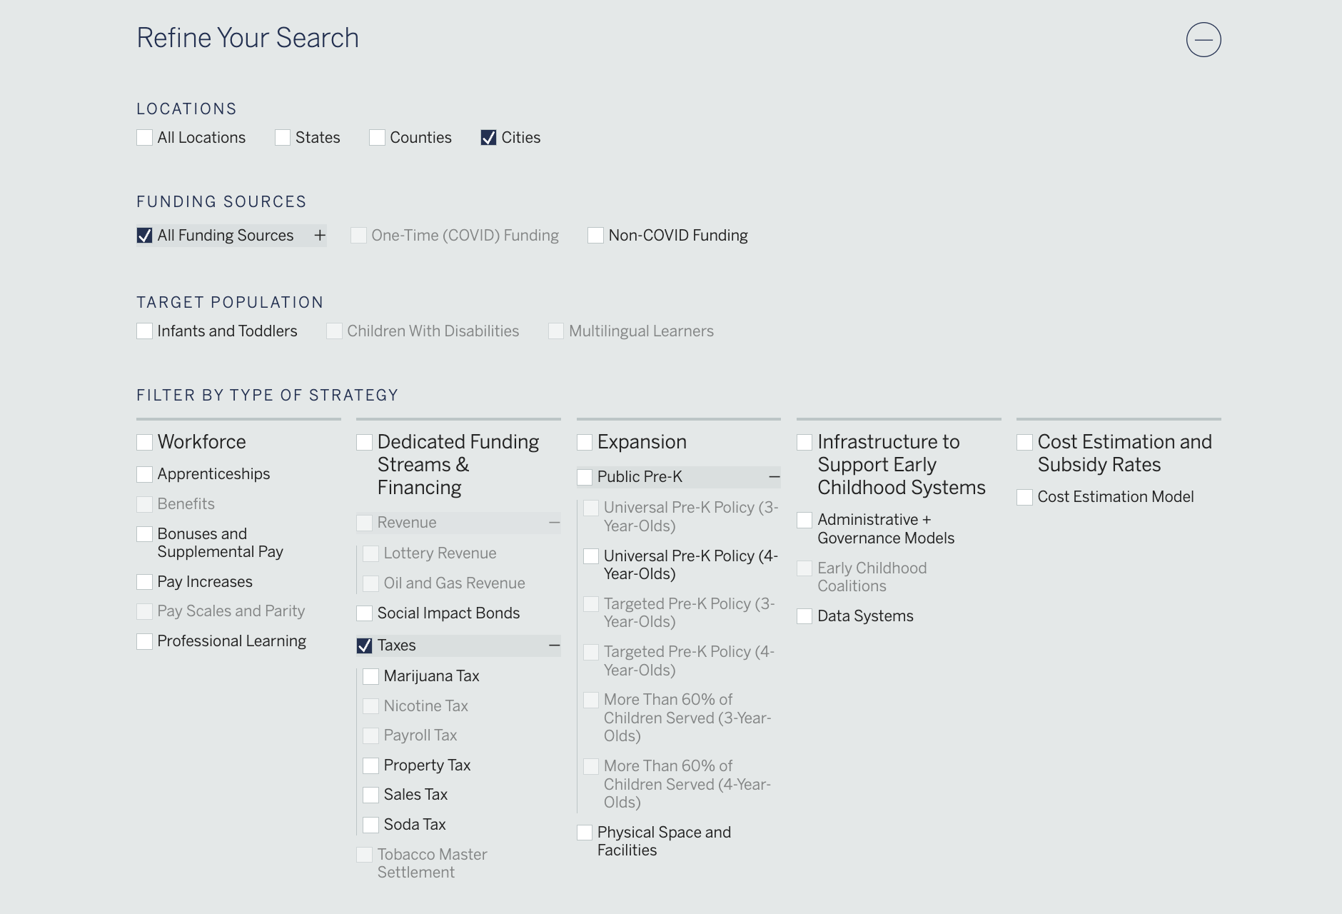
Zaentz Navigator: Sample User Pathway
You can apply filters to refine your search; for example, here we're interested in strategies related to taxes.

Slide 8
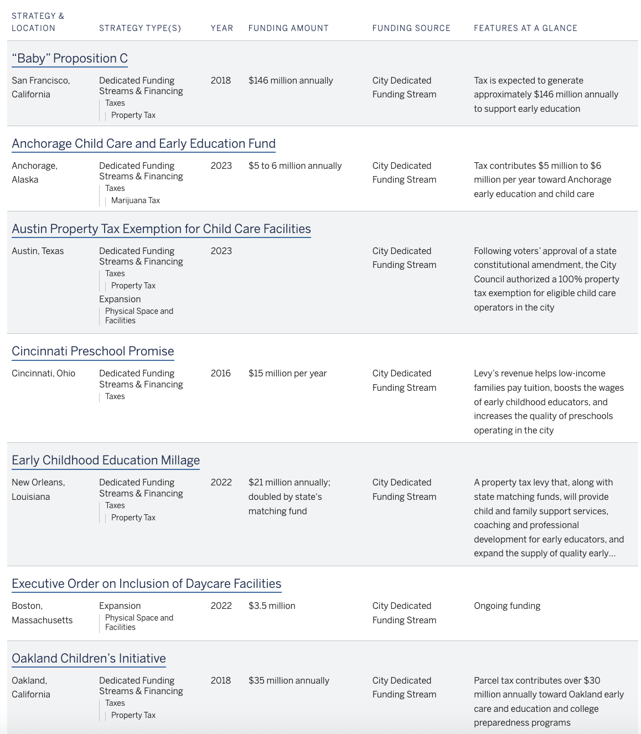
Zaentz Navigator: Sample User Pathway
You can review the search results table to determine which strategies meet your criteria.
In this example, you could elect to learn more about Anchorage's Child Care and Early Education Fund.

Slide 9

Zaentz Navigator: Sample User Pathway
In this example, the summary includes information about how the tax revenue will make child care more accessible in Anchorage.

Slide 10
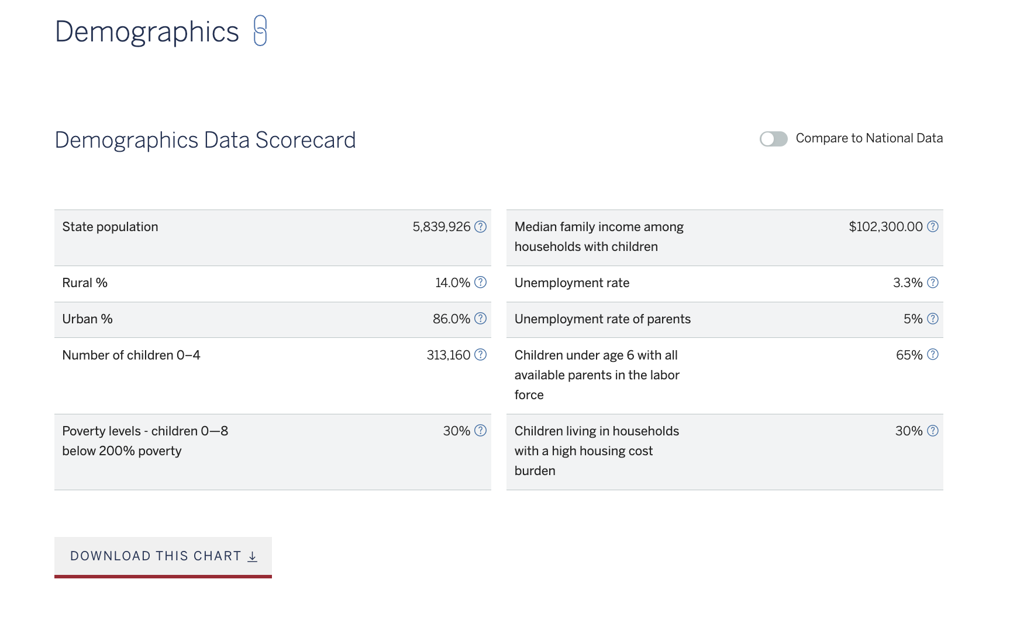
Zaentz Navigator: Location Profile
You can browse demographic data including state population, percentage of rural and urban populations, number of children ages 0-4, unemployment rate of parents, etc. You can also compare to national data using the toggle switch at the top of the chart.
You can download all charts for quick sharing on social media and email.

Slide 11
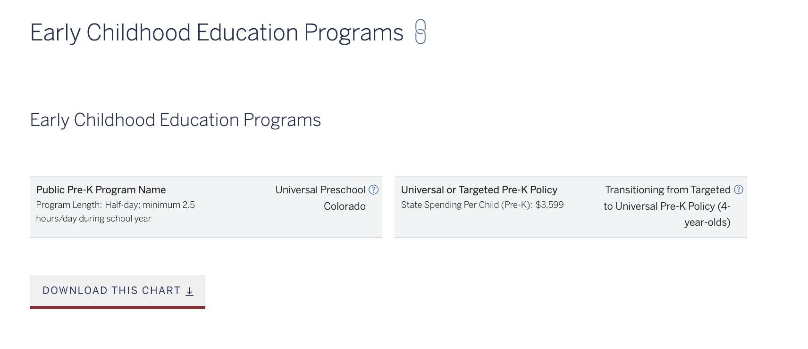
Zaentz Navigator: Location Profile
You can learn about the state's early childhood education program(s), including the Pre-K program's name and length of day, state spending per child (Pre-K), and type of pre-K policy implemented.

Slide 12
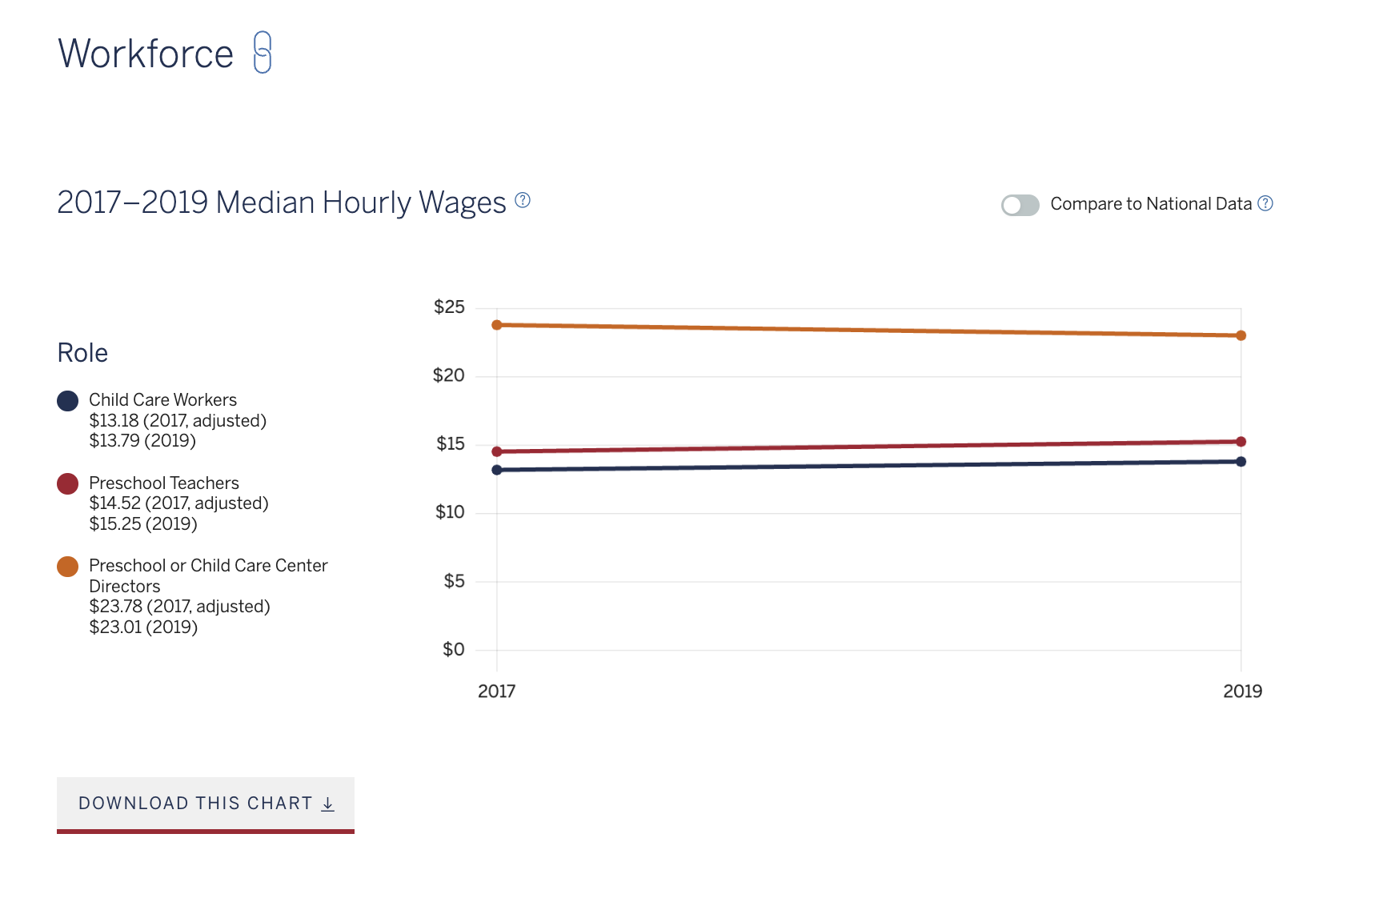
Zaentz Navigator: Location Profile
You can browse data related to the state's early education workforce, including median hourly wages for child care workers, preschool teachers, and preschool or child care center directors.
You can also use the button in the top right-hand corner to compare the state's median hourly wages to those at the national level.

Slide 13
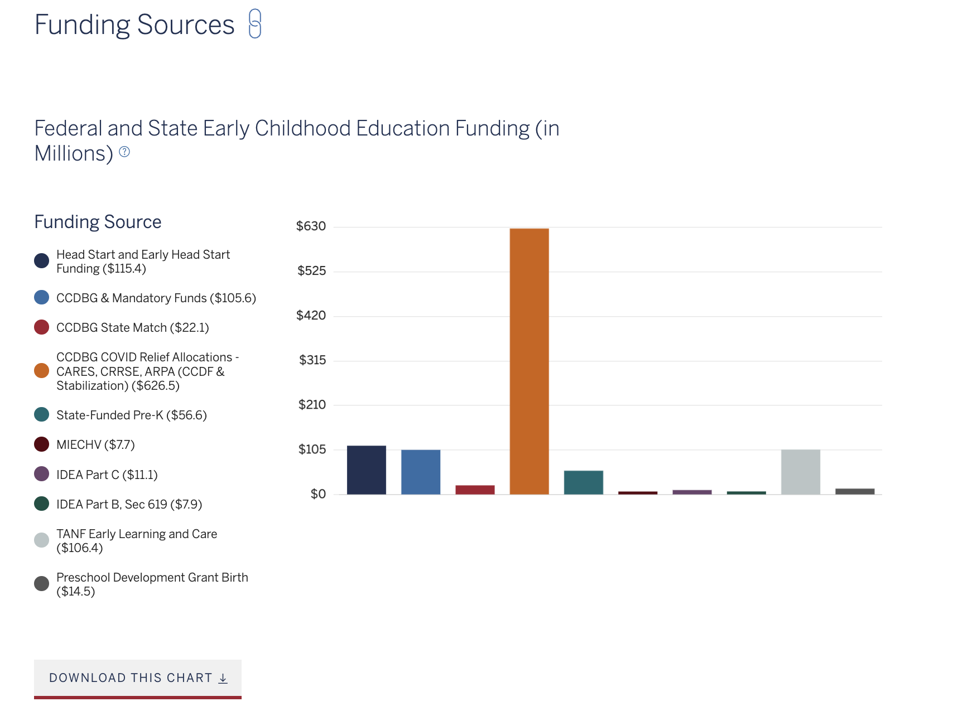
Zaentz Navigator: Location Profile
Without the stable funding that K-12 schools typically receive, states must often pull together funding for early childhood education from many sources.
The Navigator lets you browse data related to the state's early education funding sources.

Slide 14
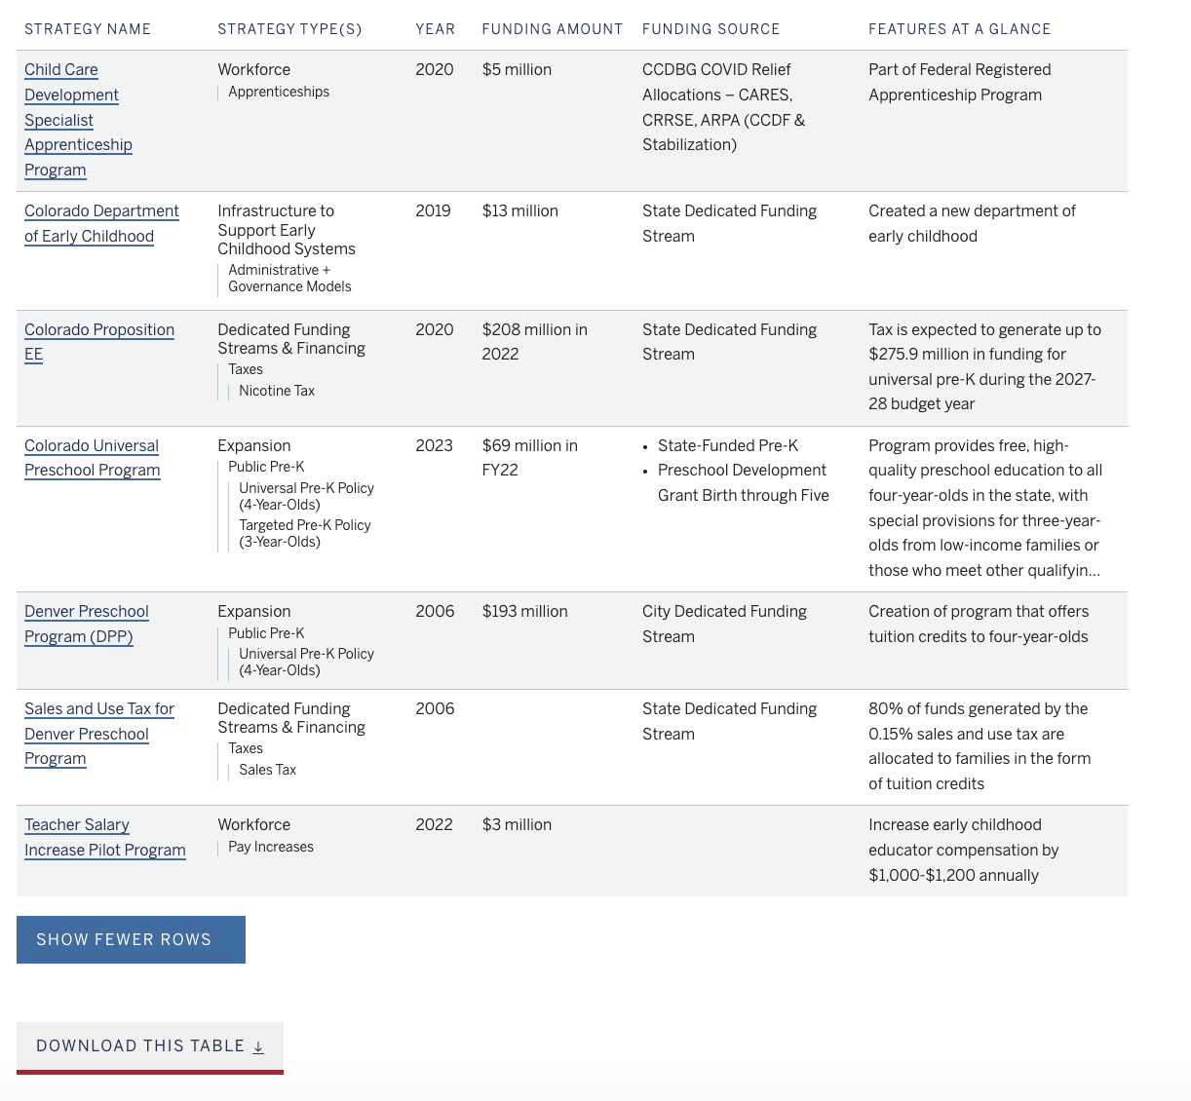
Zaentz Navigator: Location Profile
You can browse all of the state's strategies to learn how early childhood education is being supported in your chosen location.
This includes strategies implemented at the state, city, and county level.

