Slide 1
Education records competition!
Education Writers Association, Baltimore
June 5, 2026
Dr. David Cuillier, Director
Brechner Freedom of Information Project
University of Florida
cuillierd@ufl.edu
https://brechner.org/foi/

Slide 2
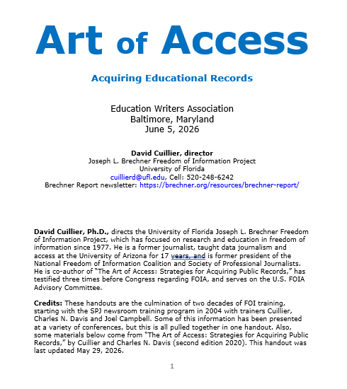
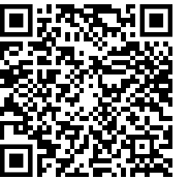
Handout and slides

Slide 3
Records competition
We start off with five record ideas to get the ideas flowing
Then, come up to the mic, form a line
Up to 60 seconds to say name, employer and record
Dave keeps things moving; timer keeps watch
Dave keeps a list on the screen for all to see
At the end, everyone votes online for the coolest database
Top 3 vote-getters receive merch and massive fame
TIPS: Think of something unique. Also, don’t go on about the story you did – focus on the exact database, where you got it from, what is in it.

Slide 4

1. Toxic classrooms
Local and federal agencies; lead in water, asbestos
Philadelphia Inquirer (2018)
Pulitzer finalist
https://www.inquirer.com/news/inq/toxic-city-philadelphia-inquirer-investigation-lead-asbestos-schools-20170618.html

Slide 5
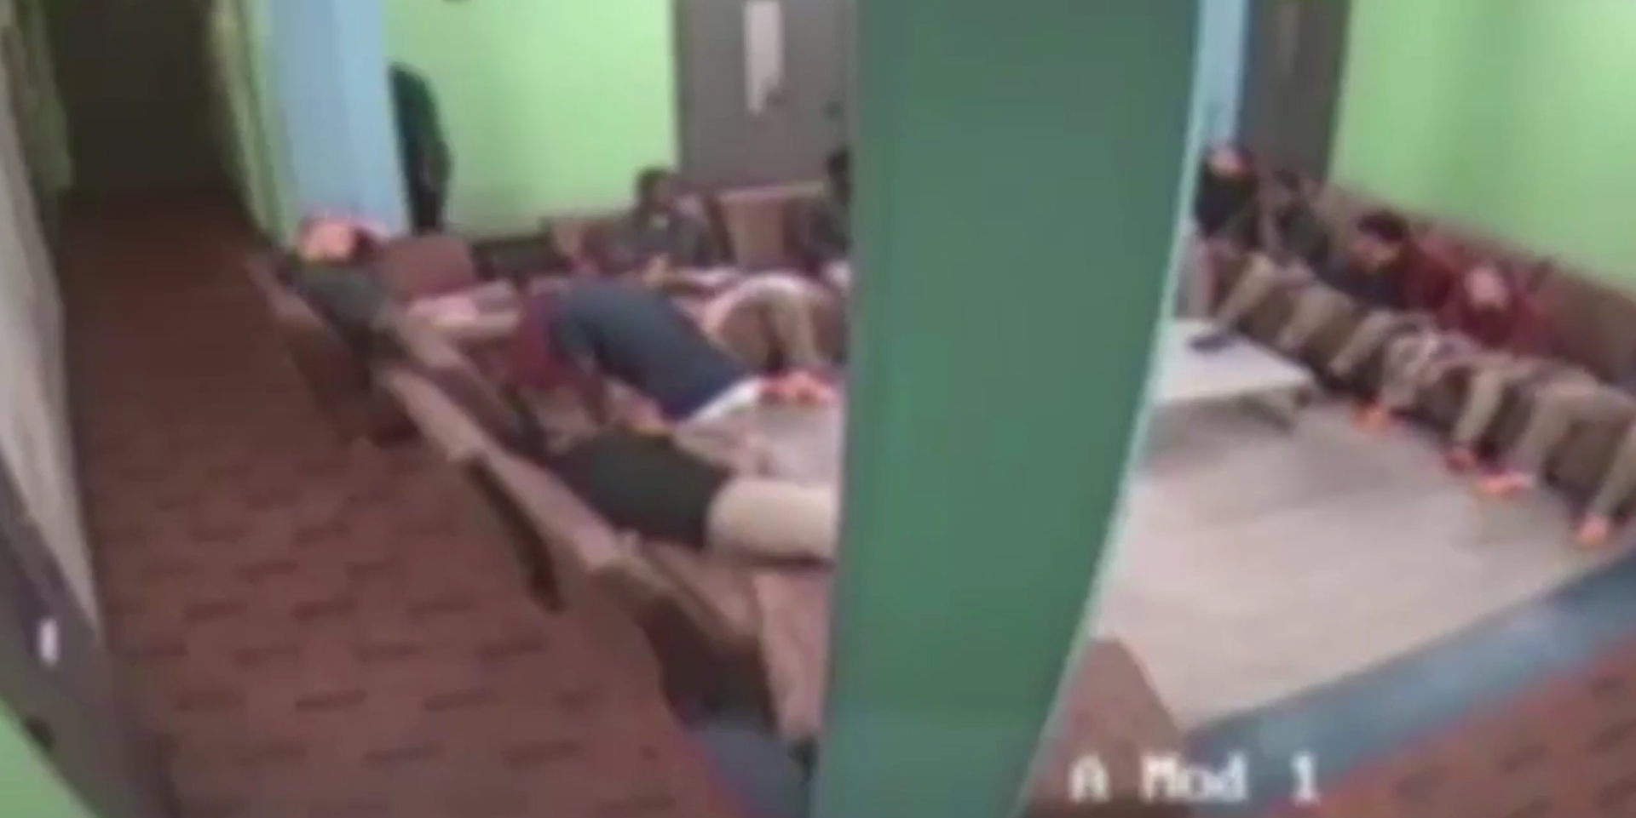
2. Fight club
Surveillance video in juvenile detention, schools
Miami Herald (2017)
Pulitzer finalist
https://www.miamiherald.com/news/special-reports/florida-prisons/article177987926.html

Slide 6

3. Gold teeth
Emails, memos between university and its foundation
Daily Bruin (2007)
(College student then – now Pulitzer winner at ProPublica)
https://dailybruin.com/2007/11/12/donations-influence-admissions

Slide 7
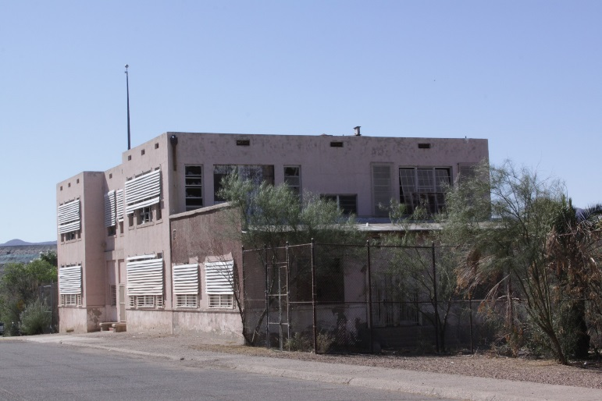
4. Slumlord profs
Property records and university employee list
ASU Cronkite News (2012)
https://data.cms.gov/provider-data/topics/hospitals

Slide 8
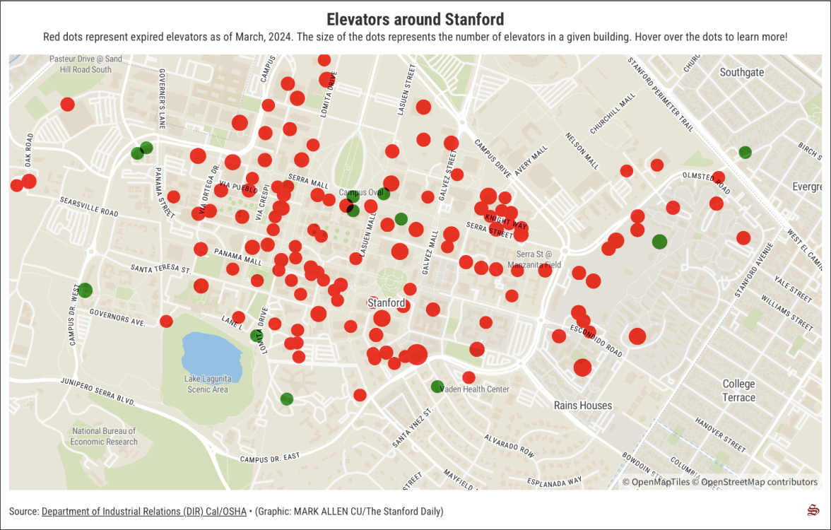
5. Elevators of death
State and OSHA inspection records
The Stanford Daily, 2024
https://stanforddaily.com/2024/03/15/94-of-elevators-on-campus-have-expired-permits/

Slide 9
Records competition
Come up to the mic, form a line
Up to 60 seconds to say name, employer and record
Dave keeps things moving; timer keeps watch
Dave keeps a list on the screen for all to see
At the end, everyone votes online for the coolest database
Top 3 vote-getters receive merch and massive fame
TIPS: Think of something unique. Also, don’t go on about the story you did – focus on the exact database, where you got it from, what is in it.

Slide 10
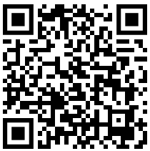
Select your favorite!

Slide 11
Select your favorite!
Small-group activity
(5 minutes):
Three cool records you will request on Monday

Slide 12
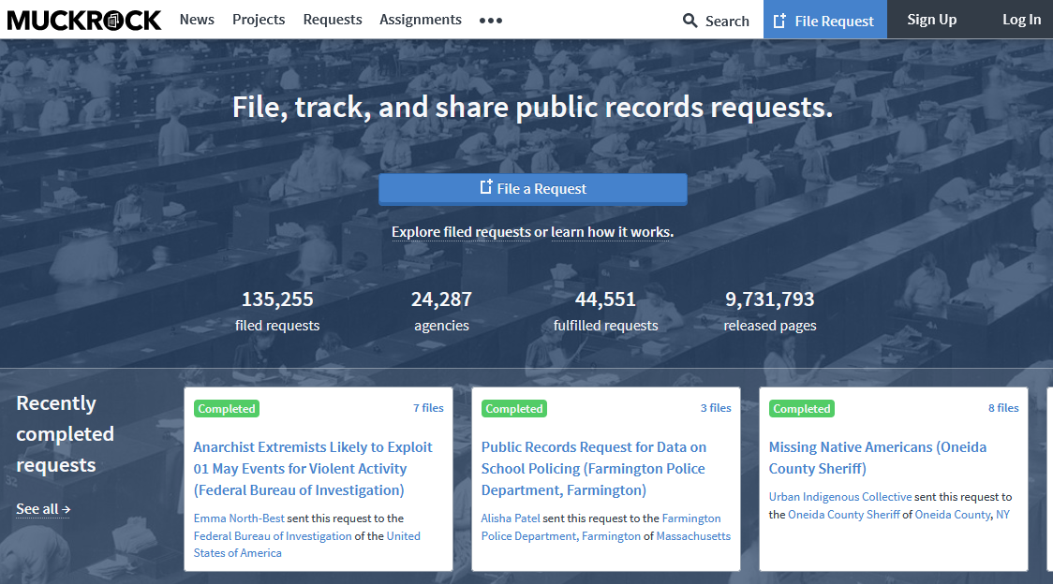
MuckRock
Handout:
Educational records, 3-9
https://www.muckrock.com/

Slide 13
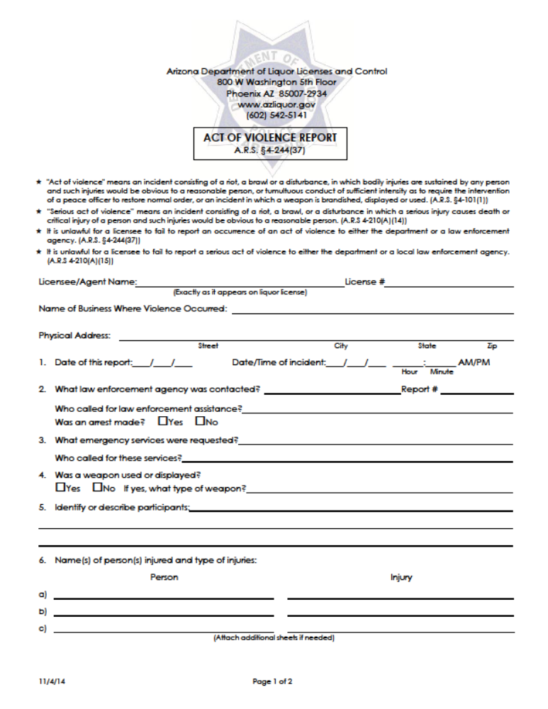
Website forms

Slide 14
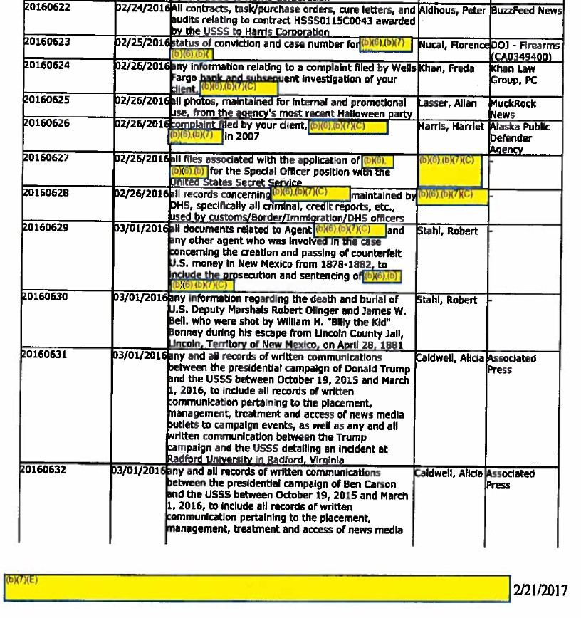
FOI logs

Slide 15
AI docu-finder
Gather FOI logs, either download or request
Input into NotebookLM (free, no account), or other AI tool
Ask it what documents to acquire!
Handout:
AI docu-finder
pages 10-12

Slide 16
What records can I request from the University of Florida about coach salaries?
Google search (158 words)
AI docu-finder (304 words)
Contracts, salaries, sponsors, budgets, etc.
Letters of Intent (LOI), MOU, term sheets, appointment letters
Incentive pay
NCAA Financial Reporting (FRS) Reports
Agreed-Upon Procedures Reports
Termination/severance records
Outside Income Disclosure Forms
Contracts
Base salaries, bonuses
Sponsorships, gear deals, media appearances

Slide 17
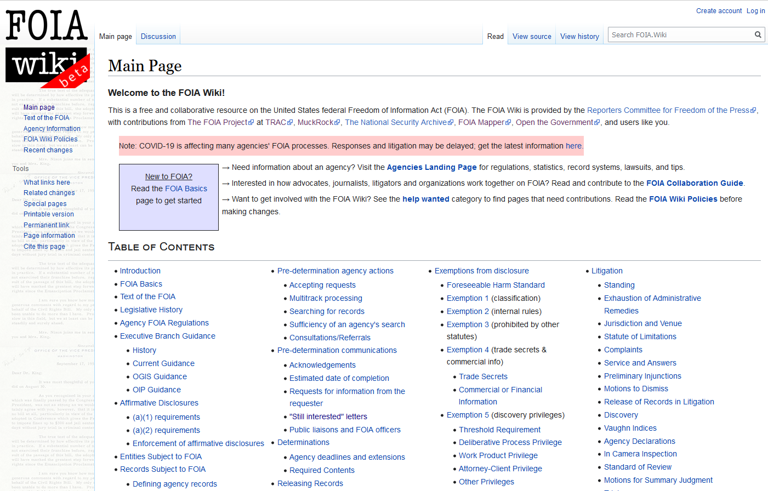
FOIA Wiki
https://foia.wiki/wiki/Main_Page

Slide 18
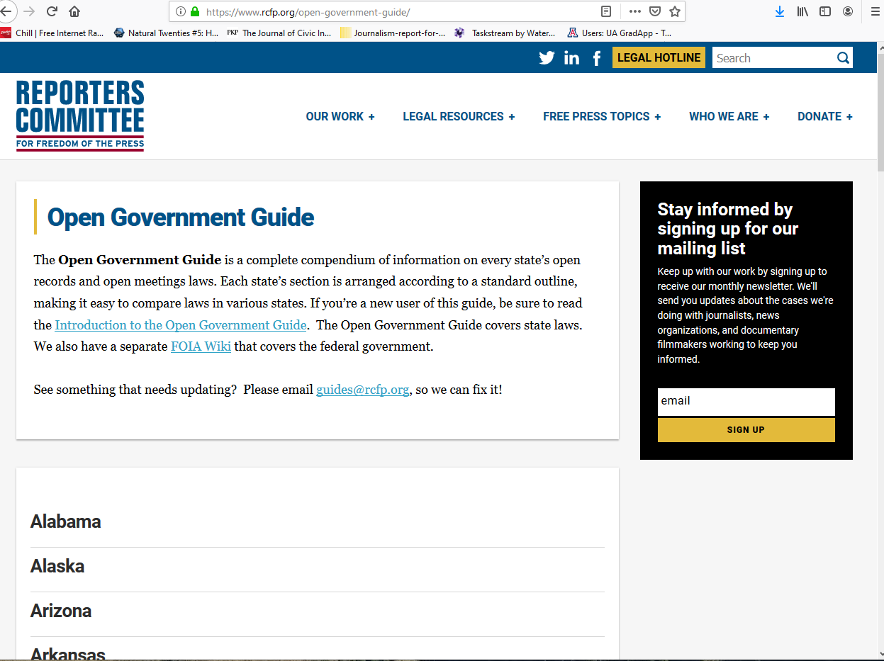
RCFP Open Government Guide
https://www.rcfp.org/open-government-guide/

Slide 19
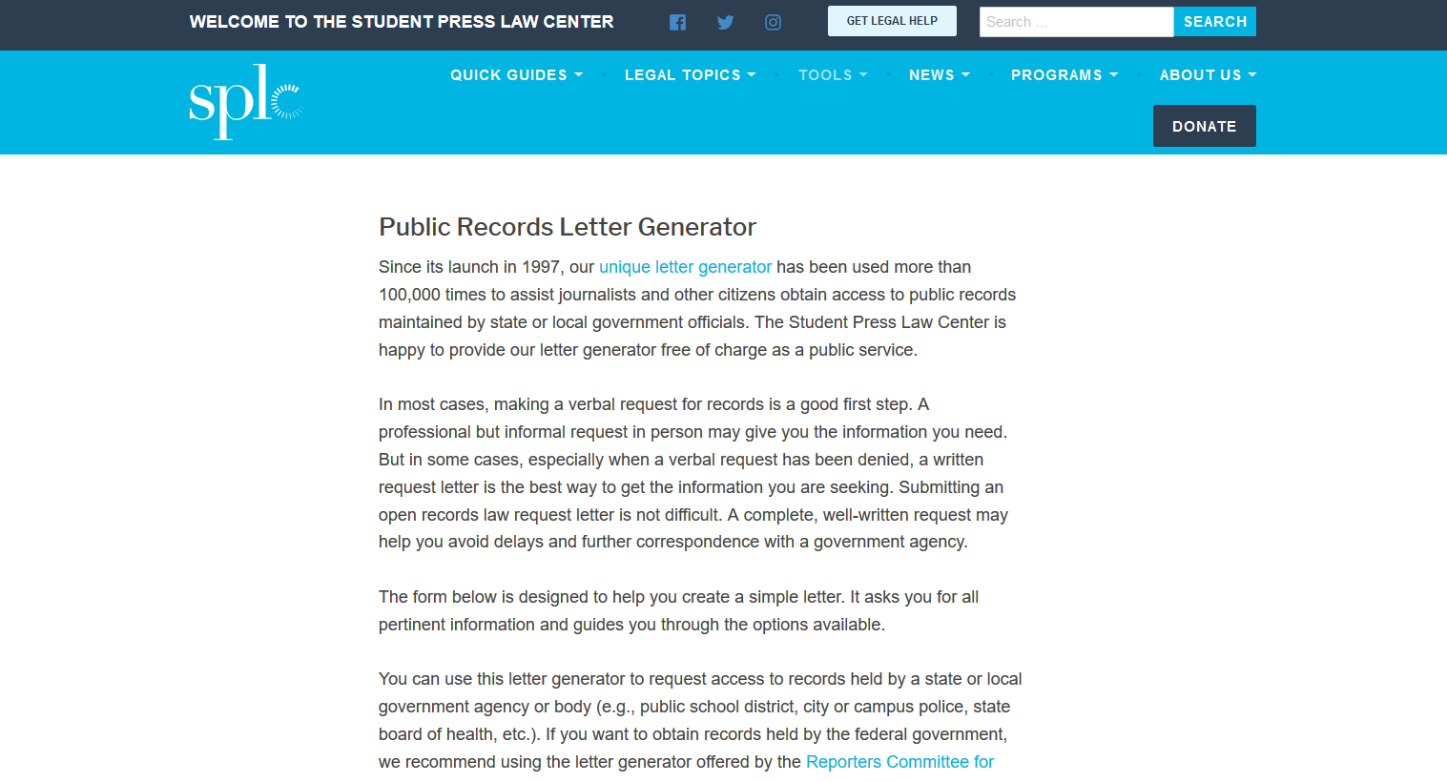
SPLC letter generator
https://splc.org/lettergenerator/

Slide 20
April 14, 2026
Mayor Robyn Tannehill
107 Courthouse Square
Oxford, MS 38655
Dear Mayor Tannehill,
Pursuant to the state open records law Miss. Code. Ann. Secs. 25-61-1 to 25-61-19, I write to request access to and a copy of copy of all expense reports for the city for the past five years If your agency does not maintain these public records, please let me know who does and include the proper custodian's name and address.
I agree to pay any reasonable copying and postage fees of not more than $5. If the cost would be greater than this amount, please notify me. Please provide a receipt indicating the charges for each document.
As provided by the open records law, I will expect your response within seven (7) business days. See Miss. Code Ann. Sec. 25-61-5(1)(a).
If you choose to deny this request, please provide a written explanation for the denial including a reference to the specific statutory exemption(s) upon which you rely. Also, please provide all segregable portions of otherwise exempt material.
I would note that willful violation of the open records law can result in a fine of up to $100 and all reasonable litigation expenses. See Miss. Code Ann. Sec. 25-61-15.
Thank you for your assistance.
David Cuillier
The Daily Mississippian
cuillier@olemiss.edu
Handout:
Sample letters, 37-39

Slide 21
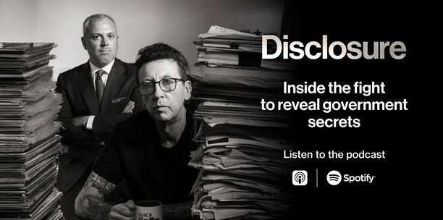
Get inspired
Jason Leopold and Matt Topic
Bloomberg News
https://www.bloomberg.com/news/newsletters/2025-10-24/-disclosure-a-new-podcast-about-the-fight-for-government-records
Handout:
Resources
pages 63-68
And weekly Jason Leopold email newsletter, FOIA Files: https://www.bloomberg.com/account/newsletters/foia-files

Slide 22

Get help
FOI resources (www.Brechner.org/FOI)
Quotes for denial stories
Annual FOI reporting award ($3,000)
https://secrecytracker.org
Https://sunshineweek.org
Email newsletter: https://brechner.org/resources/brechner-report/
David Cuillier, director
Cell: 520-248-6242
cuillierd@ufl.edu

Slide 23
Just do it!
Handout:
Overcoming denials, 40-46
Eliminate fees, 44
Hard tactics, 47-50

