Slide 1

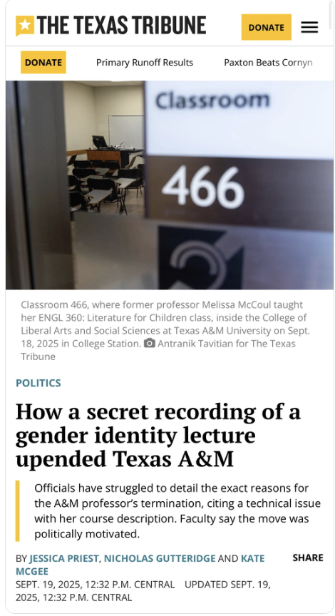
How we reported past a viral clip
June 1, 2026
Investigating a Texas A&M classroom controversy

Slide 2
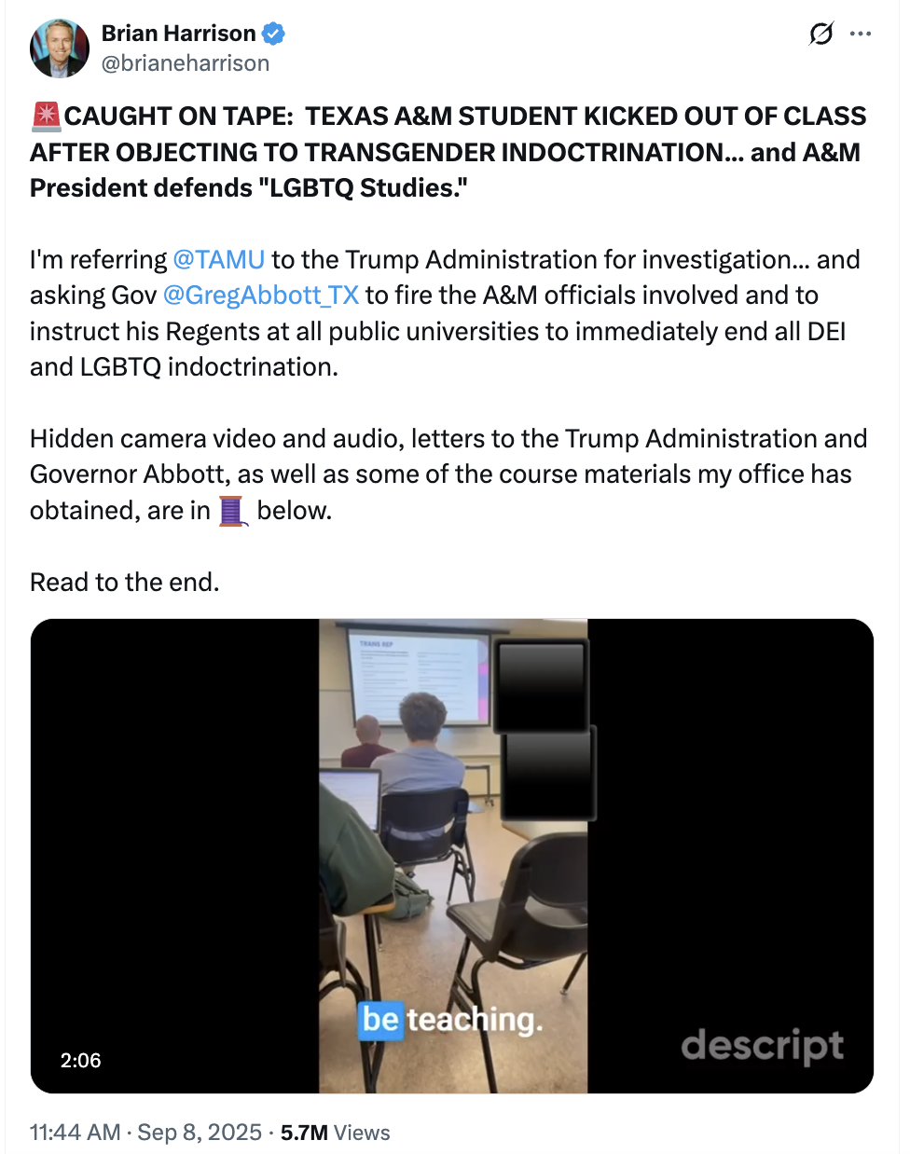
^{The public narrative 📰}
Student challenges professor over gender identity lesson
Video goes viral
Lawmakers call for firings
Professor is fired
Dean and department head are removed from administrative roles

Slide 3
Our central reporting question
What actually happened before, during and after the clip?
We needed to know:
What students were reading
What the professor was teaching
What happened in the room
Who complained
What administrators knew
Why the university said she was fired

Slide 4
From viral moment to reporting plan
Build a timeline
Track records requests and deadlines
Keep a shared source/to-do list
Save copies before posts, videos or profiles disappear

Slide 5
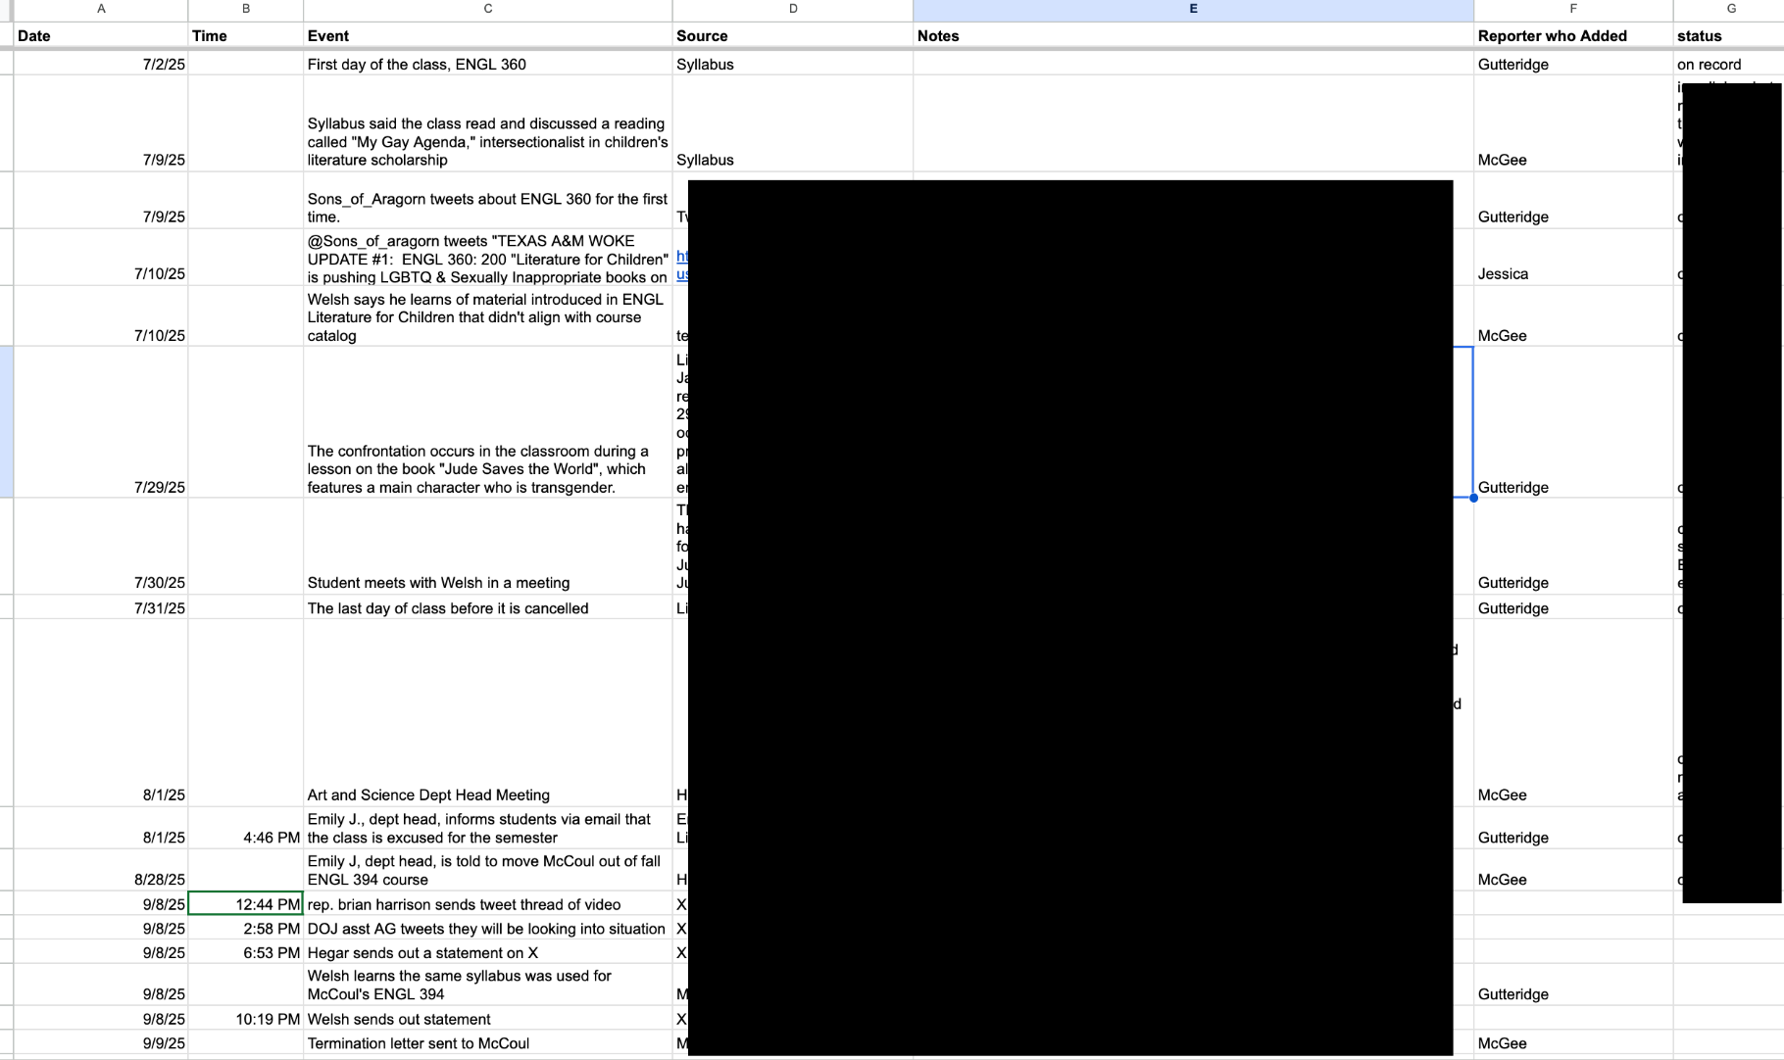
Notes:
Timeline

Slide 6
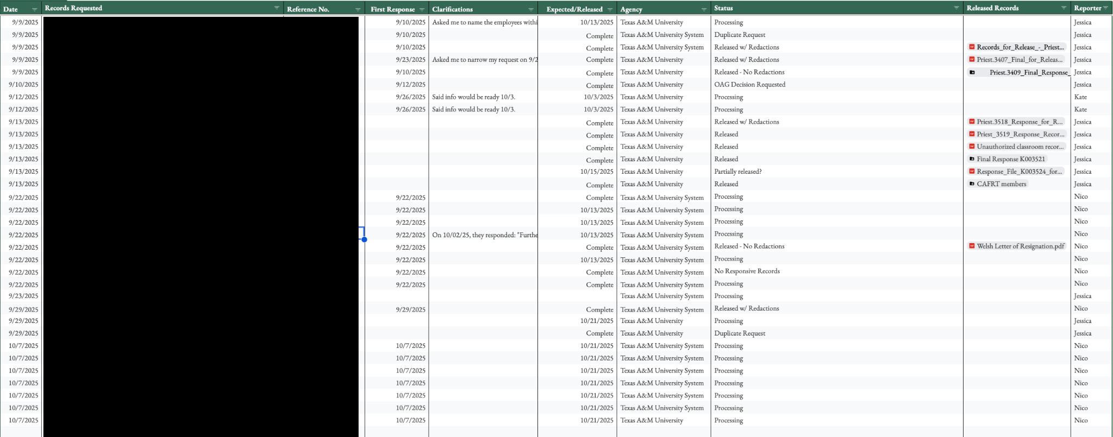
Notes:
Record requests tracker

Slide 7
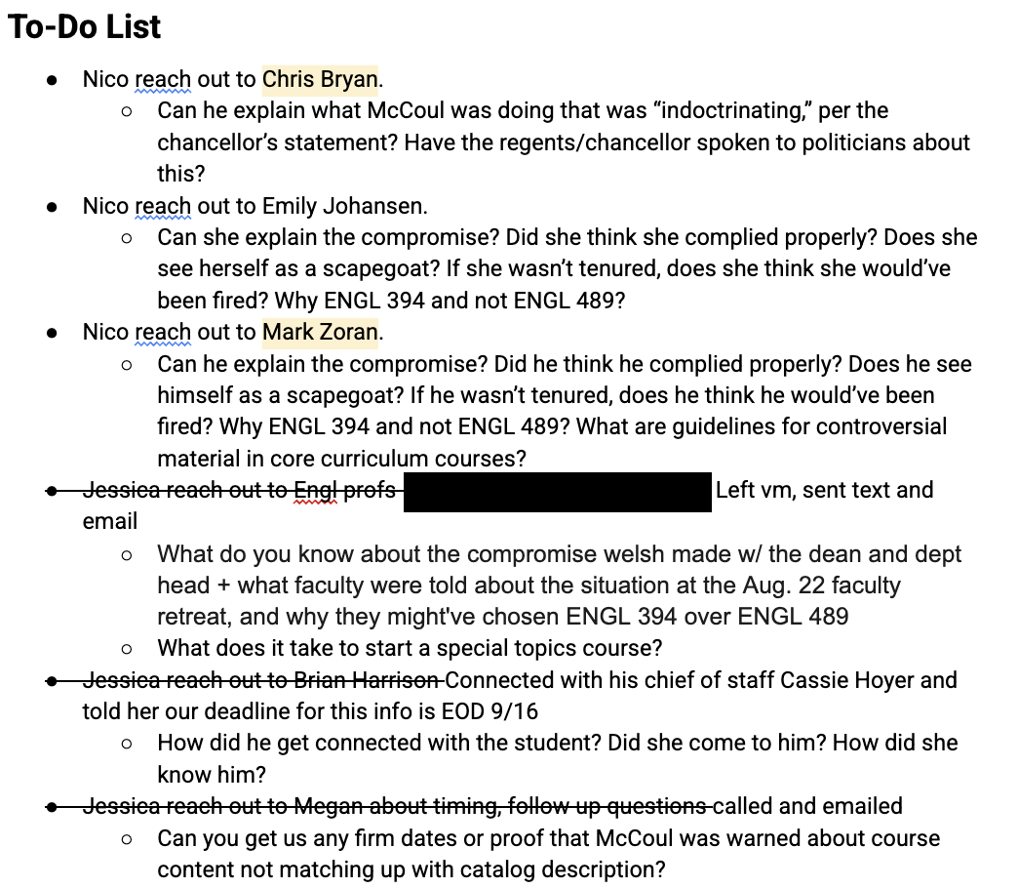

Slide 8
Talk to people in the room
“The book that caused the issue was already on the syllabus.”
Ask students:
  What happened before the recording started?
  What happened after it ended?
  Was this typical for the class?
  What were you actually reading, discussing or learning?
  Did the video match what you experienced?
Notes:
Don’t flatten the student experience.
One student said the book was already on the syllabus.
Another said publicly the class wasn’t what she expected.
The job was not to pick a side.
The job was to test both against documents.

Slide 9
Test the official explanation
Officials said: Course content did not match the catalog description.
So we checked:
Catalog description: “Representative writers, genres, texts and movements.”
Syllabus for the course in question
Syllabi for other sections of the same course
Course approval materials
Termination policy

Slide 10
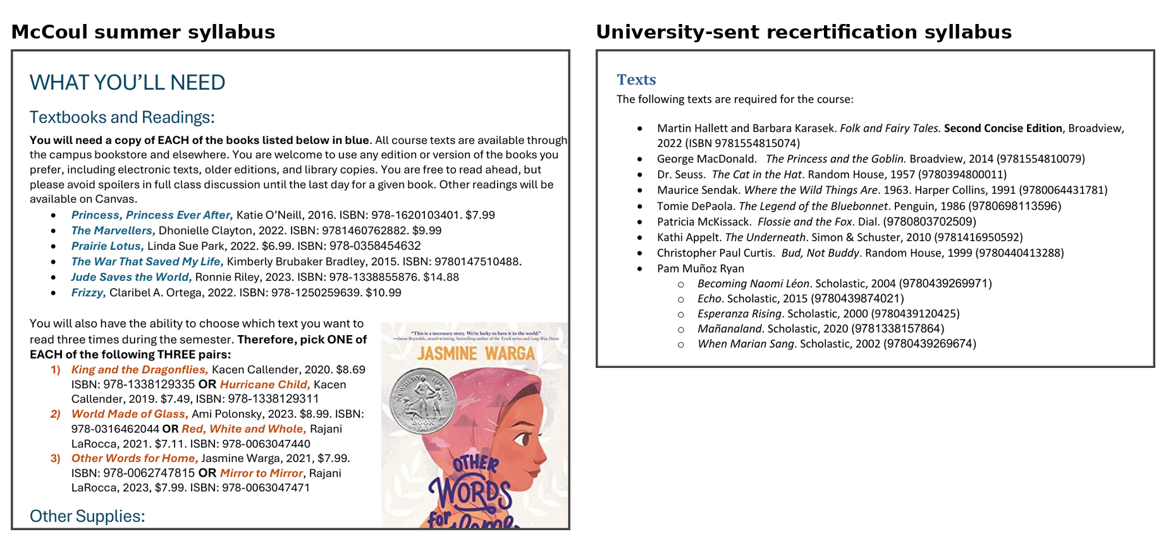
The catalog was vague. The syllabi were specific.
University’s stated rationale: course content did not match catalog description
Our reporting move: compare catalog, syllabus, recertification materials and termination letter

Slide 11
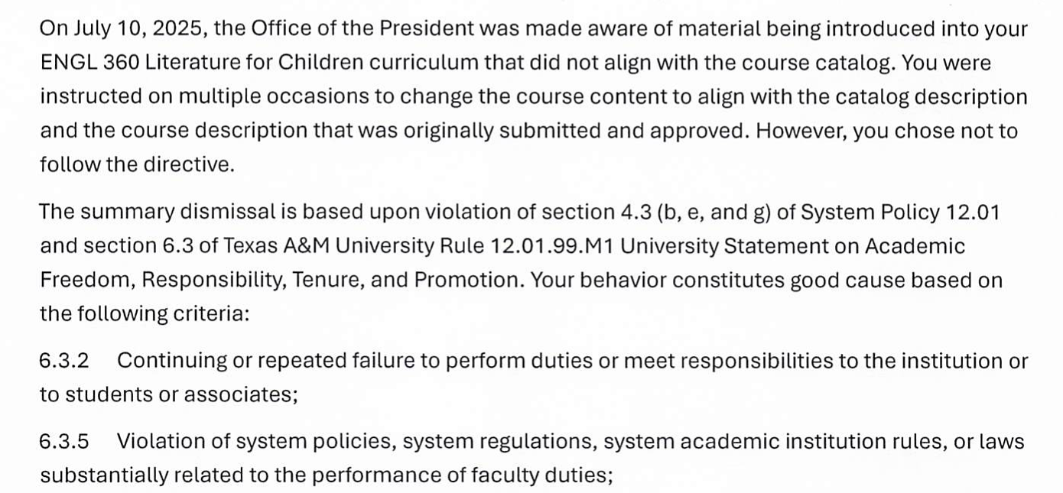
Treat the official explanation as a claim to test

Slide 12
Check the law yourself
When someone says something is “illegal,” ask:
What law?
Does it apply to college classrooms?
Is it a law, policy or executive order?
Are teaching and research exempt?
Is the university citing the same thing politicians are citing?

Slide 13
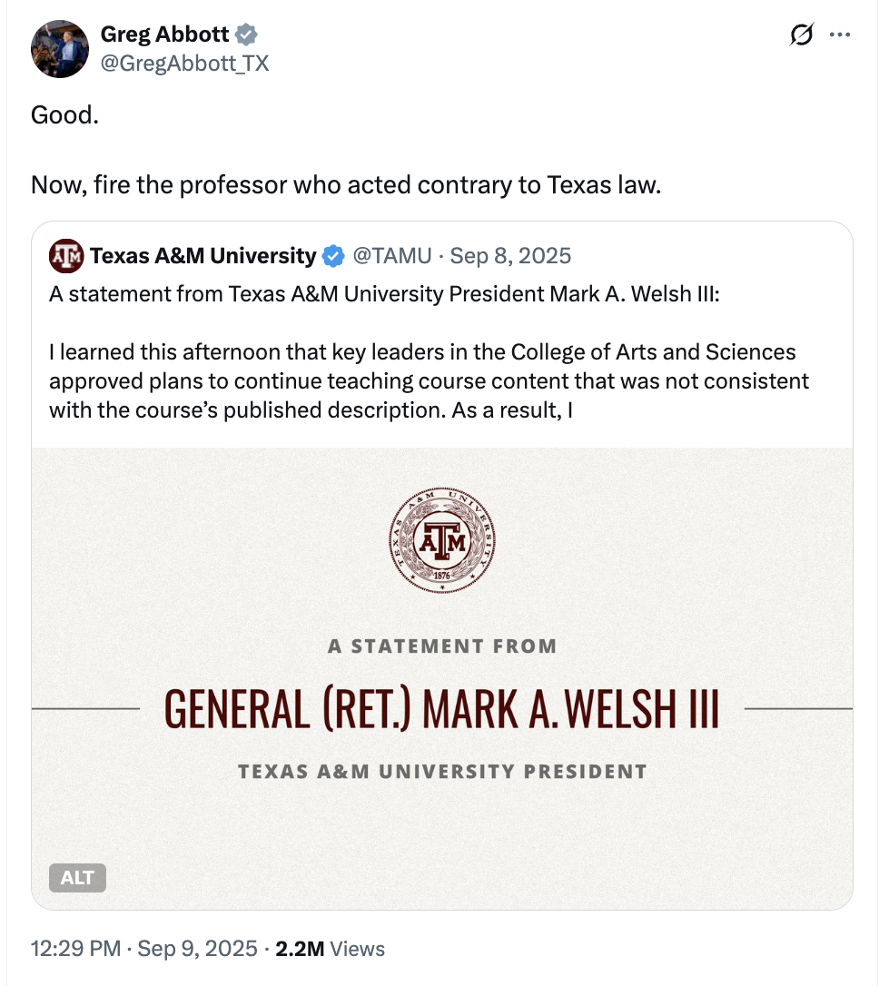
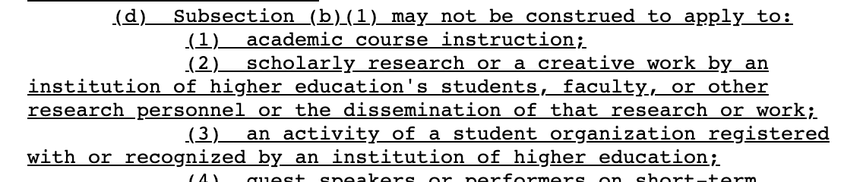
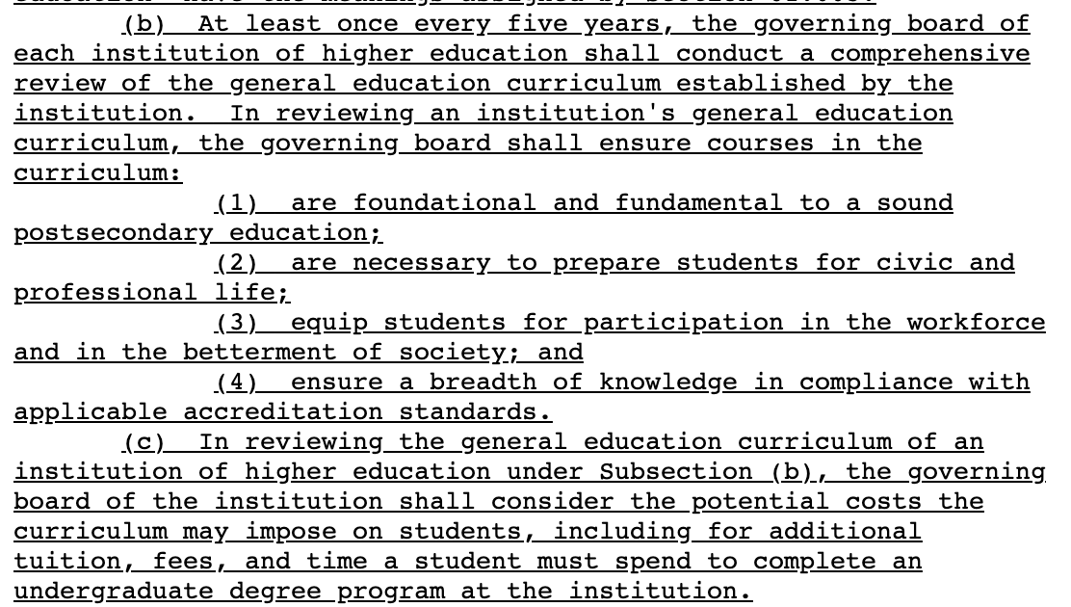
Notes:
SB 17, the state’s DEI ban, specifically exempted academic course instruction.
An earlier version of SB 37 restricted certain classroom content. That language did not make it into the final law.

Slide 14
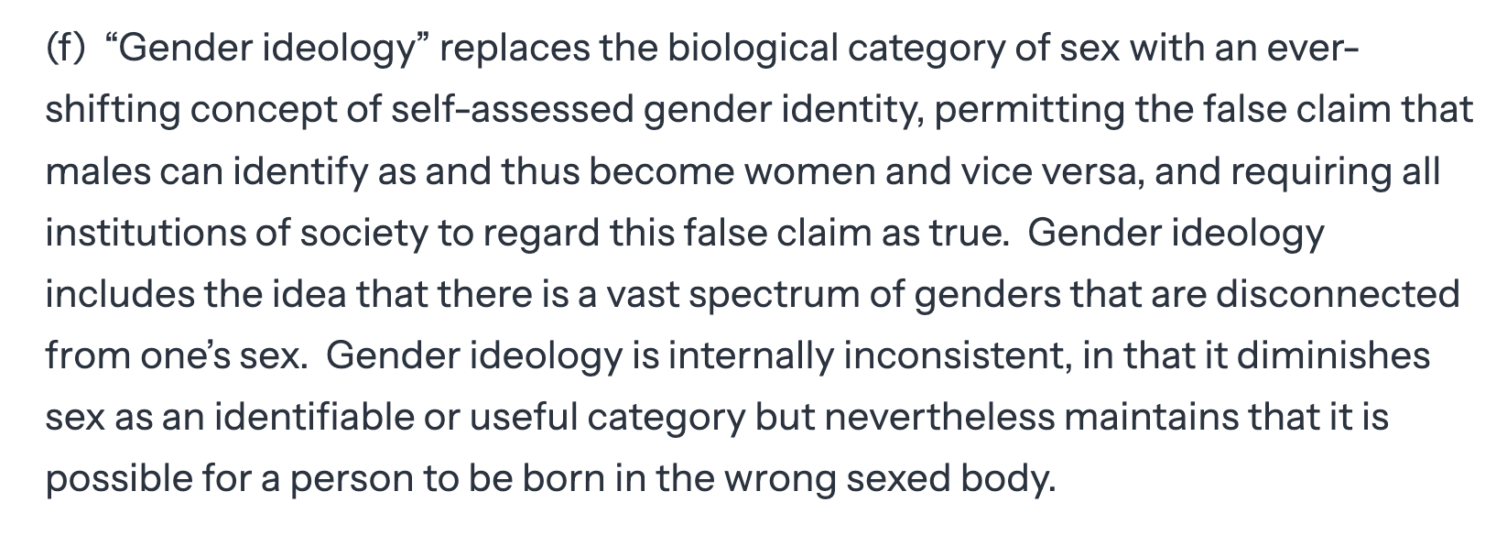
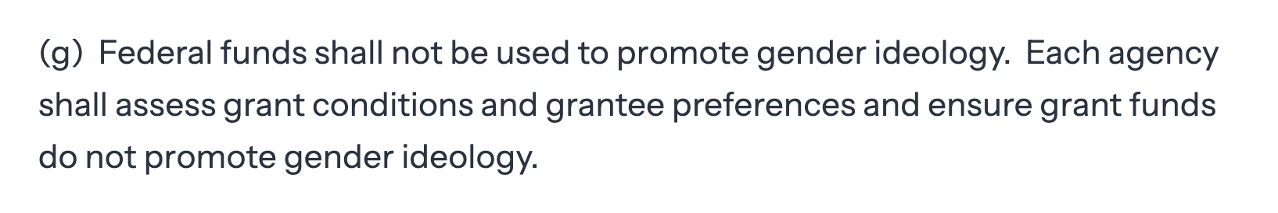
Notes:
The student cited an executive order by President Donald Trump barring federal funds from being used to promote “gender ideology,” but it did not mention teaching

Slide 15
Look for the chilling effect
Faculty considering recording lectures
Professors worried about being targeted
Departments unsure what counts as “too much”
Students and faculty feeling unsafe
Administrators reacting at the speed of social media
Notes:
Don’t just ask what happened to one professor. Ask what everyone else learned from it.

