Slide 1
Magic v. Tragic:
Covering the A.I. Hype Cycle in Schools

Slide 2
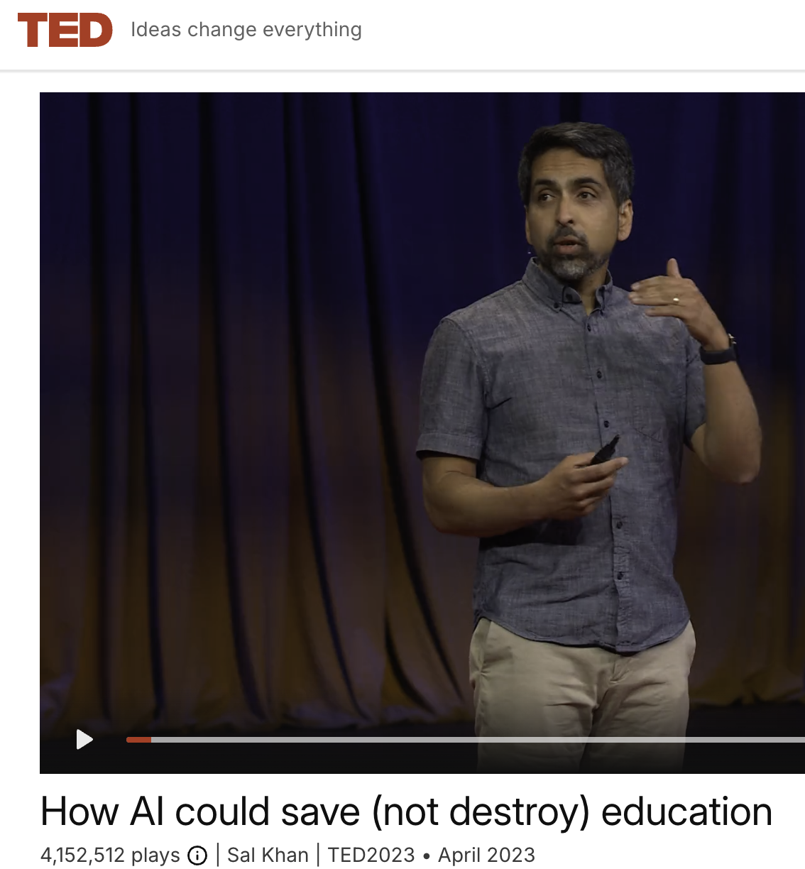
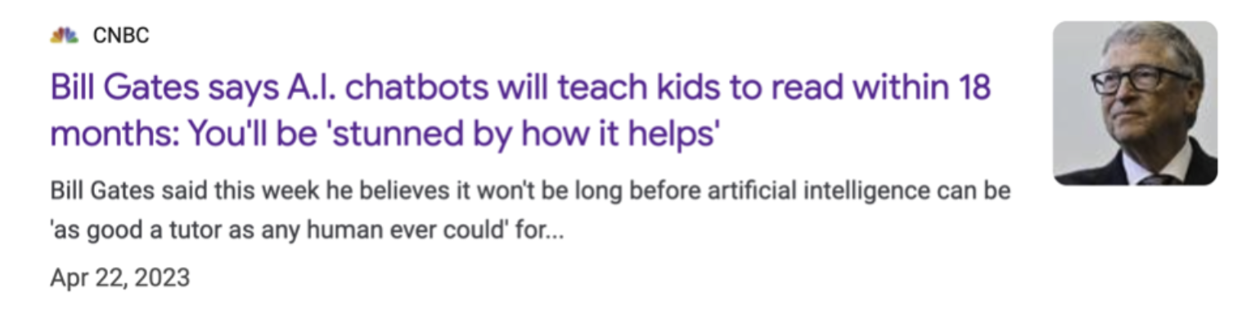
Magic visions:

Slide 3
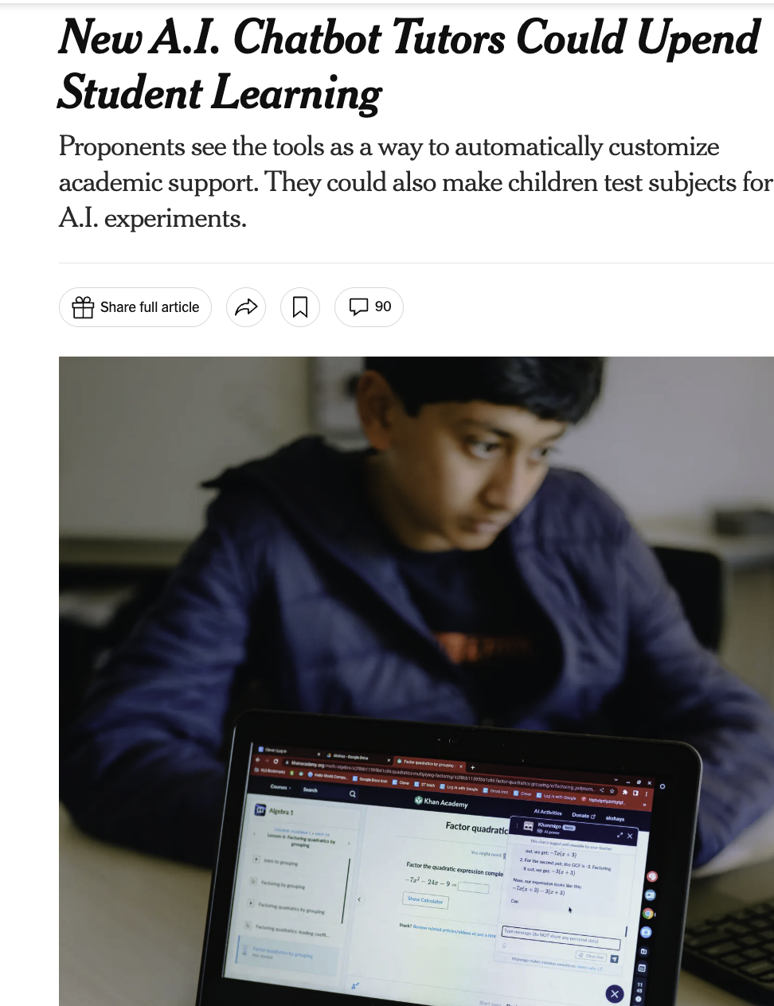
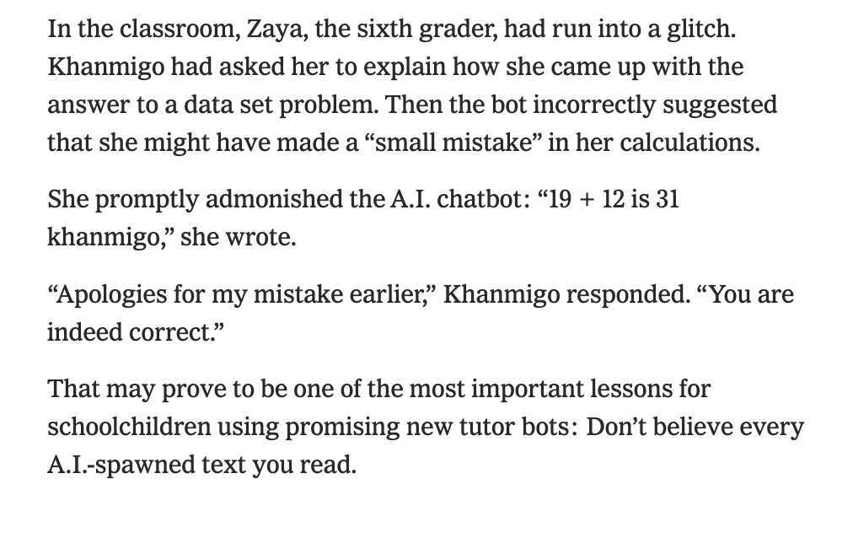
Ground Truthing #1: Khan Lab School, Mountain View, Calif.

Slide 4
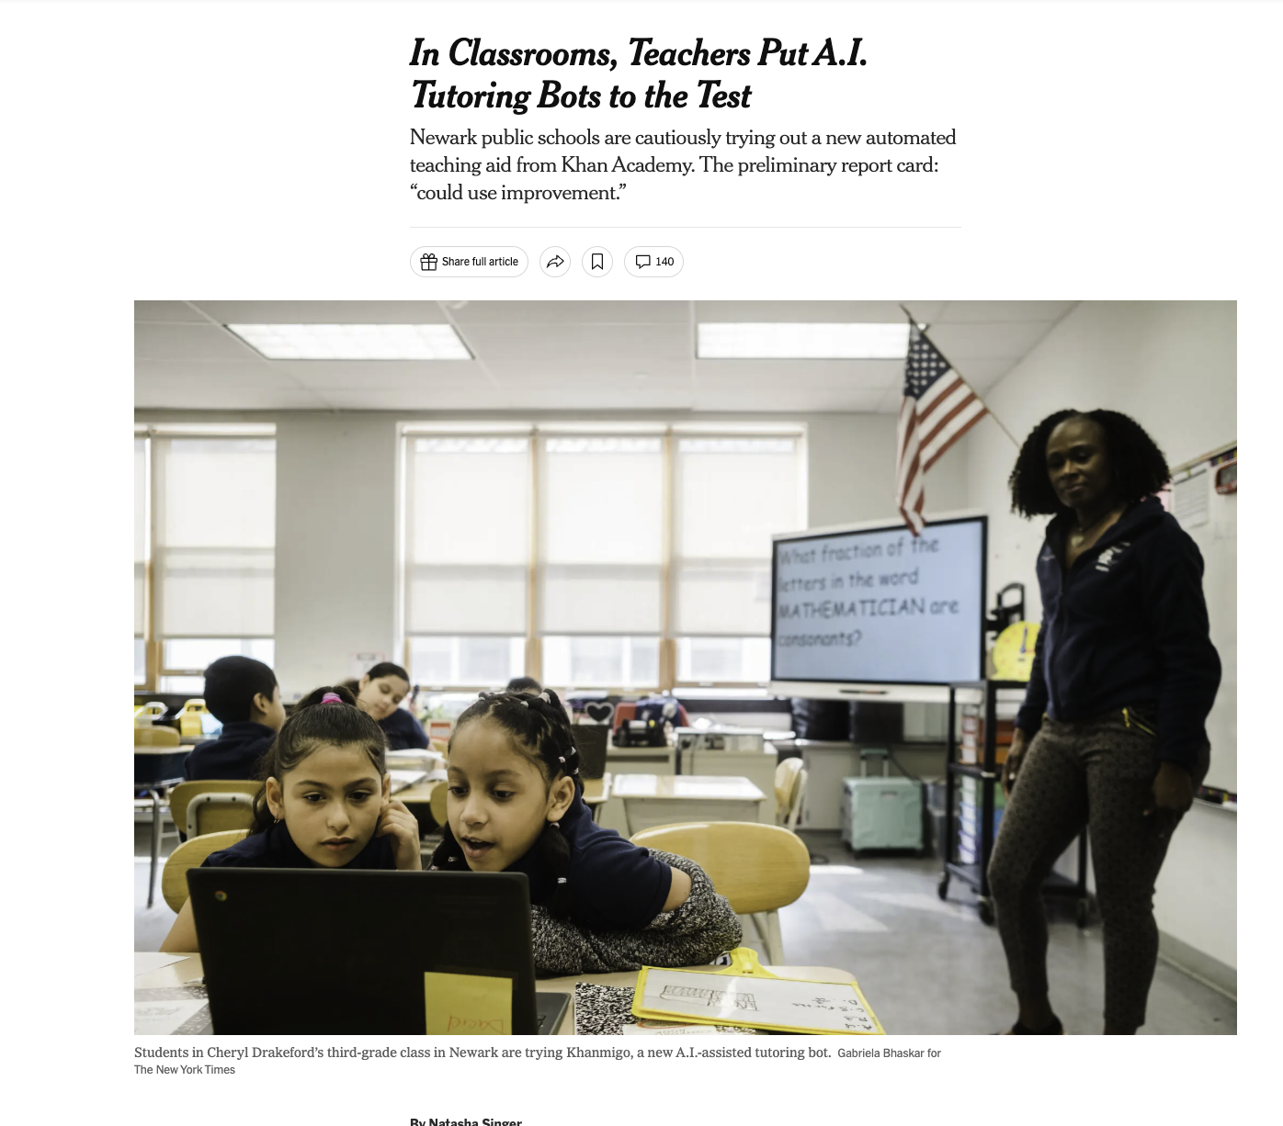
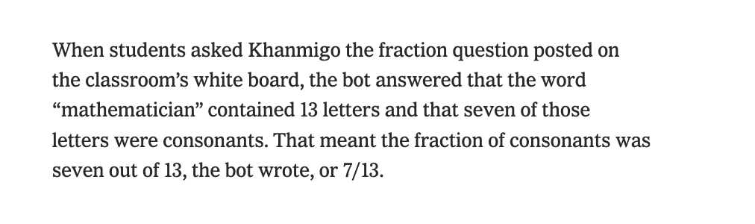
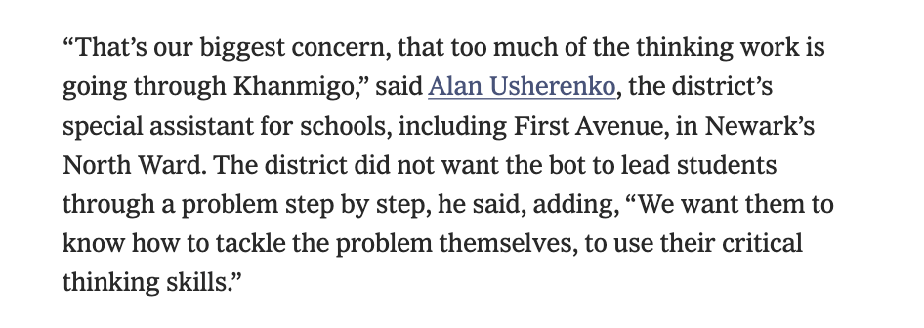
Ground Truthing #2: Newark Public Schools

Slide 5
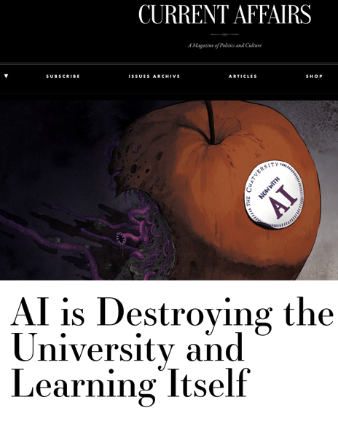
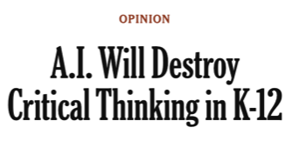
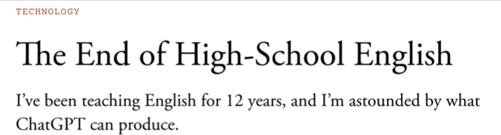
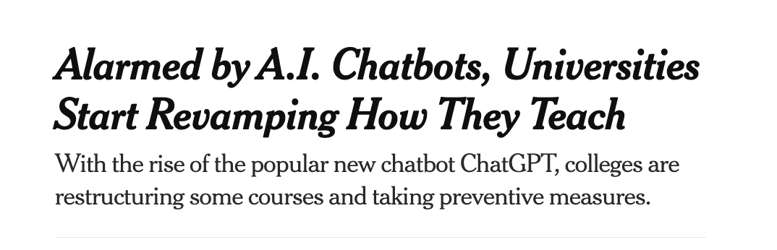
Tragic visions:

Slide 6
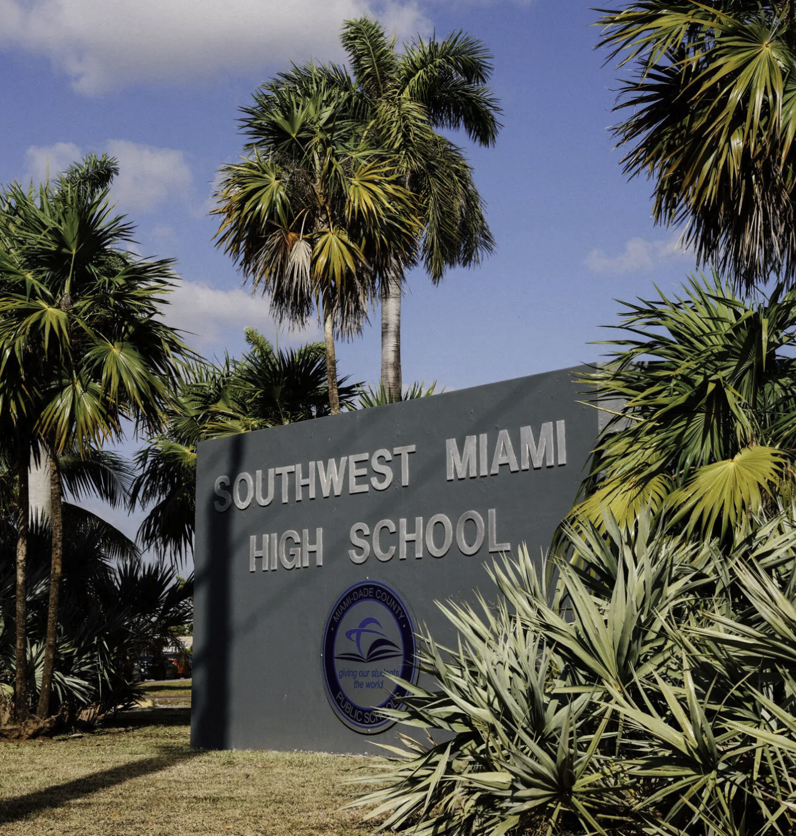
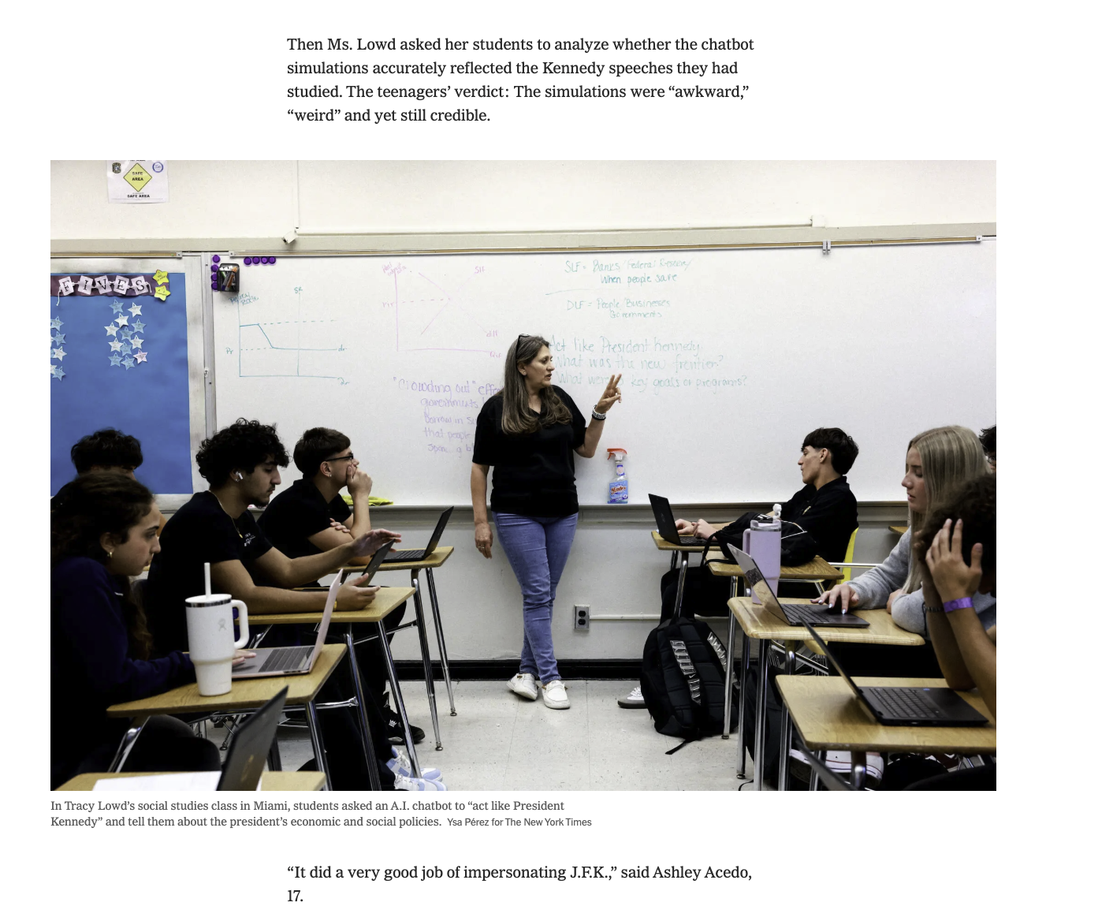
Ground Truthing: Miami Dade County Public Schools

Slide 7
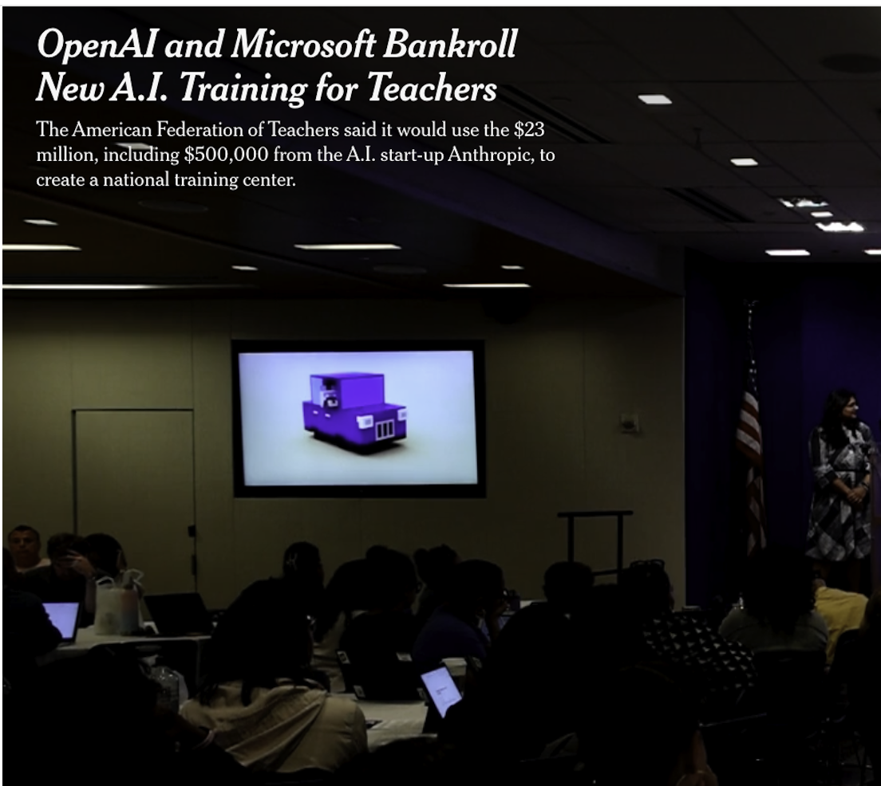
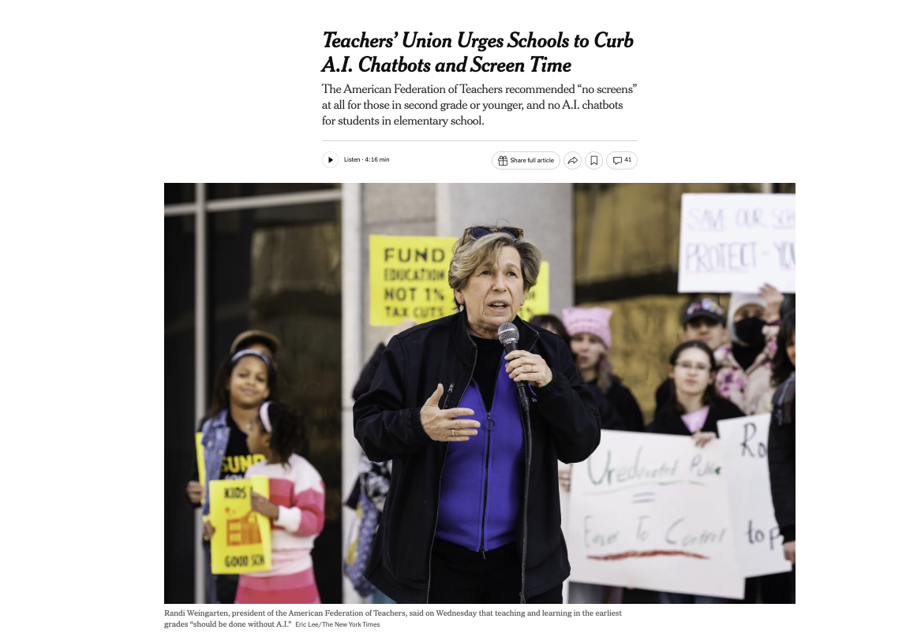
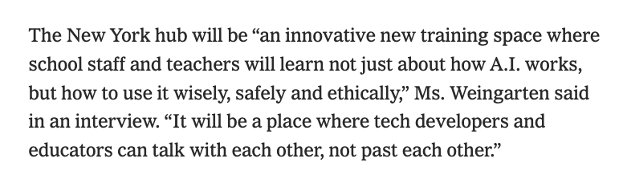
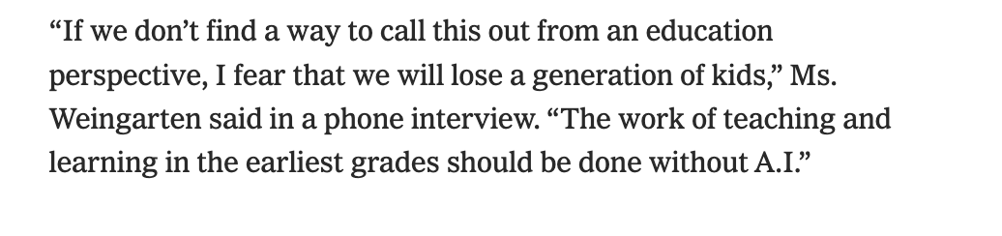
AI Hype Cycle Acceleration: Magic to Tragic in 10 months
July, 2025
May, 2026

Slide 8
-- The tech industry A.I. education narrative is product/chatbot-driven.
-- So stories ground-truthing that A.I. hype can end up being similarly bot-centric.
-- There is another way: ignore the A.I. education hype.

Slide 9
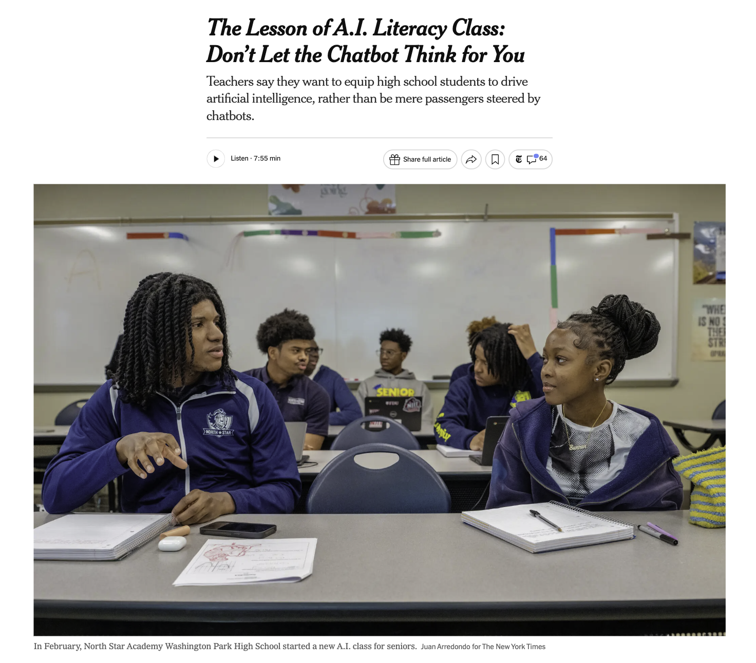
What does student-centered A.I. education look like? (hint: no A.I. bots)

Slide 10
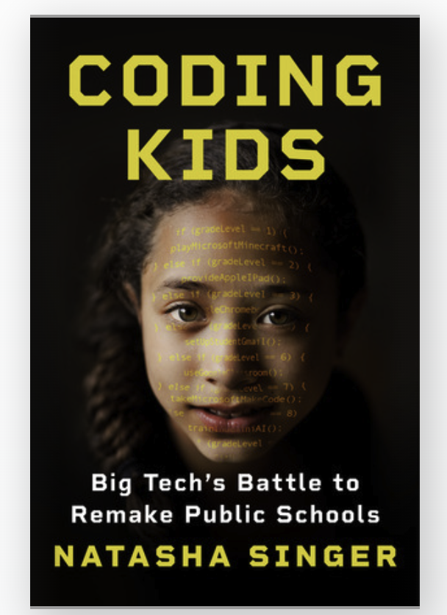
Natasha Singer, contact info
edtech reporting queries: nsinger@nytimes
book queries: natashasinger@protonmail.com
social: @natashanyt (bsky, x, instagram)

