Slide 1
Introduction to class and lecture
Medical Anthropology
Snippet of lecture on Politics and Health
Found presenting “both sides”
Prior to class students were asked to read:
  MAHA report published on the White House website (just skim)
  NYT article by Gina Kolata “Have Americans Ever Really Been Healthy?”

Slide 2
Politics and Health

Slide 3
MAHA
Executive order 14212 – February 13, 2025 – Make America Healthy Again
Assessment with action items – focus on children
We spend more on health care and have worse outcomes than most other countries

Slide 4
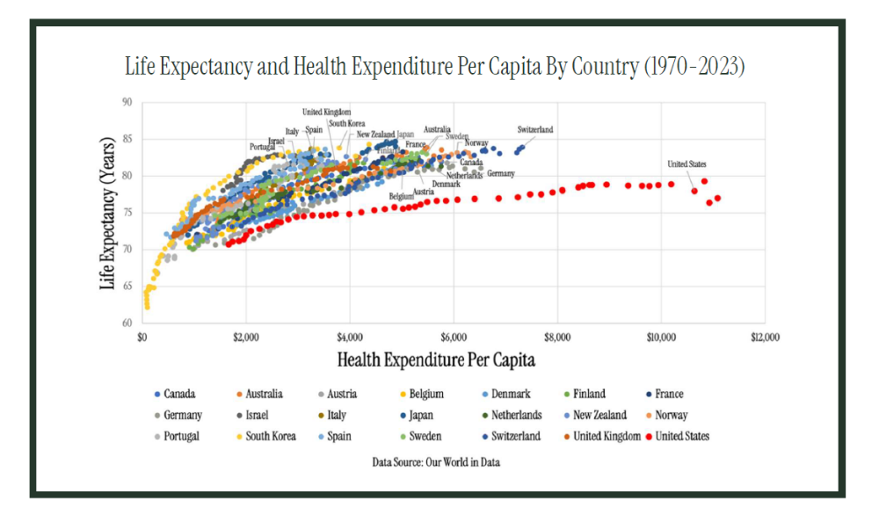
Notes:
This is from the MAHA report

Slide 5
MAHA: Chronic diseases
They identify in children:
  Obesity
    1 in 5 over 6 are obese – 270% rise from 1970 (lead to adult heart disease)
  Diabetes
    rising rates of types I and II in children
  Autism
  Childhood cancer
    up 40% since 1975
  Rising depression among teenagers
  Allergies
    Eczema and skin allergies doubled since the 1990s
    Food allergies rose 88%

Slide 6
MAHA: Causes
Poor diet – ultra-processed foods (grains, sugars, fats)
  NYTIMES:
  Arose during WWII – shelf-stable foods for soldiers
    Advertised as faster and full of nutrients
  By 70s – pesticides and farm subsidies led to loads of grain
    Corn syrup and starch
  Linked to obesity, cognitive decline, type II diabetes – may cause overeating
  MAHA:
    Nutrient depleted
    Increase caloric intake
    Food additives – food coloring, chemicals to preserve, artificial sweeteners
    Government guidelines for nutrition are not very clear
    SNAP – more likely to consume processed foods

Slide 7
MAHA: Causes
Aggregation of chemicals
  PFAS – forever chemicals (like nonstick pans)
  Microplastics – increasing presence in humans
  Pesticides
  Fluoride – added to water to prevent cavities

Slide 8
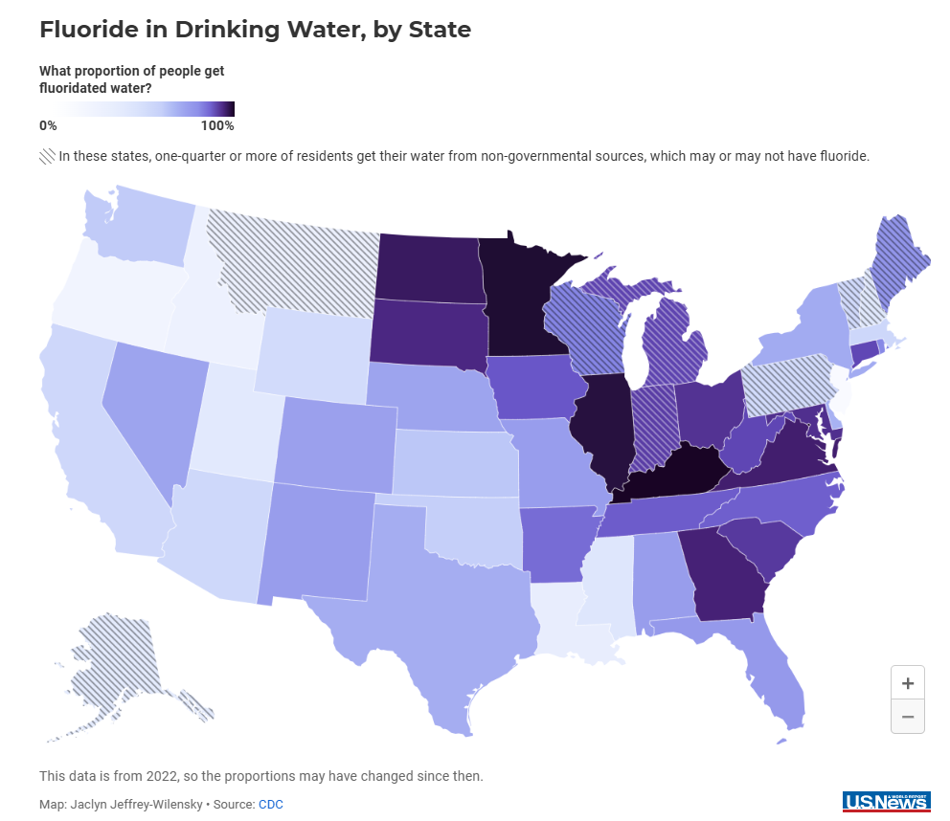
Notes:
https://www.usnews.com/news/best-states/articles/2024-12-06/map-fluoride-in-drinking-water-by-state

Slide 9
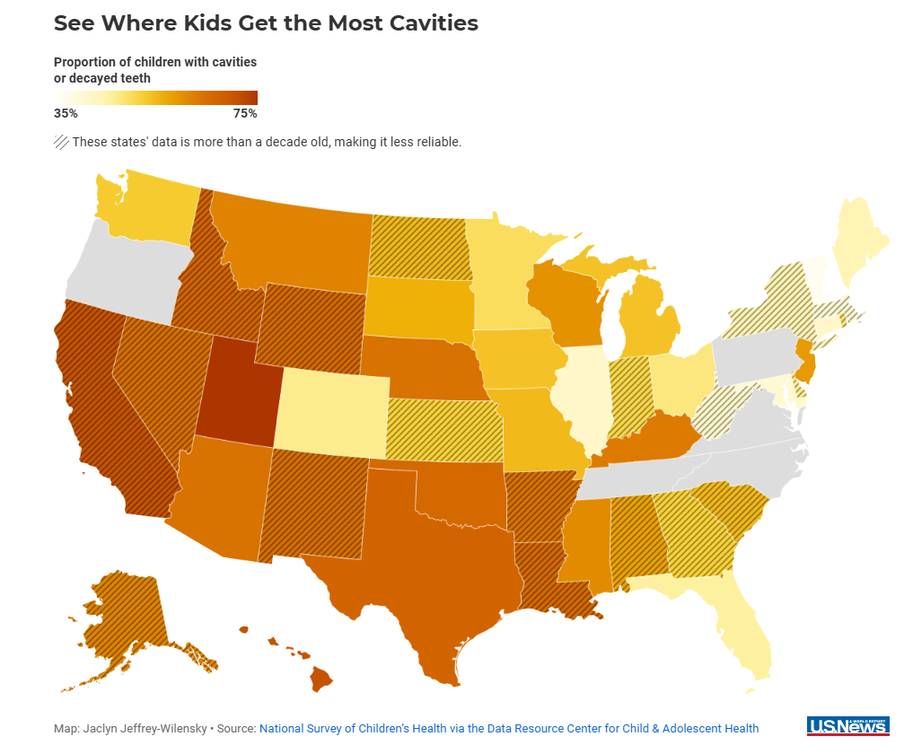
Notes:
Low fluoride states – do have higher cavities rates

Slide 10
Causes: MAHA
Lack of physical activity and chronic stress
  screen use, lack of sleep
  Loneliness on the rise
  Social media related to mental health
  Family dynamics and socioeconomic status
Overmedicalization
  ADHD medicine increased
  Antidepressants rose
  Too many antibiotics (35% unnecessary based on some studies)
  Asthma controller – rising – overprescribed for mild cases
  GLP-1 drugs
  Adenotonsillectomy – for sleep apnea
  Ear tubes
  Growth of childhood vaccine schedule

Slide 11
Who to blame?
Food industry
Chemical manufacturing industry – millions on lobbying
Pharmaceuticals – millions on lobbying and sponsored studies
“Peer review, the gatekeeping attribute that defines medical journals, is ineffective and biased; reviewers at top journals are untrained, ineffective when tested, and many have financial ties to drug companies.” - science

Slide 12
Next Steps for MAHA
Replication crisis
Expand autism data to include more variables
Get AI involved
Independent studies of food ingredients (not just FDA)
Nutrition trials
Lifestyle interventions
Drug safety research
Toxicology – map genes-environment interactions
Lots put on NIH to do – but, they are being gutted

Slide 13
Were we ever healthy?
Difficult to transport/preserve foods
Growing seasons were short
During civil war – health was poor (underweight, shorter life spans, higher risk of illness)
Start of 20th century – public health improved
  Clean water – posters encouraging parents to not give their babies beer
  No antibiotics, few vaccines
  1950/60s – high stroke and heart attack – heavy smoking
Statins and many people quitting smoking in later half of 20th century – improved heart disease
Cancer lower as people stopped smoking

Slide 14
Impacts of MAHA movement
Surge in preventable diseases – measles
Undermines scientific credibility
Promotes harmful ideologies
Policies may be poorly suited to address these concerns
Lecture then moves on to examples from other countries

