Slide 1

Under-Enrollment and School Closures
Marguerite Roza
June 4, 2026
©2026 Edunomics Lab, Georgetown University

Slide 2
T / F Recent changes in federal $ are wreaking havoc on district budgets.
Federal $ is a small slice of the pie.
Federal $ has been and continues to be stable.
End of ESSER (relief funds) left holes in budgets
Federal
8%

Slide 3
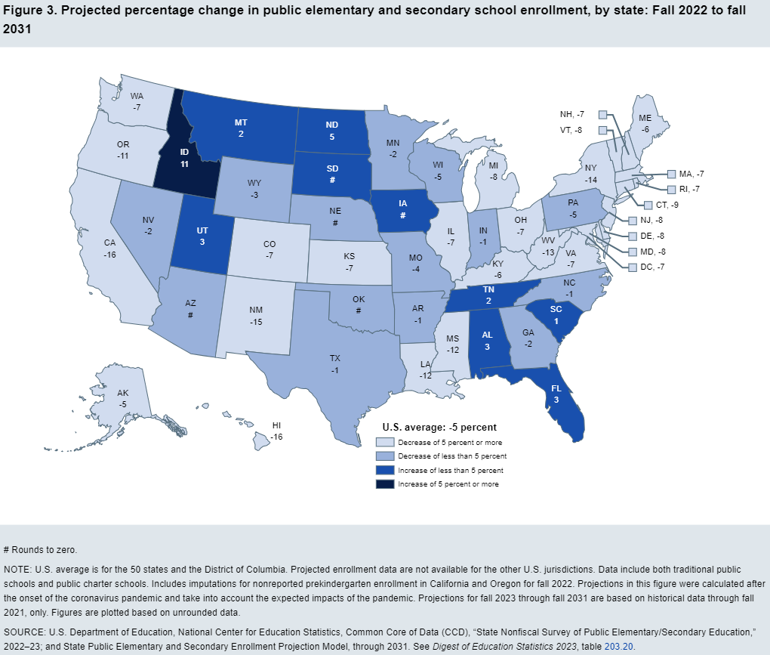
Enrollment declines (2022 to 2031) will force downsizing for years to come
T / F The bigger issue for most district finances is declining enrollment.
Enrollment drives revenues.
Federal
8%
The US has too many schools.

Slide 4

Understanding enrollment shifts now requires carefully monitoring of enrollment
ELL students
Falling birth rates mean fewer students each year.
New ELL students were masking declines.
Non-ELL students
Miami-Dade Enrollment Fall ‘25
Highline Public Schools
©2026 Edunomics Lab, Georgetown University
©2020 Edunomics Lab, Georgetown University

Slide 5
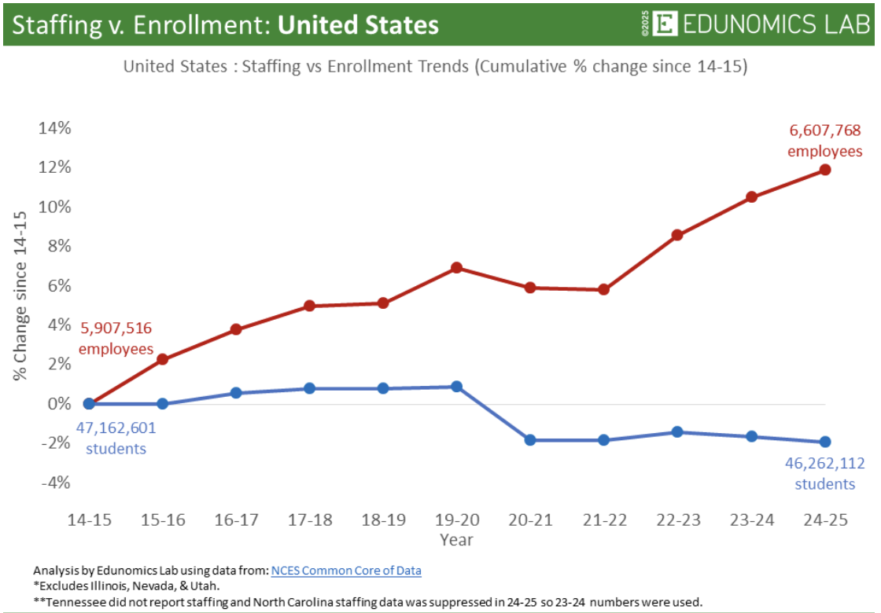
T / F Districts have more staff than at any time in history
Covid funds enabled districts to add staff.
Most won’t be able to sustain them all.
Declining birth rates and reduced immigration mean enrollments will continue to fall
©2018Edunomics Lab, Georgetown University
©2019 Edunomics Lab, Georgetown University
©2026 Edunomics Lab, Georgetown University

Slide 6
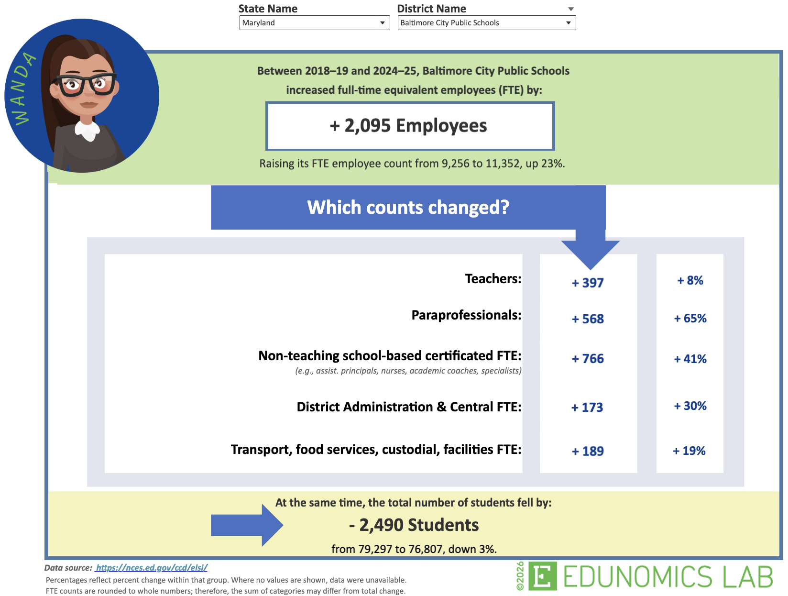
See trends for each district and state here:
edunomicslab.org/wanda
©2018Edunomics Lab, Georgetown University
©2026 Edunomics Lab, Georgetown University

Slide 7
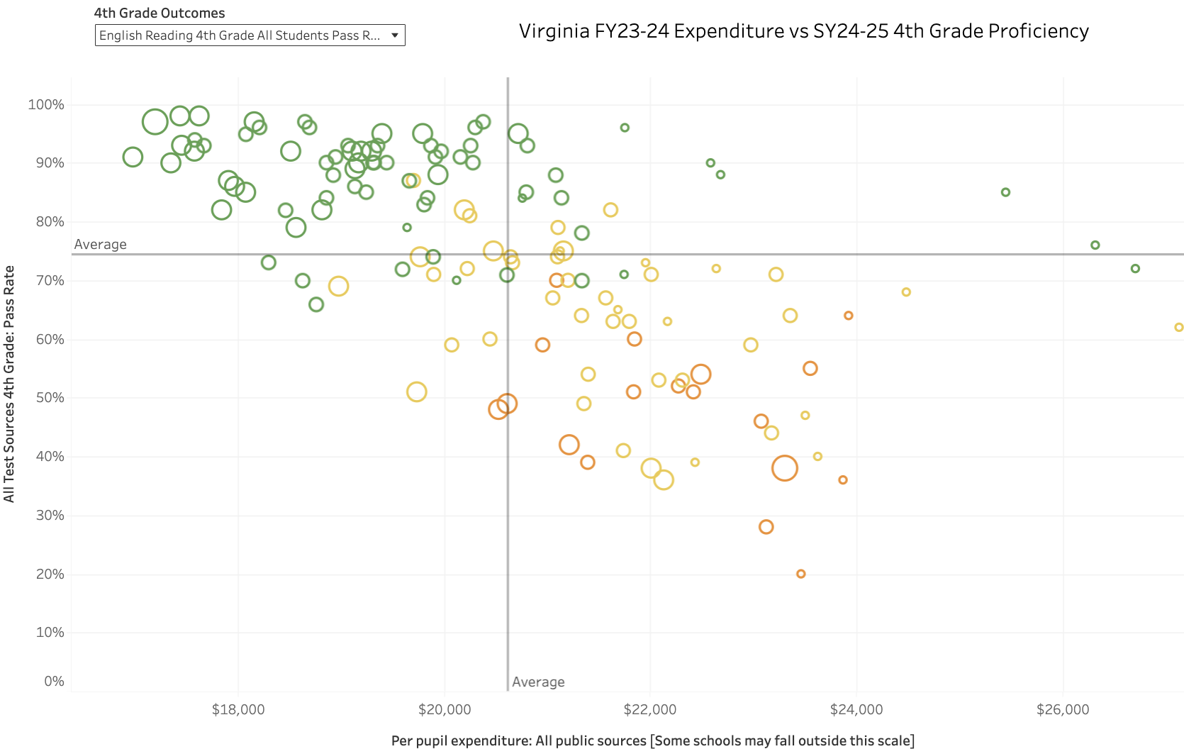
Fairfax County Elementary Schools
These schools are small and expensive.
See here for each district’s data: edunomicslab.org/spending-v-outcomes-2/
©2018Edunomics Lab, Georgetown University
©2026 Edunomics Lab, Georgetown University

Slide 8

T / F Teacher shortages continue to be a major issue for districts
October had most layoffs of this month in 22 years*
Teacher labor market update: Fewer teachers are leaving. Many more are waiting in the wings.
2026 Grads Face Worst Job Market in Years**
*https://www.usatoday.com/story/money/2025/11/06/october-job-cuts-surge-worst-layoffs/87127775007/
**https://www.wsj.com/video/series/on-the-news/companies-say-2026-will-be-worst-college-grad-job-market-in-5-years/6AB72018-8DFF-497A-831B-C4577E2AFFCA

Slide 9

Marguerite Roza @MargueriteRoza
EdunomicsLab.org
MR1170@georgetown.edu
Sign up for Edunomics Lab newsletter at http://bit.ly/EdFiNews
Sign up for Whiteboard Advisors newsletter at WhiteboardAdvisors.com

