Slide 1
Transit Nightmare
Greg Morton – gregory.morton@thebanner.com
Liz Bowie - liz.bowie@thebanner.com

Slide 2
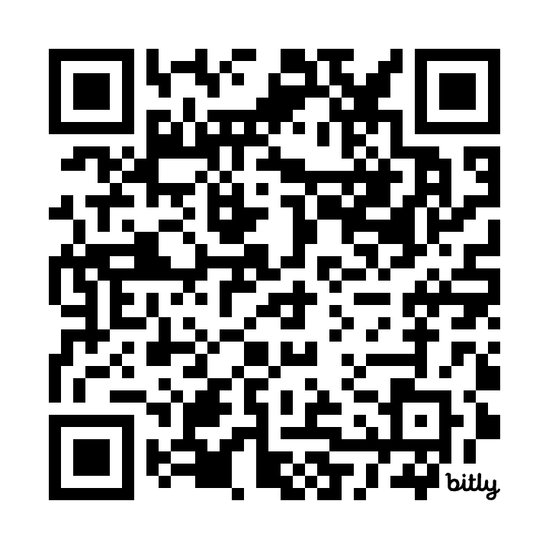
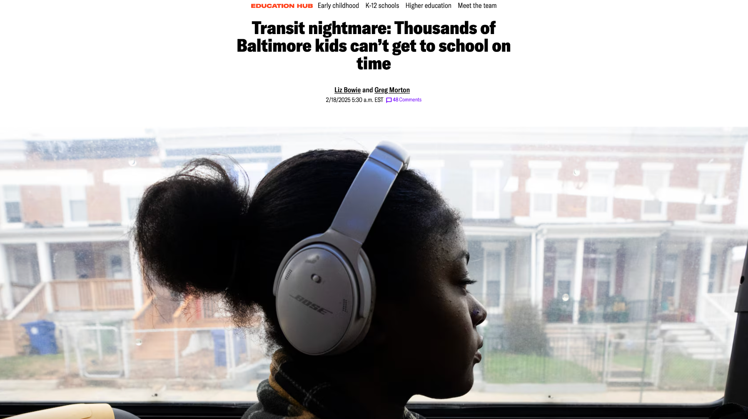
Read the investigation
bit.ly/transitNightmare
Notes:
For an investigation we completed last month, we focused on a group of transit-dependent people we felt had been undercovered: Children in Baltimore City
Baltimore City middle and high school students are the only in the state not guaranteed a ride to or from school. As many as 27,000 kids rely on Baltimore’s public transit every day.

Slide 3
Conception
We set out to quantify how hard it is for students taking public transit to get to school in a city with universal school choice.
We proved that it is nearly impossible for students to arrive on time every morning.

Slide 4
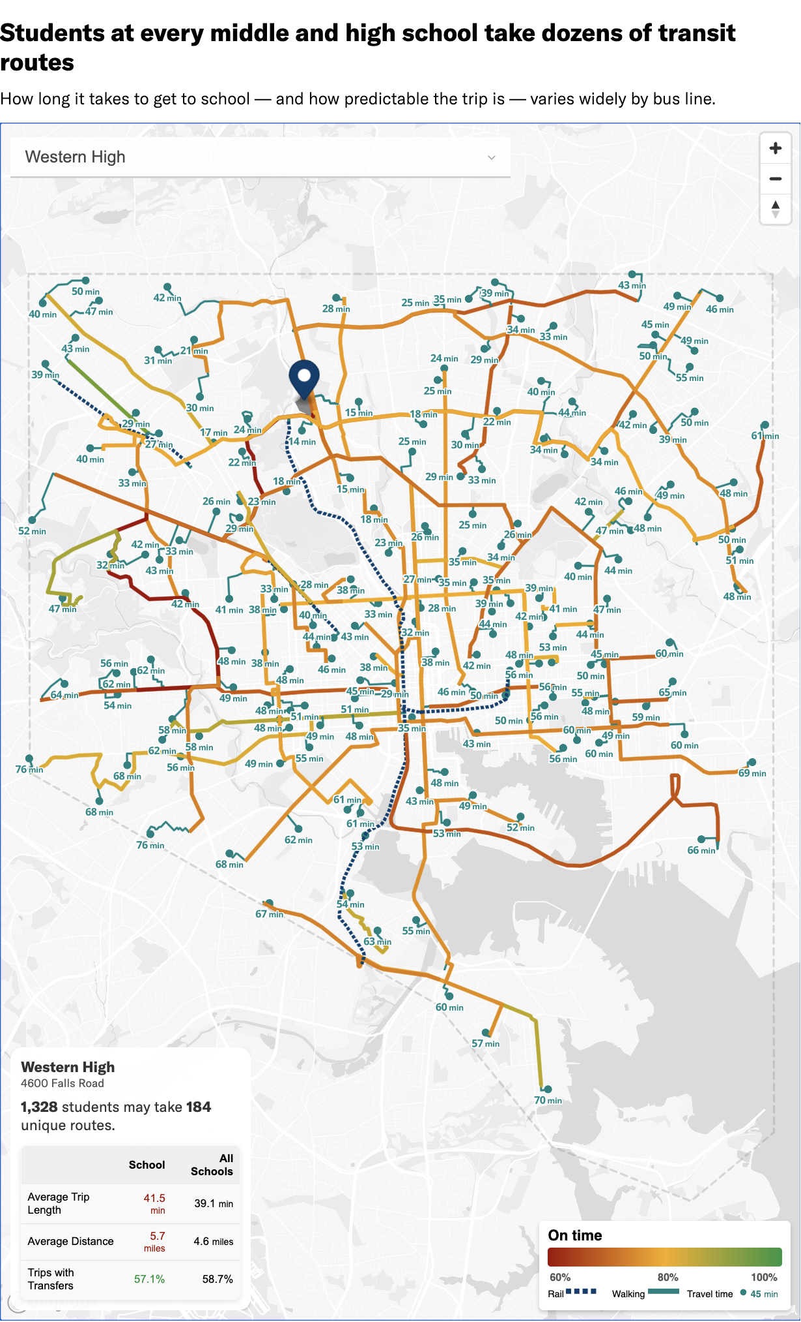
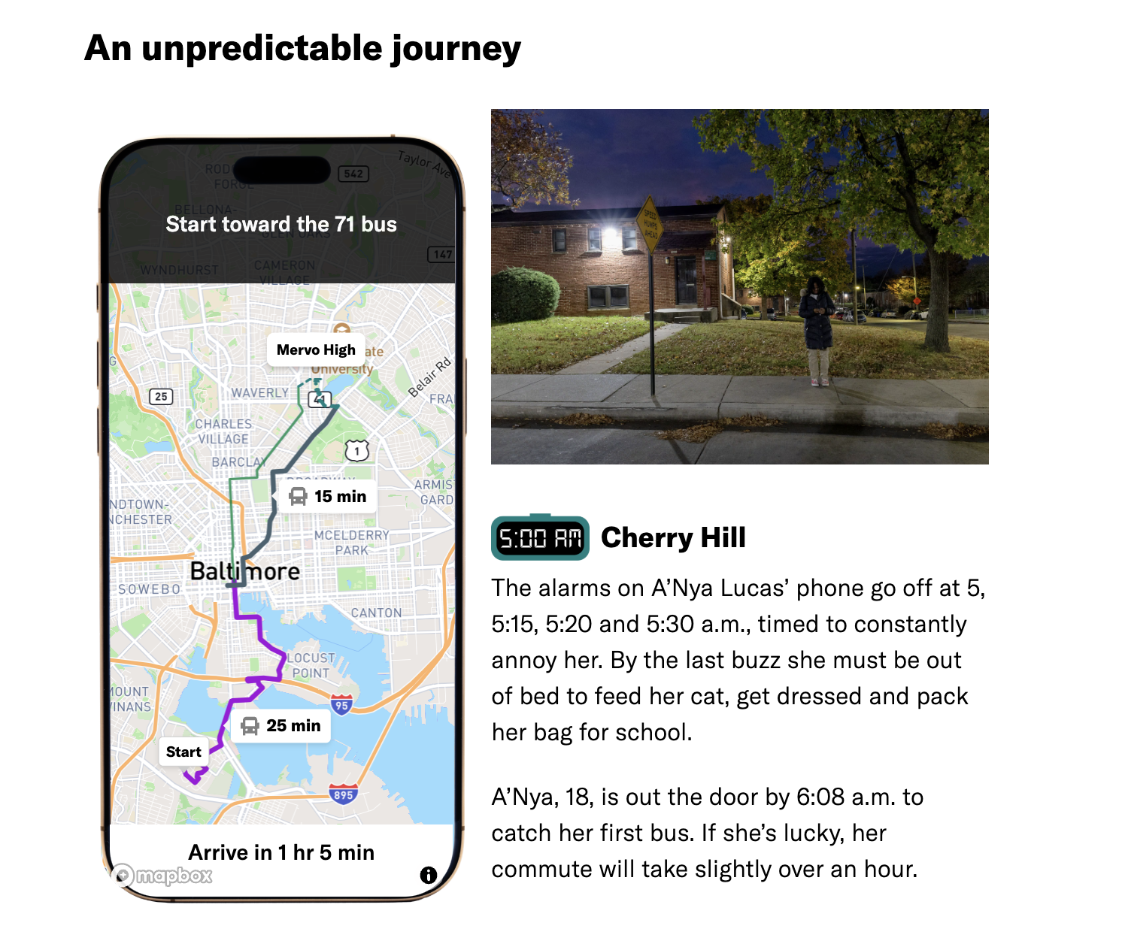
Routing

Slide 5
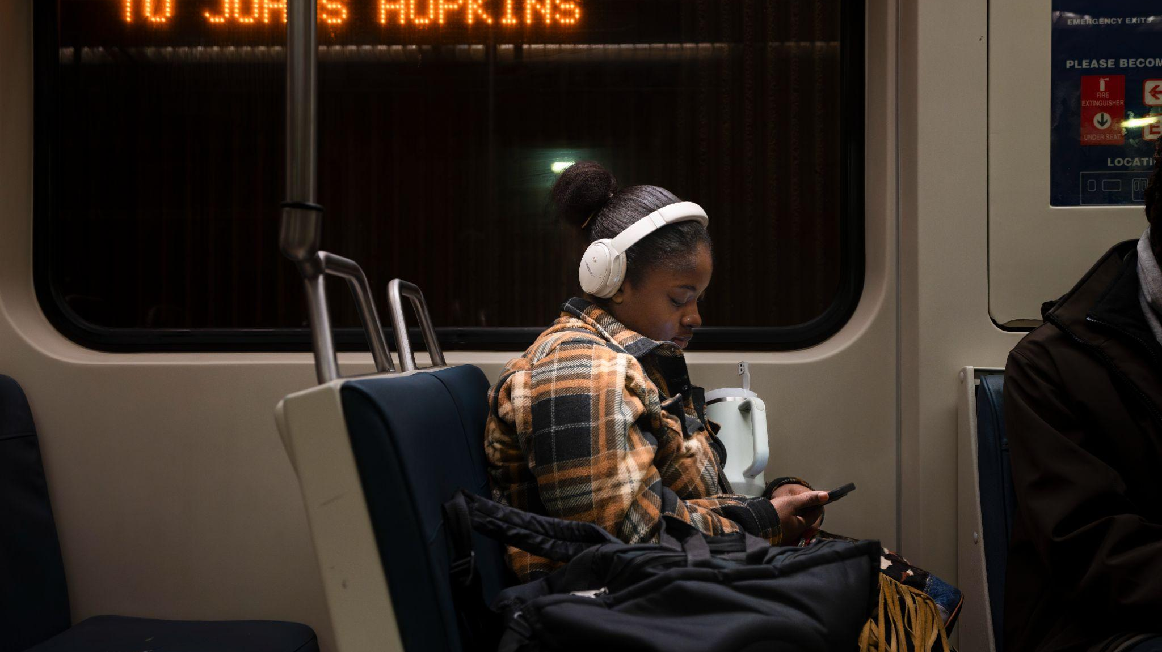
Brooke’s journey to school

Slide 6
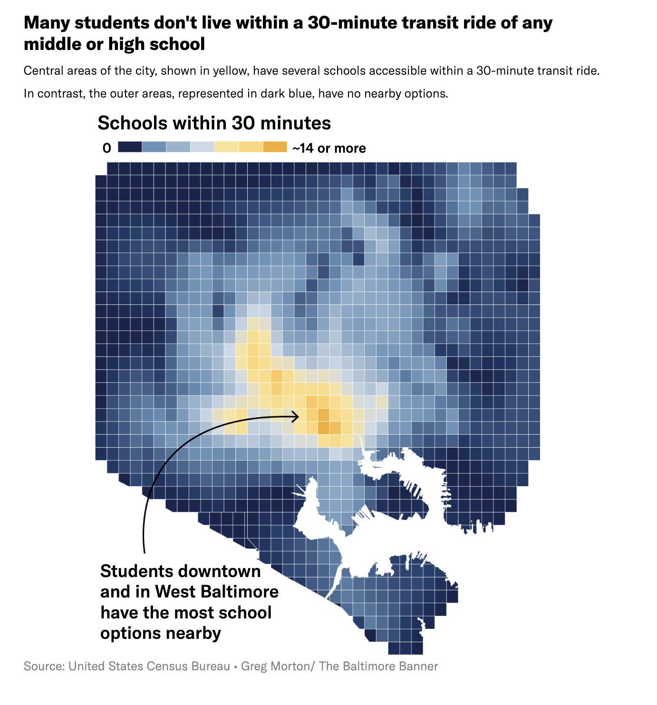
Equity
How we found and told individual student stories.
Baltimore City families resigned to the status quo.
Middle class families drove kids to school. Only the most disadvantaged students ride buses.
Can you take advantage of a public education without access.

Slide 7
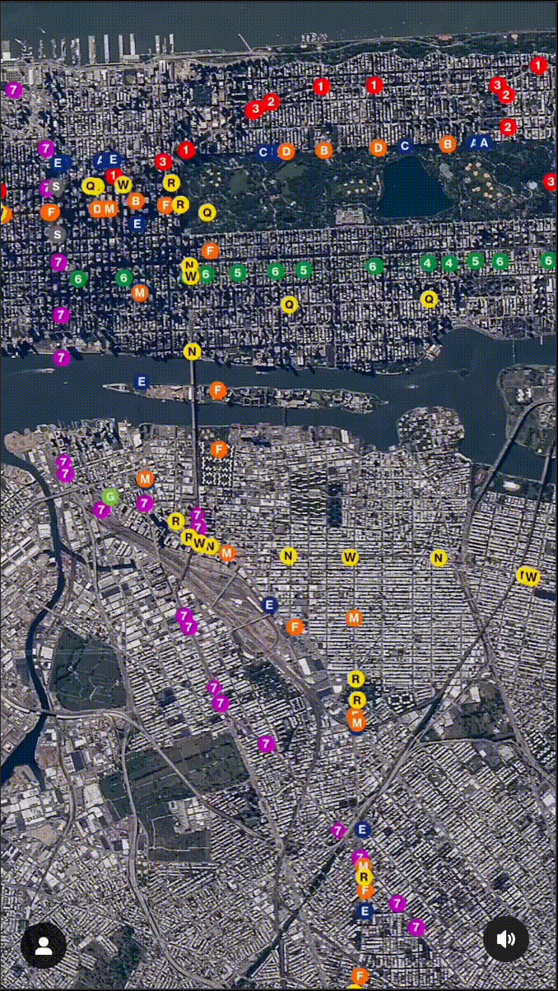
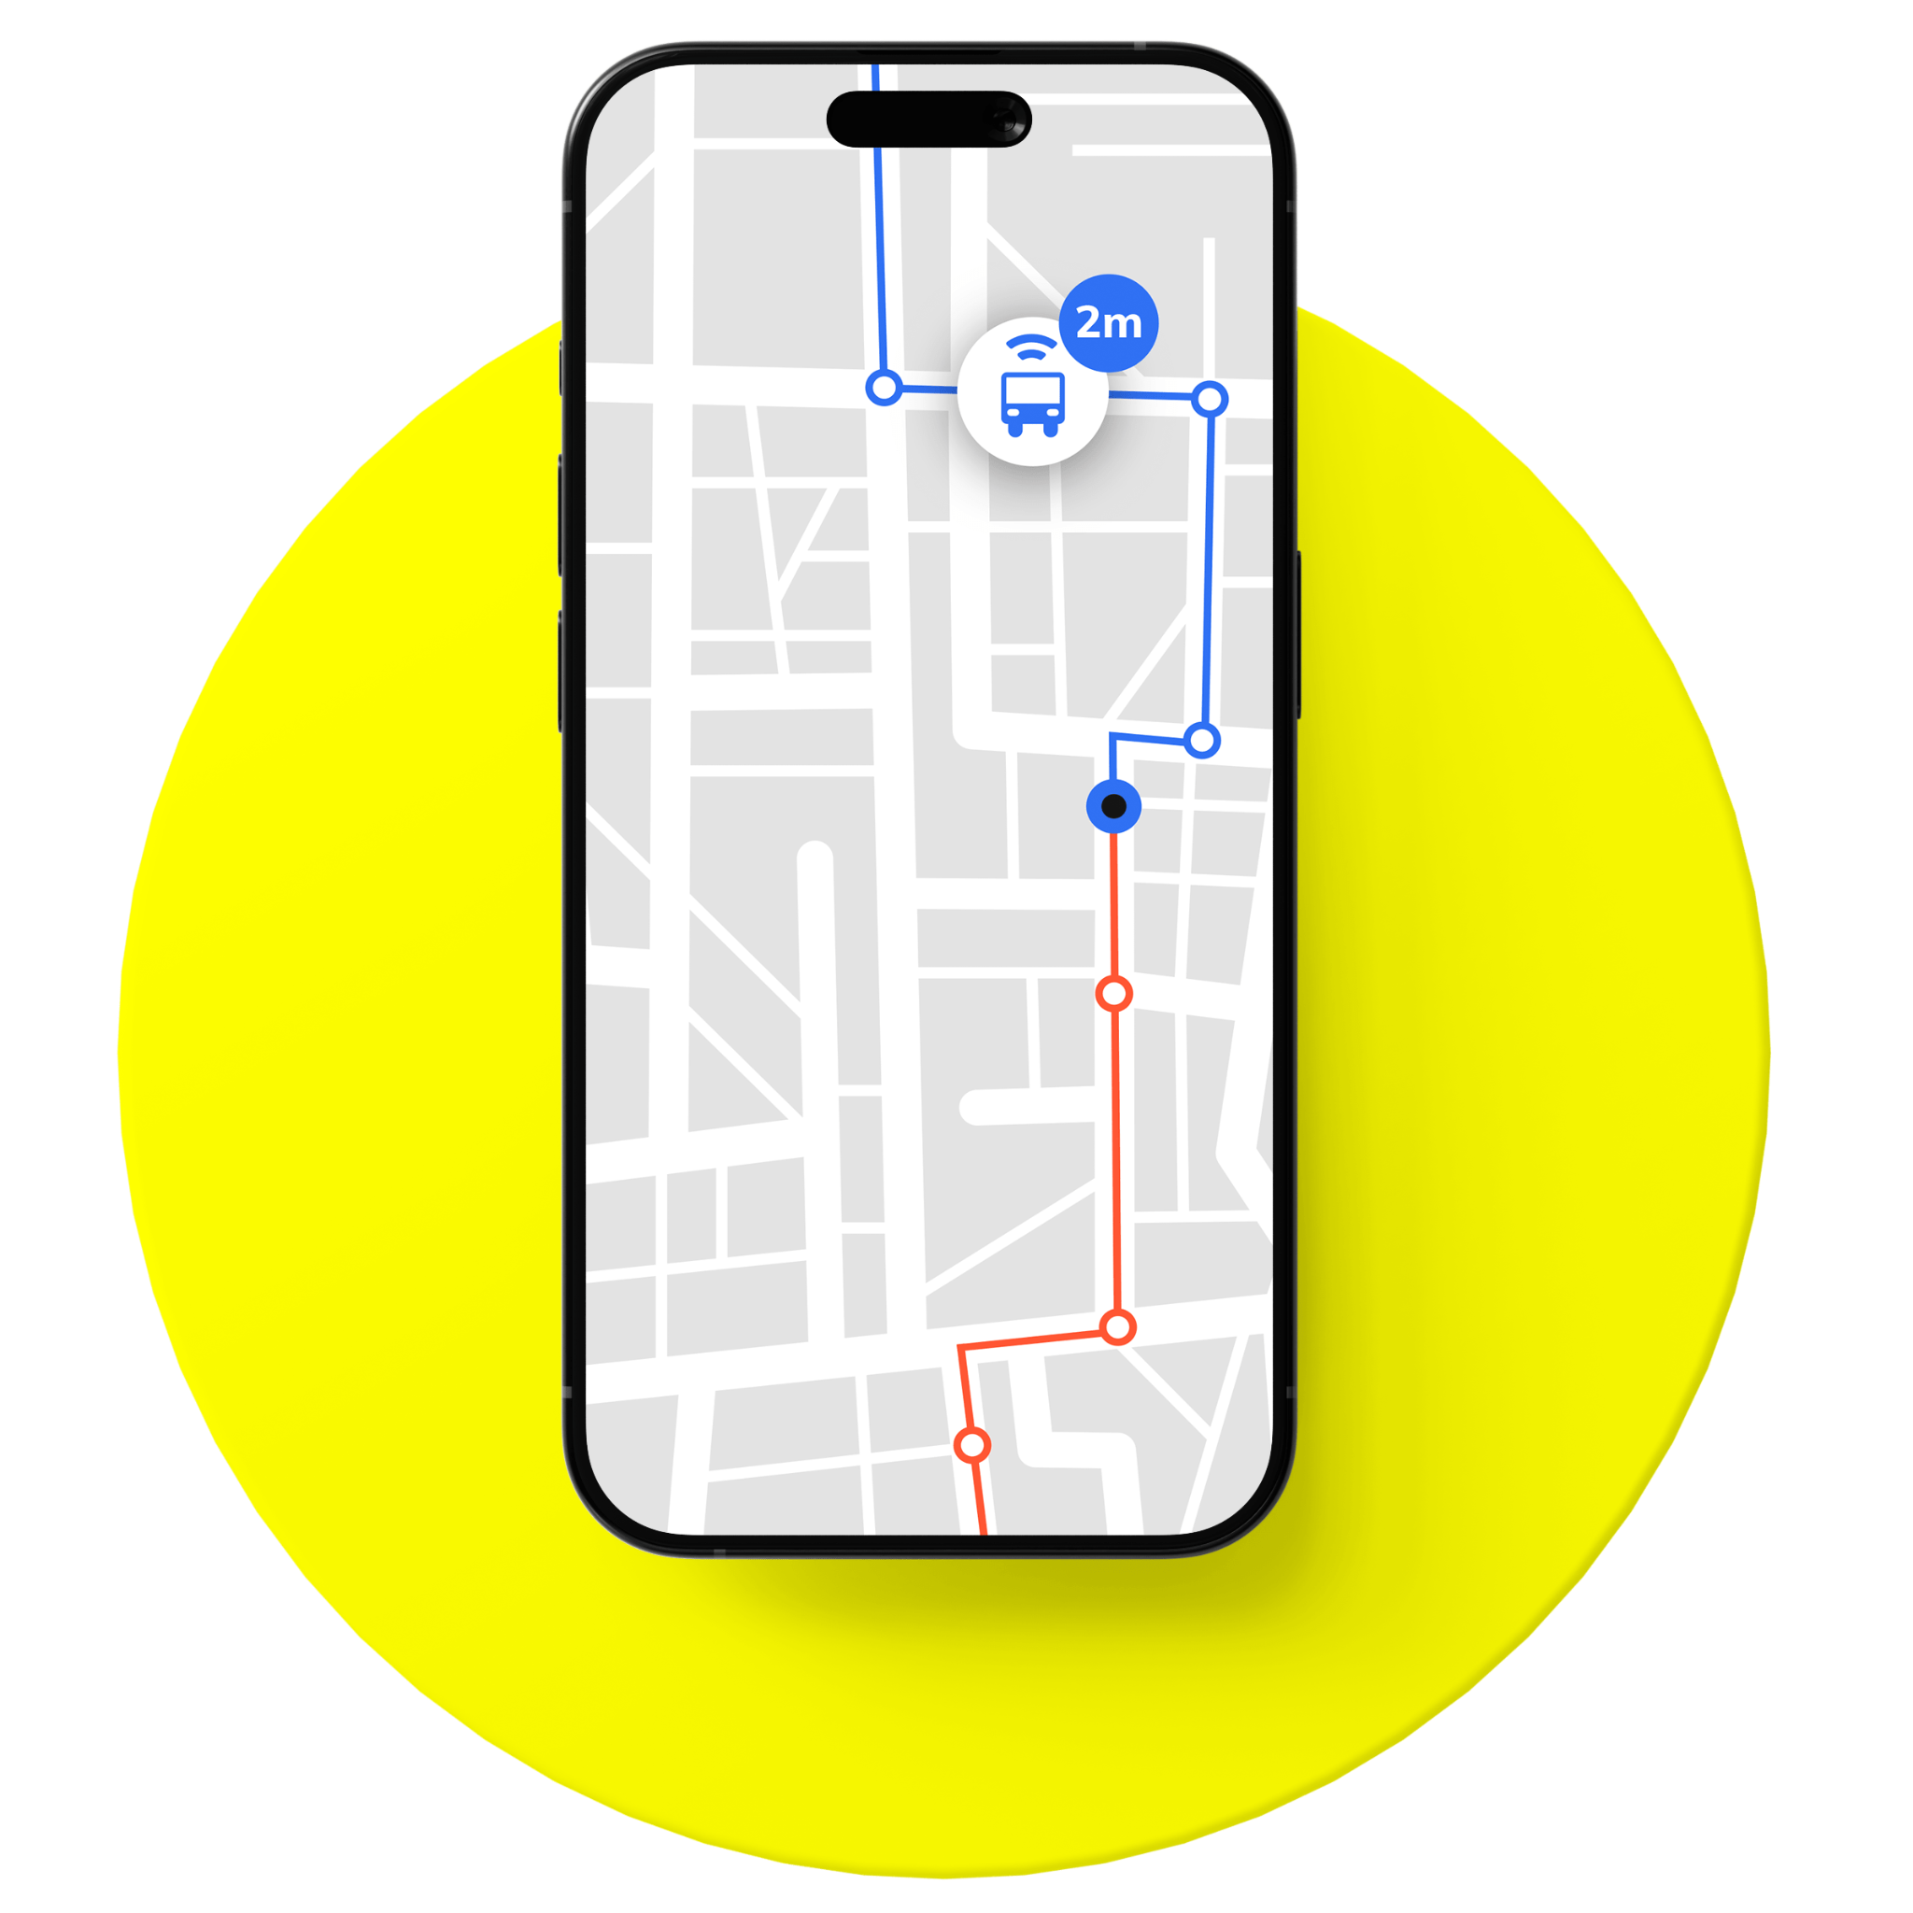
Measuring Performance

Slide 8
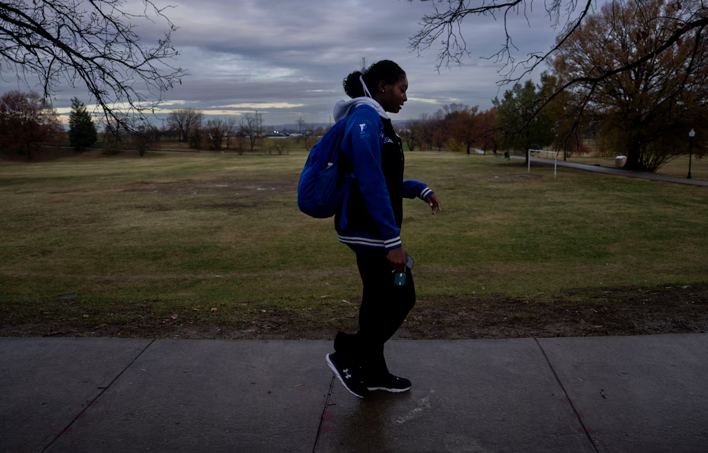
Impact on grades and futures
Citywide failure rates for high school classes are 6.6 percentage points higher than the average for the rest of the school day.
Students pick schools that they can get to rather than the schools that are best for their futures.

Slide 9
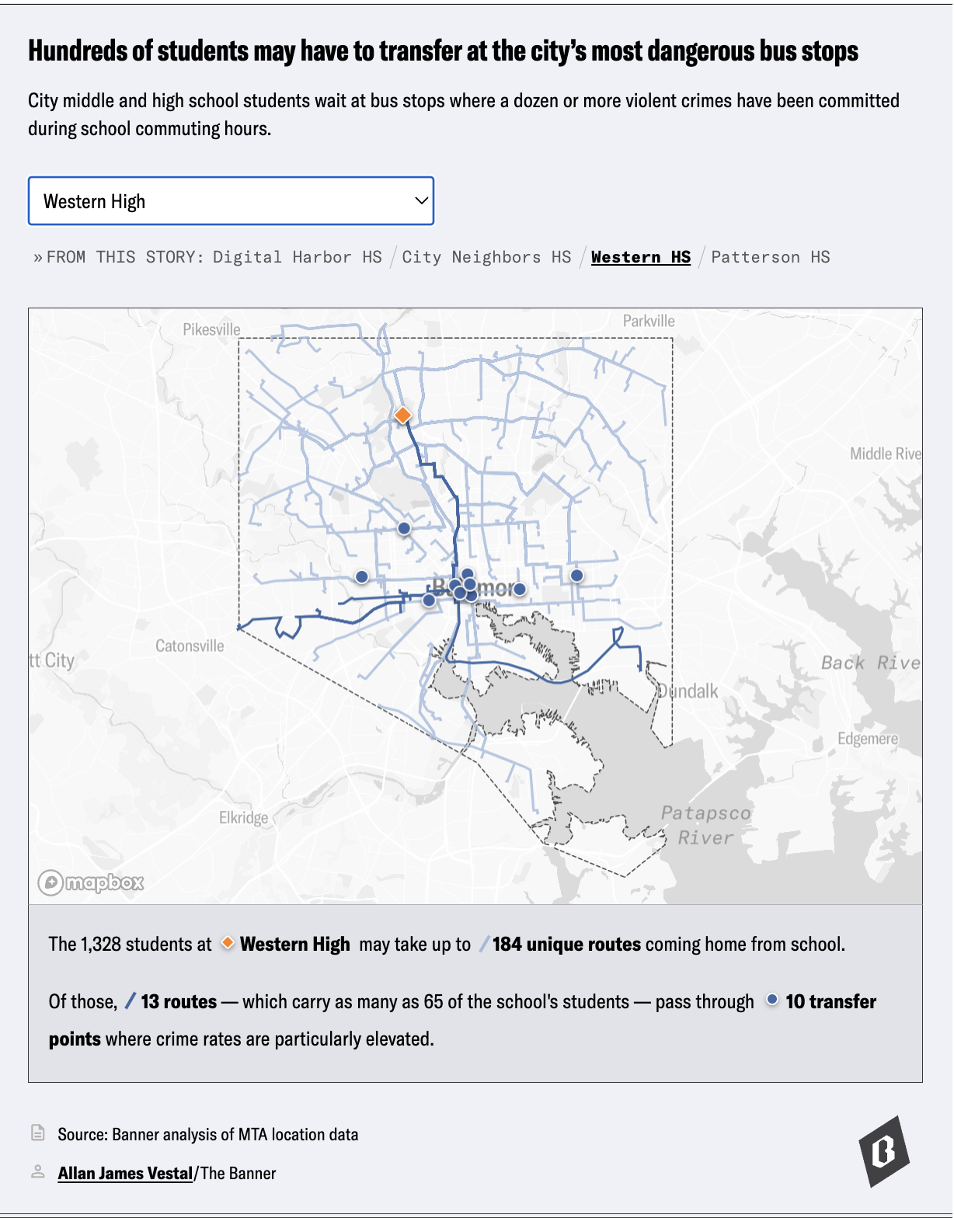
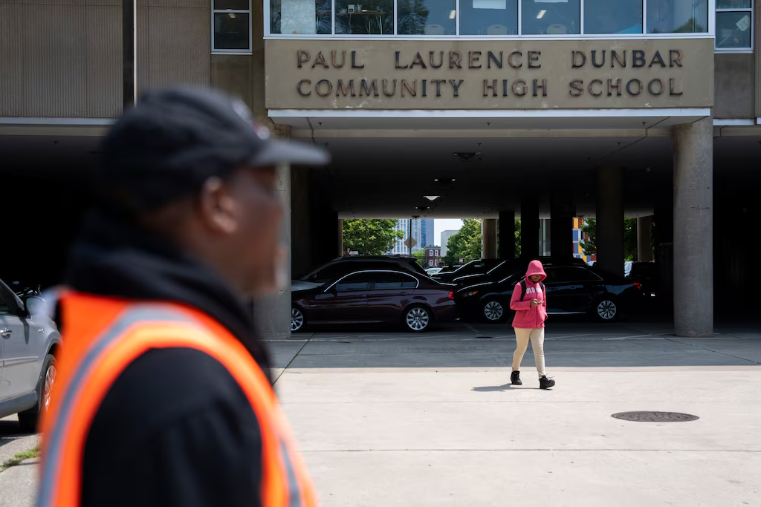
It’s not just late buses—addressing student safety
Notes:
Thousands of students needed to wait at stops where at least one violent crime was committed in the last three years during school commuting hours.
Baltimore students have been followed, harassed, assaulted and held up at gunpoint.

Slide 10
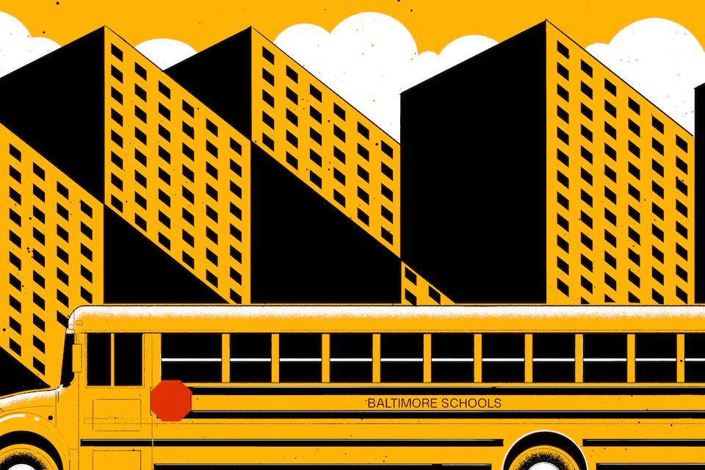
Finding a solution
We worked with HopSkipDrive to layout a solution using yellow buses, vans and cars.

Slide 11
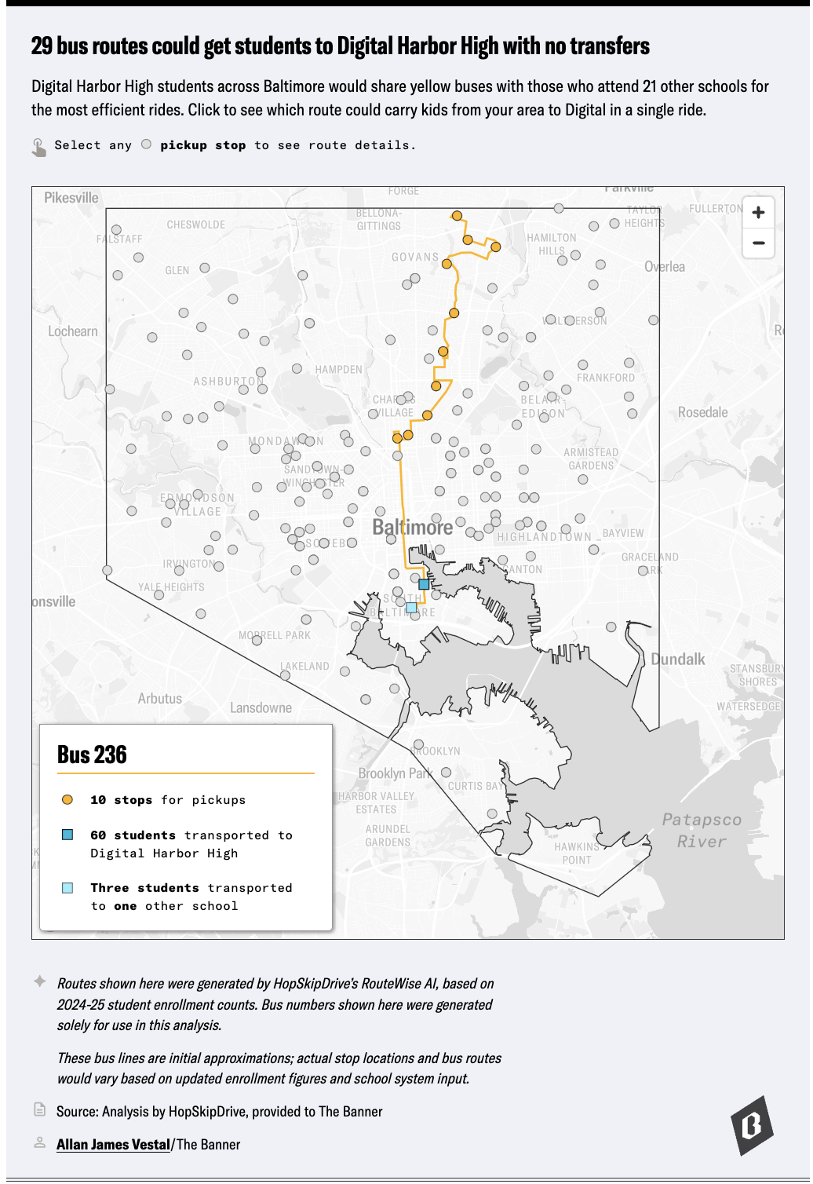
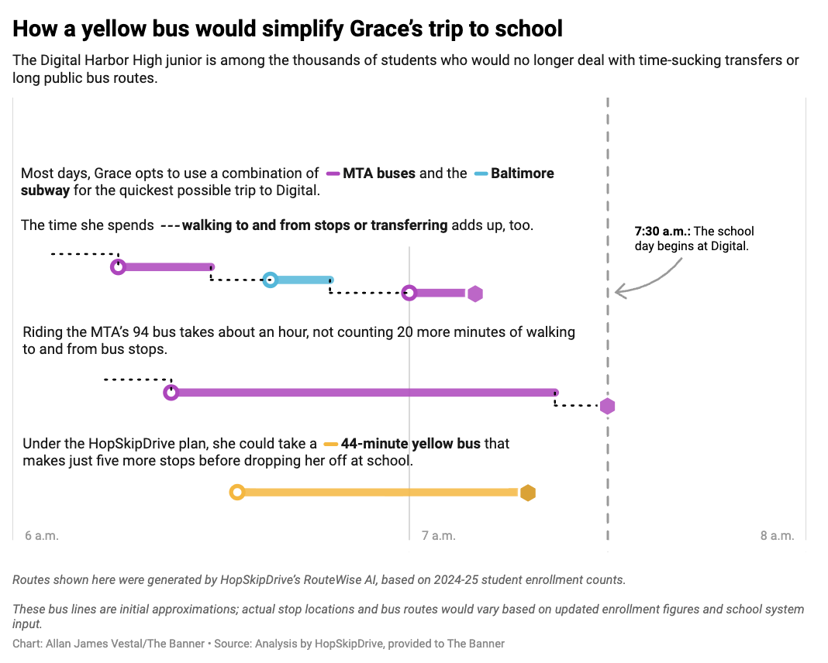
Visualizing the solution
Our challenge:
Make an abstract solution feel grounded and realistic
The solution:
Approachable and easy to understand data viz

Slide 12
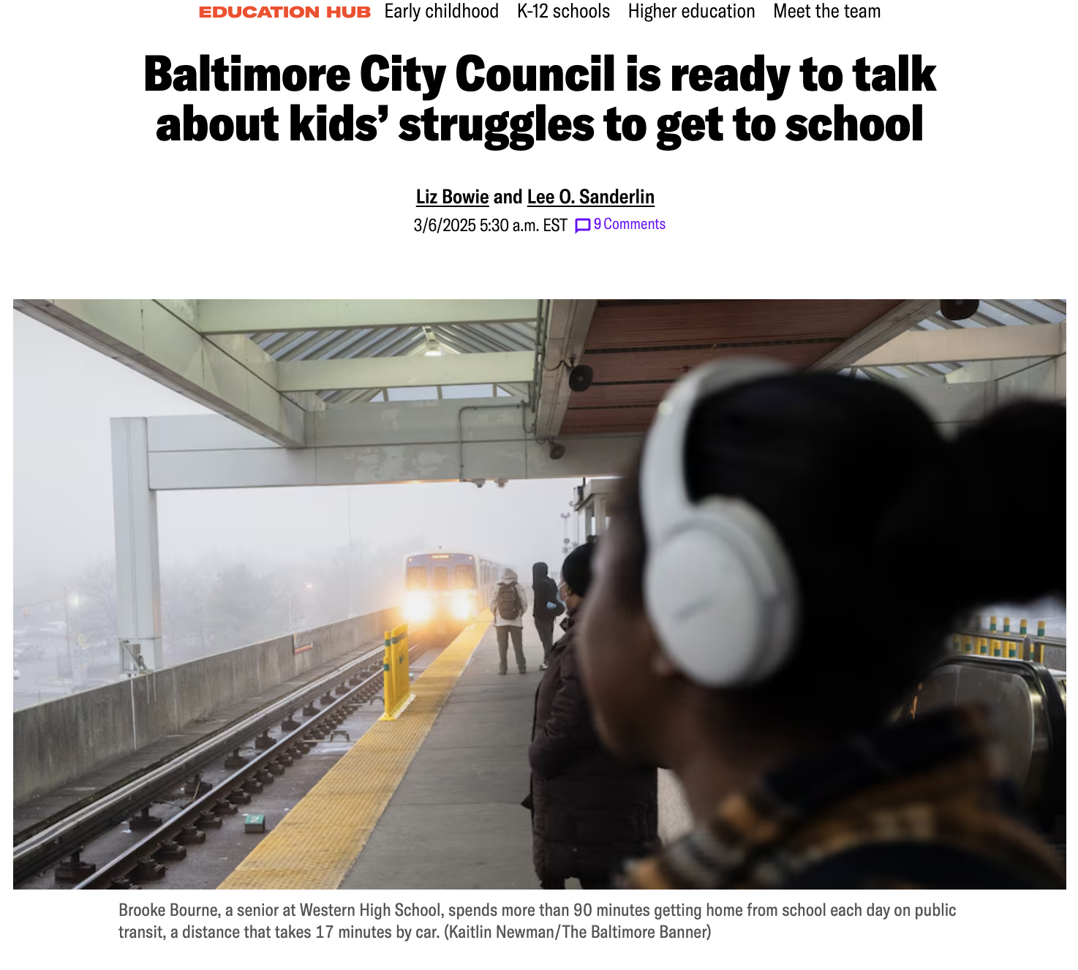
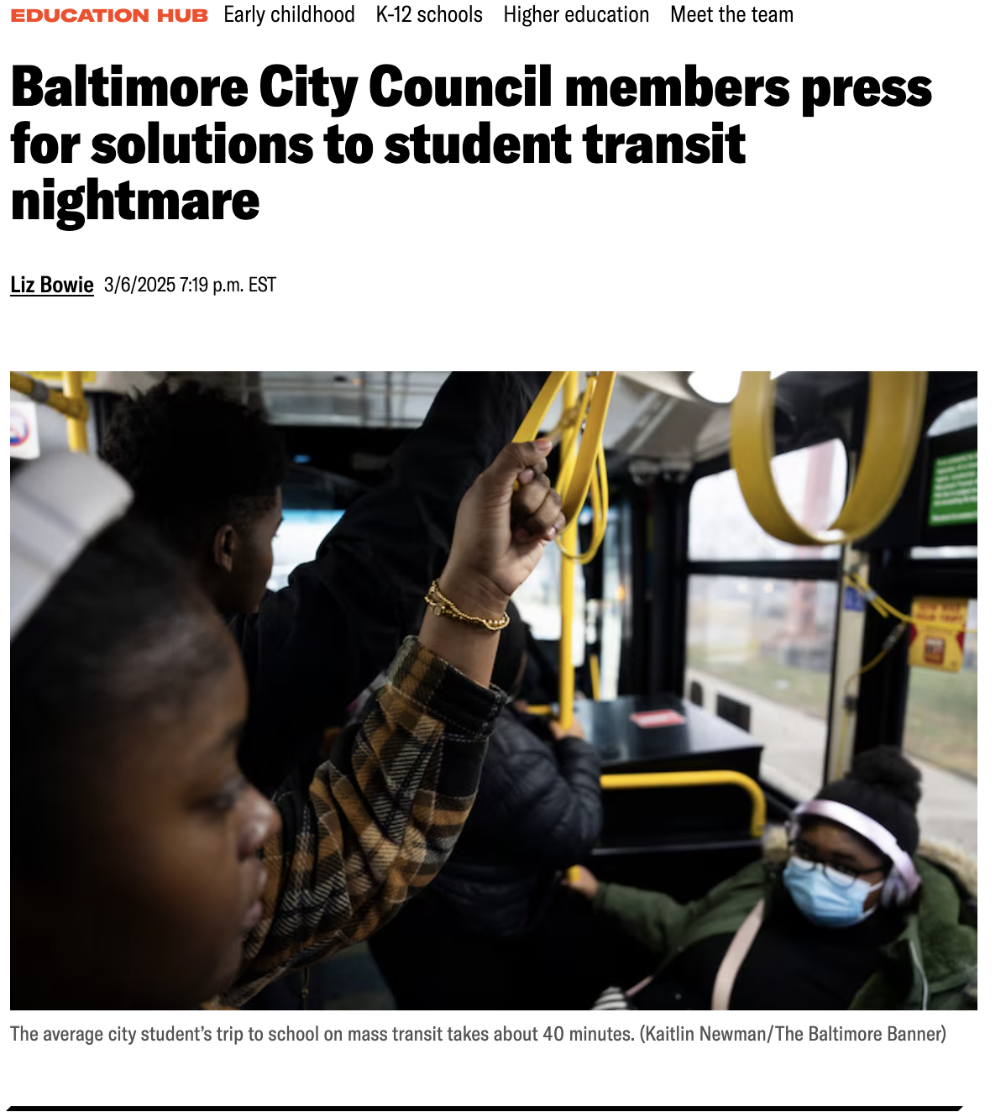
Impact
There has been no action by state or local officials to solve the problem.
Transportation is now discussed at school board and city council meetings.
Students and parents are now advocating for change.

Slide 13
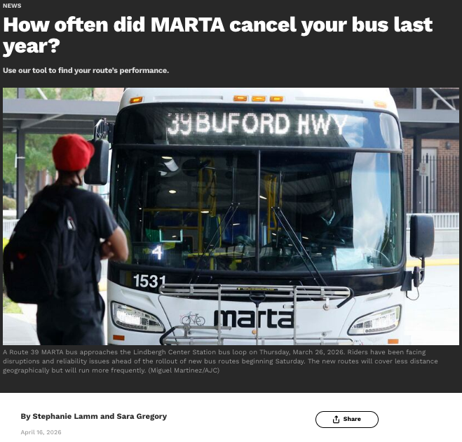
Recreating our work
Our work is public!
Reproduce our work with the code on our Github
The types of data we used probably exist in your city
GTFS is a universal format. If your city has buses, trains, or streetcars, you probably have the data.

Slide 14
Questions?
bit.ly/transitNightmare
Notes:
For an investigation we completed last month, we focused on a group of transit-dependent people we felt had been undercovered: Children in Baltimore City
Baltimore City middle and high school students are the only in the state not guaranteed a ride to or from school. As many as 27,000 kids rely on Baltimore’s public transit every day.

